Slide 1
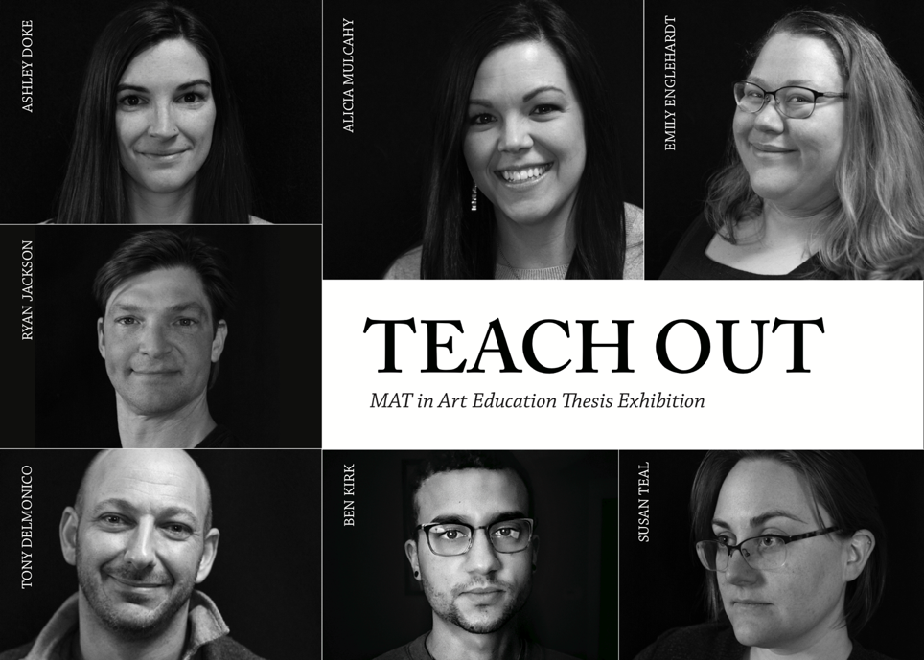

Slide 2
Tony Delmonico: Artist Statement
A1
My work juxtaposes the historical connotations of painted portraiture with those of today’s digital images on social media. New tools such as the smart phone and online photo-sharing platforms encourage people to volunteer extreme versions of themselves for the world to see. The ready availability of the camera simultaneously numbs their sense of privacy and empowers them to author reality as they see it. My painting addresses the unnerving ubiquity of subjective visual authors, the observed’ surrender to the observers’ controls, and the precarious relationship of the information-age painter to his quotidian reality.
As a high school art teacher I task myself with unlocking the creative, artistic identities of my students. Teenagers especially labor to define their identities, and digital media support their efforts to depict their experiences, however accurate or tailored these depictions may be. My painting interprets an image (posted to social media outlets) of a violent exchange between students at my school. Viewers find themselves a part of the composition by virtue of the smartphones’ gazes aiming down both at them and the brawling pair in the foreground. Evidence of the underpainting, visible in portions of the fleeing student, testifies to the process. I insert myself in the background as onlooker, a position reflecting my concern for my relationship to my school community but also a reminder of the prevailing power of an artist in the information age.

Slide 3
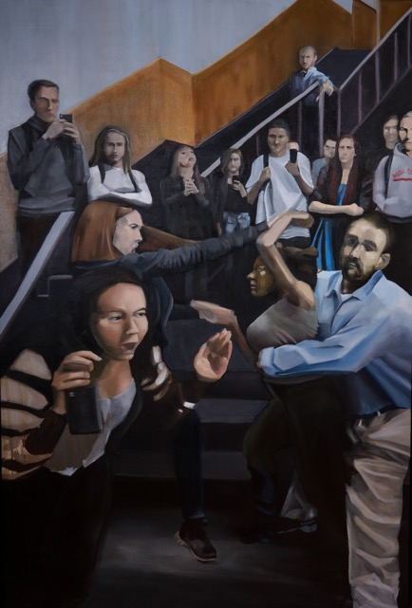
Tony Delmonico, The Order of Things (in the Information Age),
48”x77’ oil on pine board. April, 2020
A2

Slide 4
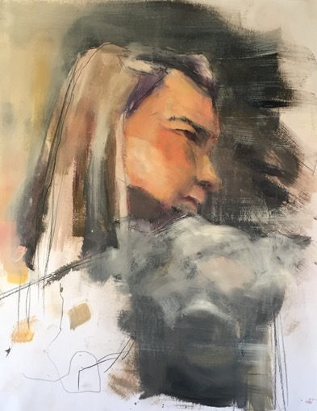
Tony Delmonico, Study #1, 14”x17” oil and graphite on bristol. December, 2019
A3

Slide 5
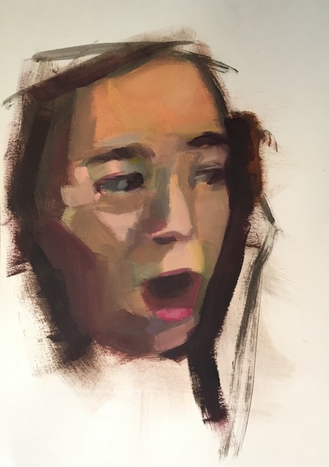
Tony Delmonico, Study #2, 14”x17” oil on bristol. January, 2020
A4

Slide 6
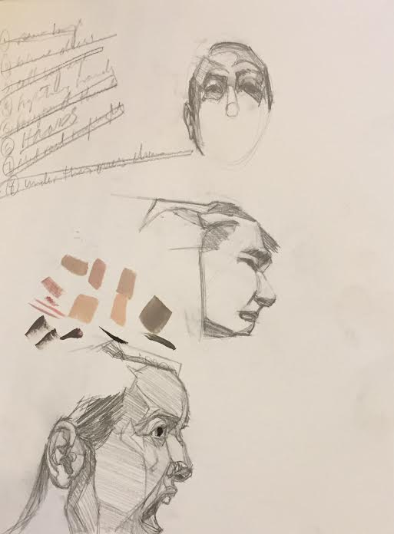
Tony Delmonico, Study #3, 11”x14”graphite on bristol. April, 2020
A5

Slide 7
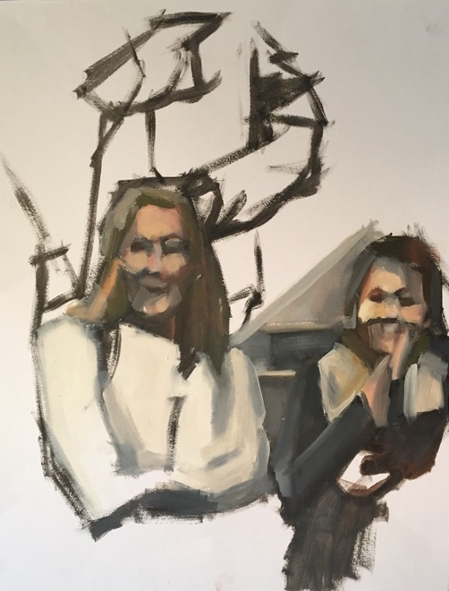
Tony Delmonico, Study #4,
14”x17” oil on bristol. February, 2020
A6

Slide 8
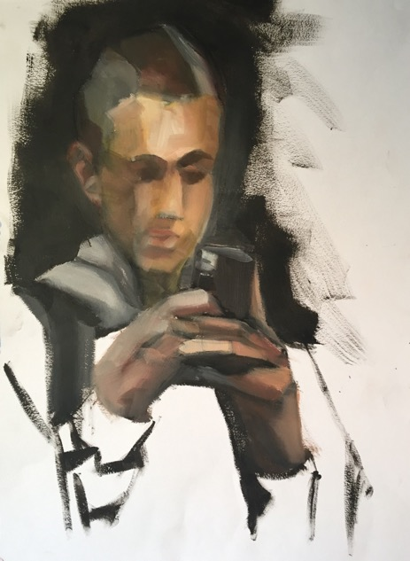
Tony Delmonico, Study #5,
14”x17” oil on bristol. March, 2020
A7

Slide 9
Ashley Doke: Artist Statement
B1
The Beauty in Flora
As an artist, I find importance in visually recording the natural world. I have always been attracted to the world around me and I have an insatiable desire to be endlessly immersed in it. I find myself exploring the different plants, trees, and other natural formations in order to take elements that are often over looked by others in our busy lives.
Accentuating the flora’s beauty allows me to reflect on the essence of each that attracts me to them. By focusing on their different qualities of shape and textures, I seek to create my own versions of the flora. My process combines each of these into one composition, creating a dynamic image that allows the eye to explore the newly created flora full of textures.
I use a traditional printmaking process from initial drawing to linoleum carving and finally printing. I get lost in the action of carving away my negative spaces; this action is akin to meditation. Printing in monochrome black creates a heightened contrast that allows for the focus to be on the organic forms of my reimagined original experience. In this way, I relive the original experience through the traditional process of carving and printing.

Slide 10
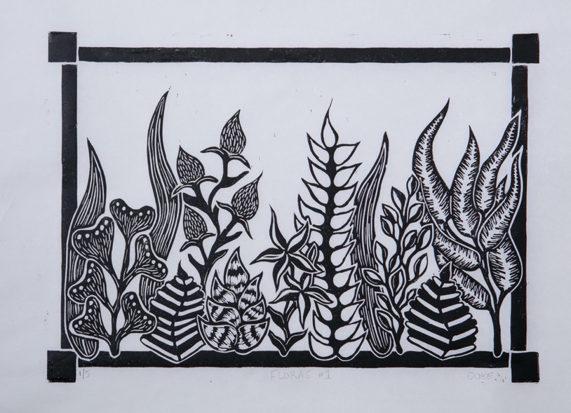
Ashley Doke, Florae #1, 12”x18”
Linoleum Print. April 25, 2020
B2

Slide 11
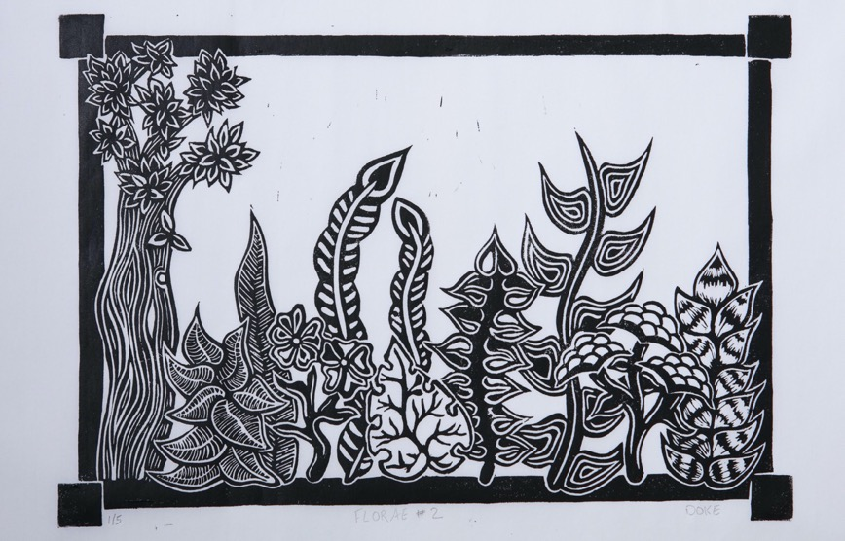
Ashley Doke, Florae #2, 12” x 18”
Linoleum Print. April 25, 2020
B3

Slide 12
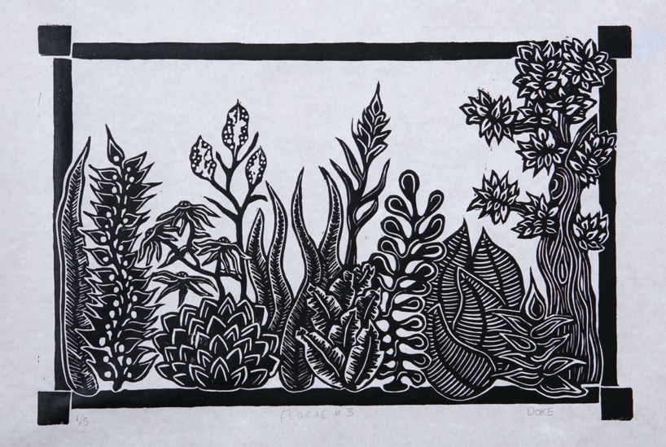
Ashley Doke, Florae #3, 12” x 18”
Linoleum Print. April 25, 2020
B4

Slide 13
Emily Englehardt: Artist Statement
C1
Art has always played a major role in my life. It provides me with an escape, a goal, a hobby, a career, a way of connecting with others, and opportunity. When I create, the rest of the world melts away; minutes turn into hours, and all that is left is me and my work. I strive for that feeling of being lost in a moment. It is comforting, stimulating, pleasurable, cathartic, and a space where one can be totally and completely themselves --it feels like ‘home.’
This series celebrates and commemorates my family --those who are family by blood, choice, luck, or fate. The emotional connections and relationships in my life have always been something I’ve treasured. I enjoy capturing my family in moments that are often joyous or contemplative in nature; moments that are special, yet ordinary. I create my images with care to show that I care who is in them. The emotional connections I have with family and friends are the driving force behind my work, and my work is my way of showing how much they, in turn, mean to me.

Slide 14
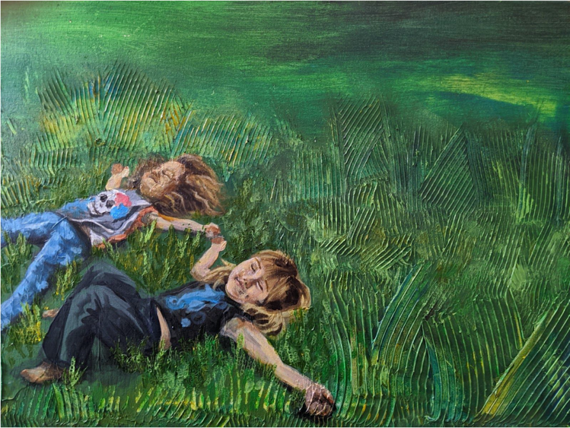
Emily Englehardt, Adelia & Cheyanne, 18"x 24” Acrylic. August 2017
C2

Slide 15
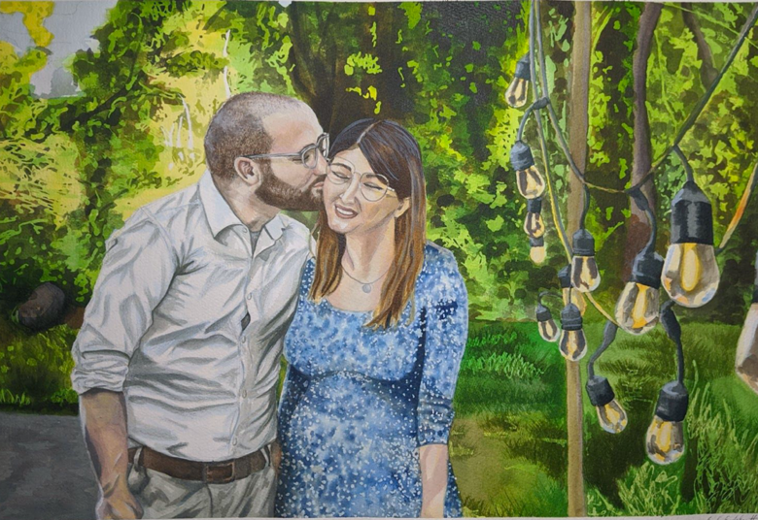
Emily Englehardt, Michael & Sophia, 15.5"x 22.5" Acrylic. March 2020

Slide 16
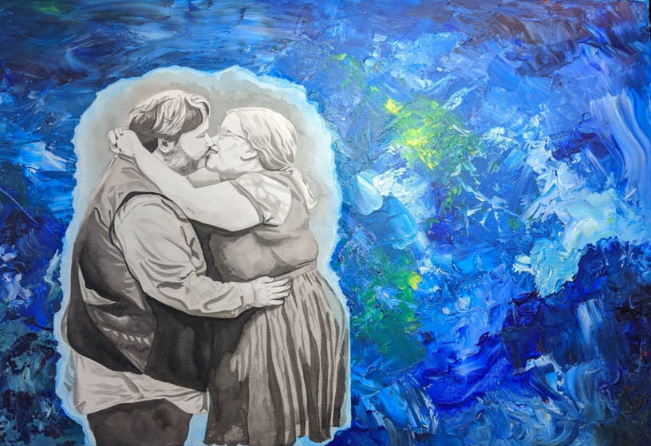
Emily Englehardt, Adam & Emily,
24"x 36"Acrylic. April 2020
C3

Slide 17
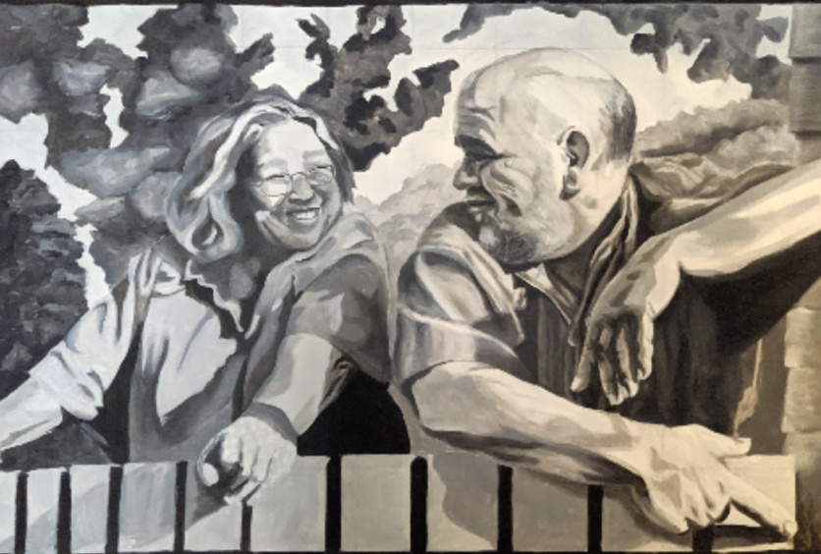
Emily Englehardt, Mom & Dad, 30"x40"Acrylic. April 2020
C4

Slide 18
Ben Kirk: Artist Statement
C1
During the summer of 2019, I found myself in the middle of a mountain, lost in a bamboo forest in Kyoto, Japan. In the span of two hours, walking deeper into the bamboo, I encountered only two other beings; a black cat, and a young Japanese student named Yamanaka. Yamanaka explained to me that there was nothing in the direction I was walking. With a bow, he took on the task of being my guide. For three hours Yamanaka led me through the bamboo, to a path, up a hill. We passed hundreds of small, ancient-looking shrines, and crimson gates. Yamanaka brought me to the top of the mountain to a 600-year-old pillar. At the tip of this pillar was a larger-than-life statue of a fox leaping through the air. We found a bench to rest on. Yamanaka taught me about bugs, and I took out my sketchbook in an attempt to capture our adventure. We shared each other’s company in solitude.
I have always felt a sense of comfort in solitude, and I have always thought of stumbled-upon, empty spaces as personal sanctuaries. This growing series of illustrations are of the sanctuaries I found while getting lost in Japan.
This series is dedicated to Yamanaka. Thank you for sharing my solitude.

Slide 19
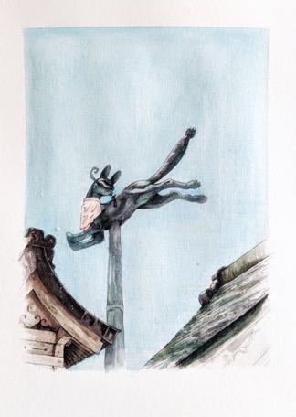
C2
Ben Kirk,
For Yamanaka,
8” x 6”
Watercolor and ink.
April 7, 2020

Slide 20
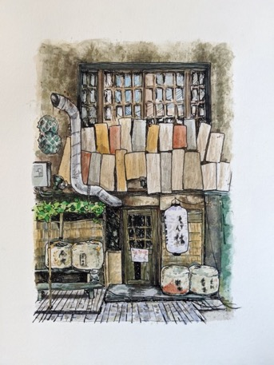
C3
Ben Kirk,
Somewhere in
Namba,
8” x 6”
Watercolor and ink.
April 7, 2020

Slide 21
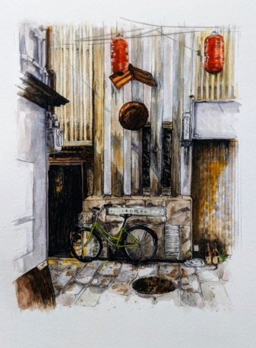
Ben Kirk, Yokocho,
8” x 6”
Watercolor and ink.
April 7, 2020
C4

Slide 22
Ryan Jackson: Artist Statement
D1
We have always gravitated to the shoreline. We have an urge to seek out this place for its beauty and promise of possibility. This boundary’s horizon gives us hope for what may come, but also diverts us from where we are. With our eyes fixed on this expanse we are misled from our present. A unique quality of the aerial perspective is that it has no horizon, no figment to distract us. This viewpoint allows us a moment to objectively see where we are.
My aim is to capture this fleeting moment. With the short-lived working time, iridescence, and fluidity of epoxy it is befitting of the task. This floor panel installation, initially designed for the Winfisky Gallery, invites its viewers to walk on and view the work from above; to be present in the work.

Slide 23
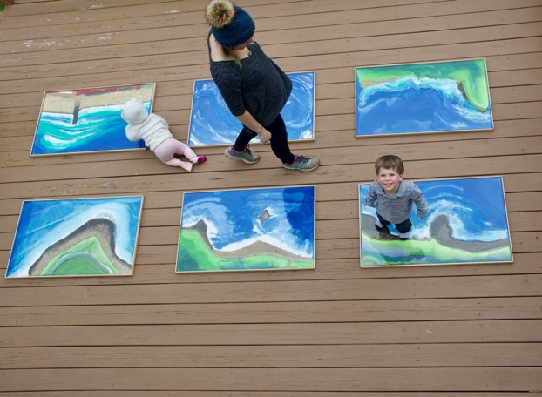
Ryan Jackson, Where Land Meets Sea,
21.5’ x 5.5’Epoxy on MDF. April 26, 2020
D2

Slide 24
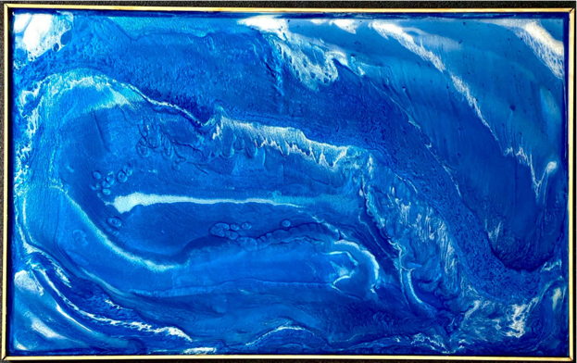
Ryan Jackson Panel 1, 24”x 38.83”
Epoxy on MDF April 26, 2020
D3

Slide 25
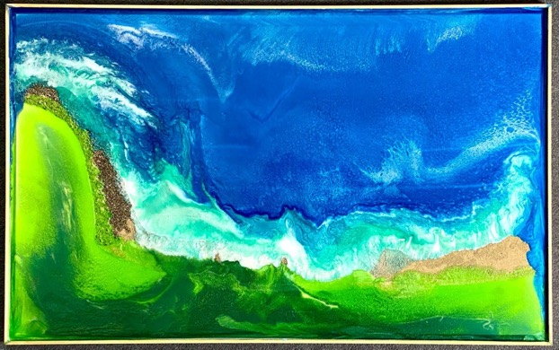
Ryan Jackson Panel 2, 24”x 38.83”
Epoxy on MDF April 26, 2020
D4

Slide 26
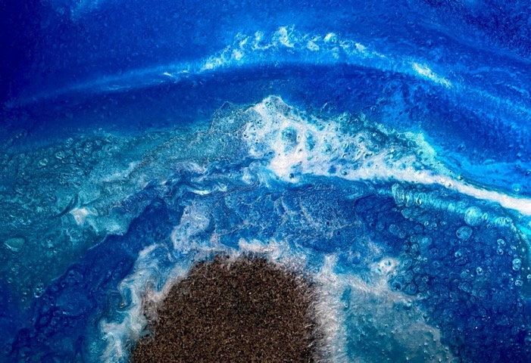
Ryan Jackson Panel 3, 24”x 38.83”
Epoxy on MDF April 26, 2020
D5

Slide 27
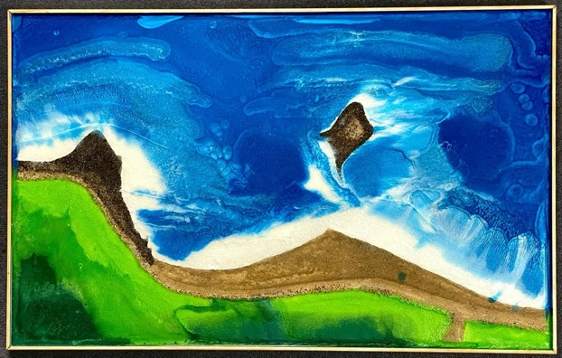
Ryan Jackson Panel 4, 24”x 38.83”
Epoxy on MDF April 26, 2020
D6

Slide 28
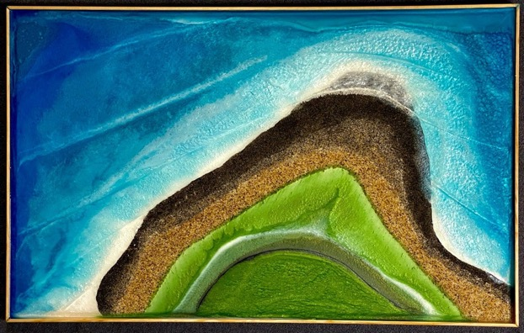
Ryan Jackson Panel 5, 24”x 38.83”
Epoxy on MDF April 26, 2020
D7

Slide 29
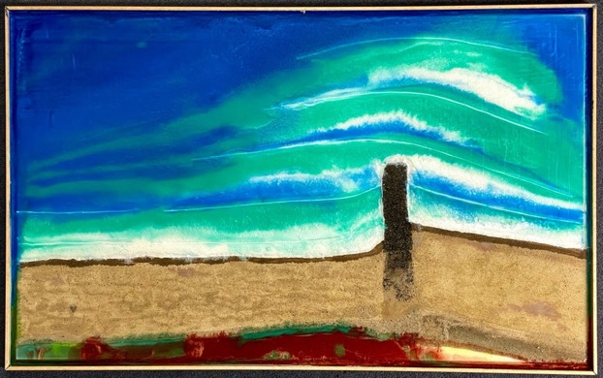
Ryan Jackson Panel 6, 24”x 38.83”
Epoxy on MDF April 26, 2020
D8

Slide 30
Alicia Mulcahy: Artist Statement
E1
Twenty-Three Days of Medically Advised Motherhood
As an artist I have always found the need to communicate my experienced emotions throughout the artistic process with the audience. In this case, the series of paintings before you encapsulate the maternal void I experienced during our four-month old son’s 23-day hospital stay. The child-friendly colors mock the grief felt with the restrictions put on my maternal instincts, every decision I made for our son was superseded by doctors’ recommendations.
The paradoxical symbolic forms in these paintings embody the innocence of childhood and the helplessness felt at not being able to care for our son as he underwent medical treatment. Cody tested positive for respiratory syncytial virus, but the focus quickly turned to a dismal diagnosis of “failure to thrive” prematurely ending my breastfeeding journey and introducing the dreaded “f” word: formula. I was being deprived the most natural part of nurturing an infant.
In an attempt to find out why Cody always breathed so shallowly and so rapidly, a series of sixteen tests and procedures were performed. The last procedure was by far the most difficult. This grid of twelve visceral images serves as an intriguing background, but for me, they are haunting snapshots of my son I never wanted to see. Photographs that will never make the baby book. They are the results of the endoscopic evaluation, yet another procedure yielding inconclusive results.
The instinctual torch was handed back to me upon our discharge and while I’m still trying to navigate these decisions without doctors, that torch will also take the form of a paintbrush. It is in the creative process where I find my voice, my strength and my passion. Connecting my role as artist and mother in these paintings allows me to nurture the relationship with my son as well as with my art.

Slide 31
Alicia Mulcahy, Boston Bound,
30”x40”
Acrylic on canvas.
April 27, 2020
E2

Slide 32
Alicia Mulcahy,
E is for Endoscopic,
30”x40”
Acrylic on canvas.
April 27, 2020
E3

Slide 33
Alicia Mulcahy, Failure to Thrive,
11”x14”
Acrylic on canvas.
April 27, 2020
E4

Slide 34
Susan Teal: Artist Statement
F1
Anxiety and Trauma, Series 2020
My body of work explores the concept of self-identity. I am the subject of my own work, visually interpreting my struggles with anxiety and trauma. Using reference photos that I take of myself in the midst of anxiety attacks, I paint realistic self-portraits with multiple faces peeling away from one another, each expressing different emotions. The distortion created within my work is an effort to translate my complex feelings of sadness, anger, and fear on to the painted surface. In this way I explore who I am. The final effect borders on disturbing as it reveals a reflection of my reality.
This series was born in January 2020, inspired by the worst experience of my life; the disappearance and death of my aunt. In the months following, more events continued to add to my stress and anxiety and as I went into isolation with the rest of the world, I found myself unable to escape the thoughts and emotions that can overwhelm me. Trying to imagine what the future holds makes my chest tight and my fears rise. Focusing on the present, connecting remotely with the people most important to me, and using my artistic practice to redirect my strong feelings help me deal with these multiple traumas. Moving forward, I will focus on the short term. To the future, I can only have hope.

Slide 35
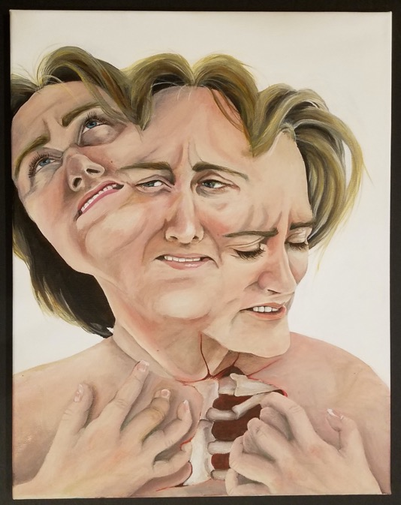
Susan Teal, Disconsolate,
16” x 20”
Acrylic on Canvas.
April 2020
F2

Slide 36
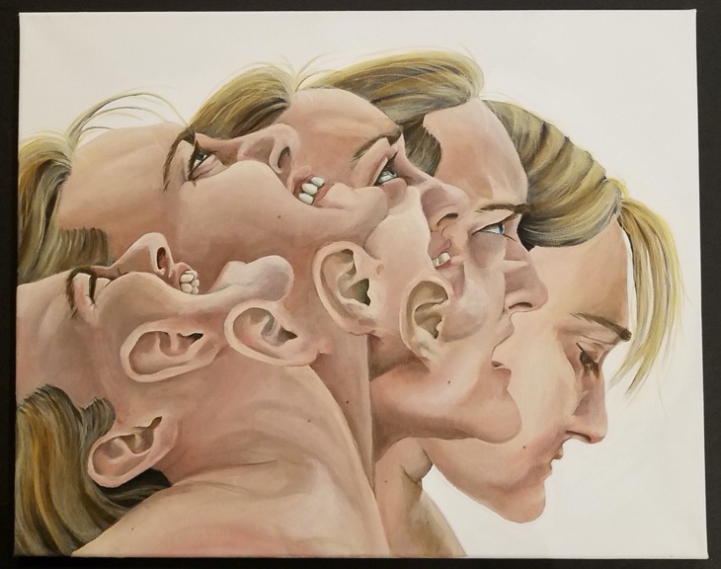
Susan Teal, Vociferation, 16” x 20”
Acrylic on Canvas. April 2020
F3

Slide 37
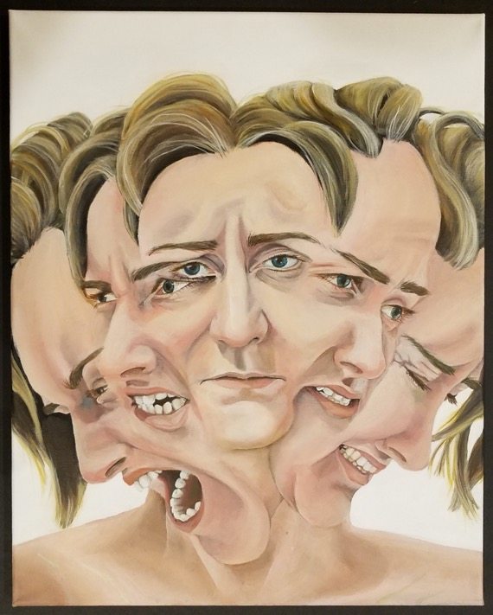
Susan Teal, Labile,
16” x 20”
Acrylic on Canvas
April 2020
F4

