Slide 1
Religion as a Tool of Censorship Against the LGBT community
An archival look at Salem State University in the 1970’s
Harley Pereira
Soc 403: Research Methods
Research Methods in the Social Sciences

Slide 2
Background
The Lesbian, Gay, Bisexual, Transgender (LGBT) community is an extremely vulnerable group in the United States. The oppression they face is felt in many aspects of our society such as policymaking, education, medical assistance, and religion. The LGBT community is vast with around 5.6% of the United States population identifying themselves as members of the LGBT community according to Gallup (Jones, 2021).
The Christian religion over the years has been known for being particularly unaccepting of the LGBT community. They have also actively contributed to the censoring of the LGBT community through their major influence. Over the course of history, the LGBT community has not been allowed to same voice as other groups and it has harmed how they are viewed. It is important to examine what this relationship looks like in terms of individuals conflicting identities, available platforms, and possible pushback.

Slide 3
Research Question:
How has Christianity been used to censor the LGBT community through language and representation? What were they allowed to say in the 1970’s?

Slide 4
Research design and methods
We were able to access some school newspaper columns from the LOG called “Some of Your Best Friends”
We also looked at Letters to the editor which came from both the LGBT group on campus and the opposing Christian group on campus
We took a sample of ten columns and letters and coded them for the terms
- Homosexuality is a “sin”
- Homophobic slurs/stereotypes
- Ways of censorship
We did qualitative research using content analysis of the Salem State University Archives of the LOG to look into the perspectives of different groups on campus from 1970-1976

Slide 5
Past research
Jonathan S. Coley (2019) and Melinda D. Kane (2013) address the conflicts between LGBT identity and Christian identity. They mention that a lot of LGBT people abandon their religion because it is harmful to them. Kane (2013) states that the LGBT community also create their own denominations in order to feel safe within their religion
Michael J. Maher (2006) talks about interviews with several contacts in LGBT related churches, but outside events such as AIDS related homophobia, discouraged the contacts from talking. He investigated what drives away the voices of the LGBT community, especially in a religious setting.

Slide 6
Past research
Jen Scott Curwood, Megan Schliesman and Kathleen T. Horning (2009) and Samuel L. Perry and Kara J. Snawder (2016) talk about platforms and the censorship of the LGBT in places such as the education system and the media. This included the banning of books in schools, violence towards LGBT students, and the ways that media exposure can change people’s opinions on the LGBT community.

Slide 7
What has not been researched?
An important question we must ask is, what about the members of the LGBT community who stay in the churches they grew up in? Does the “religiously justified” hatred cause members of the LGBT to lose their beliefs?
what happens when the LGBT is competing with the Christian community? They often have opposing messages and desires. What happens when they are competing for the same audiences such as on college campuses? Who has the resources to make more noise?

Slide 8
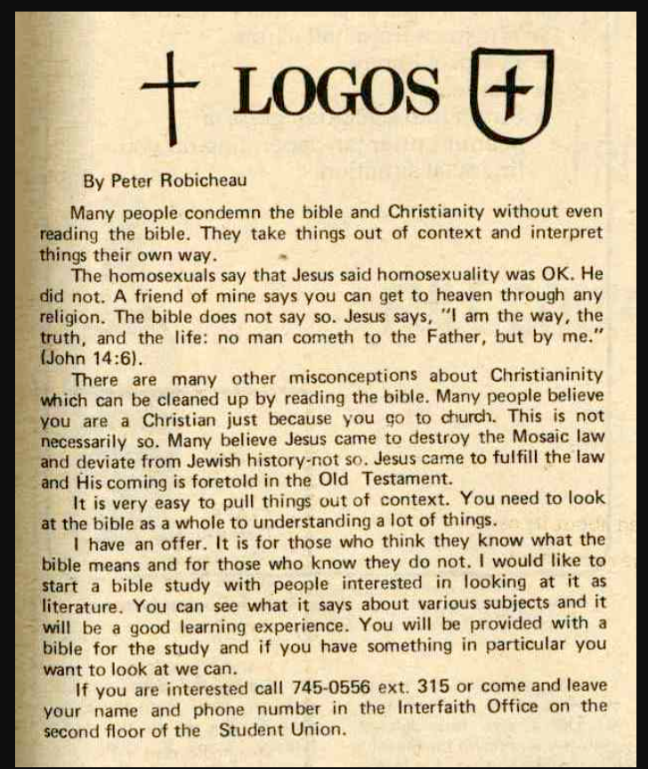
findings
Use of the word “sin”
Out of the 10 pieces of archival data we looked at, most of them contained the words “sin” or something equivalent. This was usually accompanied by statements such as “Jesus loves everyone but”

Slide 9
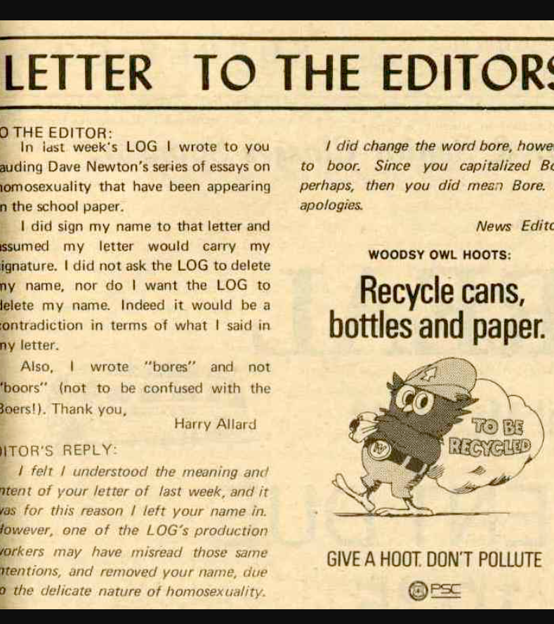
Findings
Use of slurs or stereotypes
The data had some slurs and stereotypes, but typically referred to the LGBT community as homosexuals. There were more instances of stereotypes, specifically towards lesbians, than slurs.

Slide 10
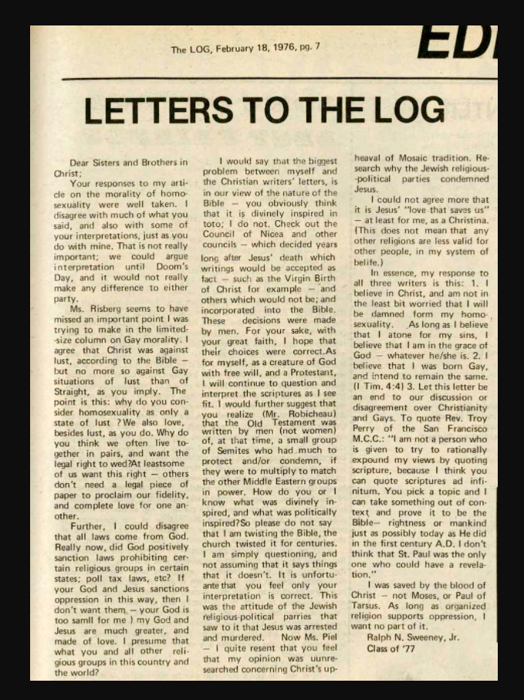
Findings
Ways of censorship
As for censorship, most of the data did not censor the LGBT community, but attempted to discredit or correct previous statements made in the “Some of Your Best Friends” column of the LOG

Slide 11
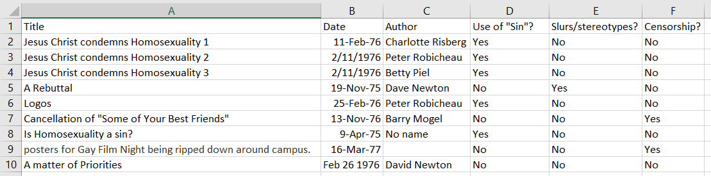
Findings

Slide 12
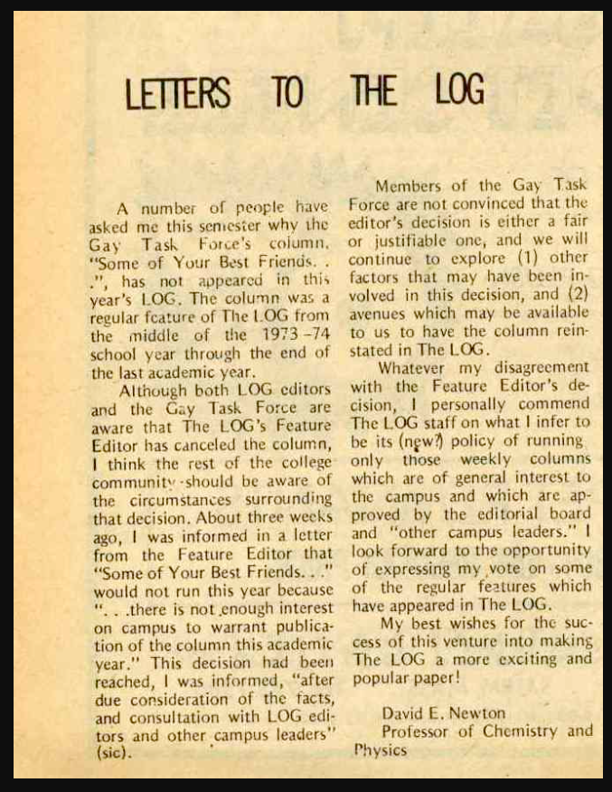
The Cancellation of “Some of Your Best Friends” in the LOG
November 13, 1976

Slide 13
conclusion
We are able to conclude from the archives and the literature that there is a conflict in the relationship between Christianity and the LGBT community in the 1970’s and still today. The archives showcases the conflict between the LGBT and Christians on Salem State’s campus. They argued over morality and Christians constantly called for their LGBT peers to recognize their “sins”.
Christians were able to call the morality of LGBT students into question and they did things such as ripping down posters for LGBT events and setting up rallies to celebrate Anita Bryant, a strong advocate against the LGBT community.

Slide 14
Bibliography
Coley, J. S. (2020). Reframing, Reconciling, and Individualizing: How LGBTQ Activist Groups Shape Approaches to Religion and Sexuality. Sociology of Religion, 81(1), 45–67. https://doi.org/10.1093/socrel/srz023
Curwood, J., Schliesman, M., & Horning, K. (2009). Fight for Your Right: Censorship, Selection, and LGBTQ Literature. The English Journal, 98(4), 37-43. Retrieved April 9, 2021, from http://www.jstor.org/stable/40503259
Kane, M. D. (2013). LGBT Religious Activism: Predicting State Variations in the Number of Metropolitan Community Churches, 1974-2000 LGBT Religious Activism: Predicting State Variations in the Number of Metropolitan Community Churches, 1974-2000. Sociological Forum, 28(1), 135–158. https://doi.org/10.1111/socf.12006
Maher, M. J. (2006). A Voice in the Wilderness: Gay and Lesbian Religious Groups in the Western United States. Journal of Homosexuality, 51(4), 91–117. https://doi.org/10.1300/J082v51n04_05
Perry, S., & Snawder, K. (2016). Longitudinal Effects of Religious Media on Opposition to Same-Sex Marriage. Sexuality & Culture, 20(4), 785–804. https://doi.org/10.1007/s12119-016-9357-y

