Slide 1


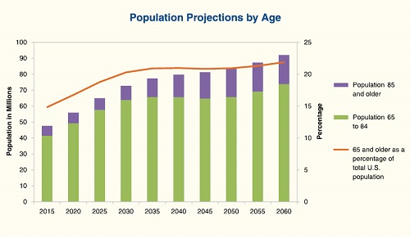
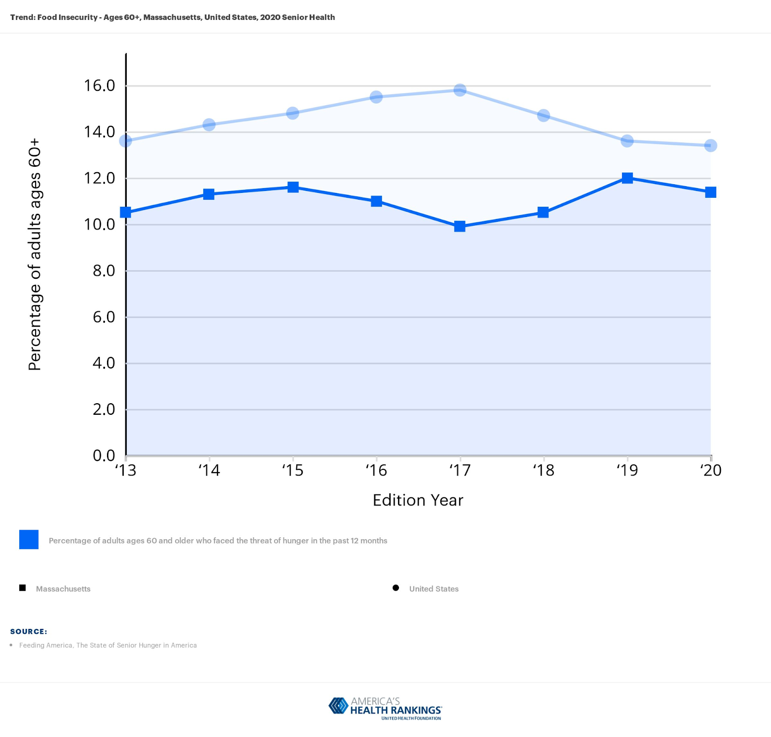
Lack of Utilization of Nutrition Services Among Community-Dwelling Elders and Reasons for Underutilization
Caroline Turnbull, BSN, RN
Salem State University
Background
Abstract
Results
Conclusion
As the elderly population of the United States grows, the need for services to help in the care of elders in the community expands
Every community-dwelling older adult should have adequate access to food and nutrition programs that promote optimal nutritional status and ensure access to safe, ample food for consumption
Home and community-based services (HCBS) are implemented in order to assist older adults in remaining safely and comfortably in their residences and communities instead of entering into a long-term care facility
It’s increasingly important to make sure all elders eligible for HCBS services are aware of their options and can receive them
The growing number of older adults in the community and the focus on health promotion in primary care accentuate the fundamental need for these programs
Samuel et al. (2018)
SNAP participants exhibited decreased rates of hospitalization and a reduced likelihood of an ED visit compared with SNAP nonparticipants
Enrolling the 47% of the 2012 eligible SNAP nonparticipants population in SNAP would have yielded $19 million in healthcare savings
Szanton et al, (2017)
SNAP is underutilized by high-risk older adults and can reduce nursing home expenses
Only 53.4% of income-eligible older adults received SNAP in 2012 and there was a 23% decrease in nursing home admission rate among SNAP participants compared to nonparticipants
Bharadwaj & Lee (2016)
Programs and policies aimed at reducing food insecurity in older adults could potentially reduce utilization of health care services
Food-insecure adults had higher rates of using ED visits than food-secure older adults
Sonnega et al. (2017)
Prior utilization of a different type of senior service significantly increased the probability of current HCBS use
Use of any type of senior service serves as a passageway to subsequent use of HCBS
Thomas et al. (2016)
Older adults receiving home-delivered meals reported improved health status and sense of well-being, especially in those older adults who either live independently or receive delivered meals daily
Casando et al. (2011)
Primary reasons for needs that were unmet by HCBS were lack of awareness, unwillingness, unavailability, and concern about the cost of services
Many eligible elders who are not currently enrolled in Meals on Wheels or SNAP would benefit from greater access to food and nutrition programs and services
Increased utilization of these services could improve patient quality of life, reduce hospitalizations or need for nursing home admission, and significantly reduce healthcare costs
With the growing elderly population, it is important for patients, their families and providers to be aware of available services to maximize patient quality of life, improve their nutritional status, and prevent hospitalization or placement in a long-term care facility
Nutrition education, screening, monitoring, and evaluation to ensure more healthful aging should be a priority of primary care providers, although there is evidence that these services are not routinely discussed in the primary care office
The Meals on Wheels program and Supplemental Nutrition Assistance Programs (SNAP) are available to community dwelling elders, yet both are underutilized by many who are eligible
Recommendations
Recommendations for practice include patient education regarding all available HCBS at routine and annual office visits
Reviewing the resources for community nutritional support programs at appointments will help facilitate the utilization of services and improve quality of life in the elderly population
A screening tool to evaluate for the need for community nutrition services and a pathway for accessing such services are ways to improve utilization
This will support older adults enjoying longer and healthier lives in their own homes, with sufficient access to food and community-based nutrition programs
Figure 1: Projections of the Population by Age and Sex for the United States: 2015 to 2060 (NP2012-T12)
Methods
6 key studies were chosen. Findings on study outcomes and practice recommendations are summarized.
Food insecurity and health care utilization among older adults in the United States (Bhargava & Lee, 2016)
Home and community-based service and other senior service use: Prevalence and characteristics in a national sample. Home health care services quarterly (Sonnega, Robinson, & Levy, 2017)
Food assistance is associated with decreased nursing home admissions for Maryland's dually eligible older adults. (Szanton, et al., 2017).
More than a meal? A randomized control trial comparing the effects of home-delivered meals programs on participants’ feelings of loneliness. (Thomas, Akobundu & Dosa, 2016).
Does the Supplemental Nutrition Assistance Program affect hospital utilization among older adults? (Samuel et al., 2017)
Unmet Needs for Home and Community-Based Services Among Frail Older Americans and Their Caregivers (Casando, et al., 2011)
References
Bhargava, V., & Lee, J. S. (2016). Food insecurity and health care utilization among older adults in the United States. Journal of nutrition in gerontology and geriatrics, 35(3), 177-192.
Casado, B. L., van Vulpen, K. S., & Davis, S. L. (2011). Unmet Needs for Home and Community-Based Services Among Frail Older Americans and Their Caregivers. Journal of Aging and Health, 23(3), 529–553. https://doi.org/10.1177/0898264310387132
Samuel, L. J., Szanton, S. L., Cahill, R., Wolff, J. L., Ong, P., Zielinskie, G., & Betley, C. (2018). Does the Supplemental Nutrition Assistance Program affect hospital utilization among older adults? The case of Maryland. Population health management, 21(2), 88-95.
Sonnega, A., Robinson, K., & Levy, H. (2017). Home and community-based service and other senior service use: Prevalence and characteristics in a national sample. Home health care services quarterly, 36(1), 16–28. https://doi.org/10.1080/01621424.2016.1268552
Szanton, S. L., Samuel, L. J., Cahill, R., Zielinskie, G., Wolff, J. L., Thorpe, R. J., & Betley, C. (2017). Food assistance is associated with decreased nursing home admissions for Maryland's dually eligible older adults. BMC geriatrics, 17(1), 162.
Thomas, K. S., Akobundu, U., & Dosa, D. (2016). More than a meal? A randomized control trial comparing the effects of home-delivered meals programs on participants’ feelings of loneliness. Journals of Gerontology Series B: Psychological Sciences and Social Sciences, 71(6), 1049-1058.
Figure 2: Food Insecurity - Ages 60+, Massachusetts, United States
Objectives
Determine key reasons for underutilization of community-based nutrition services for eligible elderly patients
Emphasize the key role primary care providers play in the education and initiation of referrals to the use of community services
Summarize key study results and findings, which are used to determine important recommendations for practice
Figure 2 illustrates the percentage of adults over the age of 60 who are food insecure in a 12-month period between 2013 and 2020 (America's Health Rankings, 2021).
Notes:
Icons:
https://cicoa.org/
https://www.mealsprogram.com/
Figure 1: ” U.S. Census Bureau. “Table 10. Projected Life Expectancy at Birth by Sex, Race, and Hispanic Origin for the United States: 2015 to 2060” ; Adele M. Hayutin. 2012. “Changing Demographic Realities,”in Independent for Life: Homes and Neighborhoods for an Aging America, ed. Henry Cisneros, Margaret Dyer-Chamberlain, and Jane Hickie. Austin: University of Texas Press, 36.
Figure 2: America's Health Rankings. (2021). 2020 Annual Report. Retrieved March 1, 2021, from https://www.americashealthrankings.org/learn/reports/2020-annual-report
Figure 2Based on the feedback from participants, not only does a nutrition service reduce food insecurity and promote aging at home, but it improves safety of elders living independently in the community. In Massachusetts, 11.4% of residents ages 60 and older faced the threat of hunger in the last year. Figure 1 illustrates the percentage of adults over the age of 60 who are food insecure in a 12-month period between 2013 and 2020

