Slide 1

The Punto Urban Art Museum in Salem, MA:
Latinx Representation in Community Art
Kate Jordan & Jane Marshall, Ph.D.
Salem State University

Slide 2
Background
  Punto Urban Art Museum is a project of the North Shore Community Development Coalition, a nonprofit affordable housing developer located in Salem, MA.
  Mission Statement: "A social justice art program focused on breaking down invisible socio-economic barriers."
  The project features 75 large scale murals within a 3 block radius in the El Punto, The Point neighborhood located in Salem, featuring local and international artists.
  Source: http://puntourbanartmuseum.org/
Notes:
Discuss origins – reception in community – can mention my reservations understanding resident needs for assimilation, privacy within affordable housing - stated goals of revitalization and economic development

Slide 3
El Punto / The Point Neighborhood
Immigrant community of workforce housing: French-Canadian, Italian, Irish until 1970s. Now majority Hispanic/Latinx population.
Currently 23.6% of Point residents are foreign born; 63% non-white.
17.6% of Salem, MA residents are identified as Latino.
Median income $41,068 in 2016.
Neighborhood experiences segregation and discriminatory attitudes, frequently disparaged among dominant groups in Salem.
Concentrated area of affordable housing – nonprofit and state-run.
Resident pride exists, isolation and safety fears also present.
  Source:
  http://www.city-data.com/neighborhood/The-Point-Salem-MA.html
  https://www.salem.com/sites/salemma/files/uploads/salemhousingneeds.pdf
Notes:
Scholarship on immigration patterns: Salem State professors Aviva Chomsky, Elizabeth Duclos-Orsello, The House of Seven Gables resettlement services
Racism/Classism on FB, etc.

Slide 4
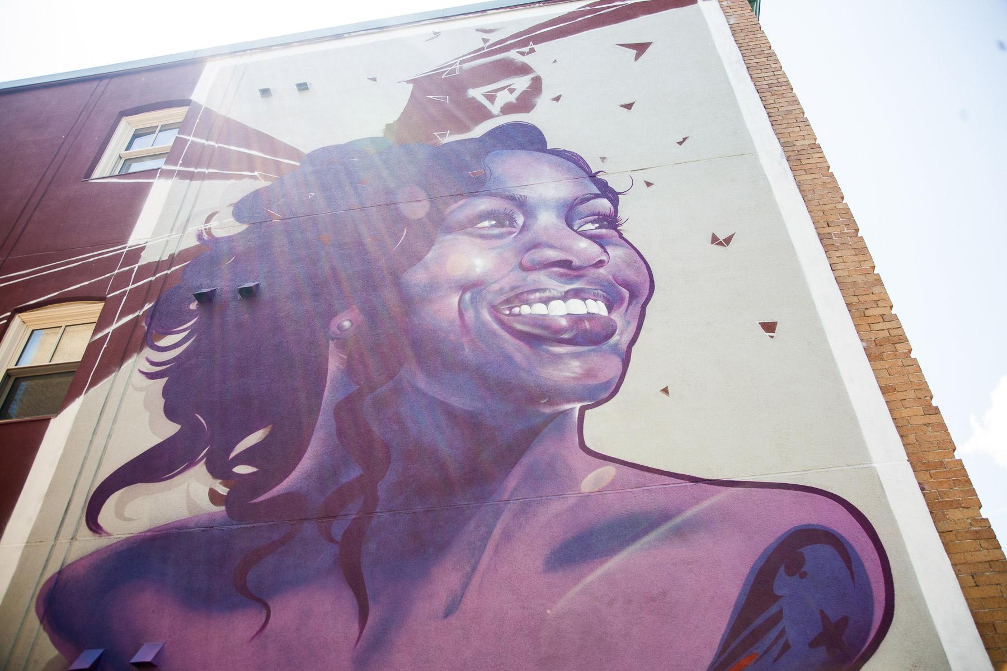
Anacaona
Ruben Ubiera-Minaya
Pride and culture.
This is me, my home, where I belong.
Notes:
Joyful community. Elevated. Gratitude.

Slide 5
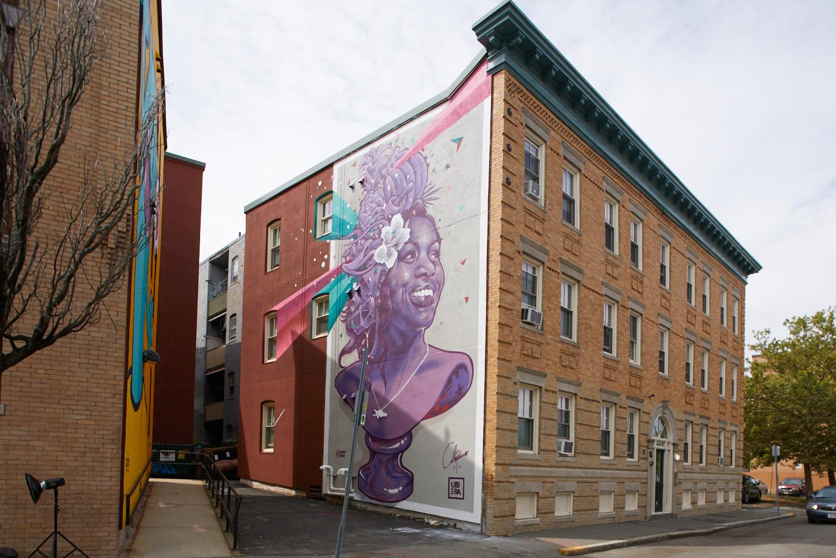
Anacaona
street view
Notes:
From Taíno anacaona, meaning
"golden flower"; from ana, meaning "flower", and caona, meaning"gold, golden")
was a Taíno cacica (chief)

Slide 6
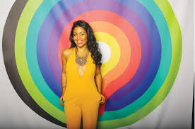
Anacaona in Real Life
Rosario Ubiera-Munaya, the artist's sister.
Executive Director of Amplify Latinx.
Founder of Conjuelos Productions, an arts programming business focused on Latinx and Afro-Latino representation in particular
Salem resident, Dominican immigrant.

Slide 7
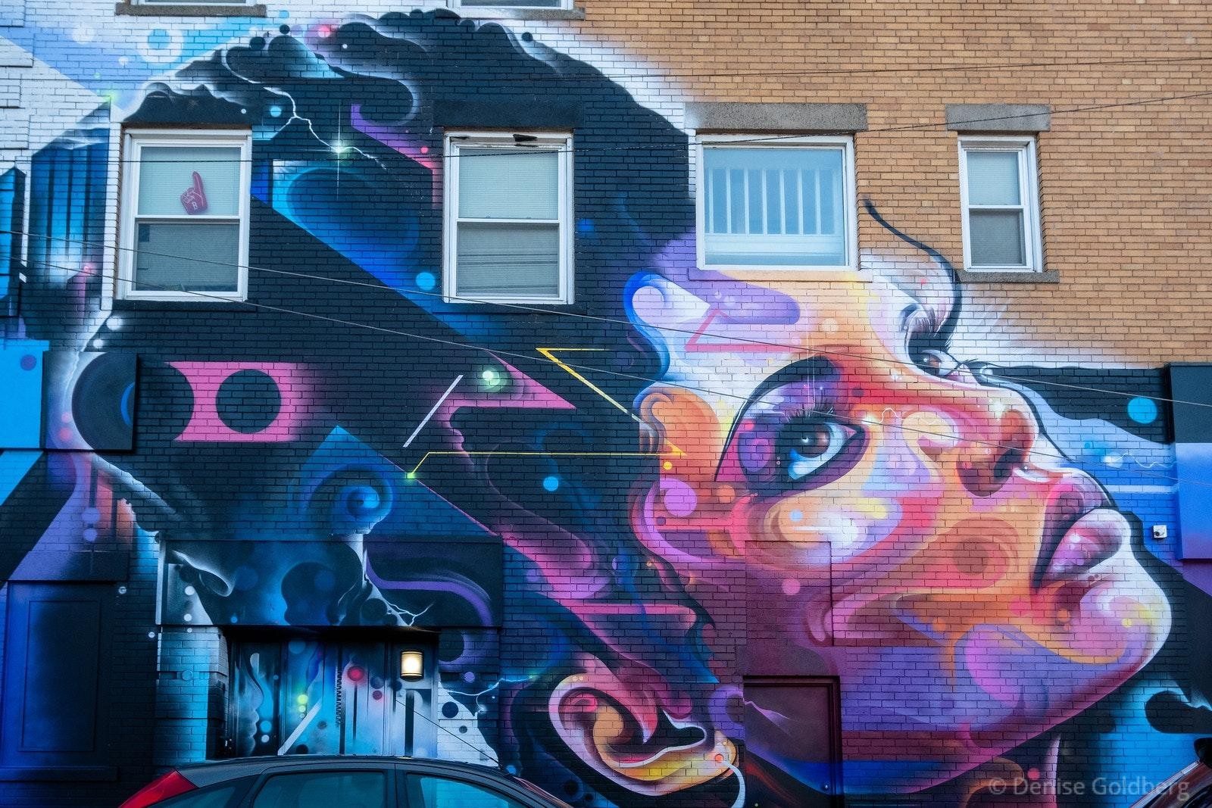
Queen of the Block
Mr. Cenz
Where I’m from is who
I am.
Notes:
Discuss notions of femininity in Latinx culture , dangers and standards for beauty , behavior, and other norm.

Slide 8
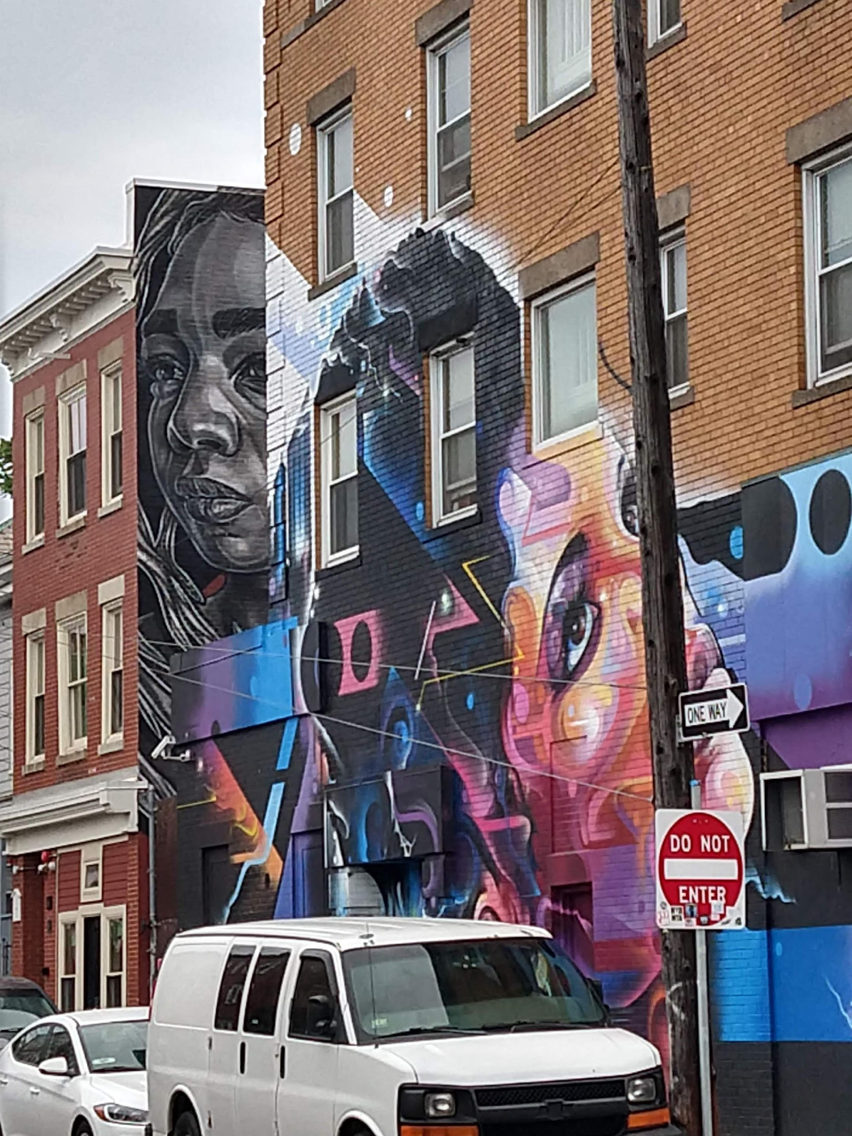
Queen of the Block street view
Notes:
Fix this rotation

Slide 9
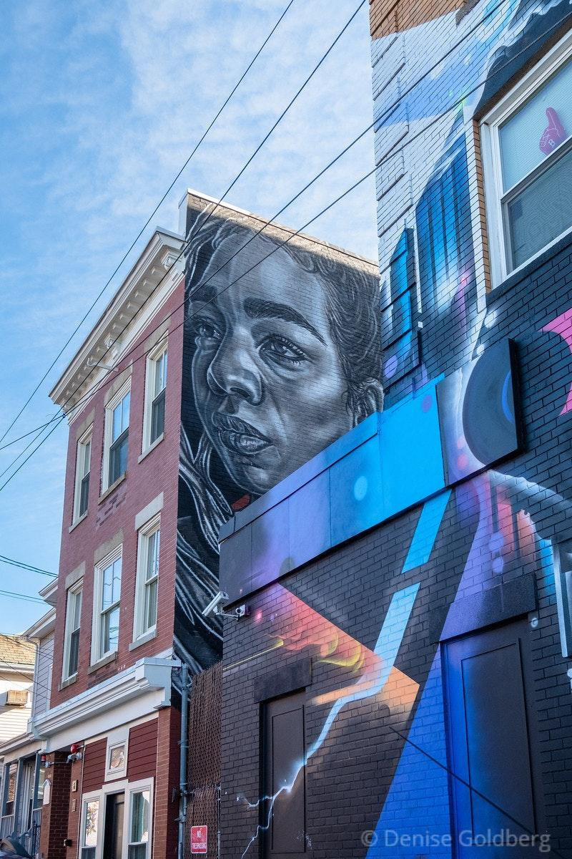
Katherine
Paola Delfin
I am a student. I am a girl.
My name, myself is between two worlds.
Notes:
Between 2 worlds , acculturation: in the U.S. , within Latino residential communities

Slide 10
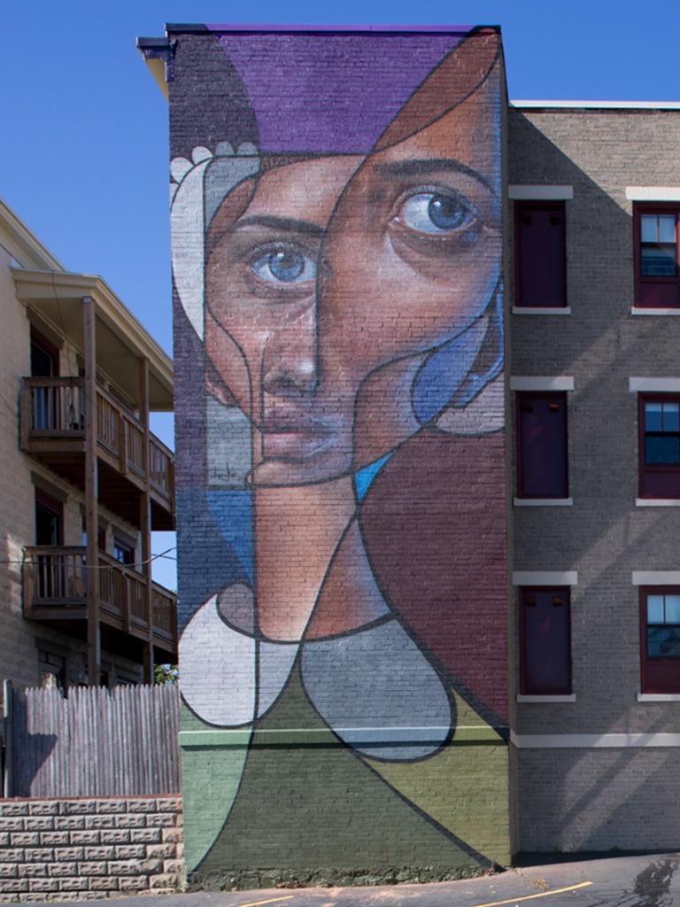
Untitled
Belin
Confusion. I feel disjointed, and torn between worlds.
Notes:
Another take on between 2 worlds.
Acculturative stress can take on multiple symptoms including dissociation.

Slide 11
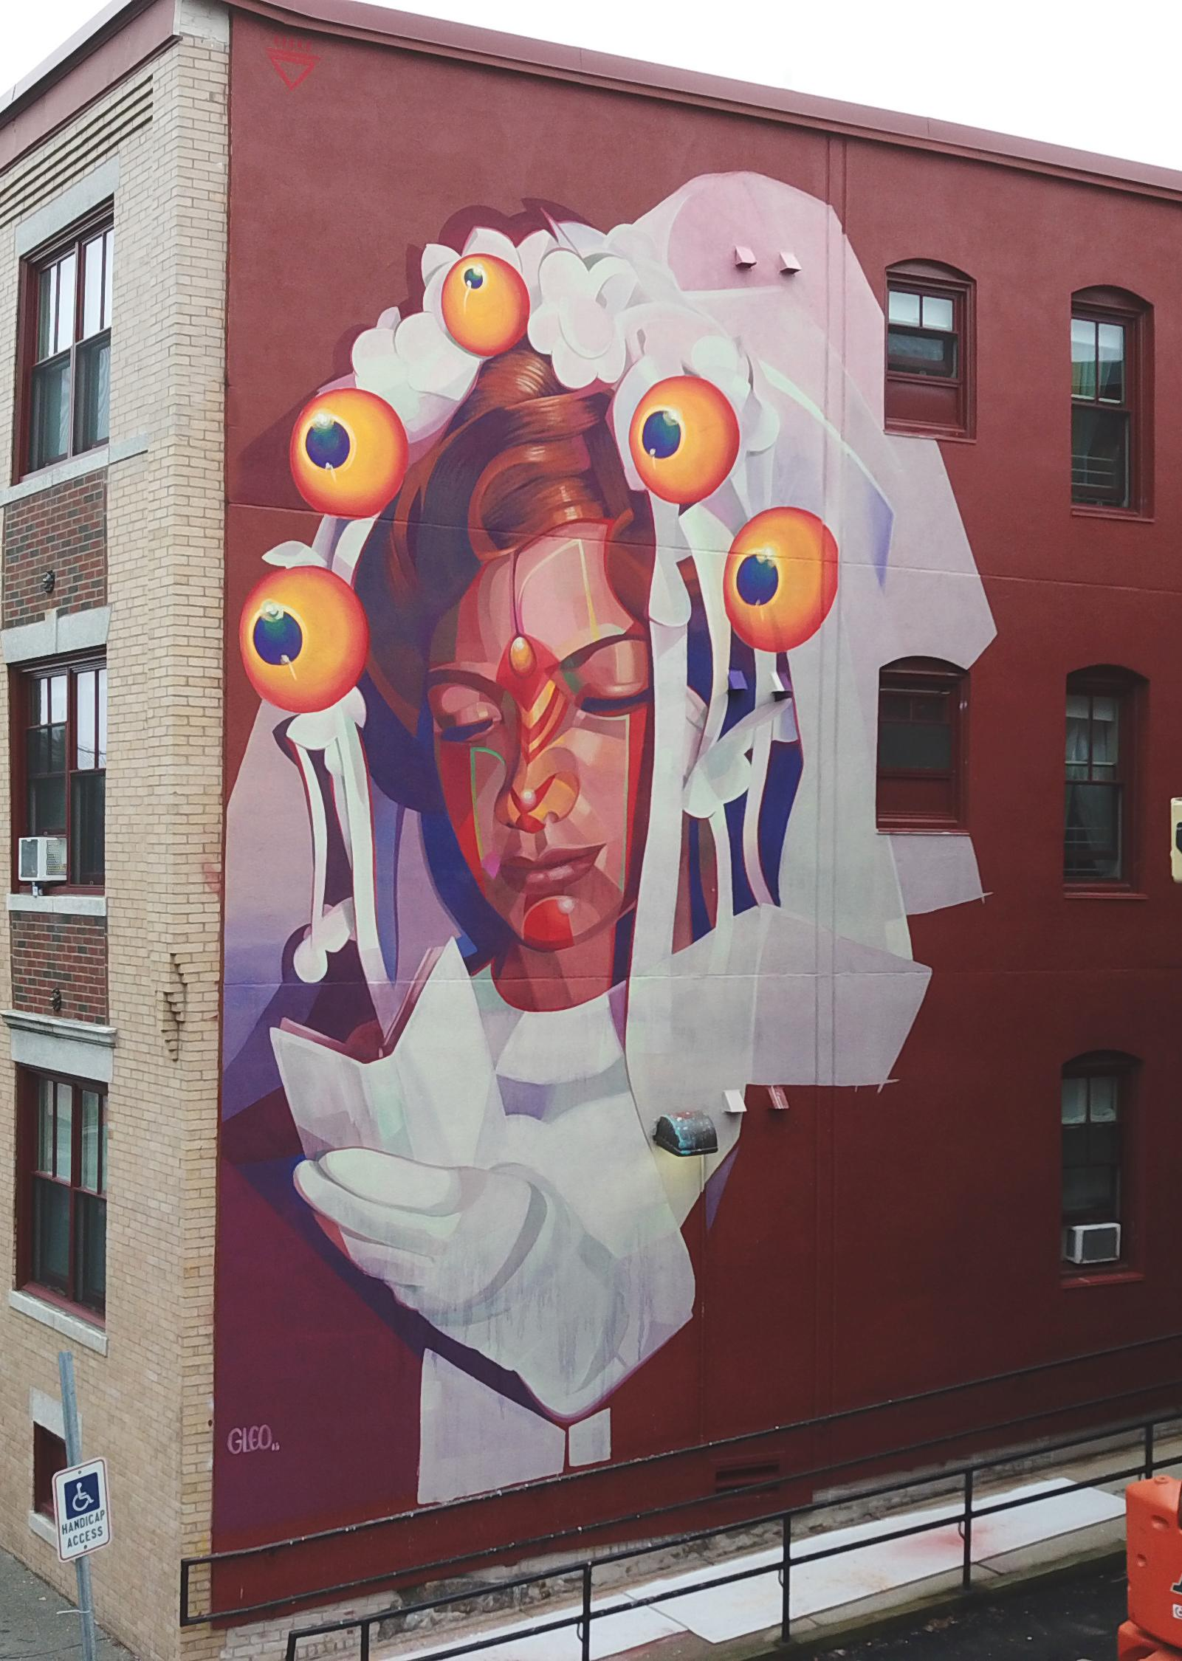
Communion with Us
GLeo
I believe in God’s plan for me.
I am reverent.
Notes:
Role of religion fatalism , church community (note the history of tearing down the Catholic Church)

Slide 12
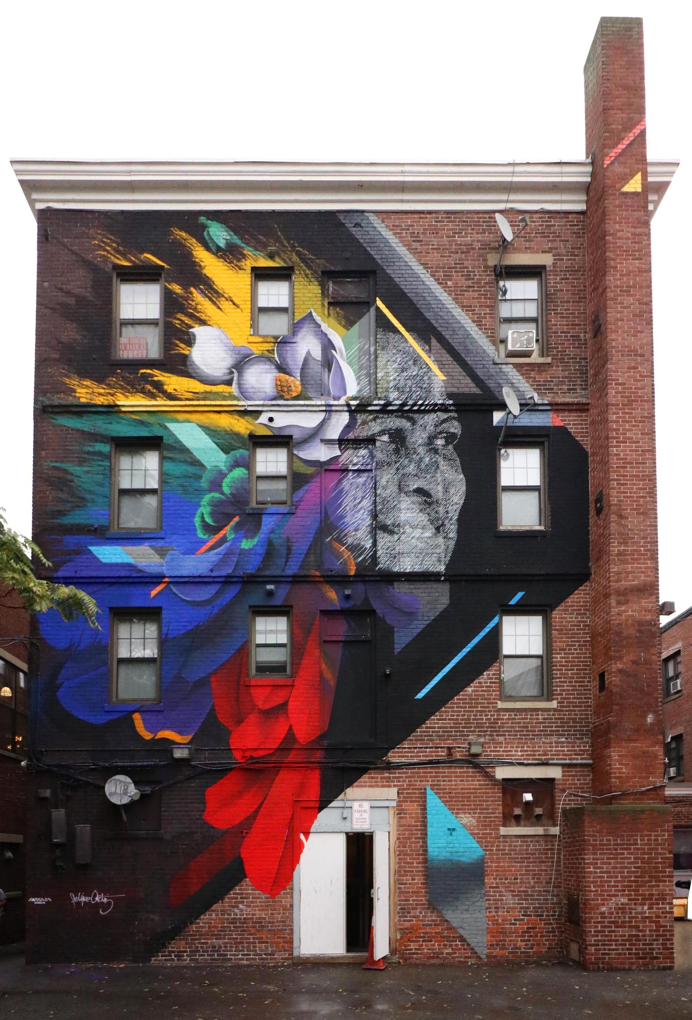
Migrar
Felipe Ortiz & Ivan Salazar
I am hopeful and faithful.
I am bringing forward those who follow, my family.
Notes:
Migration in the Family. Learned about Mexican migration typically led by men, Dominican led by women. More on The Point as a disparaged immigration neighborhood. Starting with French-Canadians, Irish, Hispanic. White flight in the 80s through 2000.
First generation families are hopeful about economic and educational opportunites, and second and third generations may be less so as evidenced by research on experience with discrimination stress..

Slide 13
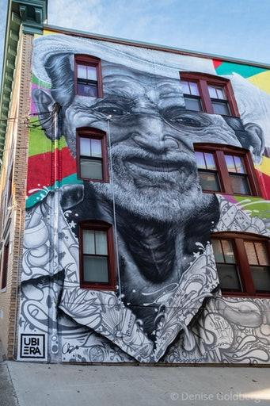
The Farmer
Ruben Ubiera
My home where the land was my work.
Notes:
Urban landscape versus rural.

Slide 14
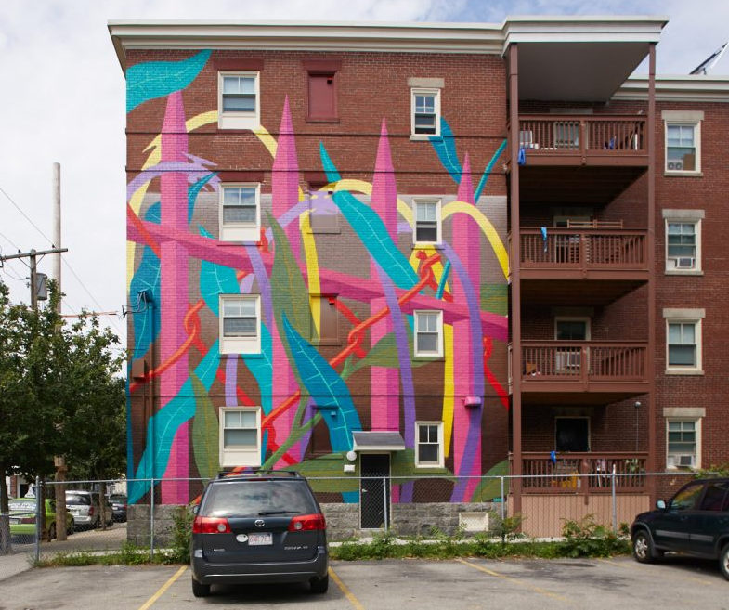
Crieciendo Juntos
El Cekis
Walls and fences separate us and keep us apart.
I can grow no matter where I am.
Notes:
Industrial and earth. Home and state control (housing) themes of urban life, empowerment

Slide 15
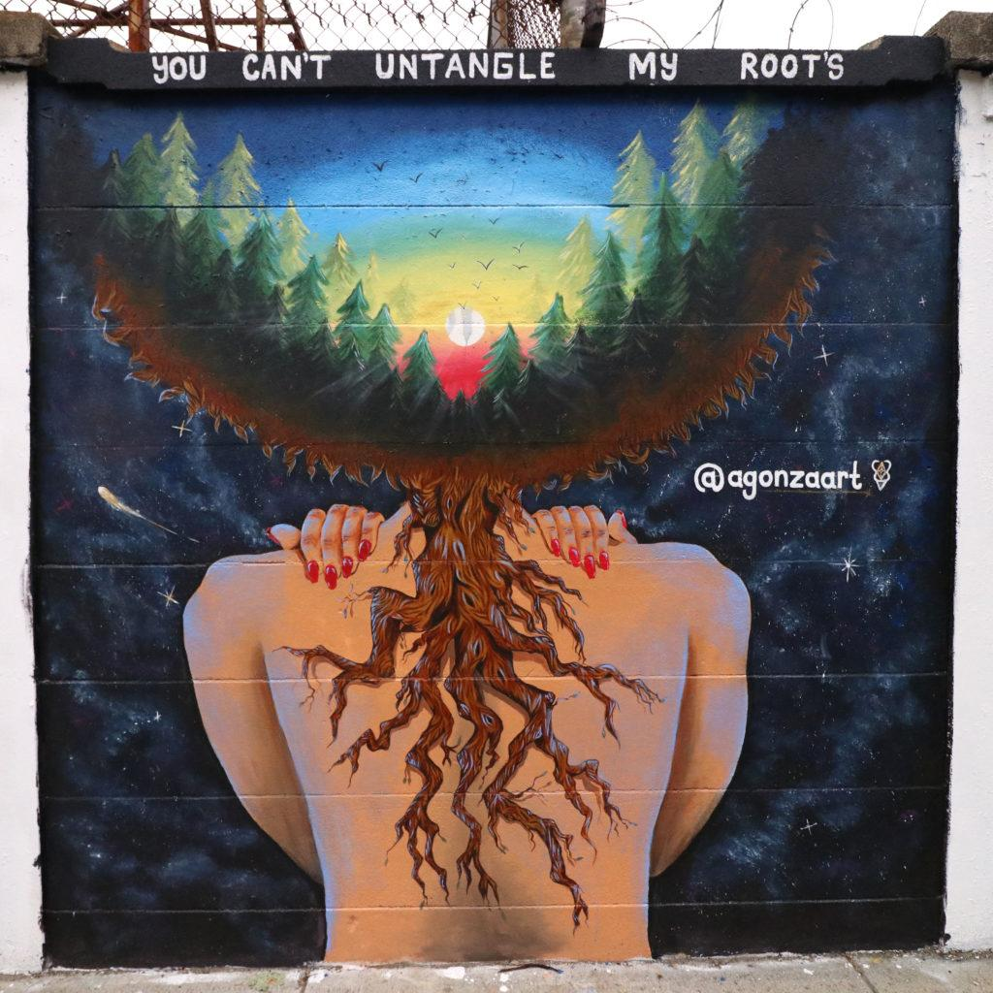
You Can’t Untangle My Roots
Angela Gonzales
My ethnic roots blend into one another.
One growing into the next.
Notes:
It’s time consuming, labor intensive, and tedious to untangle plant roots. It is possible to do. But for humans, the roots can’t be untangled. They blend in together, and cannot be torn apart.
The LatinX population (diaspora) is varied and complex. This artist is claiming her identity and power as suggested by the title. She doesn’t want people to put her into a box with a label of black, white, Mayan, Hispanic, Latina, or other labels. She may identify with all of those or none of those at all. She may identify as LatinX, not seeing her gender as binary. She may identify simply as American without a racialized component. What’s most is important is how she sees herself.

Slide 16
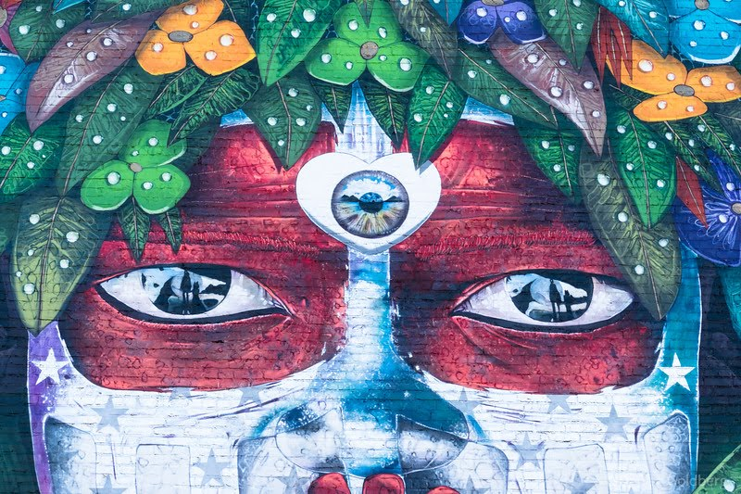
Who are LatinX?
Their numbers are relatively slim in ths Northshore community..
Love Child
Chor Boogie
You see only a part of me.
Notes:
Teklutan, Incan or Myan ruler.
Third eye to ward off evil spirits. Mountain range of salt flats, Chile. Used to power lithium for our cellular devices.
Red around the eyes. Dye used for battle and different ceremonies among Amazonian tribes people.
Stars underneath the red tribal paint.
Parent and child holding hands.

Slide 17
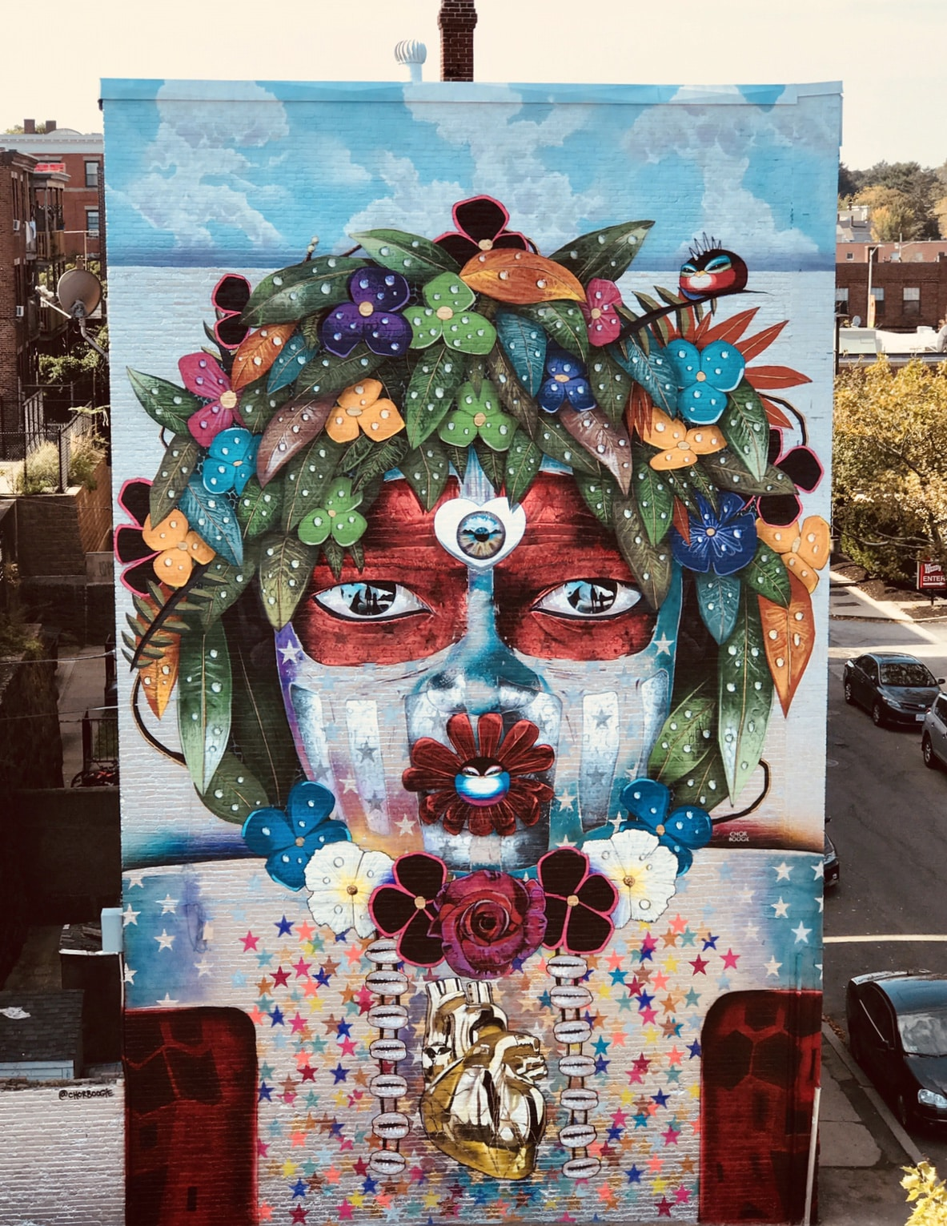
Love Child
Street view
See the whole of me.
Notes:
MECA-migration/ acculturation, acculturation/immigration, family dynamics, family life cycle, , ecological factors.
Clients’ strengths and risks.
Consider a person in their context, not just in crisis.

Slide 18
Conclusion
Punto Urban Art Museum elevates Latinx culture through collectivist, familismo, and personalismo cultural depictions in El Punto/The Point.
Attention is paid to the murals’ mediums to evoke racial and ethnic pride by onlookers.
“Representation Matters” The Punto Urban Art Museum reflects themes of migration, assimilation, and acculturation.
Notes:
The LatinX community of El Punto has reclaimed their space by transforming what was once a predominantly white neighborhood where much drug sales activity took place during the cocaine and heroin epidemics (1980s through early 2000s) into a neighborhood rich with collectivist familismo and personalismo traditions.
The murals are a way to advertise to impressionable youth, adults, and outsiders the cultural identity, heritage, and pride possessed by those who reside there.
Through bright colors, smiling faces, and complex forms, the murals exude positivity and dynamic artistry that force gazers to stare a little longer and reflect on the possible messages the artists convey.

