Slide 1
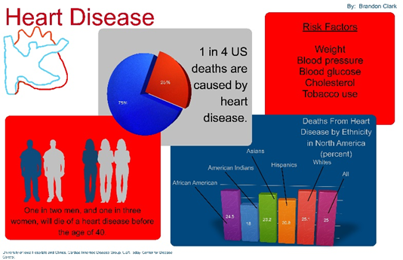
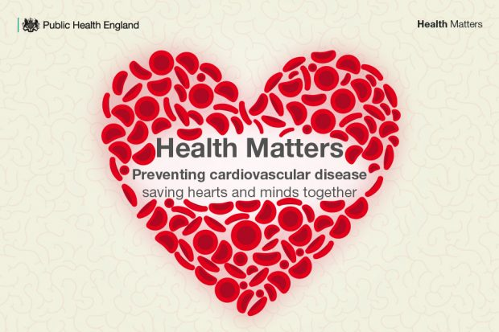
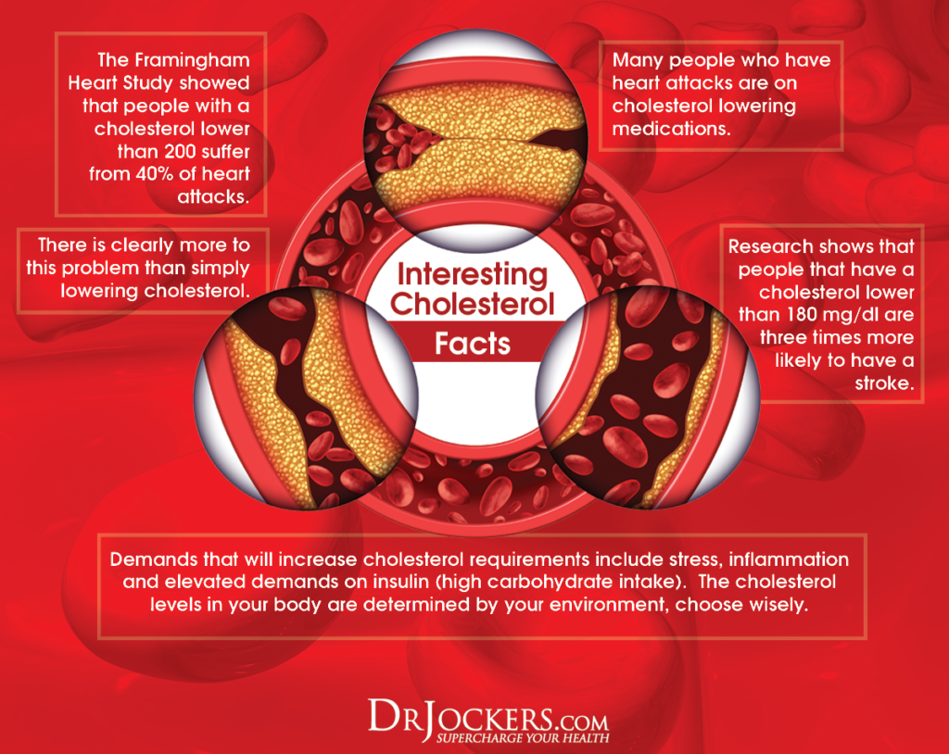
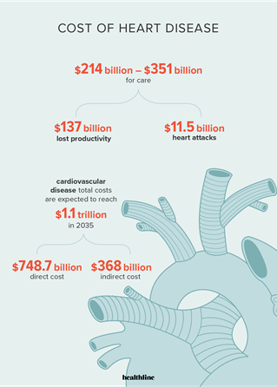
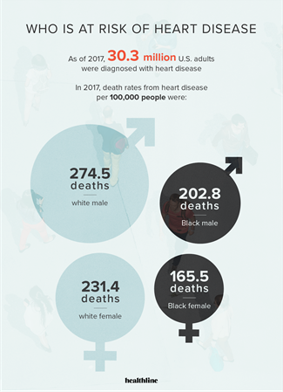
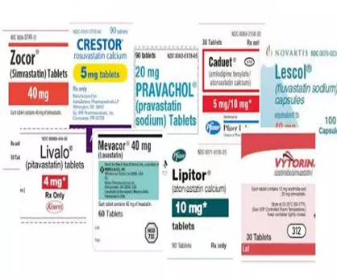
For the age group 65 and above does statin therapy Improve the outcome
of cardiovascular diseases compare to non-statin therapy.
Jeanne L Kia, MSN, AGNP
Salem State University
Salem, MA
INTRODUCTION
OBJECTIVES
Thompson et al. (2016)
A review on statin-associated symptoms (SAS).
which includes statin-associated muscle symptoms (SAMS), diabetes mellitus (DM), and central nervous system complaints.
Other possible statin side effects are; elevated liver function tests, decrease renal functions, tendon rupture, hemorrhagic stroke, depression, lower cholesterol, sleep disturbance and Interstitial lung disease.
Thompson et al. concluded that SAS and SAM are very important because they prompt reassessment, dose reduction or discontinuation of the statin treatment, and finally prompt the usage of other alternative cholesterol lowering therapy (2016).
Mistry, (2014)
Mistry, 2014, focused on Natural Cholesterol-Lowering Products: such as probiotics , exploring the different possible alternatives that probiotics can be used as cholesterol lowering drugs for the management of CVD.
The natural products suggested for cholesterol lowering are, probiotic, Phyto stanols, and phytosterols.
These products stanols and sterols are plants-based foods with beneficial health effects, and are found naturally in food such as vegetables, vegetable oils, seeds and nuts
Daily Doses of Differing Intensities of Statin Treatment
High Intensity | Moderate Intensity | Low Intensity
On average, lowers LDL cholesterol by ≥ 50% | On average, lowers LDL cholesterol by 30–50% | On average, lowers LDL cholesterol by < 30 %
Rosuvastatin 20-40 mg Atorvastatin: 40–80 mg Simvastatin: 80 mg | Rosuvastatin 5–10 mg Atorvastatin: 10–20 mg Simvastatin: 20–40 mg | Simvastatin: 10 mg Pravastatin: 10–40 mg
Simvastatin 80 mg, daily, may be associated with an increased risk of muscle-related adverse effects.
Cardio vascular disease (CVD) is the leading cause of death for men, women, and people of most racial and ethnic groups in the United States (US).
In the US approximately 655,000 Americans die from heart disease each year, that is one person dying every 36 seconds, costing the US about $219 billion each year from 2014 to 2015.
Coronary artery disease (CAD) is one of the most common type of CVD, killing 365,914 people in 2017, with about 18.2 million adults age 20 and older suffering from CAD .
The objective of this research study is to examine how statin therapy improves the outcome of CVD compared to non-statin therapy in the age group 65 years and above.
METHODS
Answering the PICOT question
“For the age group 65 and above does statin therapy improve the outcome of cardiovascular diseases compare to non-statin therapy”
The PICO question which is an “intervention question”, can be answered using
a systematic review of relevant randomized, and controlled trials studies carried out using statistical analysis studies (Stillwell et all.,2010).
The following database were used in the search: CINAHL Plus, MEDLINE, PUBMED, Cochrane Library via EBSCO.
The key words search were statins, statin therapy, CVD, health consequences of CVD, risk factors of CVD, alternative therapy of CVD, statistics of CVD, cholesterol.
A number of 14 articles published between the years of 2013 and 2020 were used for this project.
The article search was limited to those written in English with humans as main subject of the research.
CHOICE AND DOSE OF STATIN
Atorvastatin is the first-line choice of statin for most patients. If it is not tolerated, consider lowering the dose or changing to another statin
REVIEW OF LITERATURE
Johnson et al. (2014)
Used a cross sectional analysis to estimate the relationship between statin use and cardiovascular risk.
The survey revealed that participants with CVD have approximately 16% reduction in overall mortality, while people aged older than 40 years with diabetes have more than a 30% reduction in CVD outcomes and likely a reduced risk of death.
Yusuf et al. (2016)
In a double-blind, randomized, placebo-controlled trial to find out if the benefits of statins could be extended to an intermediate-risk, ethnically diverse population without cardiovascular disease (CVD).
Rosuvastatin 10 mg daily was used for cholesterol lowering, candesartan 16mg daily and hydrochlorothiazide 12.5 mg daily both used for blood pressure management.
Result, those participants who were treated with rosuvastatin experienced a significantly lower risk of CVD than those who were given the placebo.
Toth et al. (2018)
Use of an observational study to evaluate cardiovascular outcomes, healthcare use, and medical costs in statin‐treated patients with high triglycerides and high residual cardiovascular risk compared with patients with well‐managed triglycerides and HDL‐C.
Outcome, patients with high cardiovascular risk and high triglycerides and not on statin treatment had worse composite cardiovascular and health economic outcomes than patients with well‐managed triglycerides and HDL-C >1.04 mmol/L.
Gregory et al. (2018)
A longitudinal observational study with objective to compare CVD and mortality risk between patients with high triglyceride (TG) vs normal TG.
The study revealed the primary outcome to be a composite of nonfatal myocardial infarction (MI), nonfatal stroke, unstable angina, coronary revascularization, and all-cause mortality and a second composite adding peripheral revascularization and aneurysm repair.
Clough et al. (2019)
A survey in 2017 with objective to evaluate statin initiation therapy among PCP’s in statin eligible patient, and their beliefs of statins for primary prevention and statin prescription between the year of 2014 and 2015.
Result of the survey was that most providers often estimated that moderate and high intensity statins lowered ASCVD risk by 30% and 50% respectively.
At the same time a small number of providers acknowledge extremely high and low estimates of effectiveness with 8 providers stating that statins had no effect on lowering the risk of CVD.
The survey revealed that PCPs held different beliefs and opinions about the safety and efficacy of statin therapy for the primary prevention of CVD.
Zhang et al. (2018)
A retrospective cohort study to evaluate factors associated with absence of statin therapy in patients with DM and CAD.
Outcome, a quarter of the patients not on a persistent statin therapy. Being a very high-risk group of patients, a treatment with even a moderate-intensity statin would lead to a significant reduction in CV event, and treatment with a high intensity statin plus ezetimibe would lead to a further reduction.
The results also pointed out that these individuals that were not on statin therapy most likely suffered a high burden of a CV event
Mansi et al. (2016)
A cohort study on a healthy cohort of statin users and non-users, with objective to examine the associations of short-term statin use with short- and long-term known beneficial cardiovascular outcomes, such as acute myocardial infraction and acute cerebrovascular accidents, known statin-associated adverse events such as diabetes and musculoskeletal diseases, and suspected/debated statin-associated adverse events such as kidney diseases and cataract.
The study concluded that short term use of statin in the healthy cohort for primary prevention was associated with an increased risk of long-term diabetes and diabetic complications without cardiovascular benefit.
Common Heart Disease Risks:
High blood pressure. High cholesterol
Diabetes Depression Obesity
AN APPROACH TO MANAGING STATIN-ASSOCIATED SYMPTOMS
When a patient taking a statin reports symptom, a suggested approach is to:
Assess for “true” intolerance, e.g. check for a rise in creatinine kinase if there is muscle pain or check liver function tests if hepatotoxicity is suspected
Review the patients’ other medicines to check for interactions
Reassure the patient about the safety and effectiveness of statin treatment
Stop the statin
Check for resolution of symptoms, suggested timeframe is two to four weeks. If symptoms have resolved try reinstating the statin.
Prescribing Statins to Reduce
CVD Risk
ANALYSIS OF EVIDENCE
Take into account the following patient’s point of view,
Current knowledge about their CVD risk and what this means to them
Thoughts and beliefs regarding their health in the future
Readiness to make (and sustain) lifestyle changes
Feelings about taking long-term medicines to reduce risk
From the literature review, the overall view seems to be that there are various opinions on the effectiveness of statins therapy in improving the outcome of cardiovascular disease. Some studies demonstrated that patients treated with statins have experienced a significantly lower risk of CVD, overall reduction in mortality rate and death risks than those who were given placebos (Yusuf et al. 2016). However other studies concluded that even though statins have been proven to be effective in the outcome of CVD some patients still don’t benefits from this treatment.
When Should a Statin be Considered?
This is primarily determined by the patient’s level of cardiovascular risk.
STATINS
Statin is the main medication used in the prevention of ASCVD,
Adverse effects include musculoskeletal symptoms, increased risk of diabetes, and higher rates of hemorrhagic stroke.
However, the frequency of adverse effects is extremely low and, in selected patient populations, the benefits of statins considerably outweigh the potential risks
CONCLUSION
CVD risk <10%
Patients should be encouraged to make healthy lifestyle decisions; the majority can be managed without the need for lipid-lowering medicines.
CVD risk 10 – 20%
Patients should be strongly encouraged to make healthy lifestyle changes.
A discussion about the benefits and risks of medicines , both lipid and blood pressure lowering, to lower cardiovascular risk is recommended so that a shared decision on management can be reached. If lifestyle modifications have not reduced cardiovascular risk, e.g. after 6 – 12 months, recalculate cardiovascular risk and consider prescribing a statin following a discussion of the benefits and risks of treatment.
CVD risk >20% or known CVD
Lipid-lowering medicines, in addition to lifestyle changes and other medicines to reduce cardiovascular risk, depending on the patient’s individual clinical circumstances, are strongly recommended.
People with an existing cardiovascular condition or who have had a previous CVD event are regarded as “very high risk” and can be automatically allocated to this category without having to calculate CVD risk.
Also included in the very high risk group are people with genetic lipid disorders, e.g. familial hypercholesterolaemia, and those with diabetes who have nephropathy or other renal disease resulting in renal impairment (eGFR ≤ 60 ml/min/1.73m2).
Although there is a variation in beliefs amongst our researchers and clinicians of the effectiveness of statin therapy in the management of CVD, there is now irrefutable evidence that statin therapy reduces CVD events, CVD risks, mortality rate and death risks in a wide variety of patient population. Statistics show that about 200 million people take a dose of statin daily worldwide with over 30 million people in the United States, so it’s urgent for more research and trial to be done in a wide range of patient populations to give more light in the benefits of statin
REFERENCES
Johnson et al. (2014)
Yusuf et al. (2016)
Toth et al. (2018)
Gregory et al. (2018) , https://doi.org/10.1210/jc.2018-00470
Clough et al. (2019) https://www.ncbi.nlm.nih.gov/pmc/articles/PMC6405576/pdf/JAH3-8- 010241.pdf
Zhang et al. (2018)
Mansi et al. (2016) https://doi.org/10.1007/s40264-016-0412-2
Thompson et al. (2016) doi:http://dx.doi.org.corvette.salemstate.edu:2048/10.1007M0266-018-0567-x
Mistry, (2014) doi: 10.12968/bjcn.2014.19.Sup11.S14.

