Slide 1
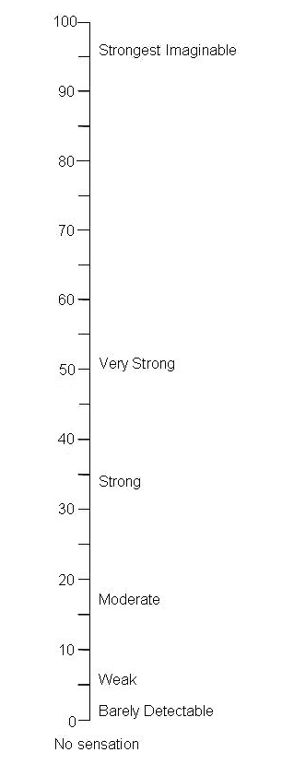
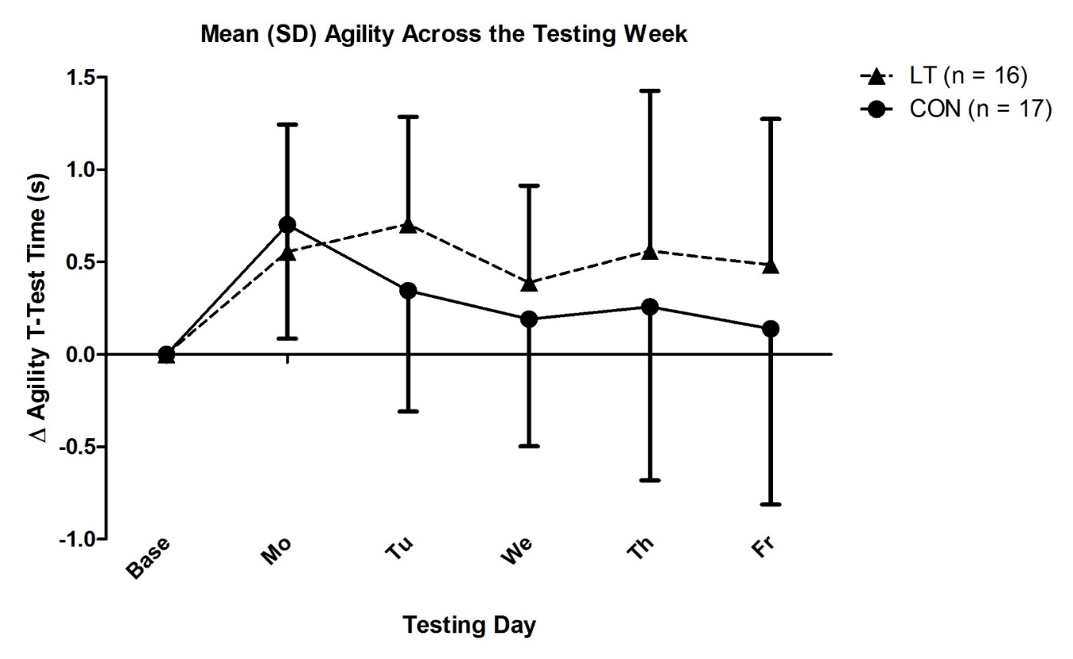
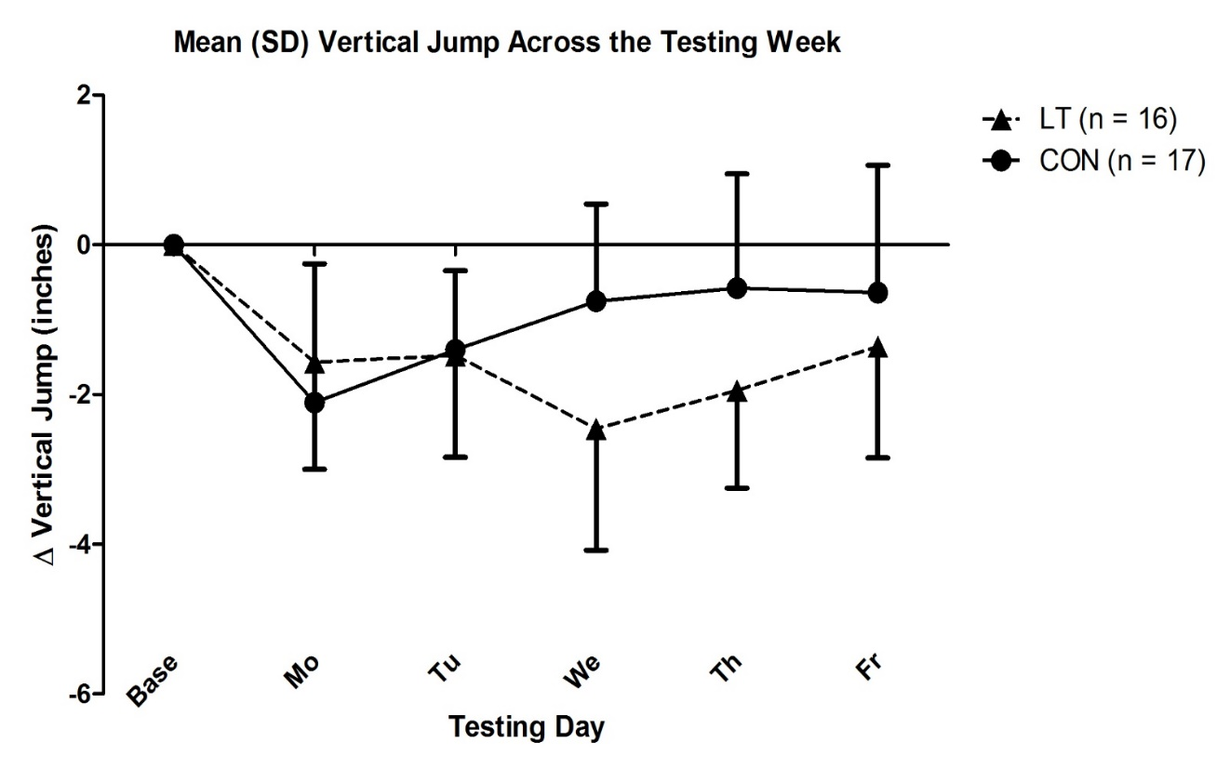
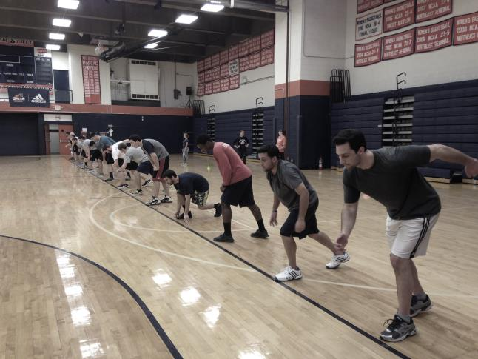
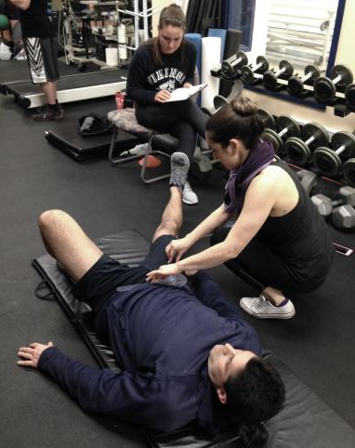
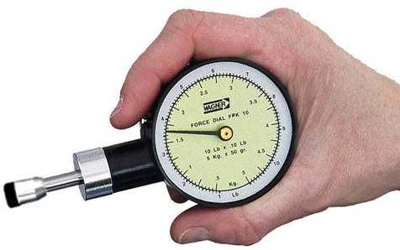
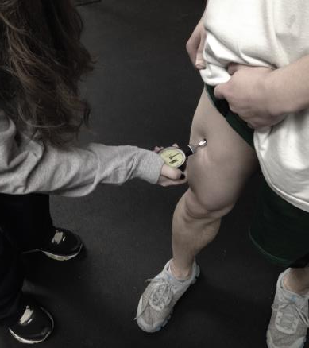
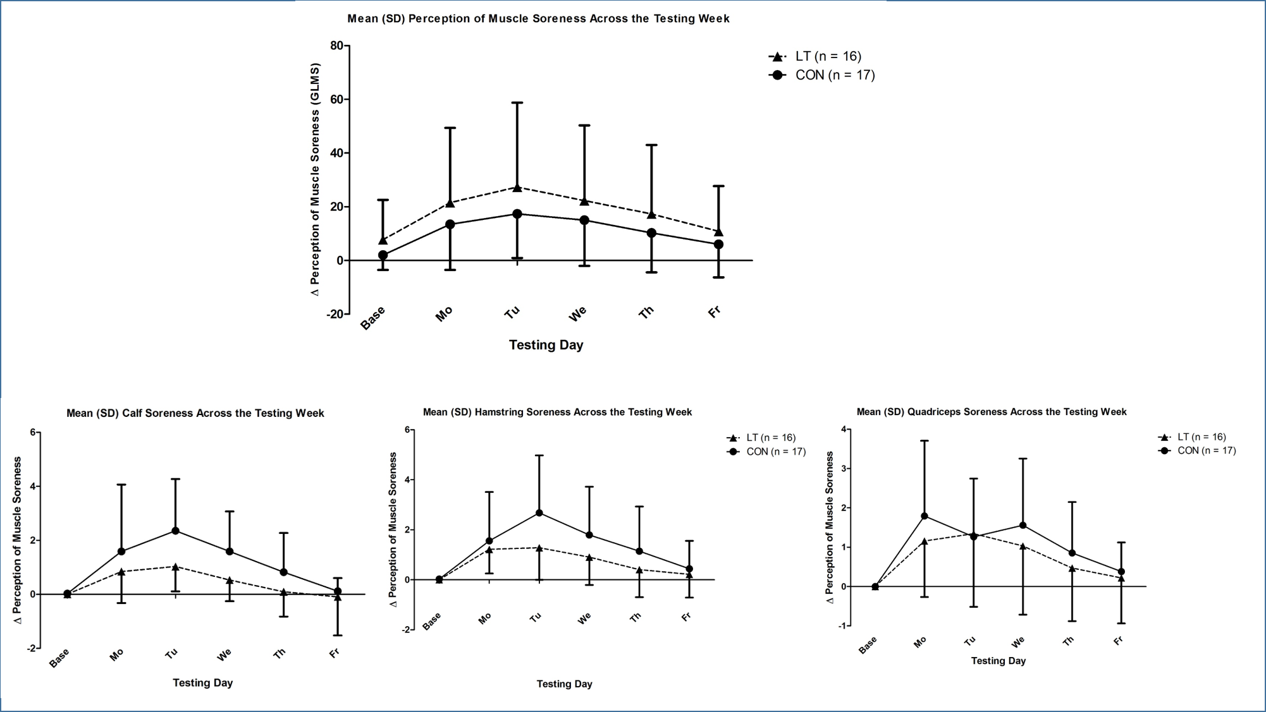
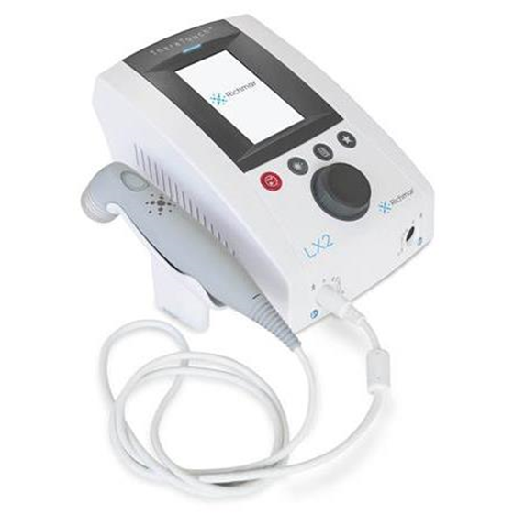
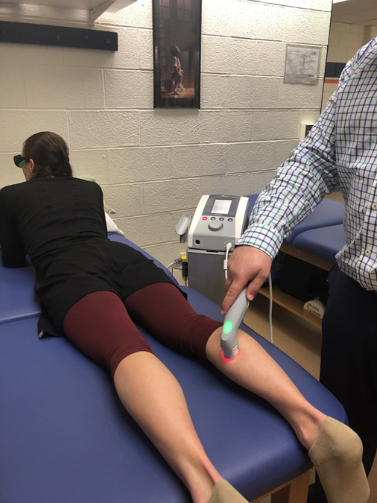
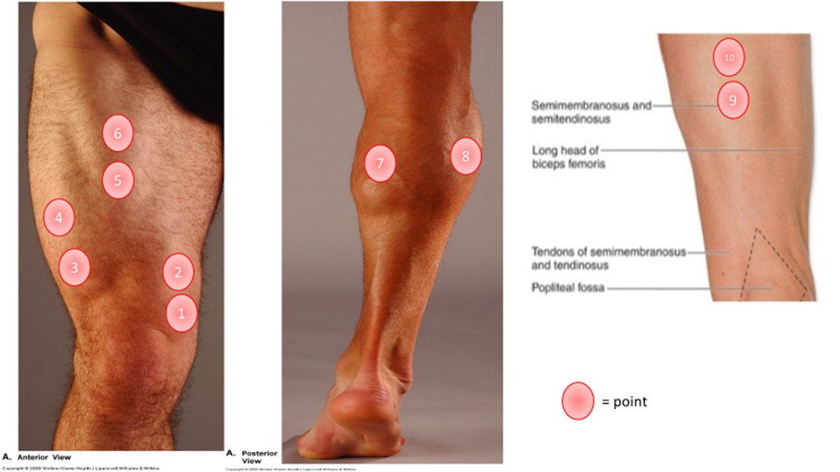
The Influence of Light Therapy on Recovery from Exercise-Induced Muscle Damage
Student Researcher: Brian Smith
Faculty Supervisors: Dr. Anthony D’Amico, Prof. Kevin Silva, Dr. Joseph Gallo, Dr. Jason Gillis, Dr. Steven Dion
Human Performance Laboratory, Department of Sport & Movement Science, Salem State University
ABSTRACT
Testing battery
Week 1 Familiarizations: The data collection process began with a baseline test including perception of muscle soreness, range of motion (ROM), vertical jump, and agility T-test. These data were collected all 8 days.
Week 2 Testing: On Monday, participants went through a repeated sprinting protocol in order to induce muscle damage (described below). Proceeding the protocol, participants began their light therapy treatment.
Vertical Jump and Agility T-Test
Figure 4. Shows the change in results of both the Vertical Jump and Agility T-Test.
INTRODUCTION: Engaging in physical activity and exercise can result in muscle damage and soreness. When muscles lengthen under tension during eccentric contraction, which can happen during daily physical activities, it can cause exercise-induced muscle damage (EIMD). When you repeat those movements at a high intensity, intracellular muscle damage can occur leading to a 24 to 48-hour delay in the onset of muscle soreness (DOMS) (Choi, 2014). There have been products invented to enhance the recovery of DOMS created by EIMD. Light therapy (LT), in this case, is a non-invasive clinical technique commonly used to treat muscular injuries. The purpose of this study is to examine the effectiveness of LT on EIMD compared to a placebo group (PL) during an eight-day trial. METHODS: Participants were divided into two groups (LT & PL) not knowing which group they were in (single-blind experiment) and were tested on their range of motion (ROM) on their hip flexion and abduction, their perception of muscle soreness (GLMS scale), vertical jump, and agility (T-test). To induce muscle damage, participants ran 40 15-meter sprints with a 5-meter deceleration zone, thereafter, commenced the LT treatment on the fourth day on. LT was applied to the quadriceps, hamstring and calf muscles on both legs. We hypothesized LT following EIMD would neither influence perceptions of muscle soreness, flexibility, vertical jumping ability, nor agility, compared to a placebo treatment group. DISCUSSION/CONCLUSION: A significant difference (p < .05) was found between the two groups in the measurement of calf soreness. The LT group reported lower calf soreness level throughout the week. No other significant differences were found between groups. This data lends itself to the theory that light therapy is more beneficial for treating soreness in Type I muscle fibers.
a. b.
Fig 4. a. Vertical Jump and Agility T-Test, b. General Labeled Magnitude Scale (GLMS),
a. b. c. d.
Perception of Muscle Soreness
Fig 2. a. sprinting protocol, b. flexibility measure using goniometer, c. algometer, d. algometer applied to muscle belly
INTRODUCTION
Muscle damage protocol
Participants completed 40x15 m sprints (5 m deceleration zone) to induce muscle damage.
Physical activity and exercise can result in muscle damage and soreness. When eccentric contractions are performed repeatedly at a high intensity, intracellular muscle damage occurs, which can impair muscle function and cause delayed onset muscle soreness (DOMS) (Choi, 2014). Light therapy is a non-invasive clinical technique commonly used to treat muscular injuries like these eccentric contractions.
Light Therapy
Participants were introduced to the light therapy machine. They put on green safety goggles because the laser may damage the retina in our eyes. In Figure 3, we see the light therapy machine and how it is applied. Also shown is the markers where the laser was applied; quads, calves, hamstrings of both legs. Using a similar protocol from Leal Junior et al.(2010), the laser probe was held for 30 seconds at a 90 degree angle at each point.
Fig 5. shows the mean change in perception of muscle soreness in general, in the quads, hamstrings, and calves.
DISCUSSION/CONCLUSIONS
RESEARCH QUESTION
Calf soreness throughout the week appears to recover faster in the light therapy group than the placebo group. Calf muscles are considered mostly Type 1 muscle fibers which are more endurance-oriented. Light therapy may be beneficial for endurance athletes more so than strength and power athletes. Light therapy has been theorized to enhance mitochondrial biogenesis and electron transport chain activity, which may enhance muscle performance (Ferraresi, et al 2015). Our results may lend support to that theory.
Will light therapy enhance recovery of muscle soreness and performance following exercise-induced muscle damage compared to a control condition?
HYPOTHESIS
Light therapy following exercise-induced muscle damage will neither influence perceptions of muscle soreness, flexibility, vertical jumping performance, nor agility, compared to a control condition.
WHAT I LEARNED
Fig 3. Light therapy machine, how it was applied, and where it was applied.
From doing this study, I learned it is important to make sure that the way you take measurements throughout the study remains consistent. Many of the differences seen in the data are small margins of difference, so an inaccurate measurement could cause those findings to be inaccurate.
METHODS
RESULTS
General design
Participants
(Table 1)
This study, was an 8-day study starting on a Wednesday with baseline measurements. The following Monday to Friday, participants performed our muscle damage sprinting protocol which included 40-15 meter sprints with a 5 meter deceleration zone. Light therapy was then implemented starting from Monday to Friday.
REFERENCES
N=33
 |  |  |  | LT |  |  | PL
 |  |  | Mean | SD |  | Mean | SD
Weight (kg) |  |  | 74.14 | 16.43 |  | 76.73 | 13.25
Age (yrs) |  |  | 20.63 | 1.59 |  | 20.82 | 1.29
Height (m) |  |  | 1.69 | 0.11 |  | 1.71 | 0.09
BMI (kg/m2) |  |  | 25.76 | 4.64 |  | 26.15 | 4.48
Baseline GLMS |  |  | 7.72 | 14.84 |  | 2.00 | 5.51
Baseline ALGO-Quad |  |  | 0.59 | 1.29 |  | 0.15 | 0.49
Baseline ALGO-Ham |  |  | 0.41 | 0.93 |  | 0.29 | 0.61
Baseline ALGO-Calf |  |  | 0.59 | 1.70 |  | 0.26 | 0.62
Baseline GONI-Hip Flex |  |  | 82.22 | 9.16 |  | 85.56 | 11.50
Baseline GONI-HIP Abd |  |  | 50.75 | 12.70 |  | 48.56 | 10.30
Baseline VJ height |  |  | 21.59 | 4.81 |  | 20.44 | 3.17
Baseline Agility |  |  | 12.95 | 1.36 |  | 13.08 | 1.44
Choi SJ. (2014). Cellular mechanisms of eccentric-induced muscle injury and its relationship with sarcomere heterogeneity. J Ex Rehabil. 10(4):200-204
Baroni BM, Leal Junior EC, DeMarchi Tet al (2010) Low level laser therapy before eccentric exercise reduces muscle damage markers in humans. Eur J Appl Physiol 110:789–79
Fritsch CG, Dornelles MP, Severo-Silveira L, Marques VB, Rosso IA, Baroni BM. Effects of low-level laser therapy applied before or after plyometric exercise on muscle damage markers: randomized, double-blind, placebo-controlled trial. Lasers Med Sci. 2016 Dec;31(9):1935-1942. Epub 2016 Sep 21
Ferraresi, C., Kaippert, B., Avci, P., Huang, Y,. De Sousa, M., Bagnato, E., Parizotto, N., Hamblin, M. Low-level laser (light) therapy increases mitochondrial membrane potential and ATP synthesis in C2C12 myotubes with a peak response at 3-6 h. PMC. 2015 Mar-Apr;91(2):411-6. doi: 10.1111/php.12397.
Leal-Junior EC., Lopes-Martins RA., Frigo L., De Marchi T., Rossi RP., de Godoi V., Tomazoni SS., Silva DP., Basso M., Filho PL., de Valls Corsetti F., Iversen VV., Bjordal JM. Effects of low-level laser therapy (LLLT) in the development of exercise-induced skeletal muscle fatigue and changes in biochemical markers related to postexercise recovery. J Orthop Sports Phys Ther. 2010 Aug;40(8):524-32.
ROM, Vertical Jump, T-Test
40 15-meter sprints
LT
N=16
Placebo
N=17
ROM, Vertical Jump, T-Test
ACKNOWLEDGEMENTS
Fig 1. A schematic of the experimental design.
Table 1. Mean (SD) participant characteristics by condition.
We would like to thank all of our volunteer participants for donating their time to our research

