Slide 1
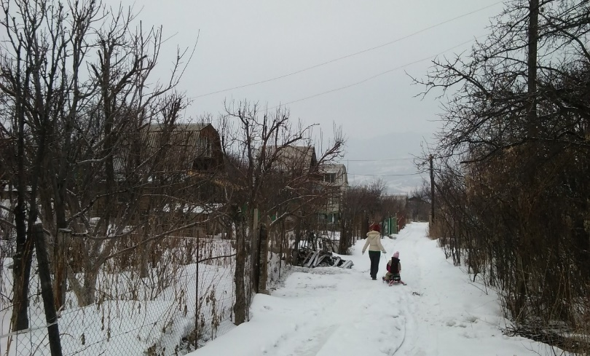
Vanessa Ruget
Salem State University vruget@salemstate.edu
Labor Migration from Kyrgyzstan to Russia

Slide 2
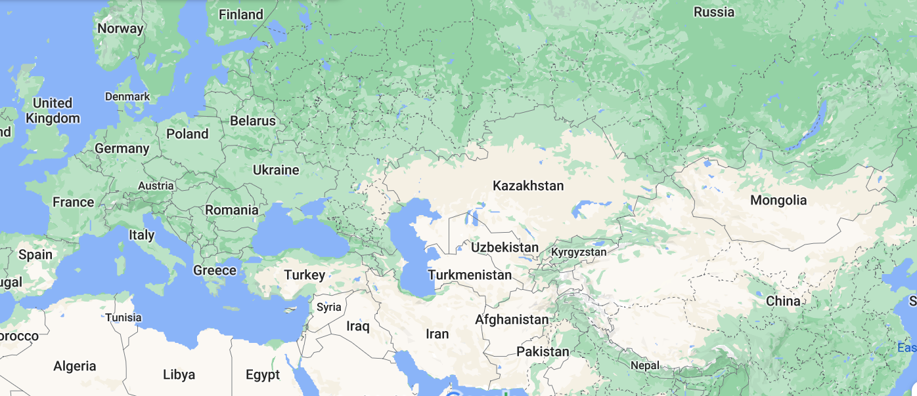

Slide 3
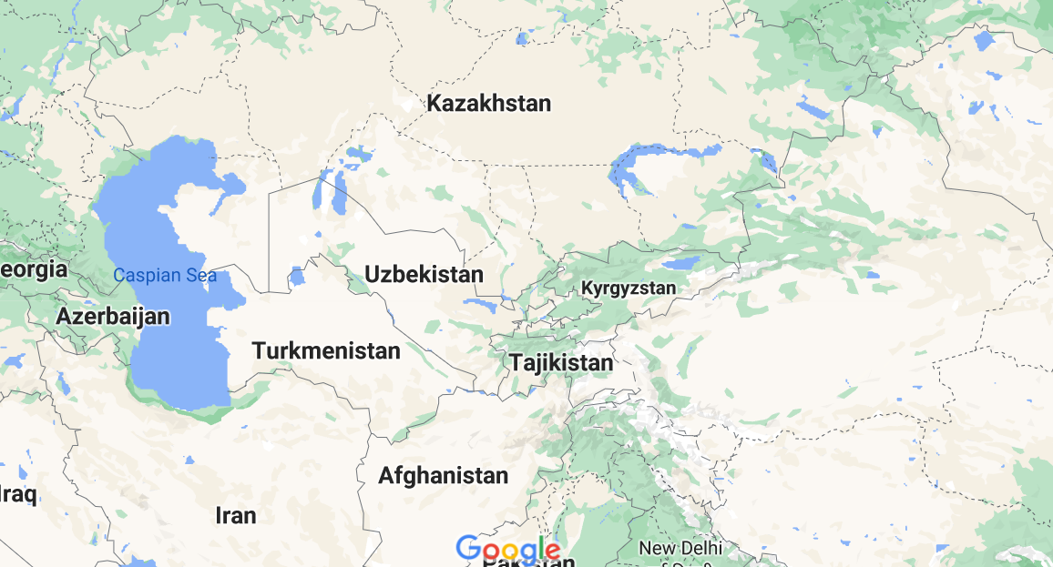

Slide 4
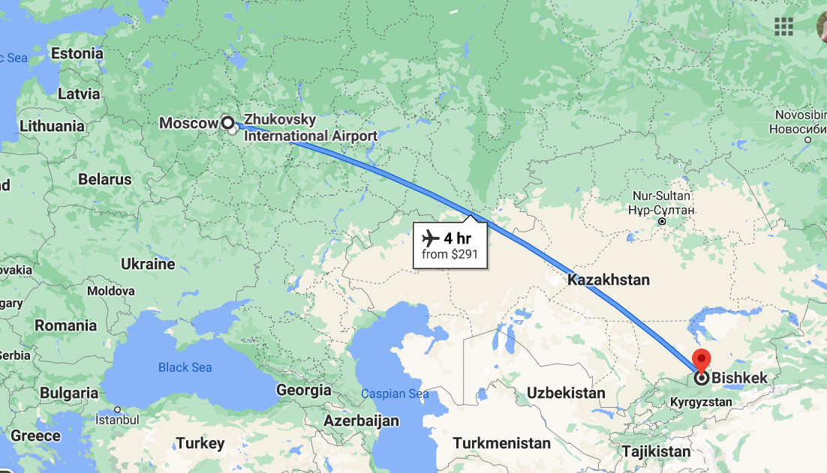

Slide 5
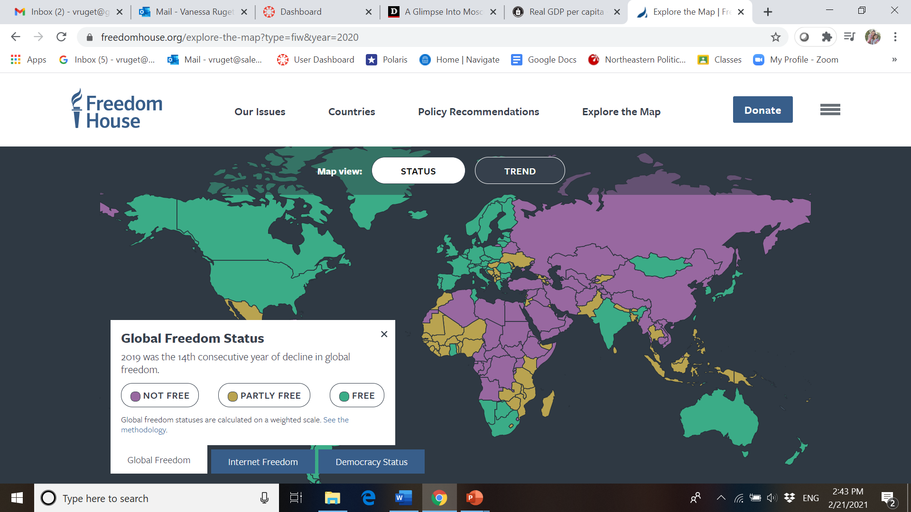
Source: Freedom House

Slide 6
Labor migration
from Kyrgyzstan to Russia
Recent flows (late 1990s) yet human mobility not new
~ 700,000 Kyrgyzstanis (~ 15% population)
Among 20% of migrants going to a less democratic country (VDem)
Circular migrants, work in construction, catering, services, trade…
Image from Google Map

Slide 7
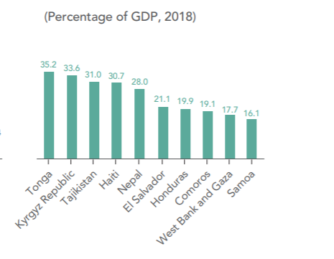
Top Remittance Recipients in 2018
World Bank
Migration and Development Brief 2019.
http://www.knomad.org/publication/migration-and-development-brief-31

Slide 8
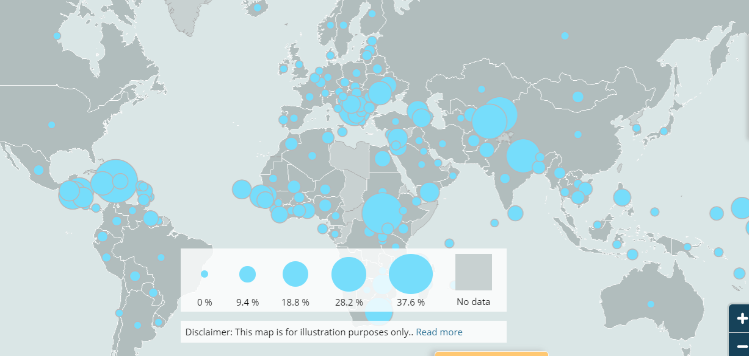
Personal Remittances received as percentage of GDP –Source: IOM Migration Data Portal

Slide 9
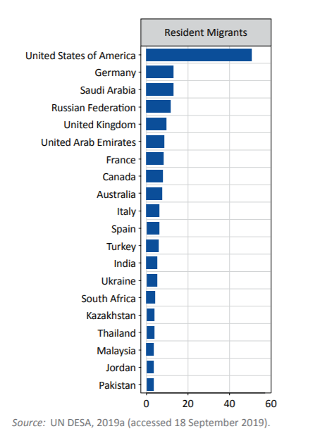
Top 20 destinations of international migrants in 2019 (millions)
IOM, World Migration Report, 2020

Slide 10
Challenges faced by migrants in Russia
Many naturalize in Russia (now: “compatriot card)
High levels of xenophobia, precarity, police abuse
Very difficult to be “documented”
Covid-19 pandemic
Difficult living and working conditions/exploitation

Slide 11

All migrants
Non EEU members (Kyrgyzstan is a member)
Migration card
Patent or work authorization
Residency registration
Medical certificate + test in Russian language and civics

Slide 12
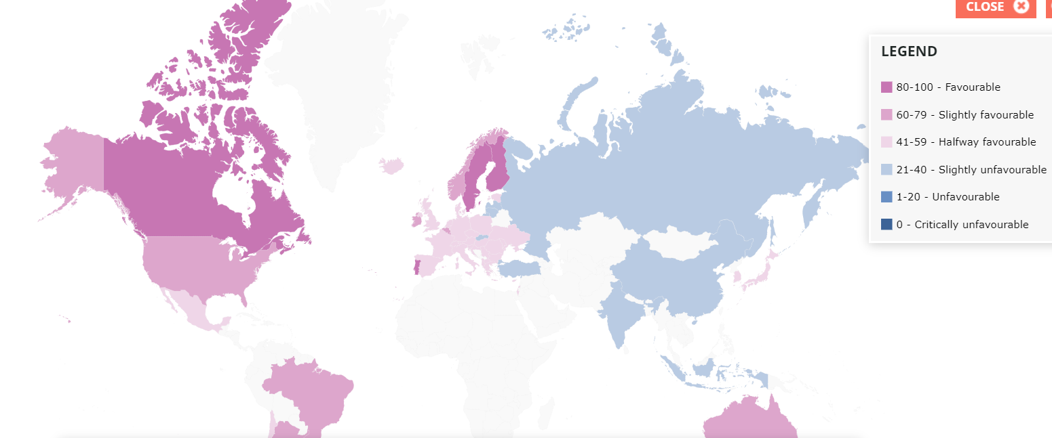
Migrant Integration Policy Index

Slide 13
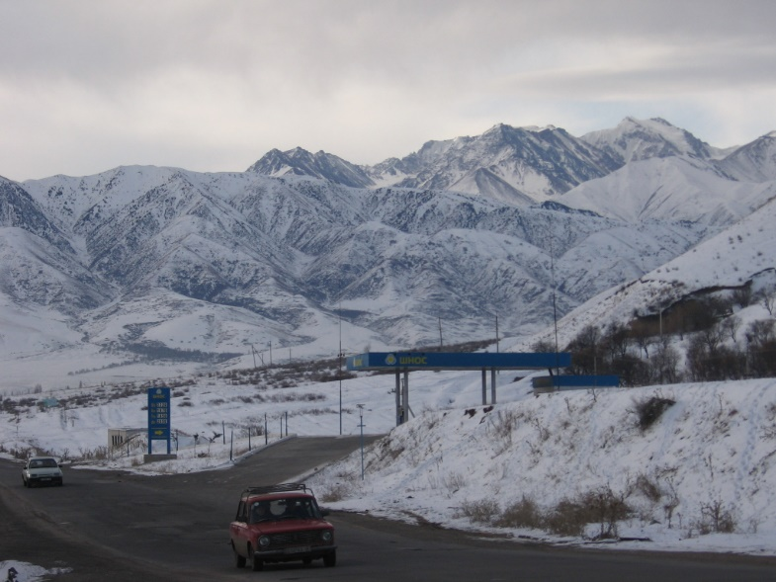
Other challenges
Weak diaspora organizations
Lack of trust in institutional sources of info
Very little support from home government

Slide 14
Potential for development
Huge remittance flows
“Transnational space par excellence” (Agadjanian et al. 2008: 642)
Ex: visa free regime Russia.
Size of migrant flows and remittances (see reports UNDP, IOM)
Russia’s “passportization” (Grigas 2016)
First generation migrants

Slide 15
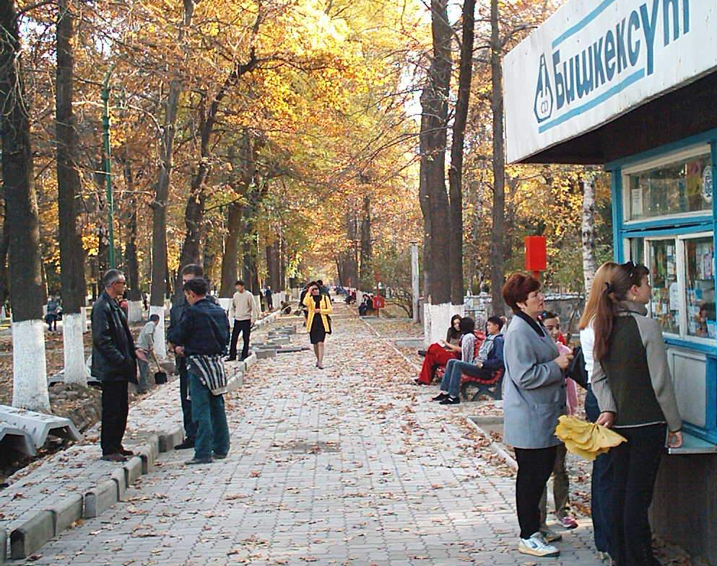
Film
https://thediplomat.com/2017/03/a-glimpse-into-moscows-little-kyrgyzstan/

Slide 16
Data from Field Work
Collaboration with Kyrgyz colleague, Burul Usmanalieva
Qualitative, semi-structured interviews with migrants
  In Kyrgyzstan or on WhatsApp
Interviews with experts (IOM, civil society, professors etc.)

Slide 17
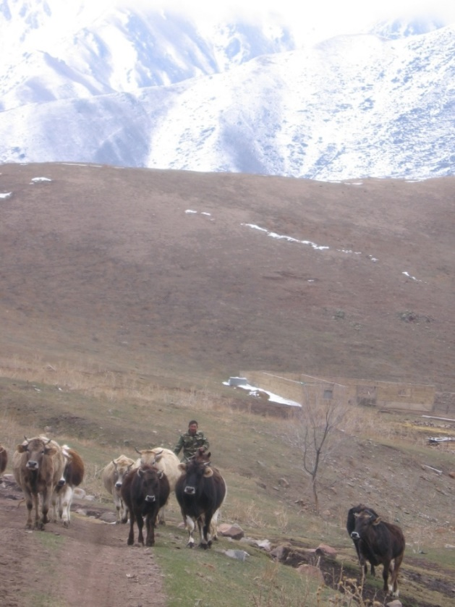
Examples of topics studied
Diaspora involvement
Dual citizenship
Views of Kyrgyzstan and Russia (politically)
Social & political transnationalism (such as external voting)
Use of smartphones

Slide 18
Stay in touch with family and friends, stay informed about homeland politics, plan to return
Limited social and political transnationalism
Little investment in homeland/not discussed online
Kyrgyz migrants in Russia
Low turnout in external elections/few migrants registered
Technology not used for diaspora building or to engage in home country
Naturalization for “convenience”
Little trust in (weak) diaspora organizations
See Ruget, Usmanalieva, multiple sources cited below
Notes:
Some kids have 2 or 3 (o4 ) ACEs

Slide 19
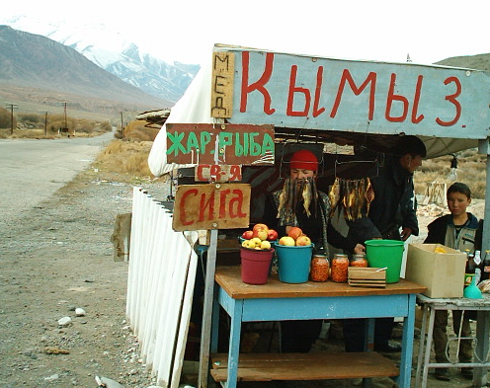
All photos are personal pictures

Slide 20
References
Abashin, Sergei. 2013. Central Asian Migration. Practices, Local Communities, Transnationalism. Russian Politics & Law 51 (3).
Abazov, R., 1999. Economic Migration in Post-Soviet Central Asia: the Case of Kyrgyzstan. Post Communist Economies, 11 (1), 237-252.
Agadjanian, V., Nedoluzhko, L. and Kumskov, G., 2008. Eager to leave? Intentions to migrate abroad among young people in Kyrgyzstan. International migration review, 42 (3), 620–651.
Aitieva, Medina. 2016. Reconstituting transnational families: an ethnography of family practices between Kyrgyzstan and Russia. University of Manchester. PhD dissertation.
Agunias Dovelyn Rannveig and Kathleen Newland. 2012. Developing a Road Map for Engaging Diasporas in Development: A Handbook for Policymakers and Practitioners in Home and Host Countries. International Organization for Migration and Migration Policy Institute.
Banerjee, Padmini, and Myna German. 2010. “Migration and Transculturalism in the Digital Age: A Framework for Studying the ‘Space Between.’” Journal of International & Global Studies 2 (1): 22-35.
Benhabib, S., 2004. The rights of others. Aliens, residents and citizens. Cambridge: Cambridge University Press.
Bauböck, Rainer. 2003. “Towards a Political Theory of Migrant Transnationalism,” International Migration Review 37 (3): 700-723.
Bernal, Victoria. 2010. “Nationalist Networks: The Eritrean Diaspora Online.” In Diasporas in the New Media Age. Identity, Politics and Community, edited by A. Alonso, and P.J. Oiarzabal, 122–135.Rino: University of Nevada Press.
Borisova, Elena. 2016. “Parenting at a Distance: Transnational Practices in Migrant Families from Tajikistan.” Forum for Anthropology and Culture, 12: 125–138.
Bosniak, L., 2000. Denationalizing citizenship. In: T.A. Aleinikoff and D. Klusmeyer, eds. Citizenship today, perspectives and practices. Washington, DC: Carnegie Endowment for International Peace, 237–252.
Brinkerhoff, Jennifer. 2009. Digital Diasporas. Identity and Transnational Engagement. Cambridge: Cambridge University Press.

Slide 21
Castles, Stephen. 2010. “Understanding Global Migration. A Social Transformation Perspective.” Journal of Ethnic and Migration Studies 36 (10): 1565-1586.
Cebotari, Victor. 2018. Transnational migration, gender and educational development of children in Tajikistan. Global Networks 18(4): 564–588.
Chamberlain, Louise. 2020. “The elections in Kyrgyzstan will be a test of democracy and inclusion.” Euractiv. September 28. https://www.euractiv.com/section/central-asia/opinion/the-elections-in-kyrgyzstan-will-be-a-test-of-democracy-and-inclusion/
Chudinovskikh, O. and M. Denisenko. 2017. Russia: A Migration System with Soviet Roots. Migration Policy Institute.
De Haas Hein. 2005. “International Migration, Remittances and Development: Myths and Facts.” Third World Quarterly 26(8): 1269-1284.
Dekker, Rianne, and Godfried Engbersen. 2014. “How Social Media Transform Migrant Networks and Facilitate Migration.” Global Networks 14 (4): 401-418.
Diener, A. (2008) 'Diasporic and Transnational Social Practices in Central Asia', Geography Compass, 2: 956–978.
Doolotkeldieva, Asel, 2013. "Kyrgyz Migrants in Moscow: Public Policies, Migratory Strategies, and Associative Networks, in Laruelle, Marlene (ed.), Migration and Social Upheaval as the Face of Globalization in Central Asia, Brill, Social Sciences in Asia, 34.
Doolotkeldieva Asel and Alexander Wolters. 2017. “Uncertainly Perpetuated? The Pitfalls of a Weakly Institutionalized Party System in Kyrgyzstan.” Central Asian Affairs 4: 26-50.
Eraliev, Sherzod, Urinboyev. 2020. “Precarious Times for Central Asian Migrants in Russia.” Current History 119 (819): 258–263.
Freedom House, 2017. Freedom in the World: Kyrgyzstan. Available from: https://freedomhouse.org/report/freedom-world/2017/kyrgyzstan
Gibau, G. S. 2010. “Cyber CVs: Online Conversations on Cape Verdean Diaspora Identities.” In Diasporas in the New Media Age. Identity, Politics and Community, edited by A. Alonso, and P. J. Oiarzabal, 110–121. Rino: University of Nevada Press.
Grigas. A. 2016. How Soft Power Works: Russian Passportization and Compatriot Policies Paved Way for Crimean Annexation and War in Donbas. Atlantic Council.

Slide 22
Heleniak, T. 2011. “Harnessing the Diaspora for Development in Europe and Central Asia.” The World Bank. Migration and Remittances Peer Assisted Learning (MIRPAL). Discussion Series.
Itzigsohn José and Daniela Villacrès. 2008. “Migrant Political transnationalism and the Practice of Democracy: Dominican external voting rights and Salvadoran hometown associations.” Ethnic and Racial Studies 31 (4): 664–86.
IOM. 2020 (2). “Migration and Migrants. A Global Overview.” World Migration Report. IOM. https://publications.iom.int/system/files/pdf/wmr_2020.pdf
Krawatzek, F. and Müller-Funk, L., 2020. Two centuries of Flows between ‘Here’ and ‘There’: Political Remittances and their Transformative Potential. Journal of Ethnic and Migration Studies 46 (6), 1003–1024.
Kuznetsova, Irina and al. 2020. “Migration and COVID-19: Challenges and Policy Responses in Kyrgyzstan.” Central Asia Program.
Laruelle, M., 2015. The ‘Russian World.’ Russia’s Soft Power and Geopolitical Imagination. Center on Global Interests, Washington DC. Available from: http://globalinterests.org/wp-content/uploads/2015/05/FINAL-CGI_Russian-World_Marlene-Laruelle.pdf
Lemon, Edward. 2019. “Dependent on Remittances, Tajikistan’s Long-Term Prospects for Economic Growth and Poverty Reduction Remain Dim.” Migration Policy Institute. Available at: https://www.migrationpolicy.org/article/dependent-remittances-tajikistan-prospects-dim-economic-growth
Lewis, David. 2015. “Illiberal Spaces:” Uzbekistan's extraterritorial security practices and the spatial politics of contemporary authoritarianism.” Nationalities Papers. 43 (1): 140-159.
Lyons Terrence and Peter Mandaville. 2008. Global Migration and Transnational Politics: A Conceptual Framework. Center for Global Studies Project on Global Migration and Transnational Politics George Mason University.
Marat, E., 2013. Labor Migration During the 2008-9 Global Economic Crisis. in Laruelle, Marlene (ed.), Migration and Social Upheaval as the Face of Globalization in Central Asia, Brill, Social Sciences in Asia, 34.

Slide 23
Martiniello Marco and Jean-Michel Lafleur. 2008 “Towards a Transatlantic Dialogue in the Study of Immigrant Political Transnationalism,” Ethnic and Racial Studies 31 (4): 645-663.
Meseguer, C. Burgess, K. 2014. International Migration and Home Country Politics. Studies in Comparative International Development 49, 1–12.
Murzakulova. Asel. 2020. “Rural Migration in Kyrgyzstan: Drivers, Impact and Governance.” Research Paper. University of Central Asia. https://www.researchgate.net/publication/344362648_Rural_Migration_in_Kyrgyzstan_Drivers_Impact_and_Governance
Nadyrbekova, Nadira-Begim, 2018. Studying the factors influencing the political participation of Kyrgyz migrants in Moscow. A Thesis Submitted in Partial Fulfillment of the Requirements for the Degree of Bachelor of Arts in Sociology at the American University in Central Asia
Nasritdinov. Emil. 2015. Building the Future: Materialization of Kyrgyz and Tajik Migrants' Remittances in the Construction Sectors of their Home Countries. Regional Migration Programme, Department for International Development, UK.
Nasritdinov. Emil. Undated. Transnational and National Identities of Kyrgyz Labor Migrants inKazan, Yekaterinburg and Moscow. Unpublished manuscript.
Newland, Kathleen, ed. 2010. Diasporas. New Partners in Global Development Policy. Washington DC: Migration Policy Institute.
Østergaard-Nielsen, Eva. 2003. “The Politics of Migrants’ Transnational Political Practices,” International Migration Review 37 (3): 760-786.
Portes, Alejandro, Luis Guarnizo, and Patricia Lanolt. 1999. “The study of Transnationalism: Pitfalls and Promise of an Emergent Research Field,” Racial and Ethnic Studies 22 (2): 217-237.
Portes, Alejandro. 2003. “Theoretical convergencies and empirical evidence in the study of immigrant transnationalism.” International Migration Review 37(3): 874-892.
Portes, Alejandro, Guarnizo Luis Eduardo and Patricia Landolt. 2017. “Commentary on the Study of Transnationalism: Pitfalls and Promise of an Emergent Research Field.” Ethnic and Racial Studies 40 (9): 1486-1491.

Slide 24
Radio Azattyk. 2015. “Мигрантам в России не до выборов.” (Migrants in Russia are not up to the elections) http://rus.azattyk.org/a/27250869.html.
Reeves, Madeleine. 2013. “Clean fake: Authenticating Documents and Persons in Migrant Moscow.” American Ethnologist 40 (3): 508–524.
Rocheva, Anna. 2014. "A Swarm of Migrants in our Maternity Clinics!” The Study of Stratified Reproduction Regime in the Case of Kyrgyz Migrants in Moscow.” Journal of Social Policy Studies 12 (3): 367-380.
Rocheva, Anna and Evgeni Varshaver. 2018. “Gender Dimension of Migration from Central Asia to the Russian Federation.” Asia-Pacific Population Journal 32 (2): 87 – 135.
Ruget, Vanessa and Burul Usmanalieva. 2011. "Social and Political Transnationalism among Central Asian Migrants and Return Migrants: A Case Study of Kyrgyzstan." Problems of Post-Communism 58 (6): 48-60.
Ruget, Vanessa and Burul Usmanalieva. 2010. “How much is Citizenship Worth? A case study of Kyrgyzstani migrants.” Citizenship Studies 14 (4): 445-459.
Ruget, Vanessa. 2014. "Citizenship in Central Asia." in: Isin, E. F & Peter Nyers (ed.) Routledge Handbook of Global Citizenship Studies.
Ruget, Vanessa. 2018. “Name the Republic that was joined to Russia in 2014:” Russia’s New Civics and History Test for Migrants." Nationalities Papers 46 (1): 20-33.
Ruget, Vanessa and Burul Usmanalieva. 2019. “Can Smartphones Empower Labour Migrants? The case of Kyrgyzstani Migrants in Russia.” Central Asian Survey 38 (2): 165-180.
Ruget, Vanessa and Burul Usmanalieva. ““In Russia, the Law Works.” How Kyrgyz Labor Migrants View Russia.” Revise & Resubmit by Communist and Post-Communist Studies.
Ruget, Vanessa and Burul Usmanalieva. “Media Coverage of Labor Migrants in Russia During the Covid-19 Pandemic.” Paper submitted to Problems of Post-Communism.

Slide 25
Sadovskaya, E., 2013. "Contemporary International Migration in Central Asia and the Rise of Migrants' Diasporas and Networks, in Laruelle, Marlene (ed.), Migration and Social Upheaval as the Face of Globalization in Central Asia, Brill, Social Sciences in Asia, 34.
Sagynbekova, Lira. 2016. The Impact of International Migration. Process and Contemporary trends in Kyrgyzstan. Switzerland: Springer.
Soysal, Y., 1998. Towards a postnational model of membership. In: G. Shaﬁr, ed. The citizenship debates, a reader. Minneapolis: University of Minnesota Press, 189–220.
Thieme, S. 2012, “Coming Home? Patterns and Characteristics of Return Migration in
Kyrgyzstan.” International Migration 52(5).
Urinboyev, Rustamjon. 2018. “Migration, Transnationalism, and Social Change in Central Asia: Everyday Transnational Lives of Uzbek Migrants.” In Eurasia on the Move. Interdisciplinary Approaches to a Dynamic Region, edited by Marlene Laruelle and Caress Schenk, 27-41. Washington, D.C.: The George Washington University.
Vertovec, Steven. 1999. “Conceiving and Researching Transnationalism.” Ethnic and Racial Studies 22 (2), 447-462.
Vertovec, Sreven. 2001. “Transnationalism and Identity.” Journal of Ethnic and Migration Studies. 27 (4): 573-582.
Vertovec, Steven. 2004 “Cheap Calls: The Social Glue of Migrant Transnationalism.” Global Networks 4 (2): 219-224.
Waldinger, Roger. 2012. Beyond Transnationalism: An Alternative Perspective on Immigrants’ Homeland Connections. In: Rosenblum, Marc R. and Daniel J. Tichenor. The Oxford Handbook of the Politics of International Relations. Oxford: Oxford University Press.
World Bank, 2019. Migration and Development Brief 31. Available at: http://www.knomad.org/publication/migration-and-development-brief-31

