Slide 1


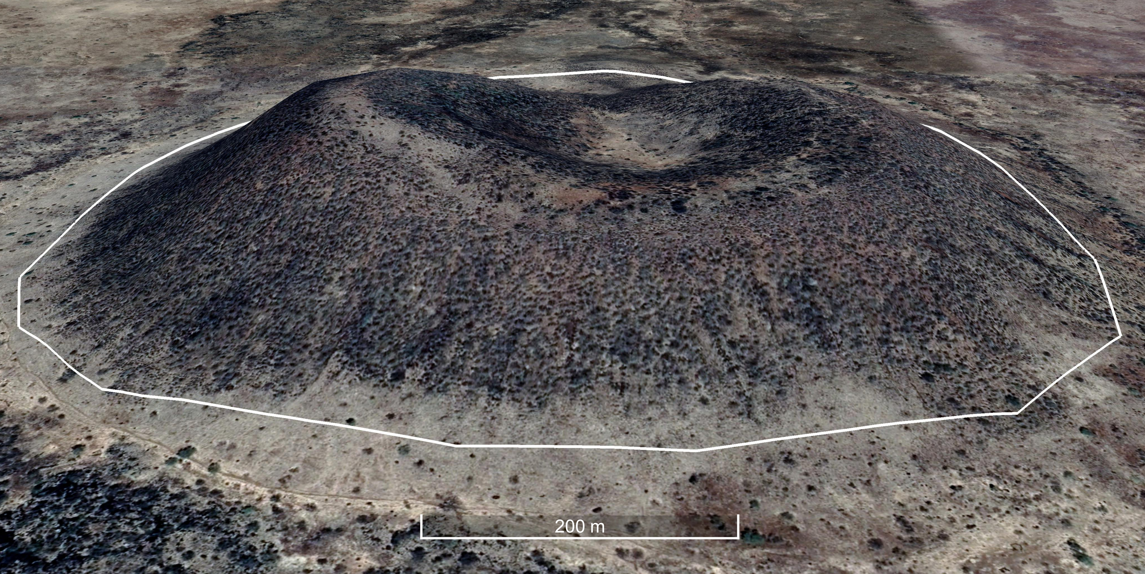
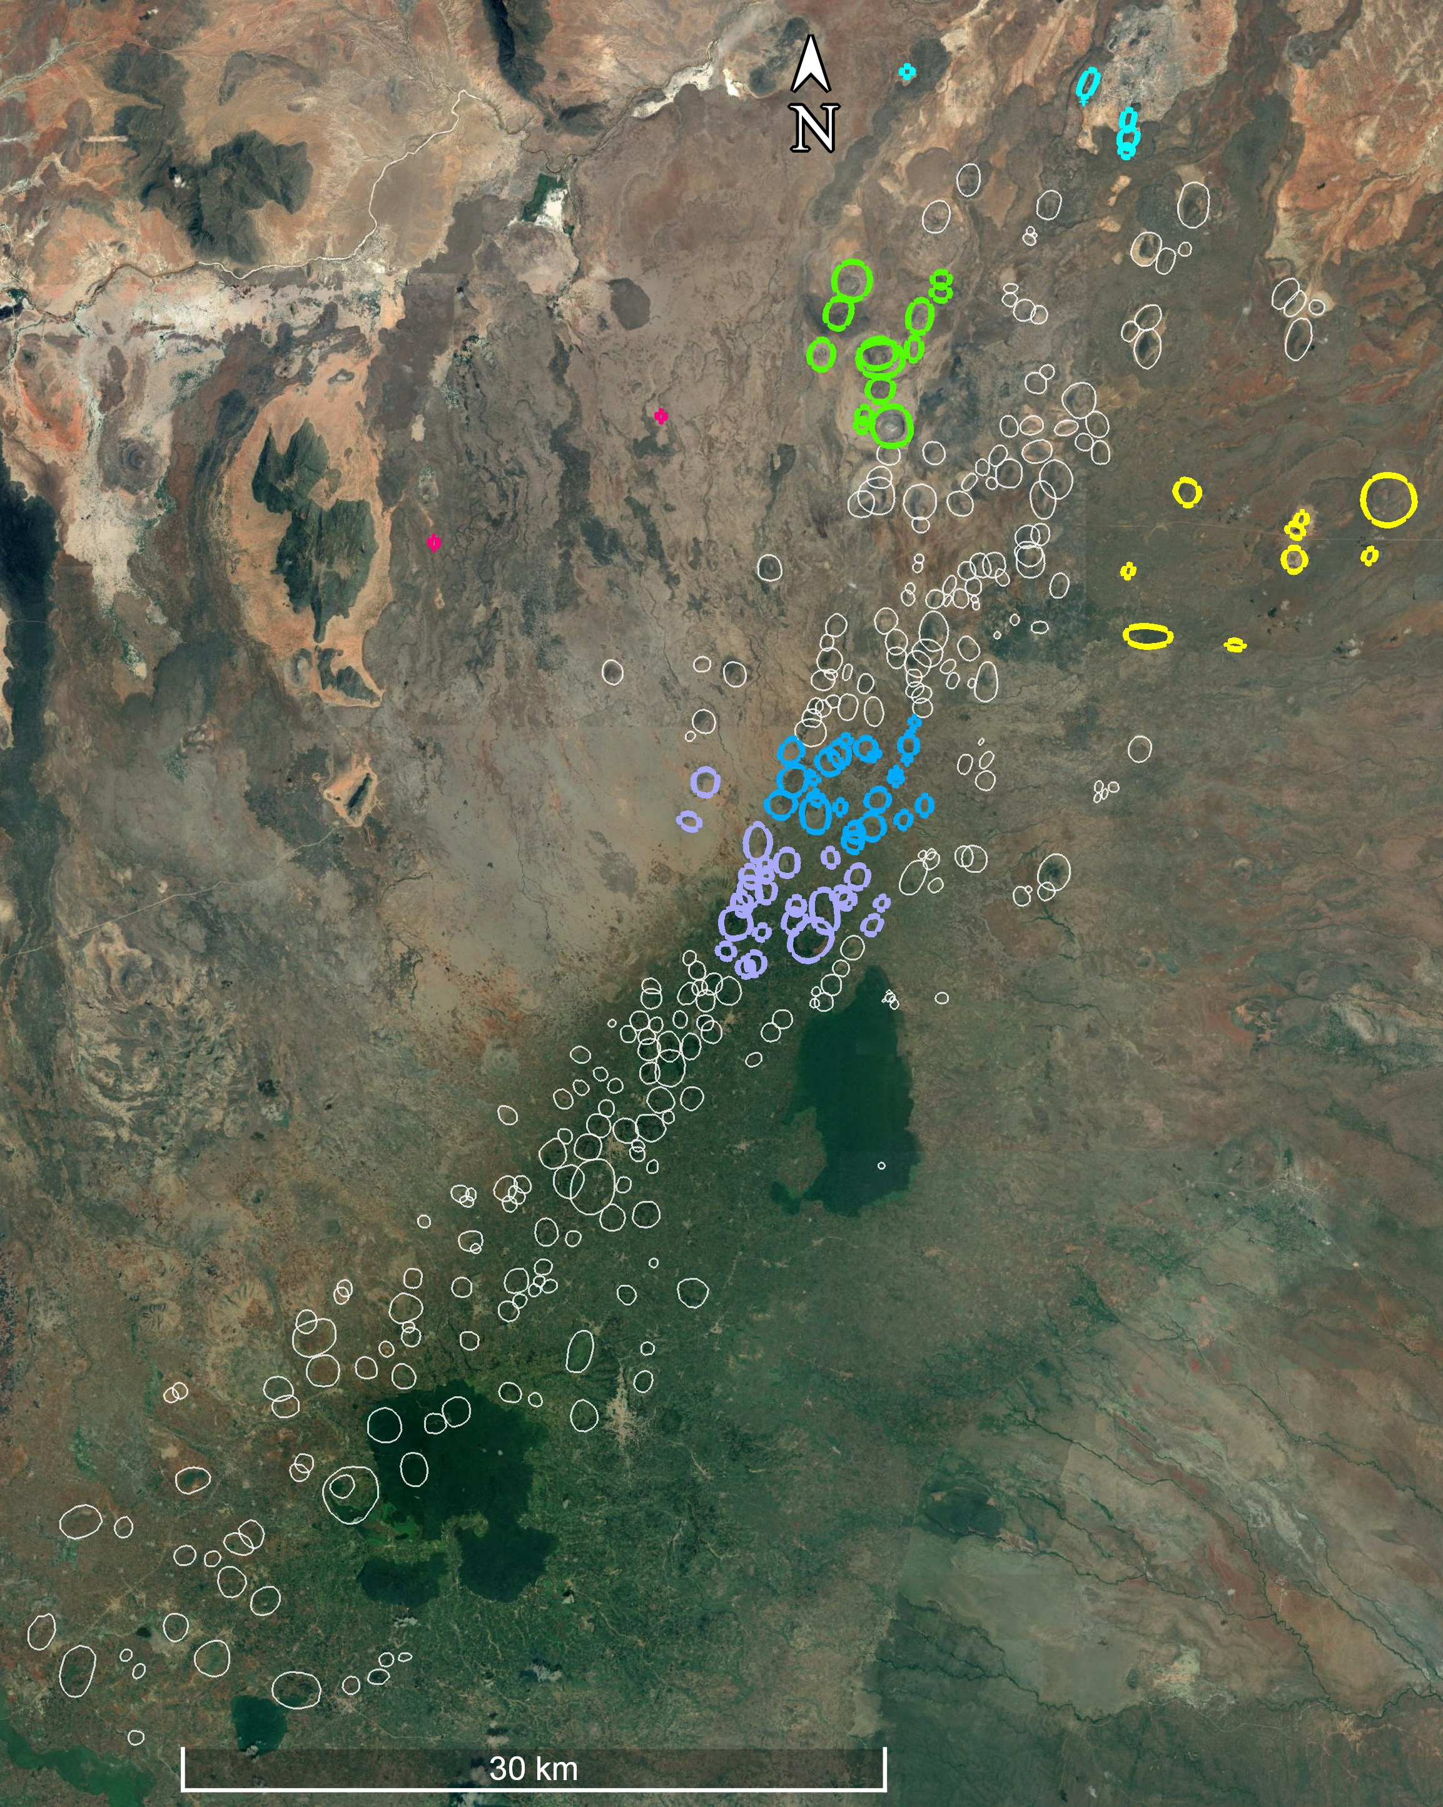
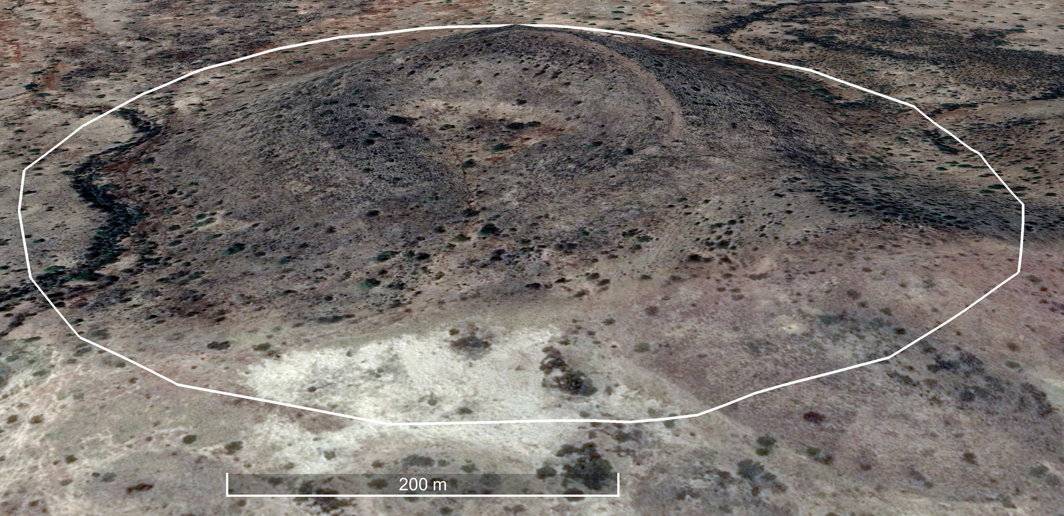
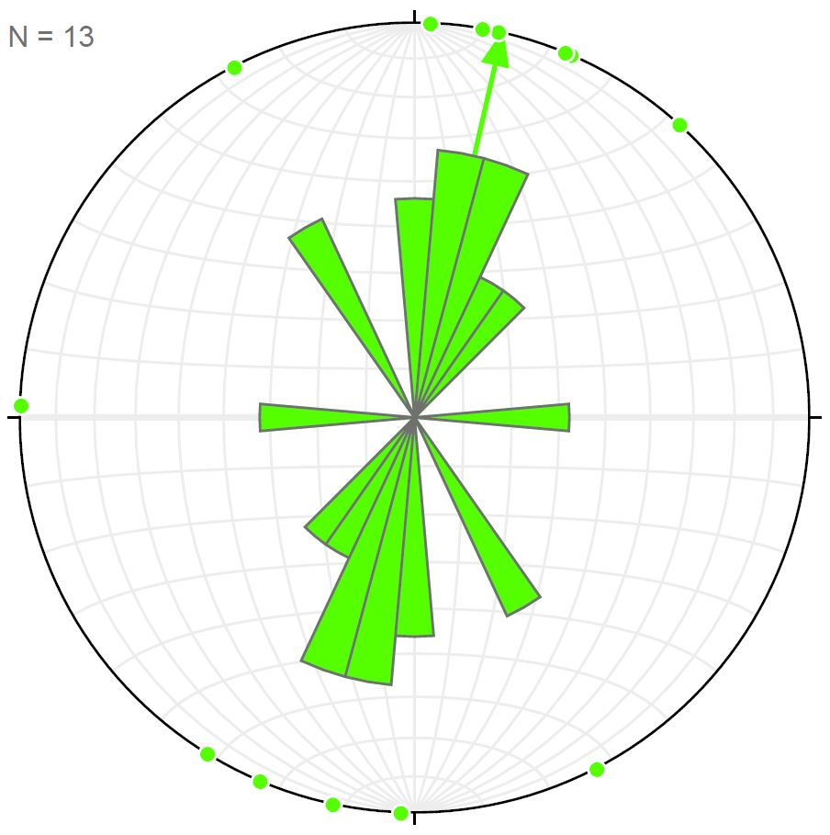
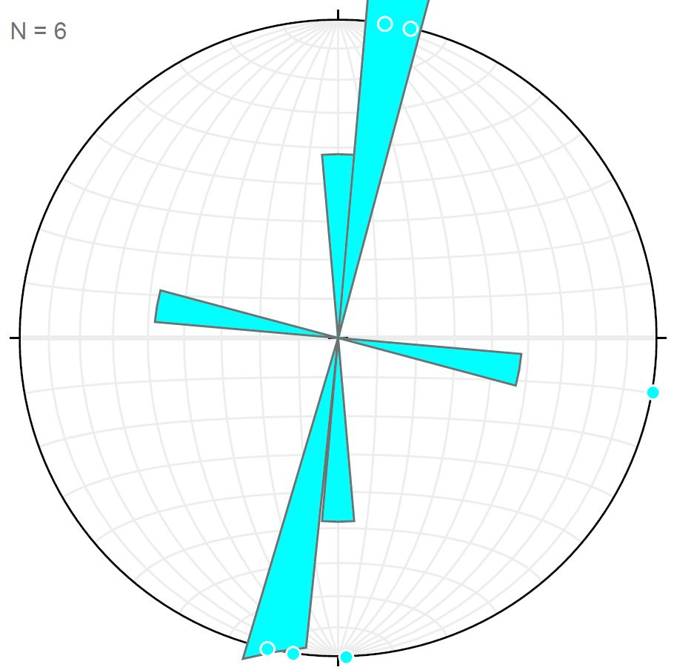
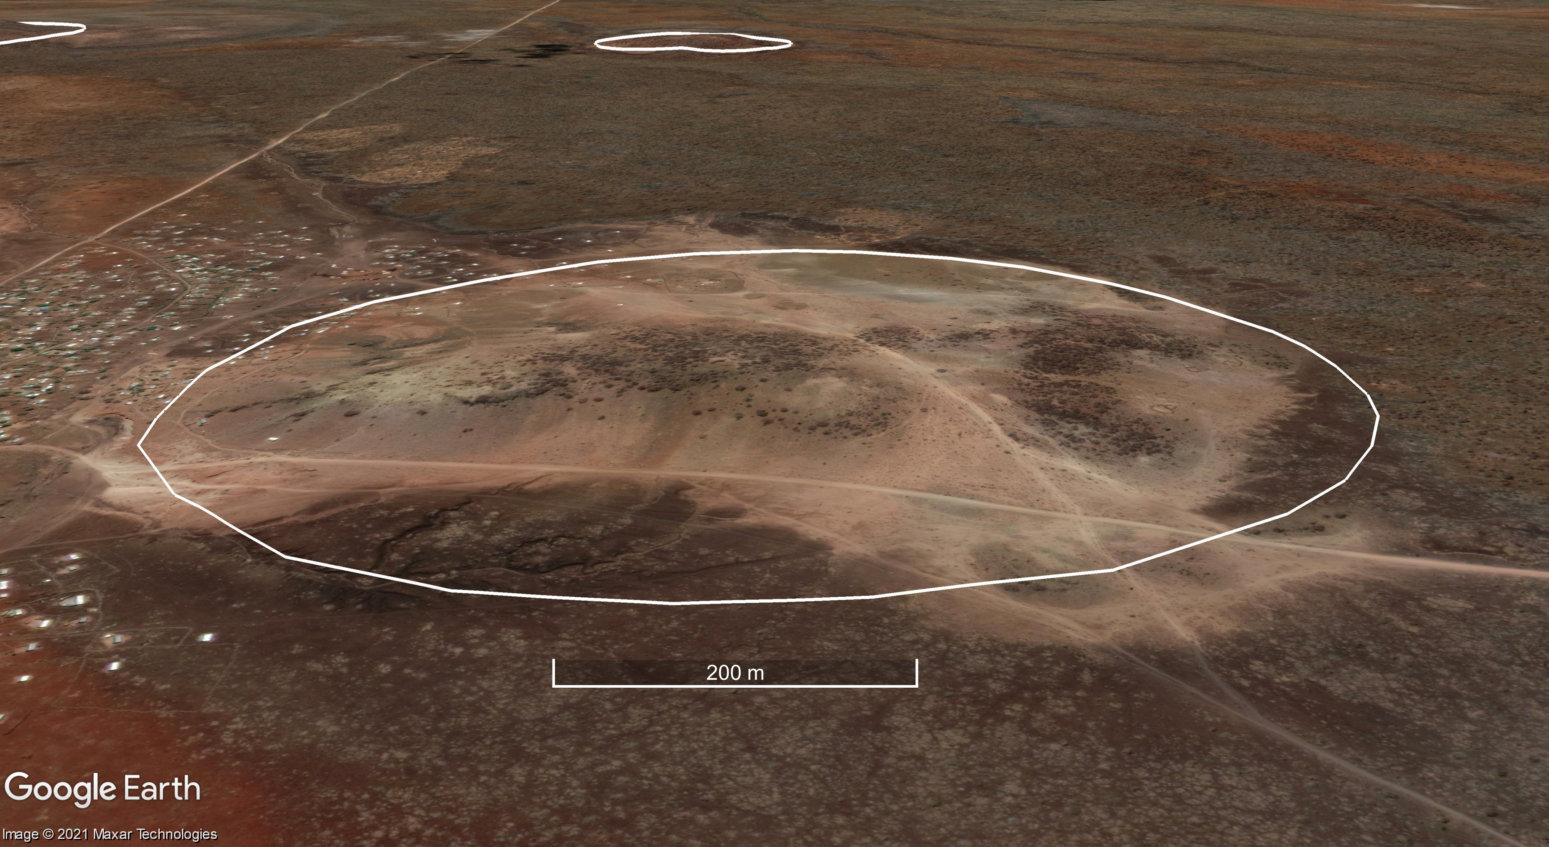
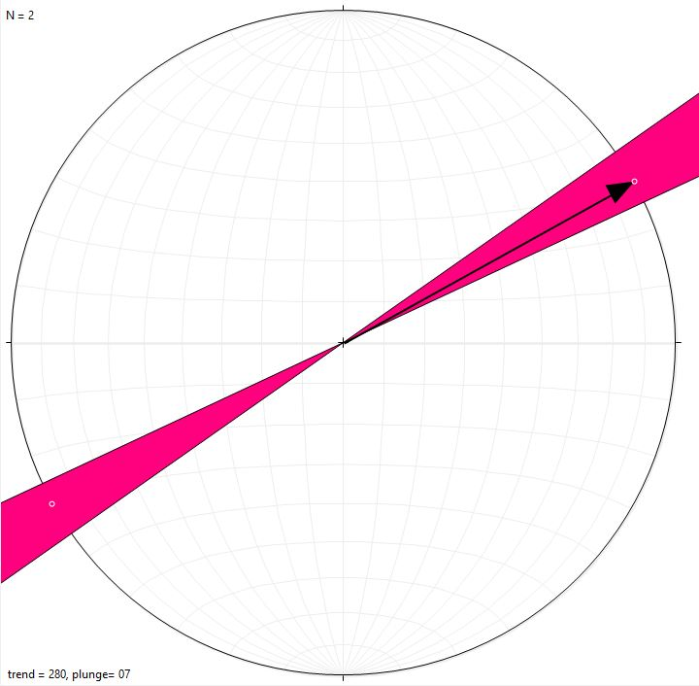
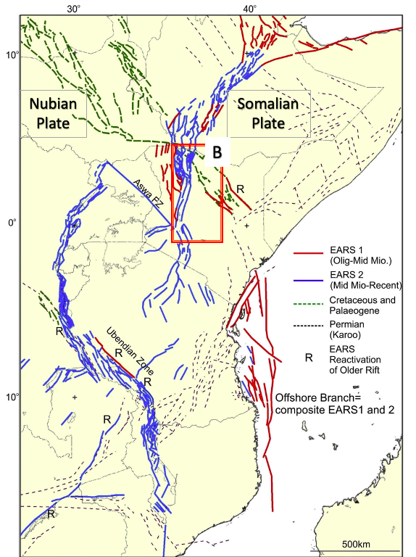
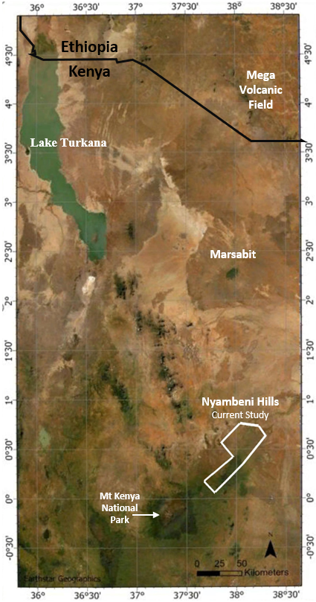
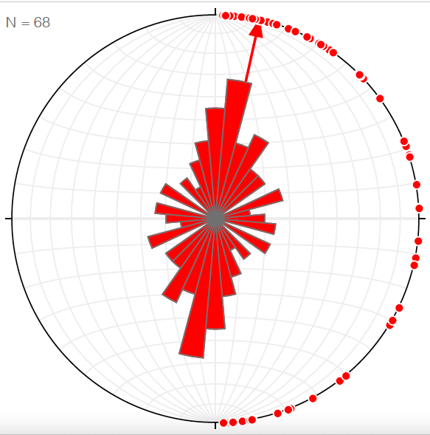
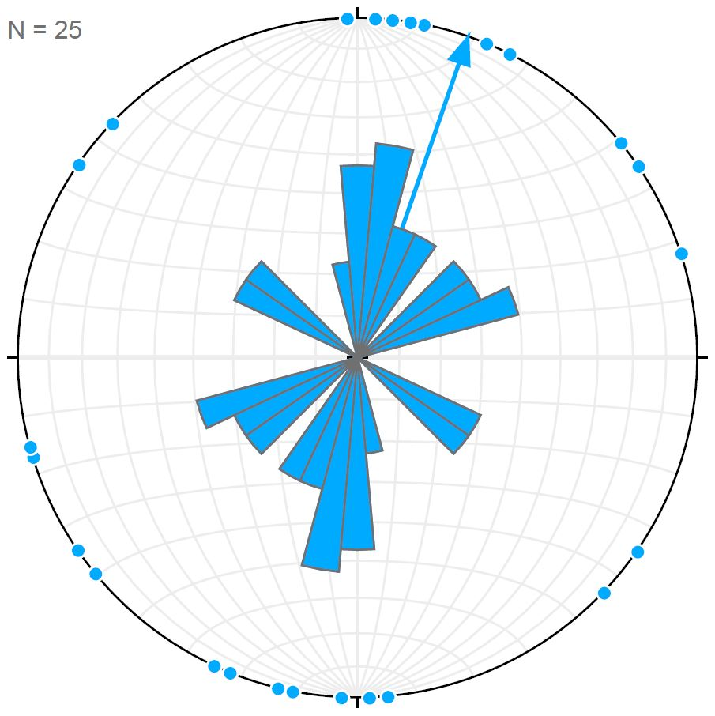
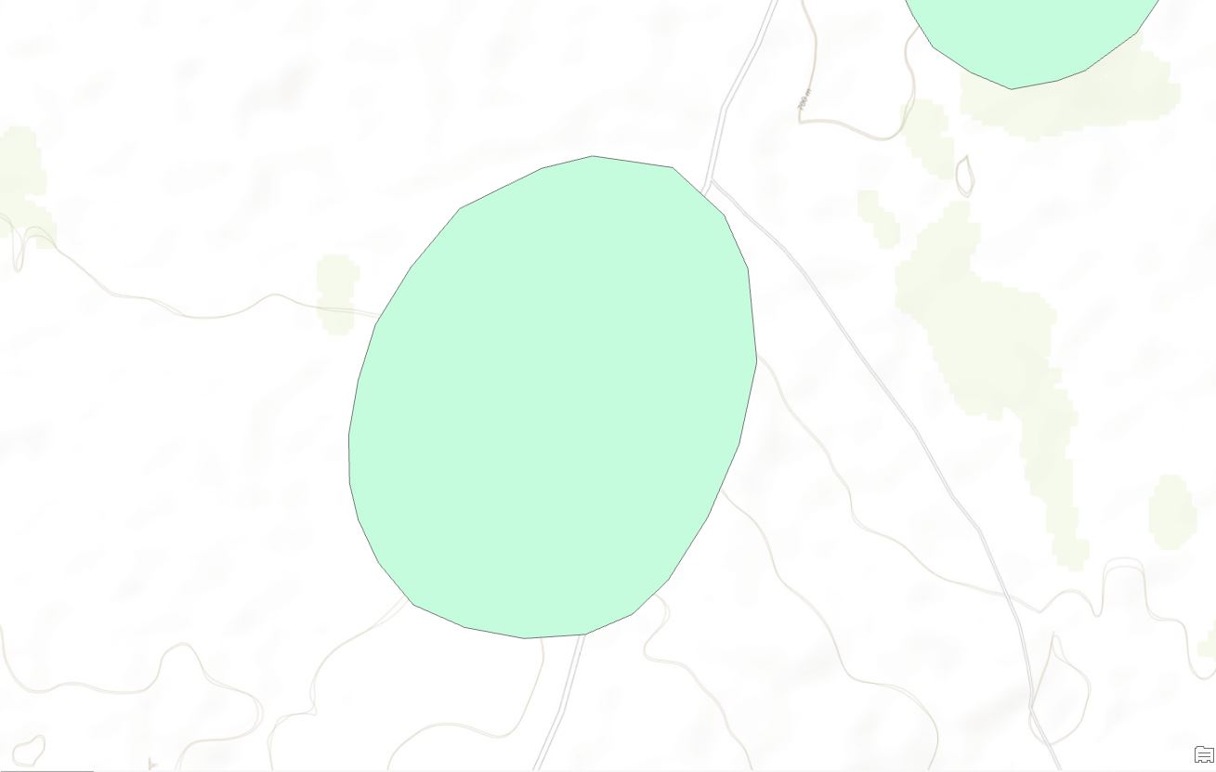
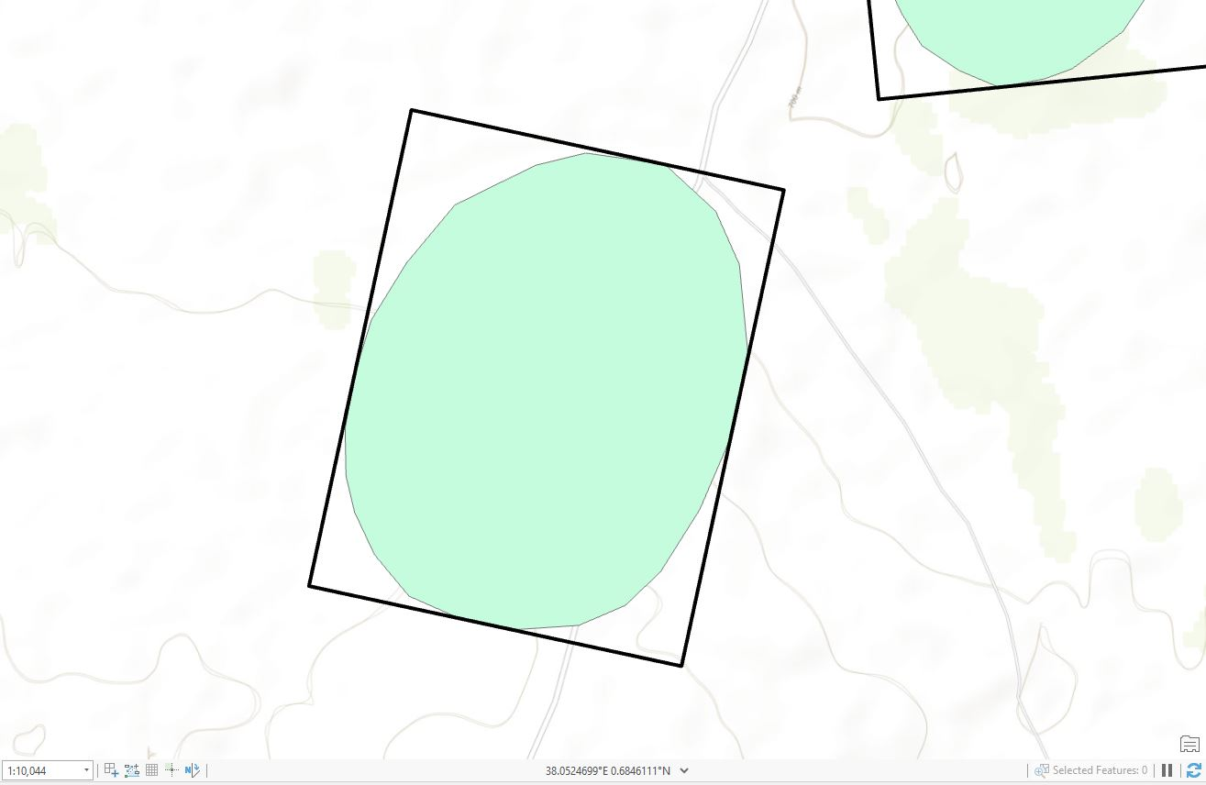
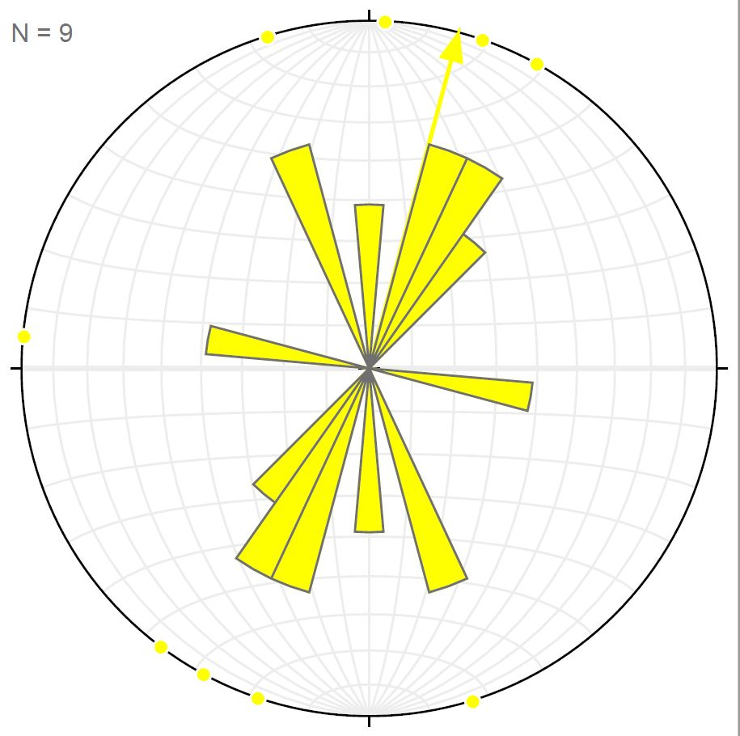
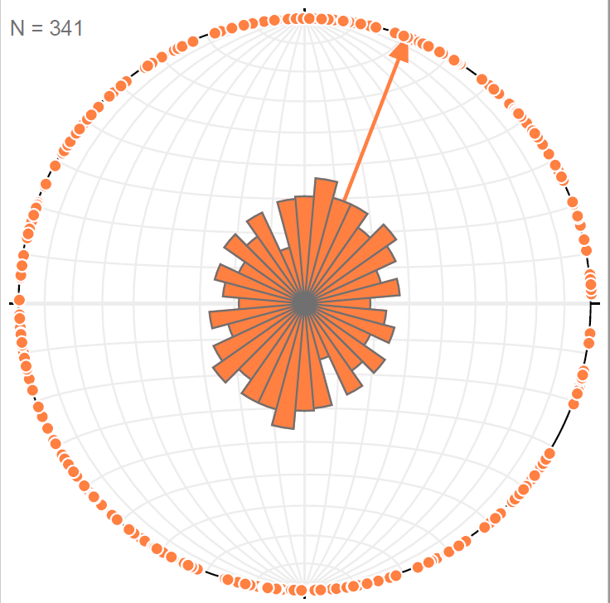
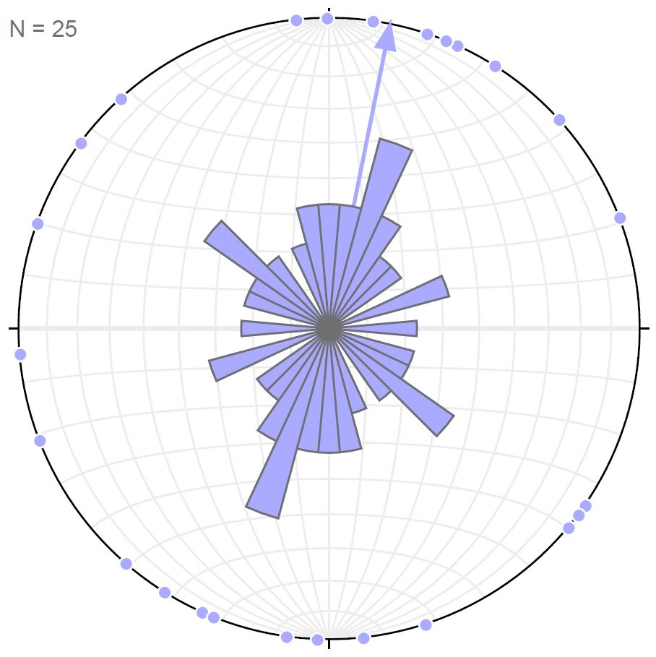
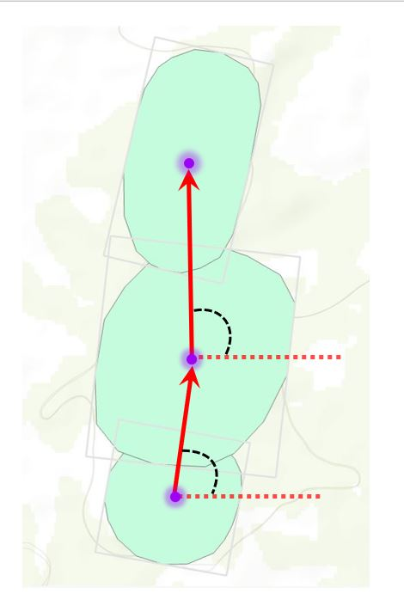
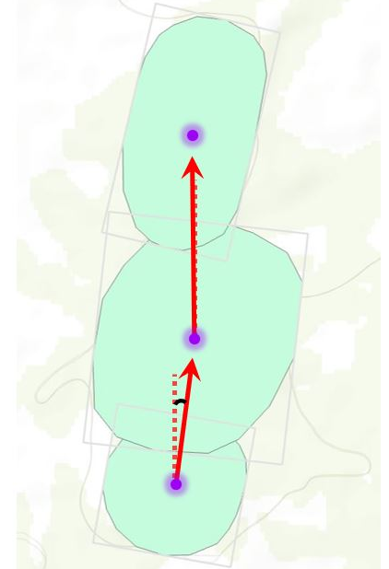
Morphology, Orientation, and Distribution of Explosive Craters in the Nyambeni Hills Volcanic Field
Sharissa Thompson* (Salem State University), Cora Van Hazinga (Salem State University), James Muirhead (University of Auckland), Sara Mana† (Salem State University)
*s_thompson10@salemstate.edu, †smana@salemstate.edu
INTRODUCTION
Volcanic fields composed of monogenetic explosive cones can be observed in the East African Rift system (EAR). Nyambeni Hills Volcanic Field is a shield volcano surrounded by scoria cones located in Kenya. Through close examination of the morphology and alignments of the volcanic features, magma paths can be inferred. Such magma paths are expected to develop perpendicular to the regional extensional stress direction (σ3), and/or follow the trends of pre-existing fracture systems in the rift zone. Google Earth Pro (GE) is utilized to map outlines of explosive craters and cones. The morphometry of each cone is analyzed and the degree of confidence in the shape is reported while mapping to allow for a more informed data analysis. ArcGIS Pro is used to generate the minimum bounding geometry that encompasses the plane-view shape of the feature, which in turn provides the short- and long-axis lengths and orientations of each feature. The long axis/short axis ratio provides an estimate of the elongation of each volcanic feature, and the trend of the long axis is indicative of the elongation direction, which can be graphically expressed in rose diagrams. The bearings between closest neighbors also provides the near angle, which can be graphically expressed on a rose diagram to provide the orientation of the linear volcanic array representing all of the data collected.
PURPOSE
Dike location and orientation can be inferred from mapping and analysis of possible linear arrays as well as the orientations of the long axes of extrusive volcanic features. These data provide a greater understanding of regional extensional stress (σ3) and comprehension of the overall fault structure in the East African Rift system, informing future studies of rifting.
CONFIDENCE LEVELS
CL 1
Confidence levels are determined by the overall appearance of degradation of a feature, which may affect the features morphometry. Confidence levels (CL) determine the reliability of a polygons outline, dividing the ranking into 3 classes. The 1st class (CL 1) typically has prominent elevation relief with discolored sediments indicating where erosion is occurring which is often termed as erosion marks. The 2nd class (CL 2) is intermediate in terms of elevation, erosion marks and other distinguishing characteristics. The 3rd class (CL 3) typically contains cones that are barely distinguishable from either other cones or from their original morphometry.
RESULTS
The long axis of 68 cones with a confidence level of 1 or 2 (Figure 3) and long/short axis ratio greater than 1.2 are good indicators of dike orientations. A near angle analysis was conducted on all of the mapped cones to analyze the general trend of the overall linear array.
200m
N=13
N=6
CL 2
Data of All Mapped Cones
CL 3
200m
N=2
Long axis
feature ellipses
A
B
Linear arrays
N=68
200m
Figure 3. Examples of CL1, CL2 and CL3. The images were modified from Google Earth Pro
v
N=25
SPATIAL ANALYSIS
N=9
Figure 4a
Minimum Bounding geometry places polygons into an enclosing rectangle to obtain the long axis and short axis lengths (meters) of each cone.
Figure 1: (A) Rifting along the EAR, modified from Macgregor (2015). (B) Turkana basin and the Nyambeni Hills in the context of other locations of previous study.
N=341
METHODS
Mapped explosive features (cones, maar craters, etc.) with the polygon tool in GE (10m resolution). Used the Elevation and Tilt angle tools to verify morphometry.
• Hillshade relief provided by ESRI is used to confirm cone boundaries.
• Cone reliability is based on confidence levels (CL) (Figure 3)
• Minimum Bounding Geometry tool is utilized in ArcGIS to find the long and short axis measurements and orientations for high confidence features with a long/short axis ratio greater than 1.2 (Figure 4)
• Geoprocessing Near Angle tool is utilized in ArcGIS to identify possible lineaments for all features
• Stereonet 11 is used to create rose diagrams of Long Axis Orientations and Near Angle Orientations
Subgroups were created using the Near Neighbor Distance (NNd) of 3,000 meters in MatLab.
N=25
Figure 4b
Near angles mark the shortest path to the nearest feature and orientation of that path. A python script was used to convert the near angle to azimuths.
Figure 2: An aerial map modified from Google Earth Pro of 341 mapped explosive cones/craters, outlined by white and colored polygons. Rose diagrams of the entire areas volcanic feature’s elongation for confident level 1 and 2 features, and near angle analysis for all mapped features. 6 smaller diagrams match the subgroups in the map that contain an error margin less than ± 30°.
References
Allmendinger, R. W., Cardozo, N. C., and Fisher, D., 2013, Structural Geology Algorithms: Vectors & Tensors: Cambridge, England, Cambridge University Press, 289 pp. ; Bemis, K.G. and Ferencz, M., 2017. Morphometric analysis of scoria cones: the potential for inferring process from shape. Geological Society, London, Special Publications, 446(1), pp.61-100. ; Cardozo, N., and Allmendinger, R. W., 2013, Spherical projections with OSXStereonet: Computers & Geosciences, v. 51, no. 0, p. 193 - 205, doi: 10.1016/j.cageo.2012.07.021 ; Chorowicz, J., 2005. The east African rift system. Journal of African Earth Sciences, 43(1-3), pp.379-410. ; Macgregor, D., 2015. History of the development of the East African Rift System: A series of interpreted maps through time. Journal of African Earth Sciences, 101, pp.232-252. ; Mazzarini, F., 2007. Vent distribution and crustal thickness in stretched continental crust: The case of the Afar Depression (Ethiopia). Geosphere, 3(3), pp.152-162. ; Morley, C.K. and Ngenoh, D.K., 1999. AAPG Studies in Geology# 44, Chapter 1: Introduction to the East African Rift System. ; Muirhead, J.D., Kattenhorn, S.A. and Le Corvec, N., 2015. Varying styles of magmatic strain accommodation across the East African Rift. Geochemistry, Geophysics, Geosystems, 16(8), pp.2775-2795. ; Paulsen, T.S. and Wilson, T.J., 2010. New criteria for systematic mapping and reliability assessment of monogenetic volcanic vent alignments and elongate volcanic vents for crustal stress analyses. Tectonophysics, 482(1-4), pp.16-28. ; Tibaldi, A., Bonali, F.L. and Corazzato, C., 2014. The diverging volcanic rift system. Tectonophysics, 611, pp.94-113. ; Van Hazinga, C., 2020. Investigating the Relationship Between Linear Arrays of Explosive Volcanic Features and the Regional Stress Field of Mt Marsabit, Kenya. Thesis. ; Van Hazinga, C., Muirhead, J. and Mana, S., 2020. Using the Extrusive Volcanic Features of Mt. Marsabit, Kenya to Identify Regional Tectonic Stress. Abstract.
CONCLUSIONS
Mean elongation trends indicate a dike propagation orientation of 012.5° ± 09.5°, which results into an extensional orientation of ~102°.
The subgroups contain consistent trend directions with the long axis and lineation rose diagrams of the entire area.
The near angle analyses provide insights on the possible existence of lineaments. Although a preferential orientation is not well defined, the obtained mean vector oriented at ~021.0° is consistent with the elongation direction and supports that data by indicating a NE-SW trend for the original data which suggests SE-NW extensional forces.
Trends from previous studies, such as Mega Volcanic Field, possesses similar values in orientation (~016°).
Acknowledgements
We would like to thank Kym as DGL staff who granted me access.

