Slide 1
Moving the Interprofessional Education (IPE) Needle Forward to Collaborative Education and Practice
Carol Gawrys and Jeramie Silveira
College of Health and Human Services Interprofessional Education Event
May 2022

Slide 2
Interprofessional Education
Occurs when there is
Interaction between students and faculty of different professions AND
Goals and learning experiences lead to achieving
  Performance of skills required for collaborative patient/client-centered teamwork
  Understanding of and respect for the role and unique contributions of the health professions
  Institute of Medicine, Health Professions Education: A Bridge to Quality (2018)

Slide 3
The Increasing Need for IPE
In order to provide quality and cost-effective care, health professionals must be better prepared to lead and collaborate in interprofessional teams.
Interest in IPE continues to grow as a means to prepare students for collaborative practice in new models of care with the goal of improving Quadruple Aim outcomes* by simultaneously addressing population health, patient experience, per capita cost, and provider work-life balance.
*National Center for Interprofessional Practice and Education (2018)

Slide 4

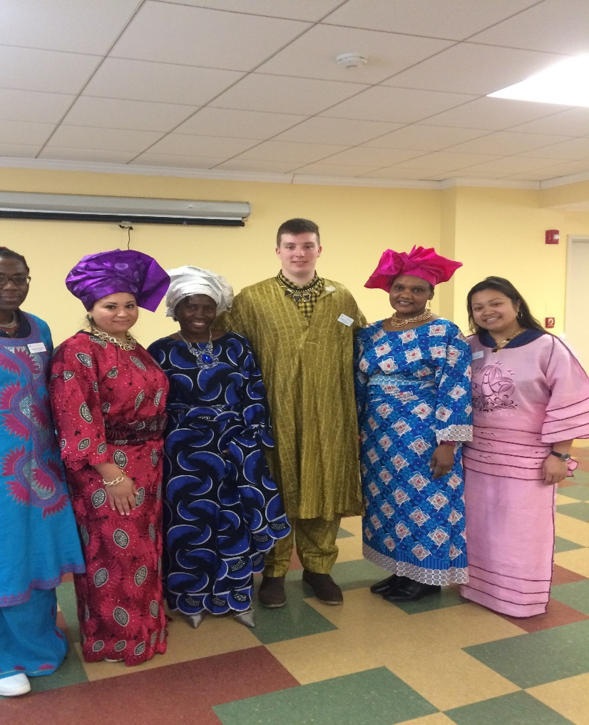
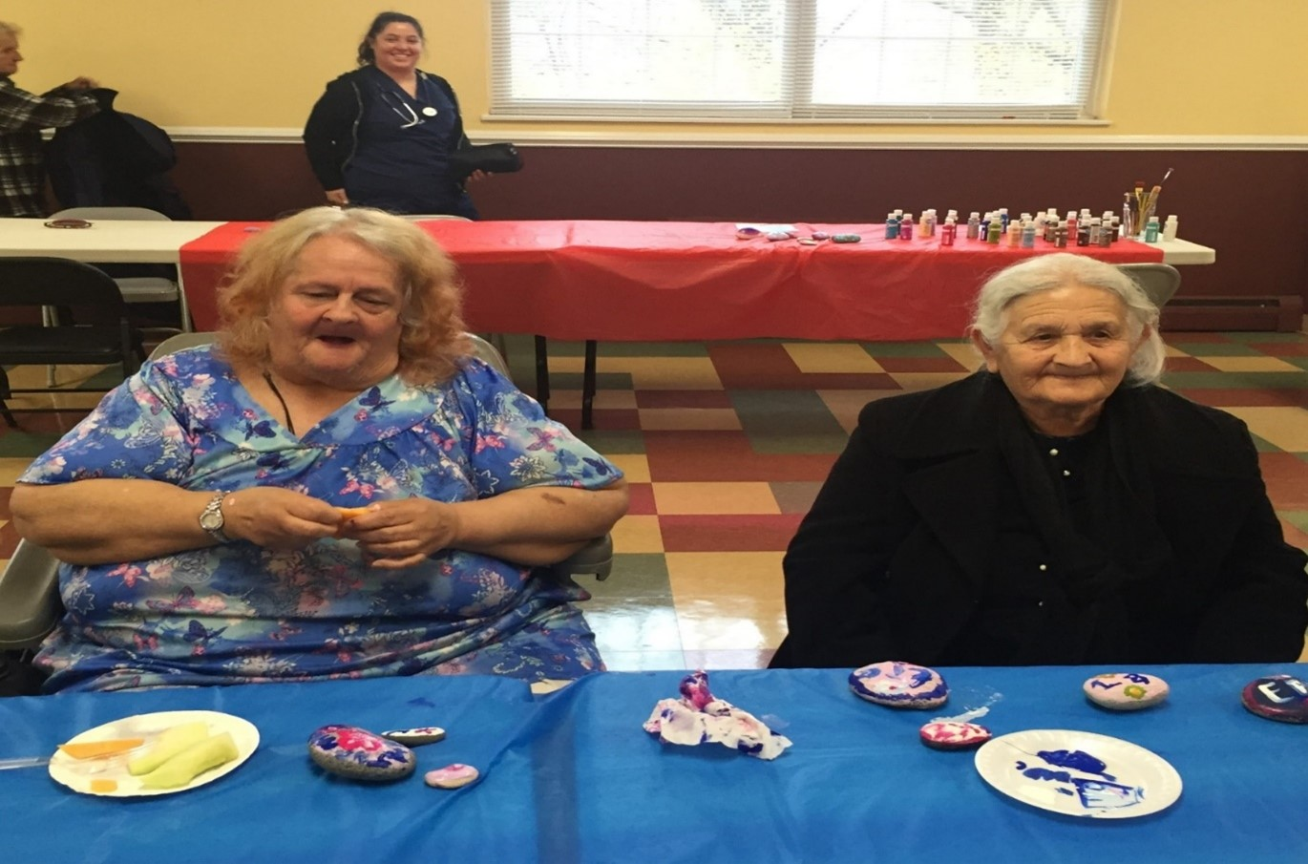
Interprofessional Education in the College of Health and Human Services (CHHS)
Each program within the CHHS has accreditation standards related to interprofessional education they must meet
Many innovative IPE assignments, case studies, clinical and fieldwork-based experiences have been developed and implemented

Slide 5
The Goal of Developing Collaborative Education and Practice
For these learning experiences to be an integrated and sustainable part of the collaborative education of our students there is a need to:
  1. Encourage institutional leaders to develop a systematic approach to foster IPE at the University and, where appropriate, with collaborating academic institutions, health systems, and community partners
  2. Provide a framework (rationale, goals, deliberate design, funding and assessment and evaluation) for program leaders and faculty to develop a plan for an Interprofessional Education Center

Slide 6
