Slide 1


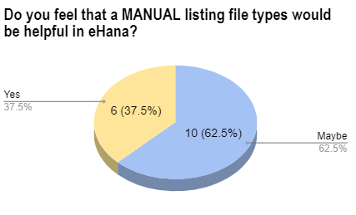
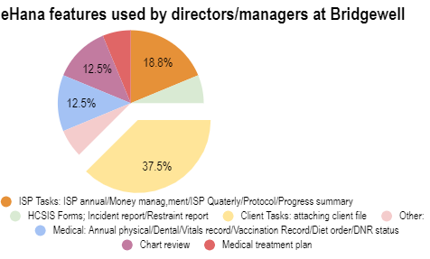
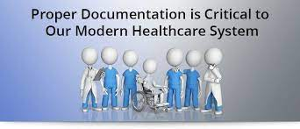
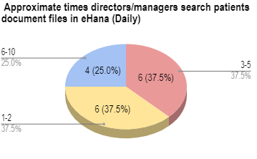
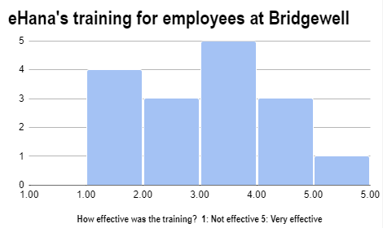

eHana Database: Classifying Client File Types Manual (Digital/Hardcopy)
To Ensure proper Client File documentation and the effectiveness of File Types
Maria Rosario Morel, Healthcare Studies
INTRODUCTION
EHANA DATABASE
MATERIALS /METHODS
REFLECTION
About Bridgewell:
Bridgewell is a non-profit organization that takes a person-centered approach; by providing community housing, day programs, outpatient treatment, recovery services, education and employment training for people with disabilities in the Eastern area of Massachusetts.
Bridgewell’s focus is to deliver services to people in need, including individuals experiencing autism, physical disabilities, substance use disorder, and homeless.
Bridgewell’s aim is to empower people to have a safety life and to achieve their fullest potential.
Bridgewell provides over 100 programs in 23 communities.
Bridgewell’s values care, dignity, integrity, respect, safety, and wellness.
Create a 7 questions survey on Google Forms for department managers regarding the effectiveness of eHana and the importance of classification and
Based on the data collected from the survey, the following conclusions could be made:
More training would be beneficial for employees to leverage their skills on eHana for proper documentation .
According to data 37.5% of the participants in the in the survey use the client task tab to upload patient’s documents.
37.5% of the residential directors/managers agreed that having a manual would benefit client documentation, other 62.5% said maybe.
Written feedback:
One of the residential manager wrote me an email stating that files are “find it fairly easy to find what I’m looking for as long as it’s within a year or two”. But because of the database transferred she now had to relabel and re-categorized hundred of documents, and it takes a long time”
With proper documentation Bridgwell will be able is protect the organization itself, the clients, and the providers.
The manual will increase Good documentation by promoting patient safety and quality of care.
About eHana:
eHana is a Cloud-based electronic health records for behavioral health and human services that stores client information and documents.
eHana has many features such as clinical records, billing & finance, staff tracking, operational tools, compliance, and document management.
Bridgewell switched from using TIER to eHana database.
SURVEY
Survey questions included;
The most and least used features in eHana.
Approximate times employees search for client files on a day.
Training employees for eHana.
How beneficial would it be to have a manual for eHana file types?
RESULTS
RELATED LITERATURE
Total number of residential director/manager ask to participate: 25
Total number of responses: 16
Written feedback from employees : 2
“Clinical record keeping is an integral component in good professional practice and the delivery of quality healthcare. good clinical record keeping should enable continuity of care and should enhance communication between different healthcare professionals. clinical records should be updated, where appropriate. Clinical records are also valuable documents to audit the quality of healthcare services offered and can also be used for investigating serious incidents, patient complaints and compensation cases.”(NIH.gov , 2016)
INTERNSHIP ROLE
Scanning and entering data into Bridgewell’s eHana electronic health record system.
Identifying and categorizing medical, program, and legal records in Bridgewell’s electronic health record system database
Comparing eHana and TIER databases to gather information about residential programs and individuals.
Transferring data pertaining to SNAP benefits (food stamps) recipients to Excel spreadsheet.
ACKNOWLEDGEMENTS
With special thanks to Melissa; Program Support Specialist and Kelly; Vice President of Residential Living for giving me the opportunity to learn from them.
INTERNSHIP PROJECT OBJECTIVE
MATERIALS /METHODS
REFERENCES
Create a hardcopy/digital) manual in eHana to ensure accurate documentation and a more effective way to find client files.
Created a binder for hardcopy manual (using word document) in alphabetical order.
Created digital manual using flipsnack.com
Categorize over 100 file types.
Create shortcut on eHana database by inserting a client file type tab.
“About Bridgewell: Massachusetts Disability & Recovery Services.” Bridgewell, 29 Apr. 2021, bridgewell.org/about/.
“EHR Features & Technology.” EHana, ehana.com/ehana-ehr.
“Mathioudakis, A., Rousalova, I., Gagnat, A. A., Saad, N., & Hardavella, G. (2016,December). How to keep good clinical records. Breathe(Sheffield, England).
https://www.ncbi.nlm.nih.gov/pmc/articles/PMC5297955/.

Slide 2
)
INTRODUCTION
REFLECTION
RELATED LITERATURE
CITATION
“
SURVEY/RESULTS
ACKNOWLEDGEMENTS

Slide 3
)
ACKNOWLEDGEMENTS

