Slide 1


Caseload Balance and Risk Stratification in Community Residential Care:
Pilot project conducted with
A Pilot Program for Nurse Case Managers
Julieanne Burridge, RN, CMGT-BC (MSN 2021)

Slide 2
Background & Significance

Slide 3
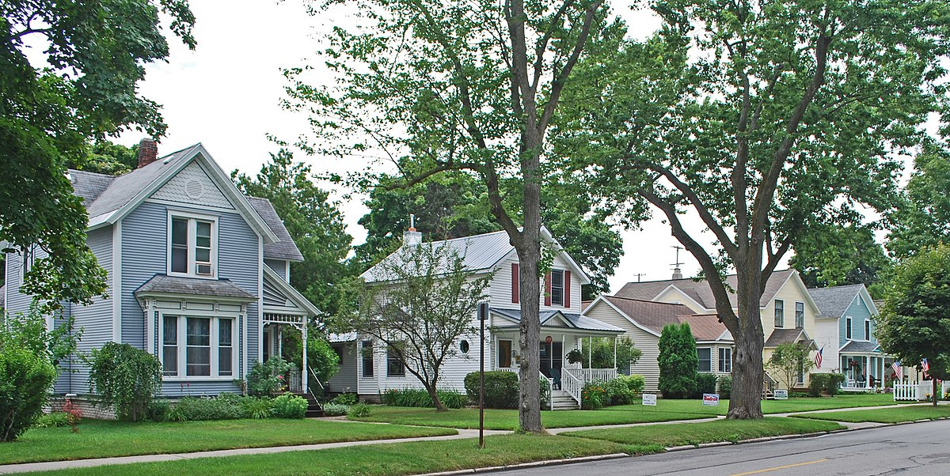
Community Residential Living
Community residences (a division of a 501(c)3) are designed to promote long-standing community involvement.
The goal is to achieve optimal health and wellbeing to promote the utmost independence, engagement, and autonomy.

Slide 4
CHRONIC CARE MODEL (Wagner, 1998)
Wagner’s interdisciplinary model for improvement of chronic illness care “assumes that the locus of care remains with the personal physician, supported by an integrated (and perhaps expanded) practice team. Targeting and case management activities, sometimes known as carve-ins or carve-outs, do not always make this assumption” (Wagner, 1998, p. 3).

Slide 5
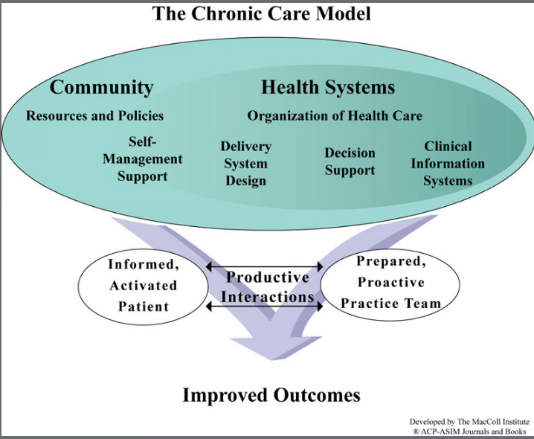
Wagner Model
Original Model

Slide 6
CHRONIC CARE IN THE RESIDENTIAL SETTING
The residential provider/agency accepts the onus of health and safety, and thus accepts responsibility for directing care.
Nurse Case Managers help to facilitate productive conversations between patient and provider utilizing an expertise that bridges the gap. The Nurse Case Manager knows the patient well, the goals of care, the status of the patient’s well-being, and current risk factors and concerns.

Slide 7
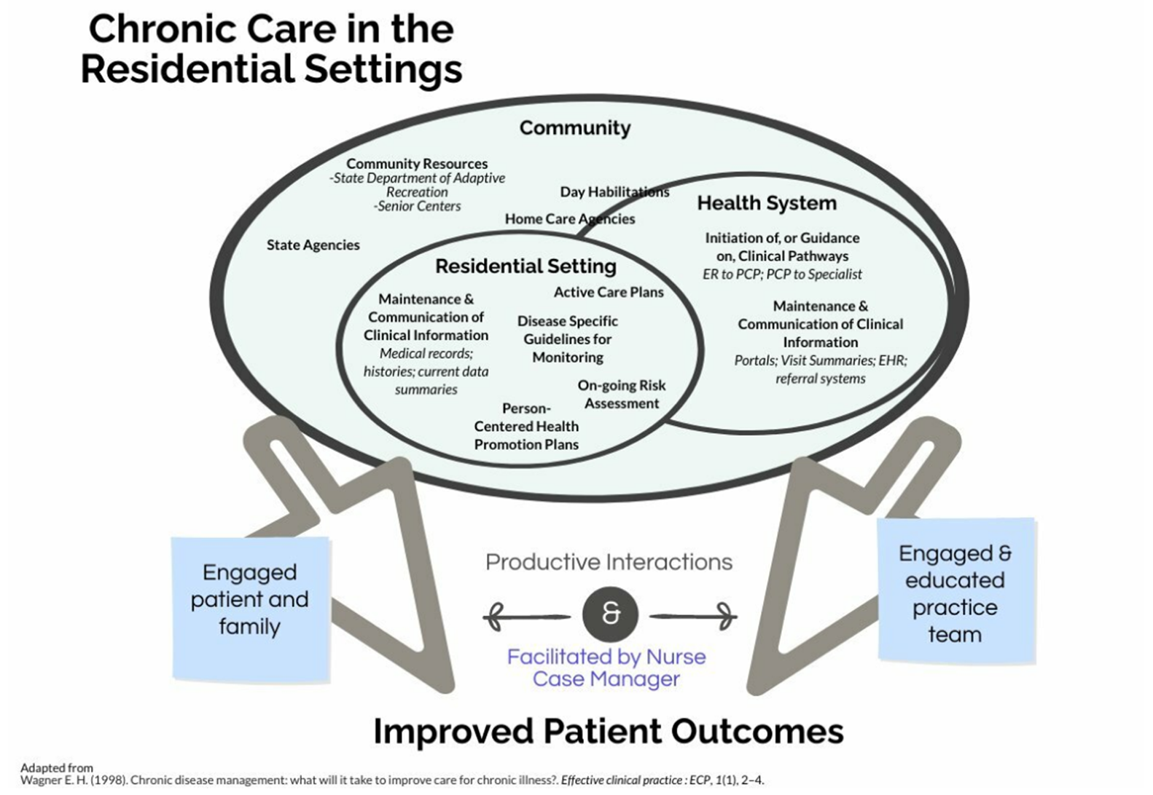
Wagner Model
Developed by
J. Burridge, RN, CMGT-BC
Adapted Model

Slide 8
Chronic Care Model: Details
- The community at-large has resources to support people with chronic conditions/illnesses but accessing these resources might require support. This is where other partners in the interdisciplinary team intersect.
- The Health System (primary care, specialists, and hospitals) is still largely perceived as the systems that treat illness and manage disease.
- The Residential Setting overlaps with the Health System. It is a distinct setting with its own structures and resources, but many of which trigger engaging with the Health System.

Slide 9
PROBLEM STATEMENT:
What components of chronic care take so much time?
How many patients/residents can a Nurse Case Manager safely balance so they have optimum outcomes?
Case A: In a middle-aged adult whose chronic illness is stable and managed, with intermittent flares, how much time does a Nurse Case Manager need to dedicate to that person?
Case B: If a person with multiple comorbidities and early-stage dementia has a fall with complicating CVA, how much nursing time does this person need for adequate management?
If there is a new development, what is the mechanism of action? What does the nurse use to guide the next steps of care?

Slide 10
PILOT PROGRAM & TOOL DEVELOPMENT OBJECTIVES:
Identify key patient indicators that are likely to increase the acuity of the patient with respect to the case manager’s time and resources
Create clinical pathways that are specific to homecare and community settings and address each patient at every level of risk, not just those at the highest risk stratification
Isolate trigger events that help the nurse case manager identify when a patient has crossed the threshold into a higher risk level and guide appropriate actions.
Determine the most balanced caseload for quality and safety

Slide 11
STAKEHOLDERS
Primary: Person with chronic illness
Secondary:
Family & Friends of the person being treated (improved outcomes for their loved one)
Residential Team and the Agency at-large (health and wellness is prerequisite for optimum engagement – mission driven)
Primary Care Team & Specialists
Third-Party Payers (cost savings)
State Funding Agencies (cost savings)
Improved outcomes person with chronic illness benefits everyone
Residential Team
Provider Agency
Health Care Providers
Family & Friends
State Funding Agencies
Third-Party Payers

Slide 12
Methodology

Slide 13
REVIEW OF UTILIZATION
What happens to the patient, or what does the patient report, that increases the resources they require?
- Identify what factors change the case managers involvement with a patient
- Identify what changes correlate to an increase in resources and to what degree
- Identify what resources are being used and how are they allocated right now
The nurse case manager’s involvement increases for episodes of acute illness/injury and when the nurse has identified an increased risk
The nurses’ expertise helps identify root causes of risk factors and enact interventions to mitigate that risk before the problem is exacerbated.
Notes:
If a person requires help dressing or bathing where they used to be able to do it themselves, it might not change the amount of time a case manager spends with the patient. It will change what direct supports are needed in the home if someone needs help dressing because they can no longer do buttons or zippers.
If it reflects a functional decline and we might get OT involved, but the nurse’s course of action will be substantially more involved if that decline is secondary to a TIA or CVA. The cardiac complications will significantly increase the amount of time the nurse case manager spends on the patient because of all the other risk factors now identified like clotting, swallow, gait/ambulation.

Slide 14
ACUITY TOOL
Comorbidities
2 | 4 or fewer active diagnoses | Comments:
4 | 5-8 active diagnoses
6 | 9-12 active diagnoses
8 | More than 12 active diagnoses
 | Total Score
Poly-pharmacy
2 | PRN medications only | Comments:
4 | Daily supplements; <5 scheduled medications (meds not number of pills or frequency)
6 | More than 5 medications daily; infrequent med changes
8 | More than 5 medications daily; frequent med changes
 | Total Score
Skin Integrity
0 | No history of pressure injury/skin breakdown | Comments:
2 | History of pressure injury/skin breakdown more than 3 years ago
4 | Pressure injury in last 3 years; or active prevention/management of risk for alteration in skin integrity; presence of indwelling device
6 | Recent/frequent pressure injury or skin breakdown
 | Total Score
Mobility
0 | Independent; walks frequently | Comments:
2 | Slight limitations; walks intermittently
4 | Requires assistance to ambulate
6 | Chairfast/bedfast
 | Total Score
Communication
0 | Able to describe current state of health; accurate reporter of medical history; able to follow provider orders | Comments:
2 | Able to describe current state of health; requires staff assistance to report medical history
4 | Able to make needs known to familiar staff; unable to effectively communicate with unfamiliar staff/providers; can follow provider orders with staff direction
6 | Able to make needs known to familiar staff but unable to follow through on provider orders
8 | Unable to make needs known; requires complete assistance from staff to convey clinical information to health care provider and to follow provider orders.
 | Total Score
General Medical
2 | Generally stable; episodic illness ≤ 2x year | Comments:
4 | More frequent episodic illness management; averages one hospitalization per year
6 | Complex chronic illness(es); infrequent flares
8 | Complex chronic illness with routine acute episodes; end of life care needs
 | Total Score
Mental Health
0 | No hx/evidence of mental illness | Comments:
2 | History of mental illness; stabilized with meds or past treatment; infrequent med changes
4 | Moderate emotional stress; ongoing treatment; chronic/major mental illness; inability to adhere to treatment
6 | Danger to oneself or others in the last year.
 | Total Score
Dementia
0 | No evidence of dementia | Comments:
4 | Monitoring for early dementia; question of diagnosis
6 | Active dementia diagnosis; noted decline in skills/abilities
8 | Stage 2/3 dementia; hospitalizations for change in mental status this year
 | Total Score
Falls
0 | Not deemed fall risk (based on completed fall assessment) | Comments:
8 | Fall risk, fall precautions in place (based on completed fall assessment)
 | Total Score

Slide 15
NURSING INVOLVEMENT
1
 | Medications: orders (annual, interim), verification of OTC meds, transcriptions, assistance with pharmacy as needed
 | annual physical; ISP assessment
 | Routine annual staff trainings (e.g., signs and symptoms, MAP recert, disease-specific trainings)
2 | RN CM will be involved to provide guidance on new diagnoses, teaching for staff or individual about prevention, treatment, and/or chronic management of diagnoses
 | RN CM will outline care plan of clinical interventions based on diagnoses
 | Routine annual staff trainings (e.g., signs and symptoms, MAP recert, disease-specific trainings)
 | Medications: orders (annual, interim), verification of OTC meds, transcriptions, assistance with pharmacy as needed
 | annual physical; ISP assessment
3 | RN CM will monitor stability of chronic illnesses, and be involved to help when needs arise.
 | RN CM will participate in regular interdisciplinary meetings to ensure needs are met & health promotion/prevention goals are established
 | RN CM will be involved with episodic care: assistance coordinating with physicians and other specialists
 | RN CM will outline care plan of clinical interventions based on diagnoses
 | Medications: orders (annual, interim), verification of OTC meds, transcriptions, assistance with pharmacy as needed
 | Routine annual staff trainings (e.g., signs & symptoms, seizures, MAP recert, disease-specific trainings, protocols and interventions, rescue meds)
 | annual physical; ISP assessment
4 | RN CM will monitor stability of chronic illnesses, and be involved to help when needs arise
 | RN CM will be in regular contact with program director re: health status
 | RN CM will have eyes on monthly or more frequently, if needed (this may change if VNA involvement)
 | RN CM will coordinate with VNA, as required
 | RN will attend important appointments, and communicate with physicians to report on changes and progress, as required
 | RN CM will participate in regular interdisciplinary meetings to ensure needs are met and health promotion/prevention goals are established
 | RN CM will establish protocols for intervention, as required (Authorization for Specialized Healthcare)
 | RN CM will be involved with episodic care: assistance coordinating with physicians and other specialists
 | RN CM will outline care plan of clinical interventions based on diagnoses
 | Routine annual staff trainings (e.g., signs & symptoms, seizures, MAP recert, disease-specific trainings, protocols and interventions, rescue meds)
 | Medications: orders (annual, interim), verification of OTC meds, transcriptions, assistance with pharmacy as needed
 | annual physical; ISP assessment
5 | RN CM will have eyes on twice monthly or more frequently, if needed (this may change if VNA involvement)
 | RN CM will monitor stability of chronic illnesses, and be involved to help when needs arise
 | RN CM will be in regular contact with program director re: health status
 | RN CM will coordinate with VNA, as required
 | RN will attend important appointments, and communicate with physicians to report on changes and progress, as required
 | RN CM will participate in regular interdisciplinary meetings to ensure needs are met and health promotion/prevention goals are established
 | RN CM will establish protocols for intervention, as required (Authorization for Specialized Healthcare)
 | RN CM will be involved with episodic care: assistance coordinating with physicians and other specialists
 | RN CM will outline care plan of clinical interventions based on diagnoses
 | Routine annual staff trainings (e.g., signs & symptoms, seizures, MAP recert, disease-specific trainings, protocols and interventions, rescue meds)
 | Medications: orders (annual, interim), verification of OTC meds, transcriptions, assistance with pharmacy as needed
 | annual physical; ISP assessment
Level | Score | Requirements
1 | 6-10 | Independent; minimal support needed
2 | 10-20 | Minimal supports; requires teaching for new diagnoses but able to report changes appropriately and seek assistance from appropriate supports.
3 | 20-34 | Requires active support to coordinate and manage care as needs arise, but otherwise stable
4 | 34-50 | Requires active support and management for chronic illness; significant risk for deterioration in at least one area
5 | 50-64 | Requires active management and coordination; significant risk for acute illness; active end of life process

Slide 16
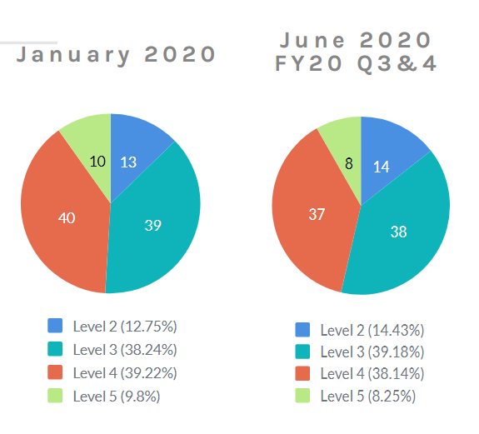

PILOT RESULTS: Resident Assessment (n=103; n=100)
Comparing assessments at two time points suggests the acuity of the individuals supported in this residential program did not change (stability).
Stability suggests people were currently well-managed and the caseload balance was achievable during the pandemic.
The plan was quarterly assessments but due to pandemic, the assessment was done bi-annually.
Experienced Nurse Case Managers are intervening where necessary out of instinct and expertise. An evidenced-based practice and structured model are needed for sustainability.

Slide 17
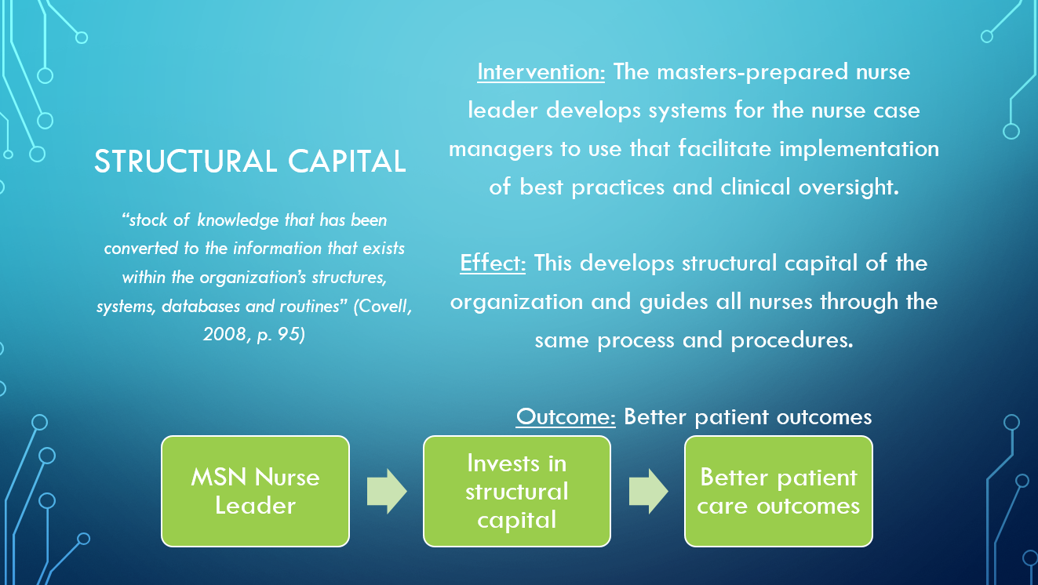
CLINICAL PATHWAYS
Covell’s Mid-Range Theory of Intellectual Capital (2008) outlines four types of capital: human, structural, relational, & social.
This excerpt from the conceptual model for the development of nurse case mangers outlines the value in developing clinical pathways to guide & standardize the nurse case managers’ interventions.
Developing clinical pathways translates the knowledge that the nurses have gained through experience into standardized practice.

Slide 18
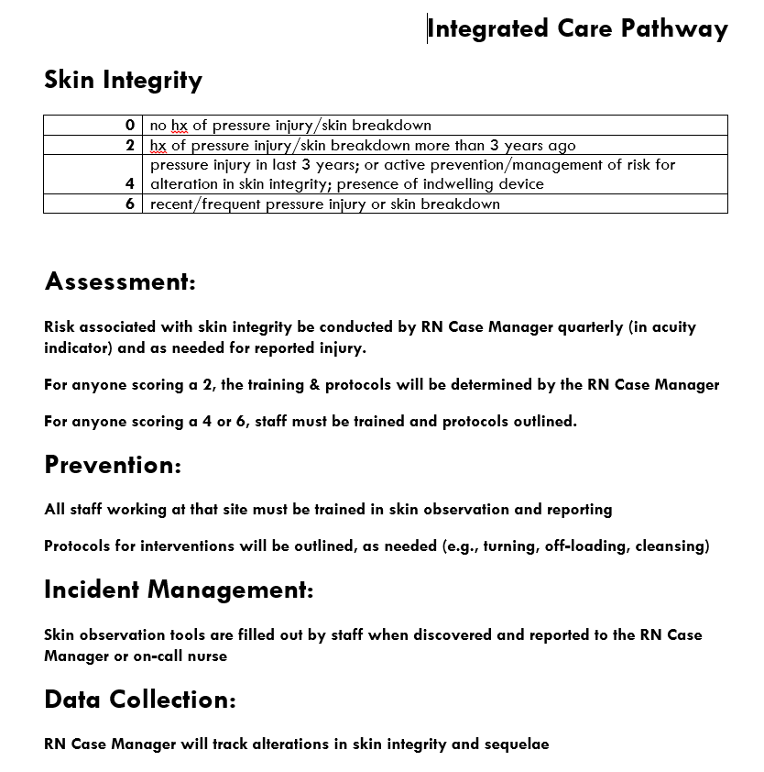
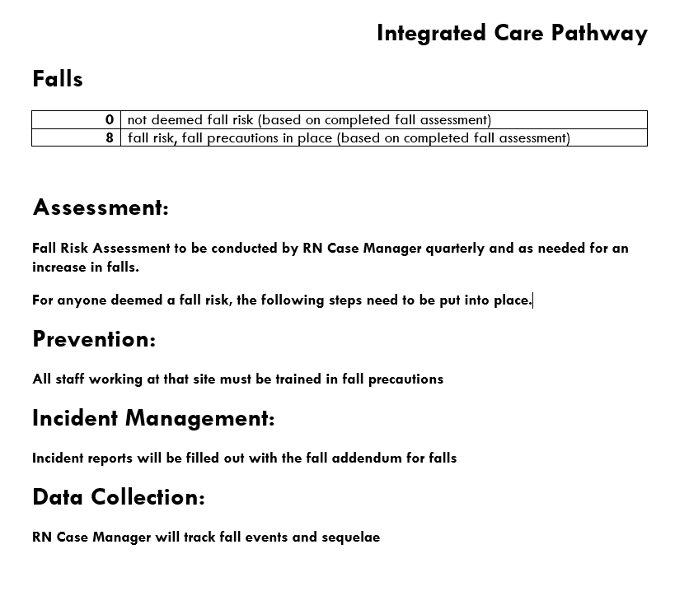
SAMPLE PATHWAYS

Slide 19
DISCUSSION
NEXT STEPS
Clinical pathways were developed for each area assessed in the acuity tool because once a risk is identified, the Nurse Case Manager needs to activate interventions.
  The team needs to identify what other events require pathways – what happens because we have done this before instead of because we have a standardized plan?
  Convert human capital to structural capital
ADDITIONAL FACTORS: QUADRUPLE AIM
Some factors are not so easily measured.
Examples: Is there a leadership vacuum in another part of the team? Is there a relatively stable patient but a family member that does not feel secure?
These factors require human discretion, but with a standard measurement of the patient, and a standardized list of supports, the supervisor can make an informed decision about where to apply resources to support both the patient and the Nurse Case Manager.

Slide 20
ACKNOWLEDGEMENTS
Many thanks to
- the Salem State N845, N742, N900/901 MSN Students and Faculty
- the Northeast Arc Nursing and Residential teams
- the ANA Mentorship Class of 2021, Camela Townsend, DNP, MS/MBA, RN

Slide 21
Select References
Covell, C., Sidani, S. (2013). Nursing intellectual capital theory: Implications for research and practice. OJIN: The Online Journal of Issues in Nursing 18(2) doi: 10.3912/OJIN.Vol18No02Man02
Leonard, M., Miller, E., & Llewellyn, A. (2012). Nursing case management: Review and resource manual (4th ed.). Silver Spring, MD: American Nurses Credentialing Center.
Roussel, L., Harris, J. L., & Thomas, P. L. (2020). Management and leadership for nurse administrators. Jones & Bartlett Learning.
Wagner E. H. (1998). Chronic disease management: what will it take to improve care for chronic illness? Effective clinical practice: ECP, 1(1), 2–4.

