Slide 1

INCREASING ACCESS TO HOSPICE CARE:
Adapting a virtual consent, patient intake, and consumer education tool to meet unique needs at end of life
PATRICIA RAMSDEN RN,BSN,CHPCA, MSN '2021
This Photo by Unknown author is licensed under CC BY.

Slide 2
BACKGROUND AND SIGNIFICANCE
Problem Statement
Due to increased COVID19 restrictions of families to visit patients in hospitals, long term care and assisted living facilities both health system and social structure obstacles arose in obtaining the prior system of utilizing signed paper consent forms in person necessary to elect hospice care.
According to the National Hospice and Palliative Care Organization (NHPCO), median length of stay for hospice patients is 18 days.
Delays in accessing care further contributes to additional pain and symptom burden, unnecessary treatments and separation from loved ones at end of life.

Slide 3
STAKEHOLDERS: Health and Community
Patients
Families, Friends , Caretakers and/or Social Supports
Referral Sources: Current Care Team at hospital, LTC, SNF, etc.
Insurance Companies
Hospice organization as a whole
Intake , Admission, Quality, Medical records, Compliance and Education
Technology Development Partners
Patient/Family Advisory Council (PFAC)
Others

Slide 4
CURRENT ISSUES
Communication structures changed and were limited
Pandemic realigned priorities delaying and/or blocking standards of care
Delay in timely access to hospice when hospice benefit is six months
Added stressors to patients and families
Frustration for referral sources
Increased workload to hospice staff

Slide 5
PILOT OBJECTIVES
Adopt virtual electronic consenting process to be user friendly and accessible for patients, families and hospice staff
Access and admission to hospice will be timely ~ s0 critical hospice care begins
Pilot the new virtual tools and evaluate to identify barriers and quality improvements
Increase ease of use to patients, families, hospice staff, and others

Slide 6
METHODOLOGY: Program Development & Evaluation (MSN-Led)
Pilot program was developed to demonstrate to the organizational leaders the usefulness of virtual tools and data (subjective and objective) that display ease and timely access to hospice care
Conduct "useful" data collection and analysis on current status and identify areas for enhancement
Weekly project meetings with interdisciplinary team updates
Plan for pilot and dissemination roll outs to groups within organization ~ needs for sustainability

Slide 7
TIMELINE
Discussions began May 2020
Team assembled June 2020
Kickoff of workflow testing July 2020
Pilot initiated August 2020
Go Live for expanded user group December 2020
Product enhancement & plans for sustainability Spring 2021

Slide 8
USER SURVEY
Q1 Rate your experience with the electronic consent process (Likert, 1 - 5 )
Q2 Tell us about your experience with the electronic consent process (free text box)
At completion of using tool
Internal users given same survey
Patient /family
n = 106 users
4.8
of 5 “stars”
18.3% reply rate
Staff
n =
25 users
4.2
of 5 “stars”
67.6% reply rate

Slide 9
SAMPLE’S SURVEY RESPONSES (N = 131)
PATIENT /FAMILY USERS
STAFF USERS (Referral & Nurse @ n = 50)
“Extremely easy to use ; comprehensive welcome video made me feel less alone”
“Fairly straightforward”
“Helpful and clear”
“Easy to follow”
“Pretty confusing”
“Makes things more difficult for patients and families”
“Easy to use but needs some improvement”
“Very helpful to be able to edit if the Dr. or date of admission change ”
“Didn’t think I 'd be comfortable with it, but it's easy to use”

Slide 10
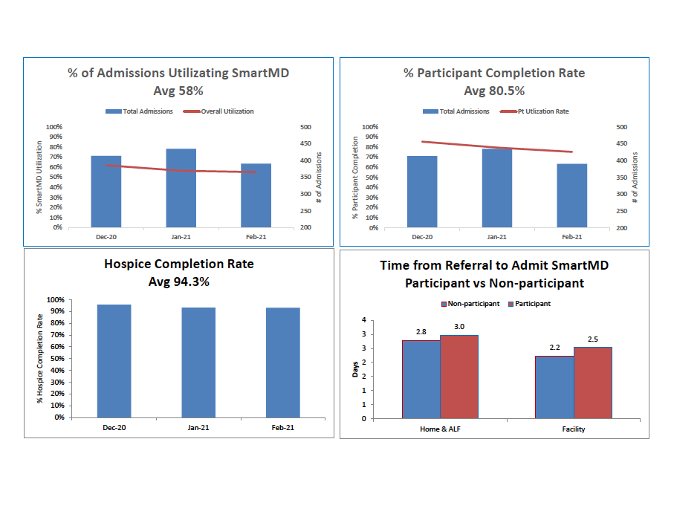

Slide 11

LESSONS LEARNED
Training , roll out and adoption to select staff took longer than expected
Opportunities exist to get current staff "buy-in" as shown by survey comments
Data analysis overview with stakeholders was needed to identify barriers, opportunities for improvement and enhancements of product
Biweekly meetings were necessary to keep stakeholders engaged and to identify workflow concerns
Realization that process remains "ongoing" and needs adaptation with any change in staffing structure or integration of new technology for sustainability
This Photo by Unknown author is licensed under CC BY.

Slide 12

This Photo by Unknown author is licensed under CC BY-SA-NC.

Slide 13
SELECT REFERENCES AND RESOURCES
Fuller, J.B., & Theofilou, B. (2021, March 4)”Are your managers in sync with your change strategy?” Harvard Business Review . Retrieved April 24, 2021 from https://www.hbs.edu/covid-19-business-impact/citations/are-your-managers-in-sync-with-your-change-strategy.
Roussel, L. A. ,T., Thomas, P. L. & Harris, J. L. (2020). Management and leadership for nurse administrators (8th ed.). Jones & Bartlett Learning.
Ruland, C. M., Moore, S. (1998). Theory construction based on standards of care: A proposed theory of the Peaceful End of Life. Nursing Outlook, 46( 4) 169-175.
https://www.nhpco.org/hospice-facts-figures/
https://hbr.org/2021/03/3-ways-to-humanize-the-virtual-health-care-experience
Link to tool we are using: https://www.smartmd.com/patient-admissions/

