Slide 1
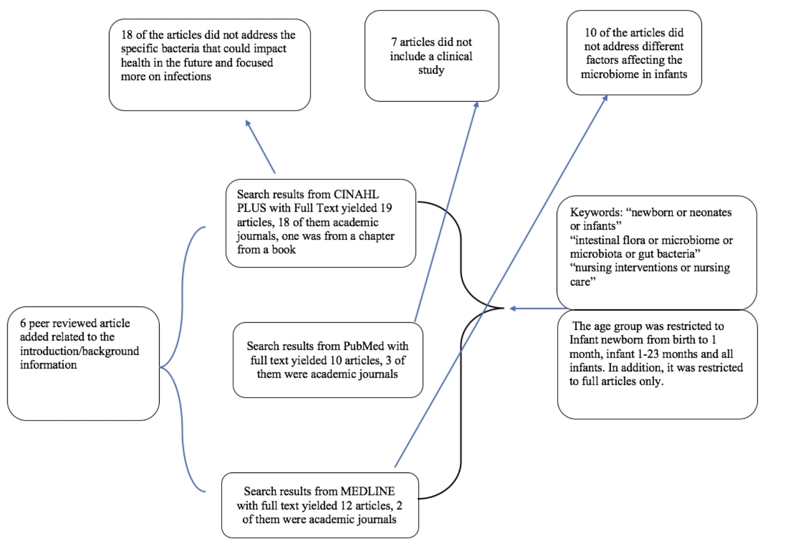
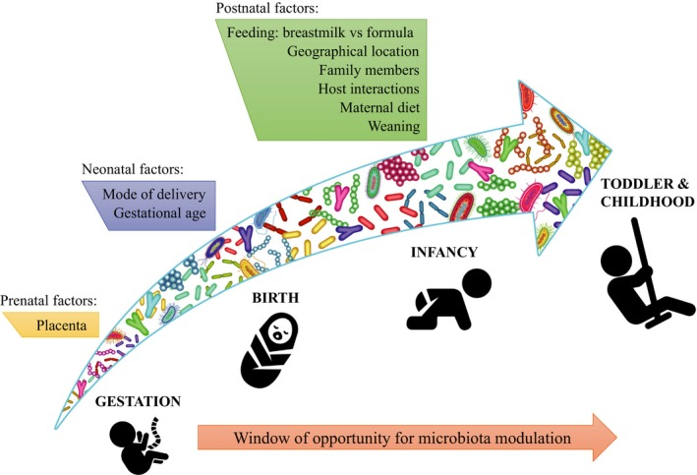
The Significance of the Microbiome: It's Role in Infant Development and Long-Term Health
Lariza Haro
Salem State University School of Nursing
Abstract
Methods
Conclusion
Humans enjoy a beneficial symbiotic relationship with bacteria. Although commonly thought to be the cause of illness, bacteria aid in food digestion along with creating resistance to disease. The microbiome refers to the aggregate of bacteria that reside in our intestinal track. There has been an effort over the past decade to map the human microbiome in order to identify this relationship. Given this crucial role of microbiota in human health, it is important to know how the microbiome is formed in infancy as it may impact one’s future ability to obtain wellness.
A review of the literature was done to examine what is known of the microbiome at the earliest stage of life and the relationship to issues later in life. The articles were identified using the databases CINAHL, PubMed, and MEDLINE. Five themes were identified across the articles studied. The microbiome: (a) of preterm infants differs from full-term infants; (b) at birth is found in both the lungs and intestines; (c) development is affected by an infant’s intake of formula vs. breastmilk; (d) present and its amount present during infancy may influence the risk of developing behavioral issues; (e) development is altered when antibiotics are administered to newborns/infants.
The choices of how a child will be fed is decided during pregnancy and consideration of the microbiome and its effect on future health has serious implications. Knowledge of the microbiome’s role in healthy growth and development should be considered when working with expectant mothers, parents and families of newborns.
A systematic review of the literature was utilized in order to identify the necessary components needed in early microbiomes and which factors play a role in affecting it. The databases referenced in this systematic review included the Cumulative Index of Nursing and Allied Health Literature (CINAHL) Plus, PubMed, and MEDLINE.
Utilizing a Boolean search, the following keywords were inserted in the search engine: newborn, neonate, infant, microbiome, microbiota and intestinal flora. Boolean operators such as “or” and “and” were utilized between the key words to ensure that articles with those terms that might be deemed important were not excluded.
The role that the microbiome plays in an infant ’s immediate and long term health is something that must be emphasized not only to pediatric and delivery nurses, but expecting mothers and families as well. More focused interventions aimed at the microbiome should be performed by nurses on a unit to ensure that the child is receiving the necessary microbes to establish their healthy microbiome.
Not only are we concerned with immediate health, but long term concerns such as behavioral issues and developing illnesses such as asthma. As healthcare providers, ensuring health continuity is one of the objectives in client care. We can provide this through microbiome-focused care to ensure adequate bacterial strains and a healthy microbiota composition in an effort to avoid issues like cystic fibrosis, behavioral issues, and even allergies.
So little was known before about the role that the microbiome played in previous decades and health was believed to be influenced by external factors apart from our immune system. Instead, it has dawned upon us that our internal microbes may be the biggest players in affecting our health.
The microbiome present and its amount present during infancy may influence the risk of developing physical and behavioral issues
The microbiome’s influence on a child’s growth and development is shown not only in how the microbiome changes, but also in the levels when compared to children with a normal microbiome (Hoen, Loughman). In the incidence of children with cystic fibrosis, the gut microbiome is more relevant than that of the respiratory tract (Hoen) whereas for children with behavioral issues, the lower the microbiome levels, the higher the incidence (Loughman).
Behavioral issues can be seen in individuals who suffer from genetic or physiological disorders, the latter which can be influenced by microbiome composition as mentioned before. Preventing an altered microbiota composition from developing would help prevent the risk of behavioral issues seen later on.
The microbiome development is altered when antibiotics are administered to newborns/infants.
The use of antibiotics to treat illness also results in a change in the microbiome (Huda, Loughman). The earlier antibiotics are used in treatment, the greater the risk of an altered microbiome (Loughlan).
Neonatal antibiotic exposure is associated with lower levels of microbiota. This is evident given that the purpose of an antibiotic is to reduce/eliminate unwanted bacteria but in the process also reduces/eliminates necessary strains such as “B.bifidum, B. breve, B. lactis and B. longum” (Forsgen 2017).
Background
An essential term to define is the microbiome. This term, often interchangeable with microbiota, intestinal flora, and gut bacteria, refers to the array of microbes/strains of bacteria found within the gastrointestinal track of the human body (Gritz 2015). These microbes come from exposures in the environment such as being vaginally born, exposures to different foods, owning/interacting with animals such as pets, and even living in different parts of a country.
It comes to our understanding that the colonization of the microbiome and the final composition will help predict what health issues can arise in the future and thus what characteristics we can alter to prevent illness. As we grow and develop, our microbiome develops throughout life as well and is influenced by a number of factors.
Results
Discussion
The microbiome of a preterm infant differs from full-term infants
The microbiome is not the same in preterm infants as it is if these infants were delivered at full-term (Korpela, Forsgren). Preterm infants have an underdeveloped microbiome in comparison to their full-term counterparts. Narrowing the gap of the microbiome in these two infant groups can take as long as 6 months (Forsgren). Over the course of the first few months of life, it is evident in preterm infants that care directed towards the infant microbiome is vital to catch up with full term infants.
The microbiome at birth is found in both the lungs and intestines
Development of the microbiome is determined not only by gestational age, but also is impacted by strains of microbes within the body and where they are found (Hoen, Korpela).
The incidence of cystic fibrosis and exacerbations early in life, are associated with the presence of bacterium that are found in the gastrointestinal tract but not found in the respiratory tract (Hoen). This indicates that despite differences in the microbial composition of the lungs and intestines, the microbiome variability between the two is not always correlated with diseases such as cystic fibrosis but our GI tract becomes most responsible in the development of diseases in life.
The microbiome development is affected by an infant’s intake of formula vs. breastmilk
A factor in both infant development as well as microbiome development is the means by which the child is fed. An important determinant of a healthy microbiome is breastfeeding of the child rather than being formula fed (Hoen, Korpela, Loughman). Breastfeeding promotes healthy microbiome development (Korpela), and is an important determinant of microdiversity in the respiratory tract (Loughman). The gut microbiota develops rapidly during infancy and changes as the child transitions to solid food (Loughman).
The difference in microbiome composition between full term and preterm infants highlights the need to provide interventions for preemies in order for them to reach the same microbiome development as that of full term infants.
Difference in diversity found within the microbiota in the lungs and the GI tract may not necessarily lead to health issues but the GI tract microbiota composition was the one to have the most effect on an infant’s health. Should the differences begin to increase however, it can cause health issues later on.
Intake of breast milk has proven to be of the utmost importance to establishing a healthy microbiota despite formula trying to mimic its affects and impacts. The more exposure to the necessary microbes in early life, the better development of the microbiota becomes and in turn enhances a healthier life. Breastfeeding was one of the most important findings in the role of the microbiome development.
A diverse and abundant microbial composition is wanted in order to mitigate the risks of behavioral issues down the line and healthcare workers should work with families to ensure this. Ensuring bacterial strain abundance would help in the risk reduction of behavioral issues that can often be seen in individuals with physiological disorders. While microbes can be found all over the body, they work together in communicating and ensuring microbial abundance can help mitigate both disease and behavioral issues later on in life.
Antibiotic use is a concern for full-term however the risk of infection is often lower than that of preemies who require longer hospitalizations and possibly invasive procedures. This is a further indication to closely examine the need for antibiotic administration.
Acknowledgements
I would like to thank my faculty advisor, Dr. Nancy Ebersole for her overwhelming support, guidance and patience while working on this thesis. I would like to thank her for the hard work in her advising given the difficult circumstances of this semester.
Thank you Dr. Scott Nowka for your guidance throughout the years of my academic career at Salem State.
And lastly I would like to thank my friends and family for their support throughout my academic career.
The aim of this literature review is to identify what we know about the microbiome from birth, how the microbiome affects future health and wellness and what can we do to ensure a healthy microbiome to reduce the risk of illness across a lifespan.

