Slide 1

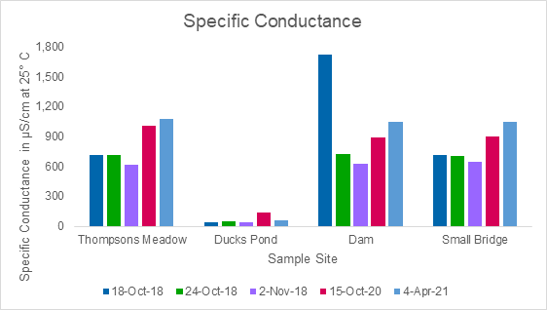
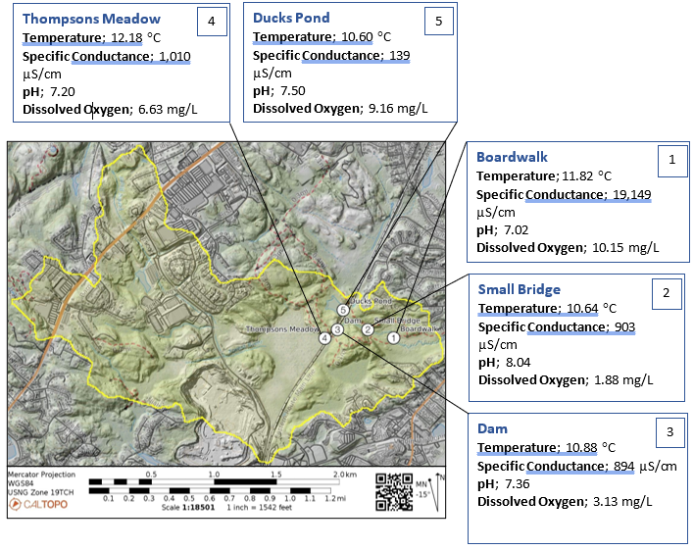
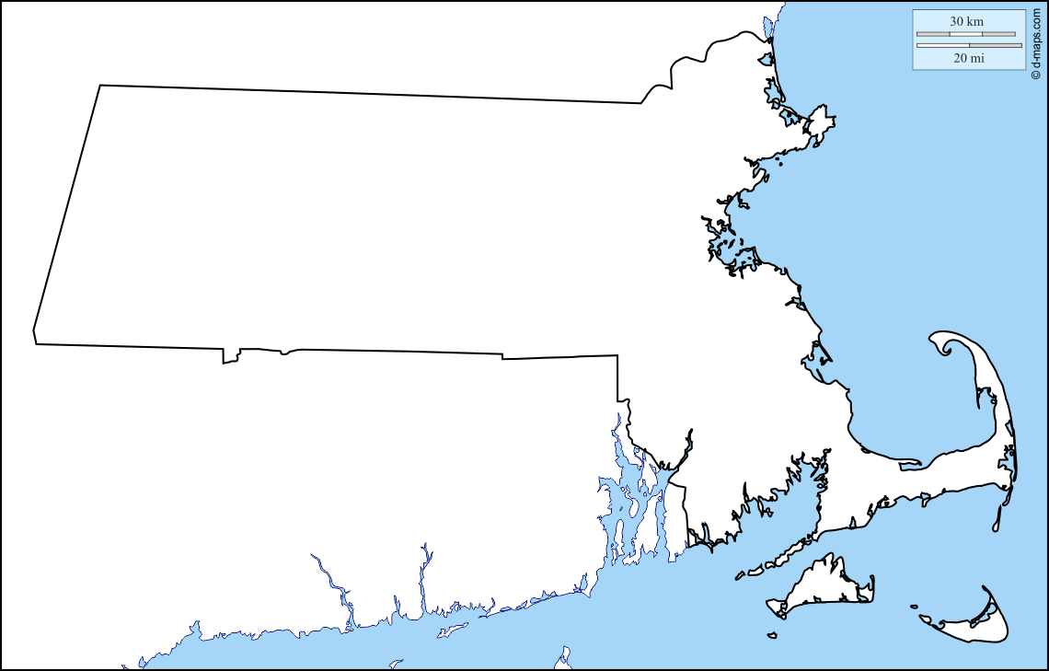
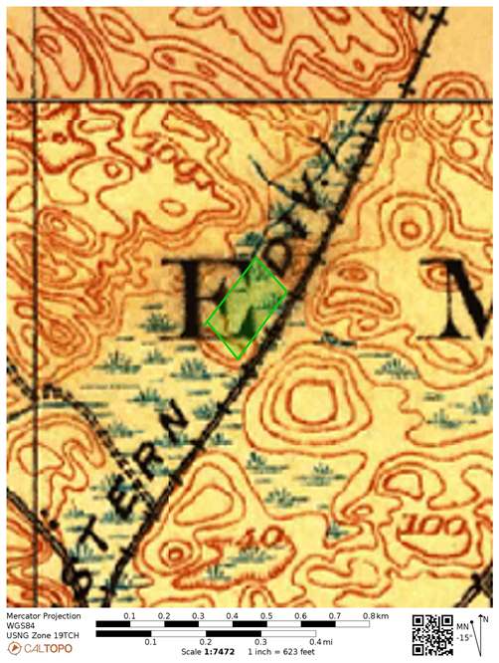
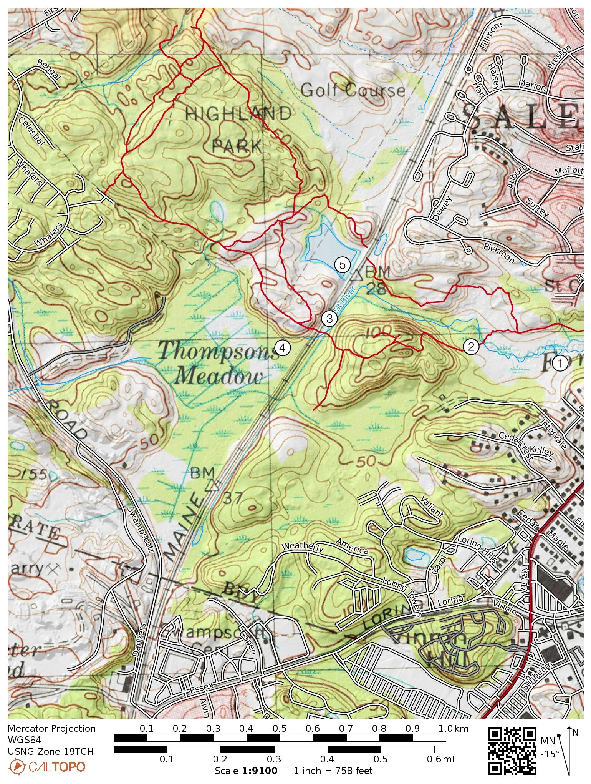
The Evolution of the Forest River Water Quality Due to Anthropogenic Impacts
Brianna Reid, Douglas Allen, Lindley Hanson (Department of Geological Sciences, Salem State University)
Introduction: The focus of this study is the variations in specific conductance within the Forest River watershed, Salem, MA. The area is characterized by harsh winters with often significant snowstorms, warranting the regular use of deicing agents causing significant contamination of local watersheds. Samples obtained from various water bodies in the Forest River watershed, contained high concentrations of Cl- ions with the exception of Ducks Pond, indicating it is hydrologically separated from other ponds in the watershed. This study is a continuation of previous work. See Fig 2. for summary of data.
Methods:
Specific Conductance in (µs/cm) was measured using a multiparameter sonde at locations in Fig. 1 and Fig. 2
The watershed was defined using StreamStats and then reevaluated using lidar and topographic maps.
Graphical representation of data was used for comparison
Hypothesis: The low specific conductance measured at Ducks Pond is hypothesized to be the result of natural isolation by topographic highs, in combination with a railroad embankment that effectively cut off the pond from the rest of the watershed which is exposed to runoff from developments.
Figure 2. This graph focuses on specific conductance measured at 4 of the 5 test sites on various dates in 2018, 2020, and 2021. Notice the dramatic difference between the specific conductance measured at Ducks Pond from all other locations.
A
B
Results: All results are consistent with the data from 2018, and support the hypothesis that Ducks Pond is a subwatershed, which has been isolated from pollution both naturally and as a result of construction of the Boston and Maine Railroad embankment in the late 1800’s. The elevated specific conductance measured for the Boardwalk in October (Fig. 1) was correlated to high tide, which was found to be the only area of study affected by the tides. All dates excluding October 23, 2020, average a specific conductance of 1,092 µs/cm which is similar to all other test sites.
Figure 1. Locus map of the Forest River watershed, outlined in yellow. Numbers represent locations where samples were taken. The individual data tables surrounding the map show the data collected at each location in October; 2020.
Figure 3. This figure shows the extent of development over the last 100 years. Fig. 3A is a historic map from the late 1800’s. The location for Ducks Pond is outlined in green. Fig. 3B is present day. Urbanization of the area has led to significant pollution of all water bodies in the Forest River watershed, except for Ducks Pond. One might predict that the upland East of Ducks Pond would be a major source of pollution. However, the low specific conductance indicates the pond is hydrologically isolated from that development by the railroad embankment. Predicted direction of runoff is represented by the black arrows.

