Slide 1

Comprehensive Implementation of Trauma informed Care in Medical Settings:
A Preliminary Framework
Phase One
Presented by – Martine Geary-Souza
May 2022
Salem State University – School of Social Work

Slide 2


Background
Importance
High prevalence of Trauma in the United States – ACE’s Study indicates around 61% of adults have experienced at least one ACE.
  Around 1 in 6 have experienced four or more types (Centers for Disease Control [CDC], 2021)
  Estimated 1 in 4 children will experience mistreatment or trauma in their lifetimes (CDC, 2020)
Childhood trauma & trauma in general has been linked to several negative health outcomes
The impact of stress on the human body is well known in medicine

Slide 3
Background Cont.
Themes
Need for Training
  Lack of ability to identify past or ongoing trauma in patients (Ertl et al., 2020)
  Lack of ability to assess and deliver appropriate and adequate TIC interventions
Increase Patient Involvement
  Successful TIC must include high levels of patient input surrounding medical choices and overall care process (Koyoki, Klest, & Anstey, 2021)
  Patient empowerment & provider collaboration with patients seen as core component to TIC (Substance Abuse and Mental Health Services Administration [SAMSHA], 2014)

Slide 4

Background Cont.
Themes cont.
Systemic & Collaborative Approach
  Effective integration of TIC incorporates individuals at all levels of the organization – front line, middle management and upper-level management (Burton, 2021)
  This approach is essential to organizational success.
Lack of Cohesive Information
  Past studies revealed that a lack of standardized or cohesive information on implementing TIC for medical professionals was a barrier
Addition of Medical Trauma
  This study seeks to include an understanding of the potential impact of medical trauma on patients

Slide 5

Purpose of Study
To determine the current baseline knowledge of Trauma Informed Care (TIC) in medical settings
To have this information provide a base of knowledge to create a framework for medical professionals to implement and evaluate TIC on an ongoing basis

Slide 6
Hypotheses
Predicted (1) a low baseline knowledge of TIC
Predicted (2) Improvement of TIC will require increased training surrounding the identification of trauma & handling disclosure as well as increased awareness of current info regarding TIC
Predicted (3) Individuals with a personal history of trauma will show higher levels of competency in TIC
Predicted (4) current knowledge lacks information regarding the biological, neurological, and physiological impact of trauma

Slide 7
Methods
Participants recruited using convenience snowball sampling and personal contacts (social media, email, etc.) for anonymous survey on SurveyMonkey
  INCLUSION CRITERIA – over 18 years of age and working in the medical field (either as a provider or administrator)
17 Participants completed the survey
Majority ages 25-34, and 45-54 (35.29%, n=6)
  Ages 18-24 (5.88%, n=1)
  Ages 35-44 (17.65%, n=3)
  Ages 55-64 (5.88%, n=1)
Majority Identified as Women (76.47%, n=13)
  Man (17.65%, n=3)
  Non-Binary (5.88%, n=1)
Majority did NOT have a personal history of trauma (64.71%, n=11)
  Reported personal history of trauma (29.41%, n=5)
  Prefer not to disclose (5.88%, n=1)
Majority were Physicians or M.D’s (41.18%, n=7)
  Nurse Practitioners (17.65%, n=3)
  Nurse (BSN or LPN) (29.41%, n=5)
  Administration (5.88%, n=1)
  Other – specified as neurological rehab (5.88%, n=1)
Years of experience in the field ranged from 1-30 years
  Mean: 18.75 years (Std. Deviation: 15.9)

Slide 8
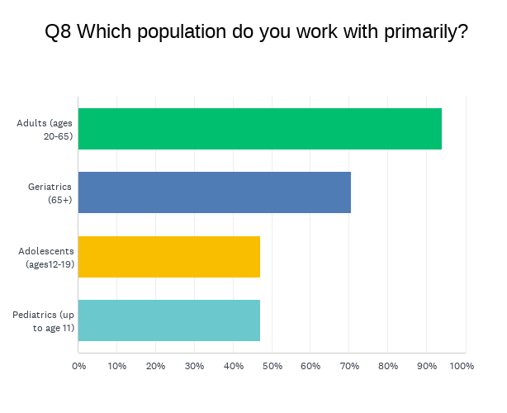
Methods cont.
Participants
Participants were asked their specialization via open response question
  Most answered “primary care” or “internal medicine”
  Other answers included
    Pediatrics
    Cardiology
    Emergency medicine
Participants were asked what age group they worked with (pictured in chart to the right)
  Majority Adults (Ages 20-65) (94.12%, n=16)
  Geriatrics (65+) (70.59%, n=12)
  Adolescents & Pediatrics (47.06%, n=8)

Slide 9
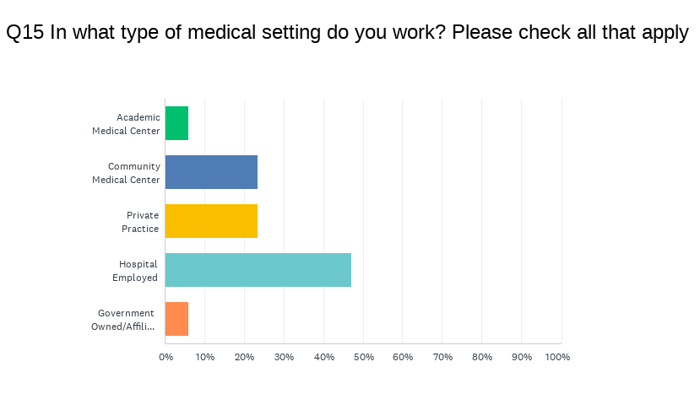
Methods cont.
Participants
Type of Medical Setting
  Majority were Hospital Employed (47.06%, n=8)

Slide 10

Measures
Prevalence of Trauma in Practice
  Likert scale, 1=Not Prevalent (less than 25%) to 4= Very Prevalent (more than 50%)
Familiarity with TIC
  Open Response – “What does TIC mean to you?”
  Multiple Choice
    Yes (62.50%, n=10)
    No (37.50%, n=6)
Received Previous Training Regarding TIC
  Multiple Choice
    Yes (11.76%, n=2)
    No (88.24%, n=15)
Use of Basic TIC Interventions in the last (6) Months*
  Yes/No answer
  Ask patients to assess symptoms of distress; Provide information to family about emotional or behavioral reactions that indicate their family member may need help; Teach patient ways to cope with upsetting experiences, etc

Slide 11
Measures cont.
Competence and Comfort in Providing TIC*
  Likert scale, 1=Not Competent to 3=Very Competent
  Eliciting details of a traumatic event without retraumatizing patients; Understanding the scientific or empirical data behind assessment and intervention for traumatic stress; etc.
Barriers to Providing TIC*
  Likert scale, 1=Not barrier to 3=Significant barrier
  Time constraints; Getting training in trauma informed interventions and assessments; etc.
Understanding Necessity of TIC
  Likert scale, 1=Strongly Disagree to 5=Strongly Agree
  Individuals with trauma are more likely to experience psychological or emotional impacts of trauma than they are to experience physical impacts; There are effective screening tools in place for medical professionals to assess for past or ongoing traumatic stress; etc.

Slide 12
Measures Cont.
“Active Listening”
Asked to rate implementation of TIC in current work setting & likelihood to consider history of trauma in care plan
  Scale of 0-100
  Implementation: M= ~37% (SD=26.9)
    Range: 0-100
  Level of Consideration: M=69% (SD=22.9)
    Range: 27-100
Awareness of Secondary Traumatic Stress
  Yes/No response
    Yes (31.25%, n=5)
    No (68.75%, n=11)
Strategies to Build Trust with Patients
  Open Response
“Empathy”
“Therapeutic use of Self”

Slide 13
Results
Hypotheses (1) –
  Awareness of prevalence of trauma was higher than anticipated (M=2.53, SD=.98)
Hypotheses (2) –
  88% of participants had not received any formal training (n=15)
  Around 30% of participants reported they were not competent in understanding information regarding trauma and trauma interventions were confusing (n=5)
Hypotheses (3) –
  Differences in mean competency scores of individuals with a trauma history (M=10.80, SD=4.49) versus individuals without (M=9.91, SD=2.91) were not statistically significant.
Hypotheses (4) –
  Responses indicated a lack of awareness of the long-term physiological impact of trauma

Slide 14
Results Cont.
Overall Competency in Practicing TIC
  Competency score calculated from 10 variables using SPSS software – mean score: 10.18 (SD=3.25)
    Min – 6
    Max - 18
Understanding Necessity of TIC
  Total score calculated from 5 variables using SPSS software – mean score: 19.17 (SD=2.37)
    Min – 16
    Max - 25

Slide 15
Discussion
Limitations
Strengths
Small sample size makes it difficult to do inferential statistics
Implicit bias from respondents – individuals interested in trauma more likely to complete survey
Limited understanding of current knowledge through survey instrument
TIC Provider Survey is a validated survey instrument
Intention to go farther than previous studies with defining TIC for medical professionals
  Further data collection of Phase One
  Phase Two – focus groups with patients
  Pelvic Exam Practice Standard Study

Slide 16
Preliminary Framework
The Comprehensive Approach
Interdisciplinary and Intradisciplinary collaboration
Systemic organizational involvement
Treating the “whole person”
Patient Engagement
Screening & Identification of trauma
Forming collaborative relationships with patients & building trust
Handling disclosure appropriately
Knowledge & Awareness of Trauma
Understanding the prevalence and importance of a history of trauma in patient history
Knowledge of trauma = an increased ability to provide preventative care
Impact of Trauma & Secondary Trauma
Trauma on a chemical level
The impact of chronic & traumatic stress
The lifelong impact of developmental trauma
SECONDARY TRAUMA –
  Self care & Professional Boundaries
  Utilizing professional support

Slide 17
Acknowledgements
I would like to thank my co-researchers and authors – Neitza Sierra-Diez; Rebecca Vincent; and Samantha Pizzi.
To Professor Saltikoff for your support & guidance throughout this process
To Dr. Simmons for always pushing me to strive for more, and to my mentor at Boston Children’s - Dr. Frances Grimstad for giving me the opportunity to do this research.

Slide 18
References
Bendall, S., Eastwood, O., Cox, G., Farrelly-Rosch, A., Nicoll, H., Peters, W., Bailey, A. P., McGorry, P. D., & Scanlan, F. (2020). A systematic review and synthesis of trauma-informed care within outpatient and counseling health settings for young people. Child Maltreatment, 26(3), 313–324. https://doi.org/10.1177/1077559520927468
Burton, R. A., Epstien, M., & Dubay, L. (2021, August 7). Early adopters of trauma-informed care: An implementation analysis of the advancing trauma-informed care grantees. Center for Health Care Strategies. Retrieved December 16, 2021, from https://www.chcs.org/resource/early-adopters-of-trauma-informed-care-an-implementation-analysis-of-the-advancing-trauma-informed-care-grantees/
Campbell, C. (2021). Medical Violence, Obstetric Racism, and the Limits of Informed Consent for Black Women. Michigan Journal of Race & Law, 26, 47–75. https://doi.org/10.36643/mjrl.26.sp.medical
Cations, M., Laver, K., Couzner, L., Flatman, S., Bierer, P., Ames, C., Huo, Y., & Whitehead, C. (2021, September 10). Trauma-informed care in geriatric inpatient units to improve staff skills and reduce patient distress: A co-designed study protocol. BMC Geriatrics. Retrieved November 16, 2021, from https://bmcgeriatr.biomedcentral.com/articles/10.1186/s12877-021-02441-1.
Centers for Disease Control. (2021, April 6). About the CDC-Kaiser Ace Study |Violence prevention|injury Center|CDC. Centers for Disease Control and Prevention. Retrieved November 16, 2021, from https://www.cdc.gov/violenceprevention/aces/about.html.
Dueweke, A. R., Hanson, R. F., Wallis, E., Fanguy, E., & Newman, C. (2019). Training Pediatric Primary Care Residents in Trauma-Informed Care: A Feasibility Trial. Clinical Pediatrics, 58(11–12), 1239–1249. https://doi.org/10.1177/0009922819859868
Ertl, S., Bokor, B., Tuchman, L., Miller, E., Kappel, R., & Deye, K. (2020). Healthcare needs and utilization patterns of sex‐trafficked youth: Missed opportunities at a children’s hospital. Child: Care, Health & Development, 46(4), 422–428. https://doi.org/10.1111/cch.12759

Slide 19
References cont.
Green, B. L., Saunders, P. A., Power, E., Dass-Brailsford, P., Schelbert, K. B., Giller, E., Wissow, L., Hurtado de Mendoza, A., & Mete, M. (2016). Trauma-Informed Medical Care: Patient Response to a Primary Care Provider Communication Training. Journal of Loss & Trauma, 21(2), 147–159. https://doi-org.corvette.salemstate.edu/10.1080/15325024.2015.1084854
Harik, J.M., Hundt, N.E., Bernardy, N.C., Norman, S.B. and Hamblen, J.L. (2016), Desired Involvement in Treatment Decisions Among Adults with PTSD Symptoms. JOURNAL OF TRAUMATIC STRESS, 29: 221-228. https://doi.org/10.1002/jts.22102
Menschner, C., & Maul, A. (2021, August 7). Key ingredients for trauma-informed care implementation. Center for Health Care Strategies. https://www.chcs.org/resource/key-ingredients-for-successful-trauma-informed-care-implementation/
Stevens, N. R., Ziadnid, M. S., Lillis, T. A., Gerhart, J., Baker, C., & Hobfoll, S. E. (2019, July 25). Perceived lack of training moderates the relationship between healthcare providers’ personality and sense of efficacy in trauma-informed care. PubMed Central (PMC). https://www.ncbi.nlm.nih.gov/pmc/articles/PMC7076724/
Substance Abuse and Mental Health Services Administration (SAMSHA). (2014). Samhsa's concept of trauma and guidance for a trauma-informed approach. SAMHSA's Concept of Trauma and Guidance for a Trauma-Informed Approach | Youth.gov. Retrieved November 16, 2021, from https://youth.gov/feature-article/samhsas-concept-trauma-and-guidance-trauma-informed-approach.
Trauma-informed care implementation resource center. (2021, August 9). Center for Health Care Strategies. https://www.chcs.org/resource/trauma-informed-care-implementation-resource-center/
What is trauma-informed care? (2020, April 13). Trauma-Informed Care Implementation Resource Center. https://www.traumainformedcare.chcs.org/what-is-trauma-informed-care/
Widiger, T. A., & Oltmanns, J. R. (2017, May 12). Neuroticism is a fundamental domain of personality with enormous public health implications. PubMed Central (PMC). https://www.ncbi.nlm.nih.gov/pmc/articles/PMC5428182/

Slide 20
Questions?

