Slide 1
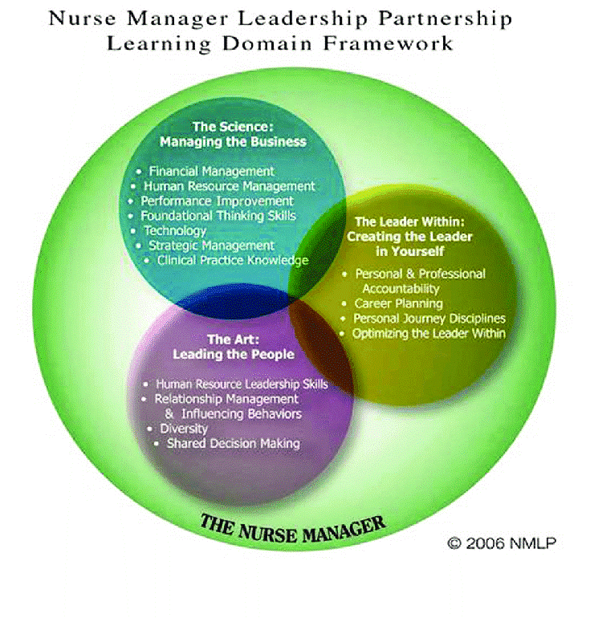
Ambulatory Nursing Leadership:
New Nurse Manager Residency Program
BACKGROUND & SIGNIFICANCE
Brie L Trefrey RN, BSN, DNC (MSN’ 2021)
Who are Nurse Managers & What do they do?
Serve as Change Agents
Mentor, Lead, Coach
Oversee unit-based operations
Personify role of nurse and leader
PROGRAM SPECIFIC AIMS
To develop a New Nurse Manager Residency Program aimed towards meeting the unique needs of leaders in outpatient settings.
Research warns that inexperienced Nurse Managers have a negative impact on the satisfaction and retention of Nurses under their supervision
Ambulatory Nurse Leadership Residency
Communication and Relationship building
Knowledge of healthcare environment
Leadership
Professionalism
Business Skills
Historically, Nurses exhibiting superior leadership skills were promoted into leadership positions without formal training
Leadership development among Nurse Managers can decrease nurse burnout, increase satisfaction, and avoid staff shortages
Methodology: Project Development (Stages) & Evaluation
11/2020 Review existing programs
Develop survey tool
5/2021 Survey new nurse managers
Develop content from data & identified gaps in learning opportunities
Implement ambulatory new leader residency
Evaluate ambulatory nurse leader competency
Refine program based on evaluations
References:
AONL Nurse Leader Competencies. AONL. (2015). https://www.aonl.org/resources/nurse-leader-competencies.
Coogan, E., & Hampton, D. (2020) How does a new nurse manager orientation program impact competency and empowerment. Nursing Management, 51(12), 22-27
Acknowledgements
Julia Edmondson, MSN, FNP-BC at MGH

