Slide 1
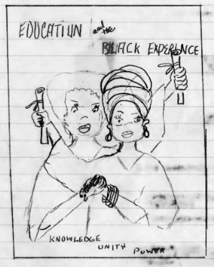
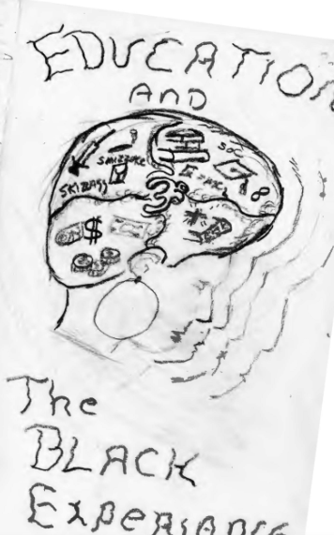
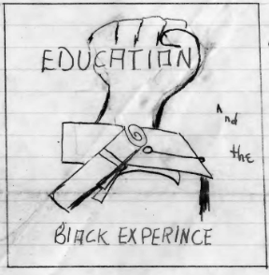
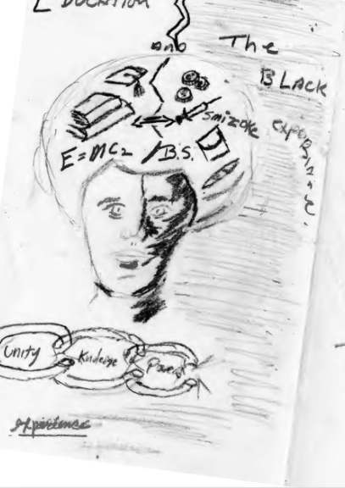
Representation of Black women in the faculty at Salem State University
By Morgan McCarthy & Camryn Willis
Sociology Department
SOC 403

Slide 2
Introduction
The Black community at Salem State University has advocated for a change in the lack of representation for decades. We have gathered archival data from Salem State University which provides us information from the past. We have taken current data from Black faculty and have compared it to the findings in the archives to fully understand the changes made over time.

Slide 3
Research Question
How has the lack of representation of Black women in the faculty of Salem State University changed over time with activism from the Black community at the school?

Slide 4
Literature Review
The overall themes found throughout the literature on this subject were gender segregation, lack of representation of Black faculty, and the consequences these have on students.
Research and Theory on Equality and Education by Lynch
The effect that equity has on students education
It is vital to a students success to have representation
Equitable Classrooms In a Changing Society by Cohen
Cohen found as society progresses, classes need to progress for students to reach their full potential
Classroom environments are important to student success
Discrimination, diversity, and Sense of Belonging: Experiences of students of color by Hussain
Students of Color reported feeling unsupported by their school
appreciated personal relationships between diverse peers, but found that the school did not
In Configurations of Inequality: Intersections of Gender, Class, and Race by Taylor & Francis
Overlapping of multiple oppressions from each identity
Black women in the faculty at Salem State have reported being discriminated against by both their gender and race
In Breaking the Connection: Occupational Gender Segregation and the Gender Wage Gap by Taylor & Francis
Occupational gender segregation as a cause of wage inequality & lack of representation
Future policies should be focused on economic equality first

Slide 5
Literature Review
The overall themes found throughout the literature on this subject were gender segregation, lack of representation of Black faculty, and the consequences these have on students.
In The Complexity of Working With White Racial Allies: Challenges for Diversity Educators of Color in Higher Education by Ridon
White allies are crucial in advocating for diversity in faculty in higher education
Afraid of changes that may affect their personal reputation
Challenging The Gendered Microaggressions in The Academy by Haynes-Brat
Microaggressions that women experience in the workplace and the bystander effect
Bystander action is critical in ending microaggressions
Afro-American collaboration with the Womens Caucus to work together against discrimination and microagressions
They're Moving in Spaces They’re Not Used To: Examining the Racialized Experiences of African American Students in High School STEAM Academy by Fletcher
African American students excelled a social justice centered education
Coping with racialized experiences to be more successful
Black students advocating for Black studies and an Afro-American Society

Slide 6
Research on Faculty Diversity at SSU
Campus Climate Assessment Project: Salem State University Report 2017 by Rankin and Associates Consulting
A survey sent out to the Salem State community to collect information about the academic environment with a specific focus on distribution of power and privilege
  21% of 3,086 responses to the survey were staff and administration
19% of People of Color and 21% of Multicultural respondents reported experiencing exclusionary, intimidating, offensive, and/or hostile conduct within the past year
Only 23% of People of color in the faculty reported feeling “very comfortable” with the campus climate

Slide 7
Methods & Data Collection
Archival Data Research
  Arthur Gerald Records
  Association of Black Faculty Administration
  Afro-American Society Records
  Affirmative Action Committee
We looked at over 20 research articles on the subject of women in professional faculty, Black women faculty, and gender segregation in occupations. We took the information within these as a guide to how we will structure our research by using outside information on the subject that already exists.
We also took information from the Salem State University archives ranging from the early 1960’s to late 1970’s to gather information about how representation of Black women in faculty has changed over time. We were also able to obtain information on how this lack of representation has affected Black students negatively.

Slide 8
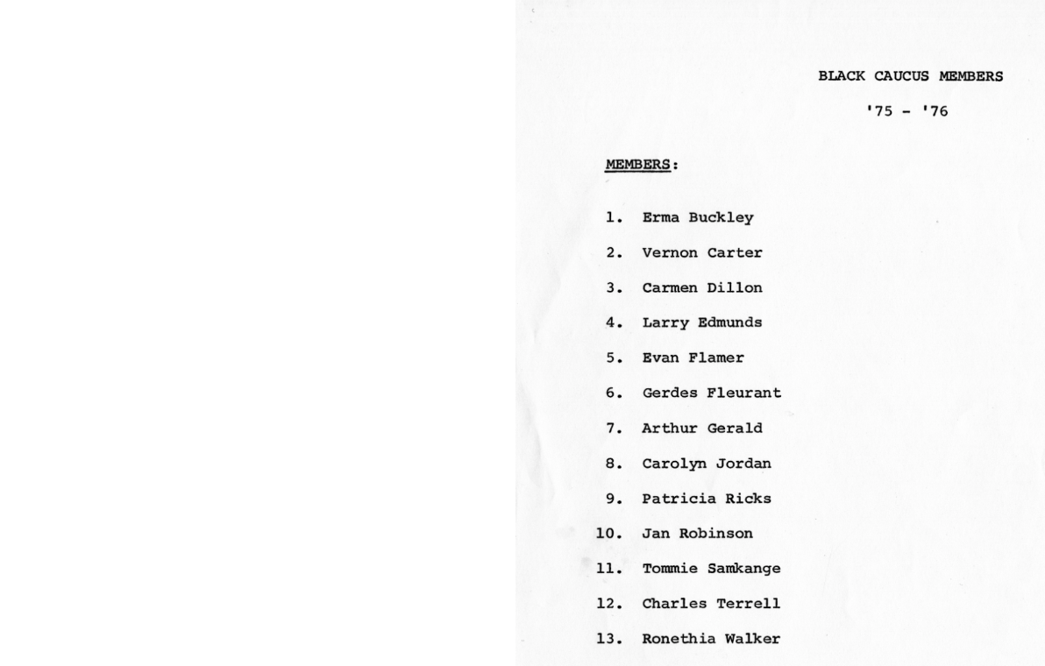
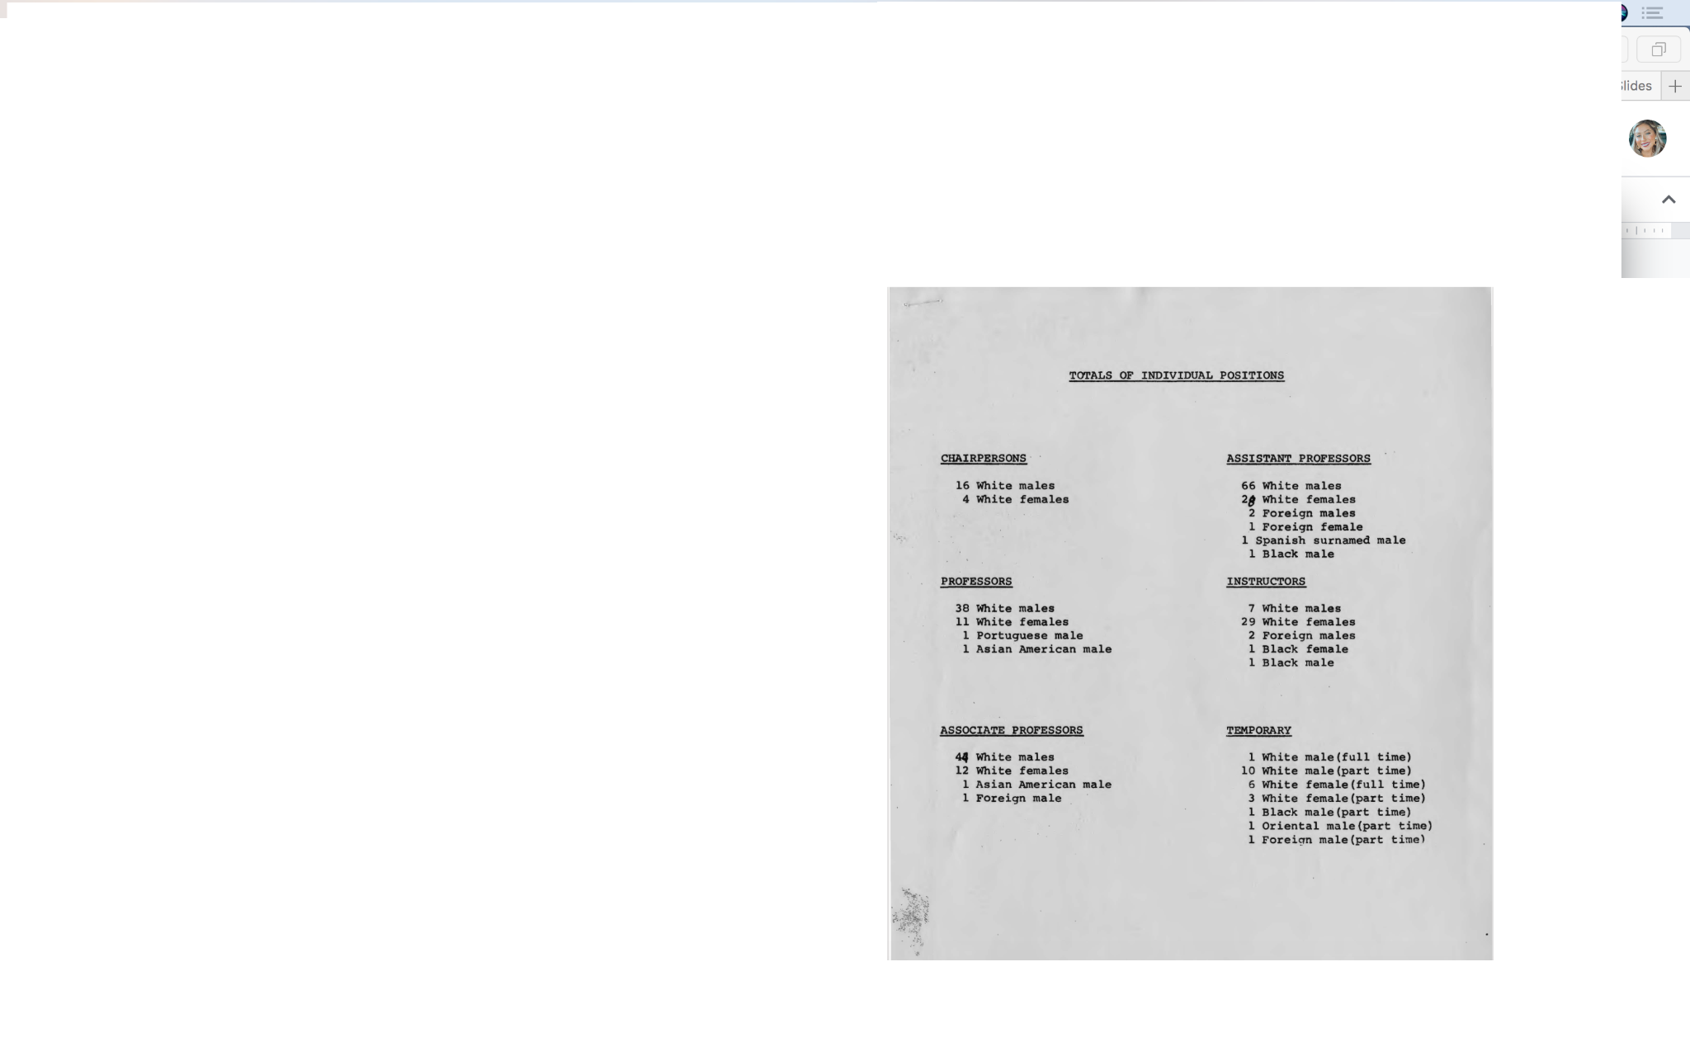
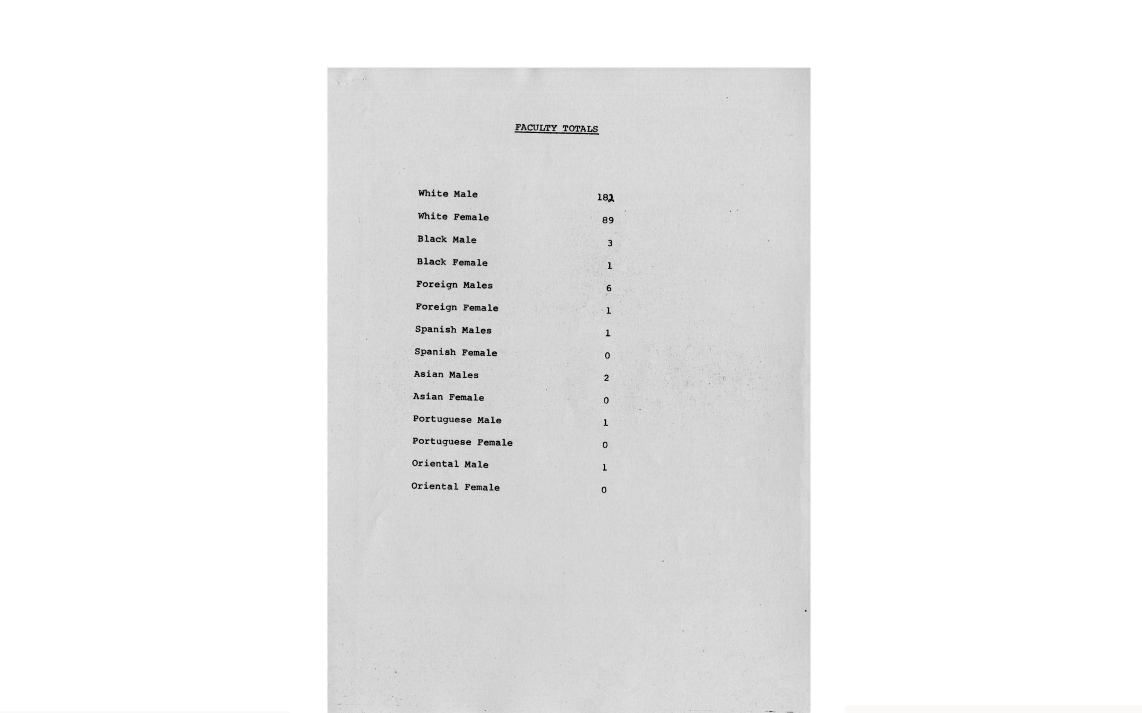
Lack of Black Professors
During the years of 1975-1976 Salem State only had about 13 Black professors, which we couldn’t figure out whom identified as female. Based upon the names given we can infer that 6 out of 13 members were female.

Slide 9
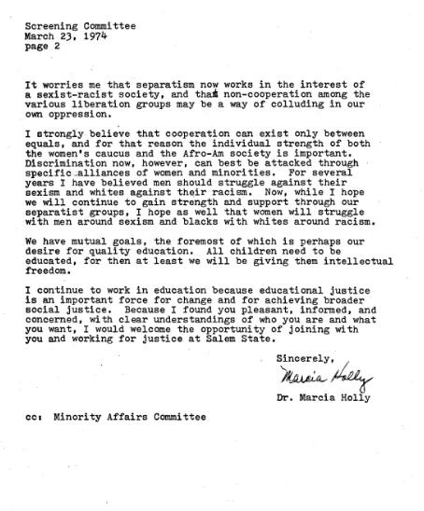
Beginning of Affirmative Action:
A Woman’s Experience
Dr. Holly advocates for Afro-American society and women caucus should work together as alliances as a way to combat discrimination
“I strongly believe that cooperation can exist only between equals, and for that reason the individual strength of both the women's caucus and the Afro-Am society is important. Discrimination now, however, can best be attacked through specific alliances of women and minorities.”

Slide 10
Beginning of Affirmative Action:
The Association of Black Faculty and Administration
The creation of The Association of Black Faculty and Administration
“To serve as the collective voice of Black faculty and administrators with regard to the general welfare of Black people at Salem State University.”

Slide 11
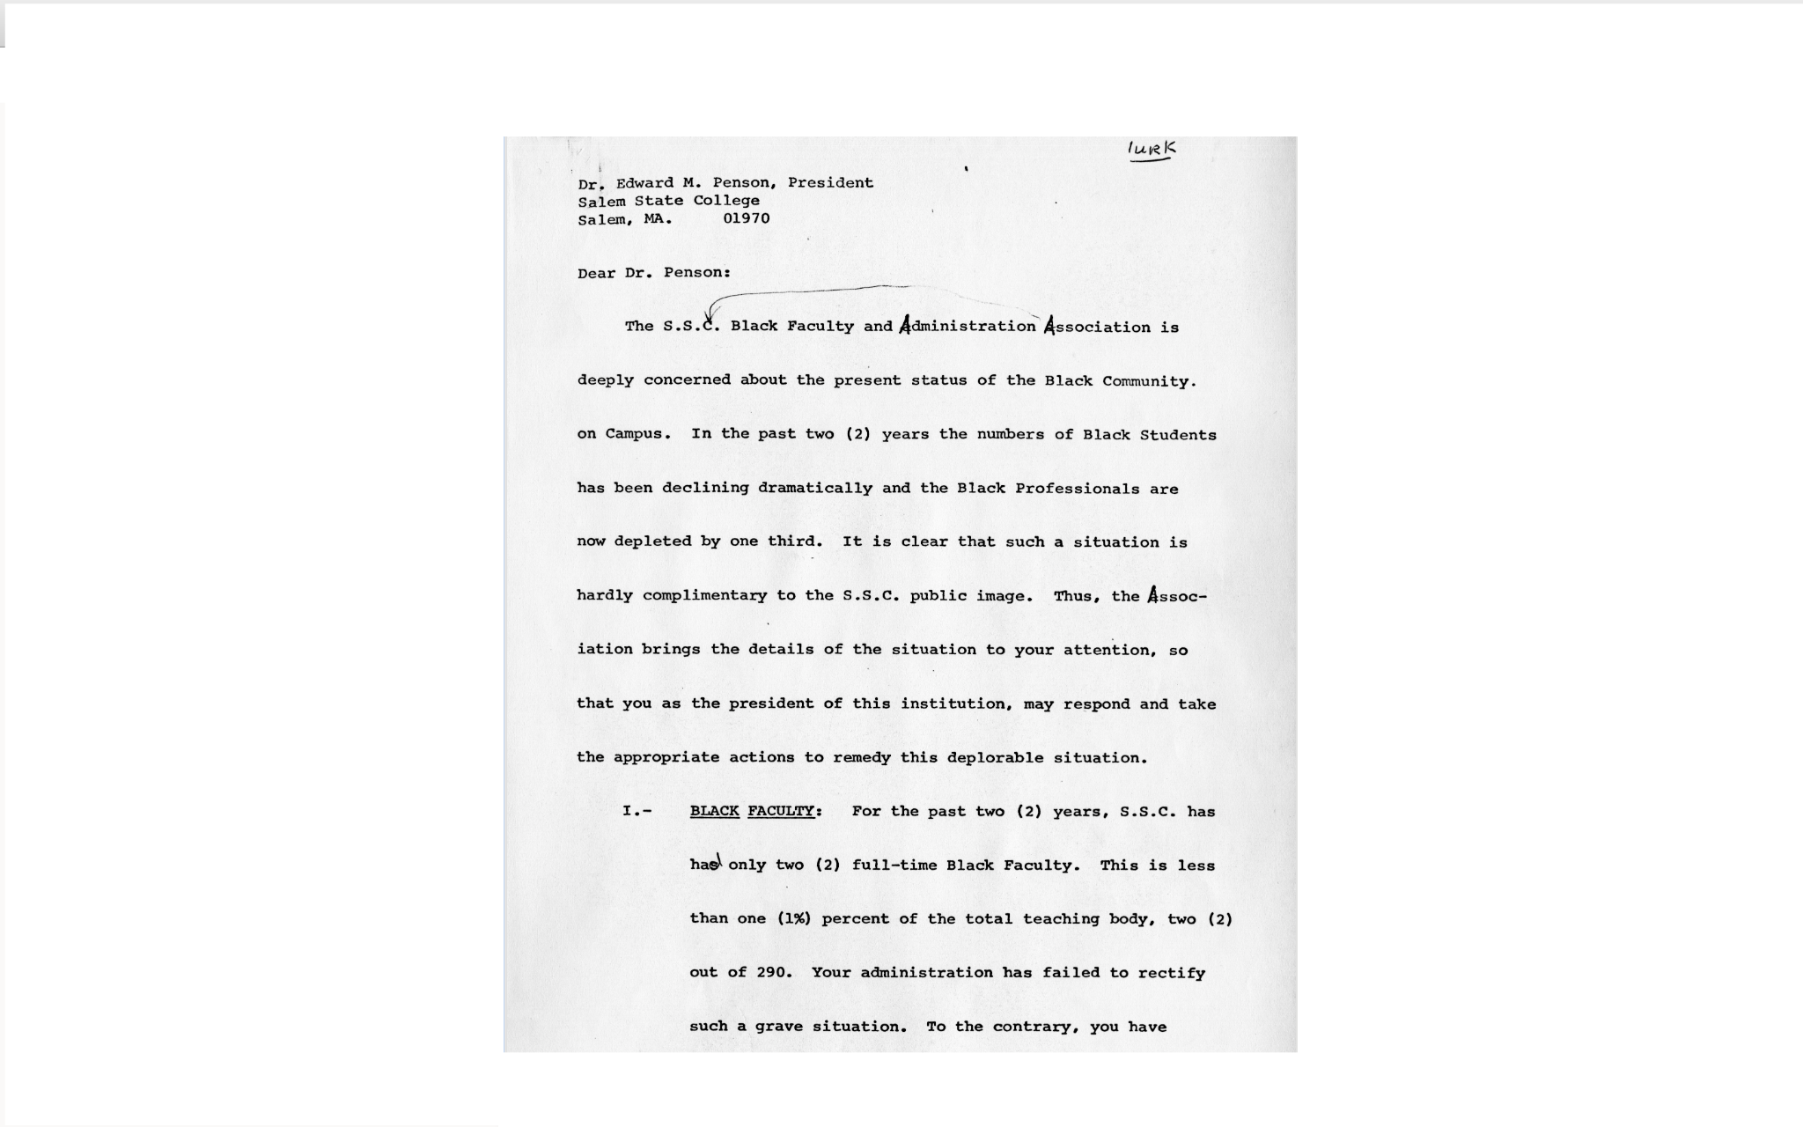
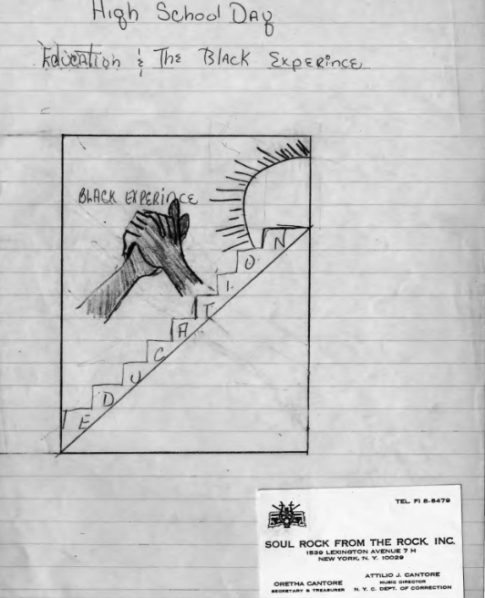
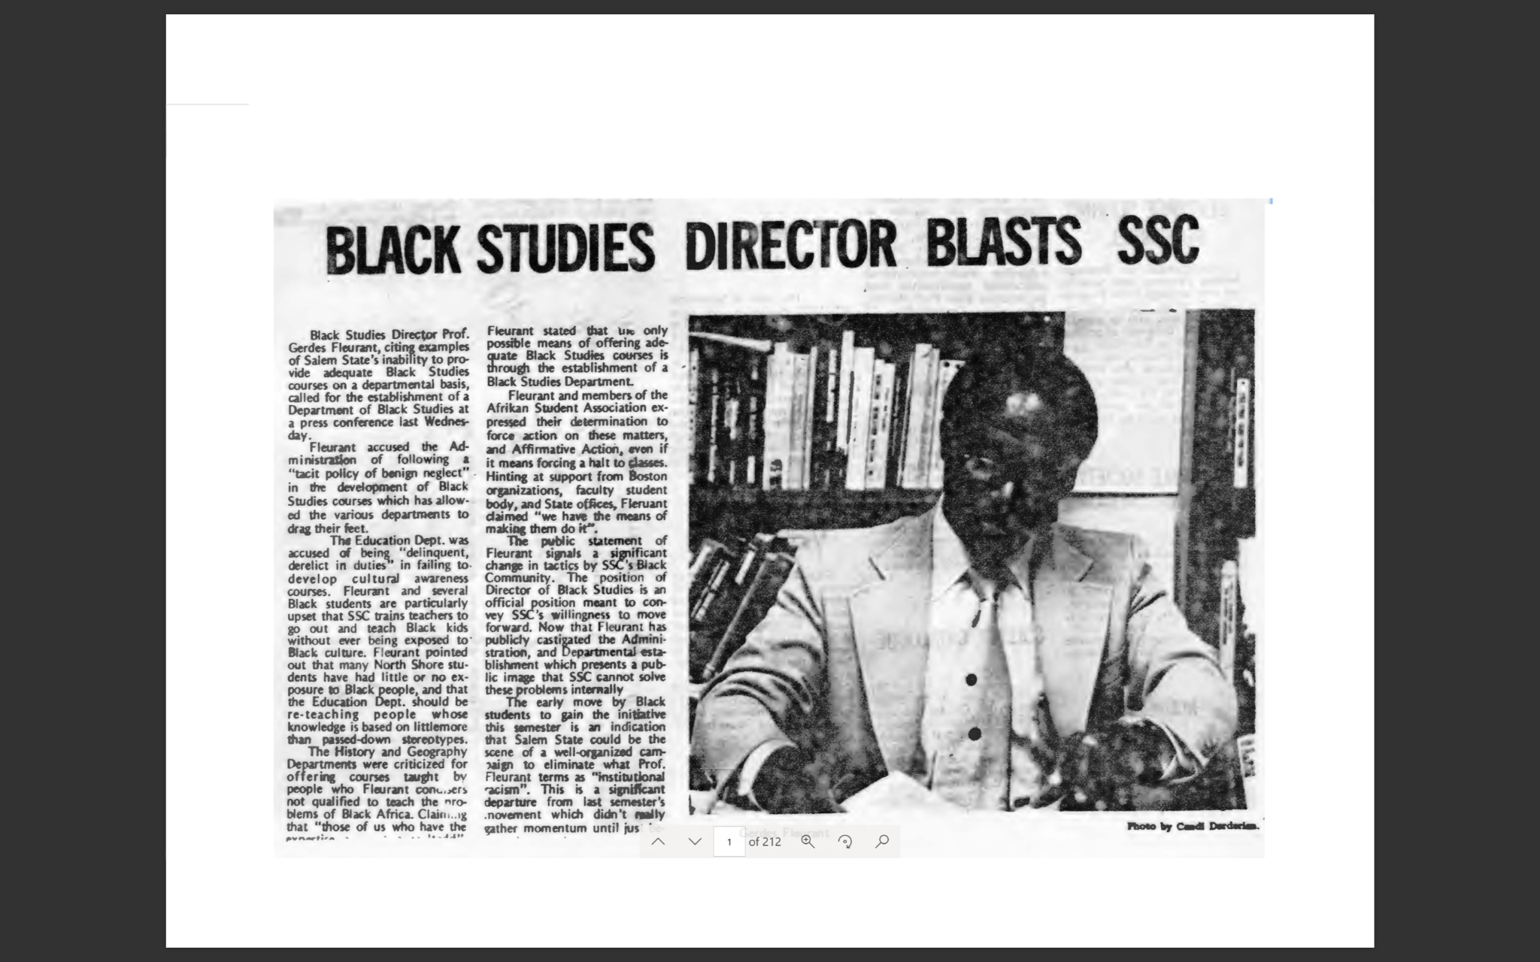
Lack Of Representation: Affecting Students 1970’s
-First Image: SSU Black faculty and Administration Association reach out to President Penson about the lack of Black community on campus.
-Second Image: Students draw how they feel their experience is at Salem State
-Second image: Professors have to fight for Black studies to be taught, Professor Gerdes Fleurant says that Salem State isn’t putting full effort into knowledgeable Black studies, for example, “ Fleurant accused the administration of the following a “tacit policy of benign neglect” in the development of Black studies”.

Slide 12
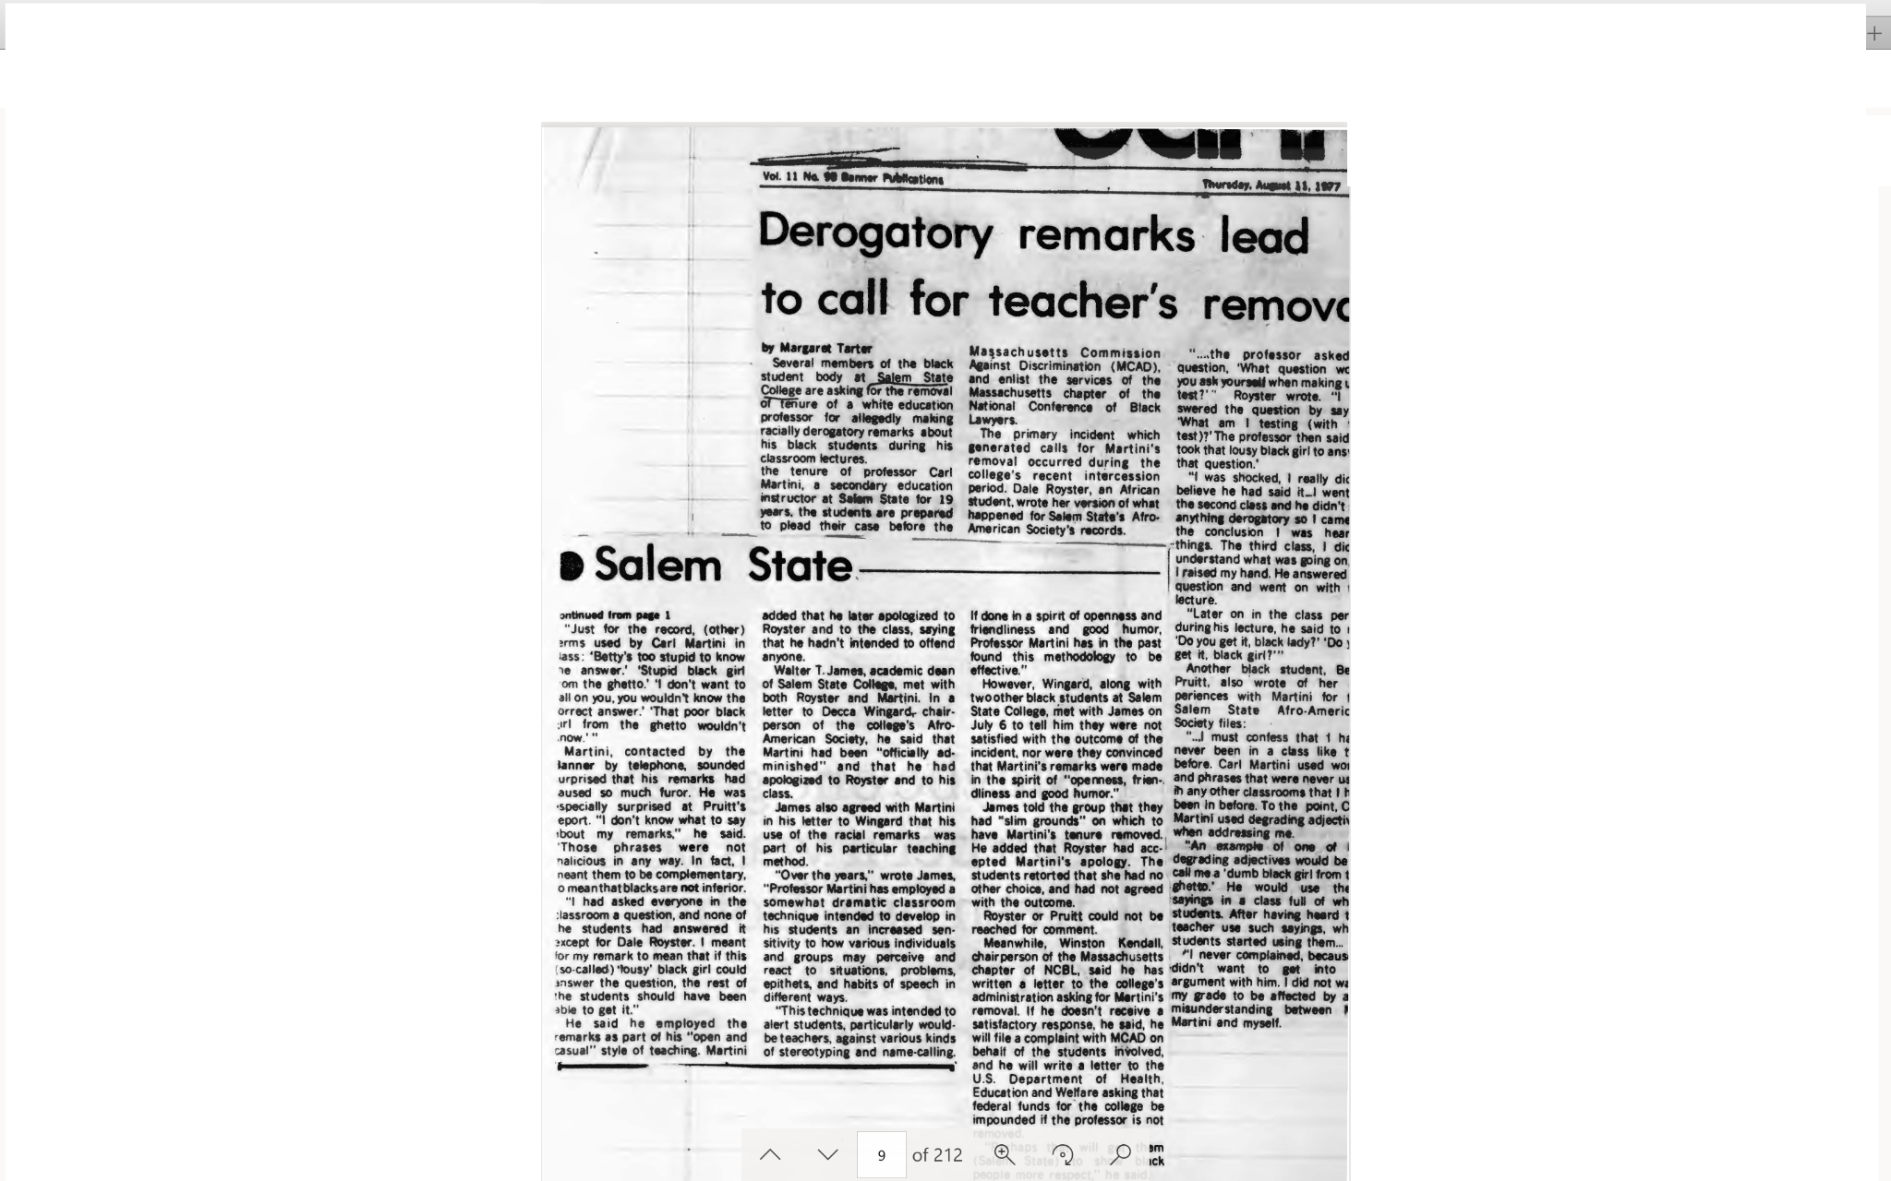
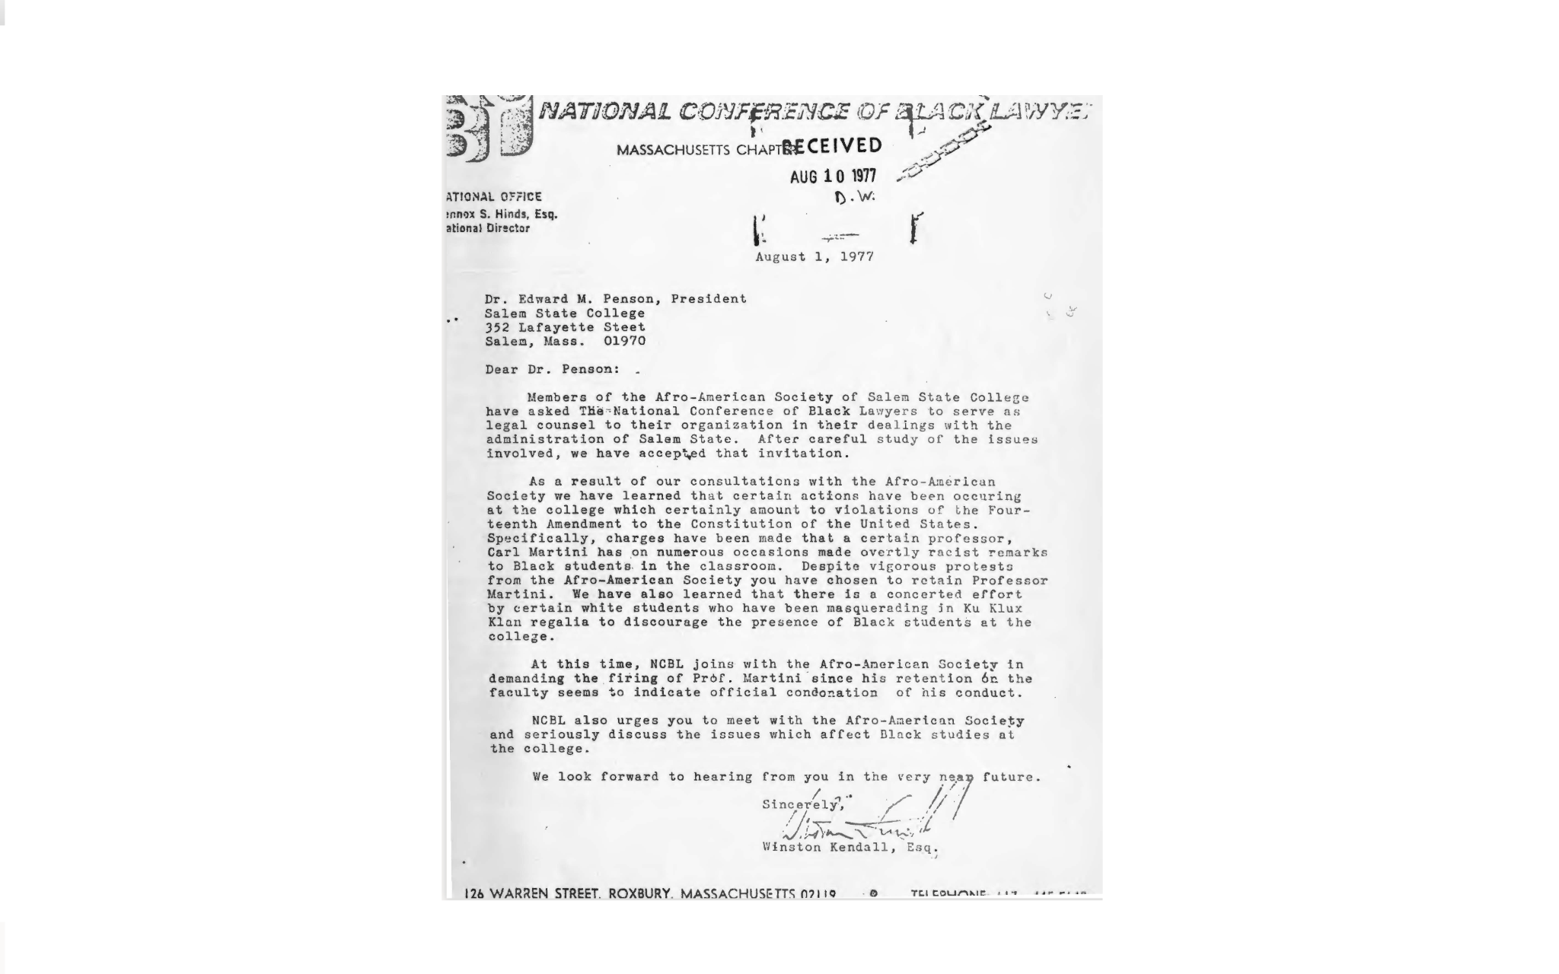
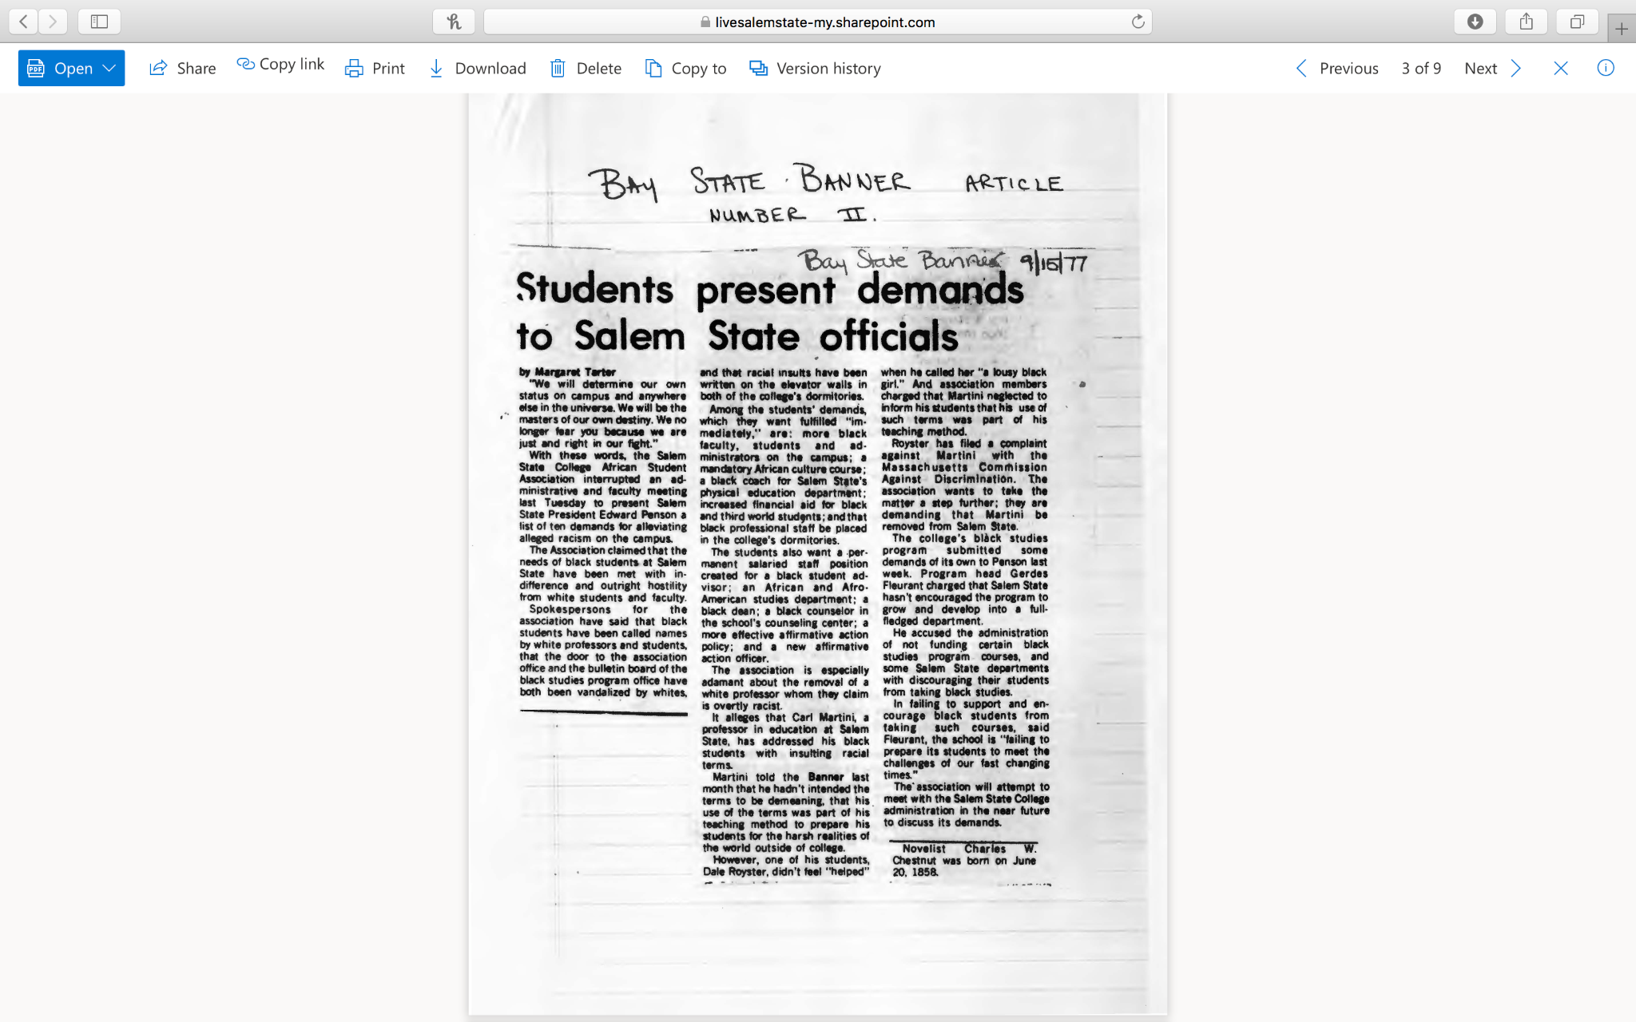
Lack Of Representation: Affecting Students
Professor Martini at SSU is removed after racially discriminative comments were made to a students. Caused discouragement among Black students.
Letter from Winston Kendall, from the National
Conference of Black Lawyers, August 1, 1977
Discusses how KKK groups targeting Black students at SSU to discourage Black attendance
African American Association at SSU stands up against President Penson about alleviating racism on the campus. Black students activism for racism and lack of representation at SSU.

Slide 13
Conclusion
Lack of representation of Black women in archives
  There was not extensive information on the amount of Black women in faculty, this leads us to believe that there were none until they are finally recorded in the late 1970s as part of the faculty
Despite advocating for more representation of Black faculty and Black women by the Black Caucus and later the Association for Black Faculty and Administration, lack of representation persisted
  For over 50 years there has been a disproportionate amount of Black people on the faculty
The Campus Climate Study done in 2017 proves that the lack of representation of Black women in faculty is still a pressing issue. Not only do the few Black faculty feel uncomfortable in their environment, the Black students feel the consequences of this as well.

Slide 14
Bibliography
Chapter Four: Breaking the Connection: Occupational Gender Segregation and the Gender Wage Gap. (2001). In Complex Inequality (pp. 91–118). Taylor & Francis Ltd / Books.
Lynch, K. (2000). CHAPTER 4: Research and Theory on Equality and Education. In Handbook of the Sociology of Education (pp. 85–105). Springer Nature / Books.
Cohen, E. G. (2000). CHAPTER 11: Equitable Classrooms in a Changing Society. In Handbook of the Sociology of Education (pp. 265–283). Springer Nature / Books.
Avasilcăi, M.-A. (2020). Methods of Protection of Employees’ Rights through Human Resources Department. Scientific Annals of the “Al. I. Cuza” University, Iasi. Sociology & Social Work / Analele Stiintifice Ale Universitatii “Al. I. Cuza” Iasi Sociologie Si Asistenta Sociala, 13(2), 117–126.
Chapter Two: Configurations of inequality: Intersections of Gender, Class, and Race. (2001). In Complex Inequality (pp. 29–59). Taylor & Francis Ltd / Books.
Fletcher, E. C., & Hernandez-Gantes, V. M. (2021). They’re Moving in Spaces They’re Not Used to: Examining the Racialized Experiences of African American Students in a High School STEAM Academy. Education and Urban Society, 53(3), 357–376. https://doi.org/10.1177/0013124520928610
Haynes-Baratz, M. C., Bond, M. A., Allen, C. T., Li, Y. L., & Metinyurt, T. (2021). Challenging gendered microaggressions in the academy: A social–ecological analysis of bystander action among faculty. Journal of Diversity in Higher Education. https://doi.org/10.1037/dhe0000315
Mathew, A. C., Risdon, S. N., Ash, A., Cha, J., & Jun, A. (2021). The complexity of working with white racial allies: Challenges for diversity educators of color in higher education. Journal of Diversity in Higher Education. https://doi.org/10.1037/dhe0000310
Hussain, M., & Jones, J. M. (2021). Discrimination, diversity, and sense of belonging: Experiences of students of color. Journal of Diversity in Higher Education, 14(1), 63–71. https://doi.org/10.1037/dhe0000117
Yi, V., & Ramos, D. (2021). Collective achievement and resistance: Understanding the motivations of doctoral women of color. Journal of Diversity in Higher Education. https://doi.org/10.1037/dhe0000296
Arthur Gerald Records. Salem State University. Last Modified September 23, 2020.
Afro-Am Society Records. Salem State University. Last Modified September 23, 2020.

