Slide 1

Lasting Psychological Effects on Survivors of Intrafamilial Child Sexual Abuse and the Available Resources and Interventions in Massachusetts
Honors Thesis by Adrianna Hartman

Slide 2
What is Intrafamilial Child Sexual Abuse? (ICSA)
Childhood sexual abuse affected 57,329 children in just 2016 alone (RAINN, 2016).
Currently, it is estimated that there are around 39 million survivors of childhood sexual abuse in America (TAALK, 2017).
ICSA is a form of sexual abuse that happens by an immediate family member such as a parent, sibling, aunt, or uncle.
The frequency of childhood sexual abuse means that many clients of social service agencies may have experienced ICSA as a child or adolescent, but it is unknown how knowledgeable social service agency workers are at referring these clients for treatment (Ceccucci, 2018).

Slide 3
Why is ICSA a Problem?
Intrafamilial childhood sexual abuse can have a particularly significant impact on children, leaving them with depression, anxiety, and even eating disorders, which often can continue into adulthood (Jay et al., 2018).
These symptoms can impact their ability to form meaningful relationships and develop self-confidence as they get older if it is not treated as soon as the symptoms present themselves (Nelson, 2019).
Higher rates of suicidal behaviors, including death by suicide, are common among survivors of ICSA (Centers for Disease Control and Prevention, 2020).
Men with a history of child sexual abuse are six times more likely to attempt suicide than men without a history of child sexual abuse. Women with a history of childhood sexual abuse have a nine times greater risk of a suicide attempt than women without a history of child sexual abuse (Centers for Disease Control and Prevention, 2020).

Slide 4
Continued…
Intrafamilial childhood sexual abuse can be complicated by the difficult feelings of dependency on the perpetrator and feelings of betrayal (Kristensen & Lau, 2007; Trickett et al., 2011).
According to the study done by Roberts and Colleagues (2004), intrafamilial child sexual abuse has been associated with certain outcomes in adulthood, those of which include being part of a “nontraditional” family (having a single mother and stepfather), mental health issues, and teen pregnancy (Roberts et al., 2004).

Slide 5
Interventions available
Medical assistance
Cognitive Behavioral Therapy (CBT)
Eye-Movement Desensitization and Reprocessing (EMDR) & Electric Therapy (ECT)
Dialectical Behavior Therapy (DBT)
Peer/survivor support groups

Slide 6
Research Design
This study examined the lasting psychological effects on survivors of ICSA, as well as the various resources and interventions available to these survivors in Massachusetts.
Participants:
  individuals over the age of 18 who work with survivors of intrafamilial childhood sexual abuse (ICSA) in Massachusetts.

Slide 7
Research Design
Procedures and materials:
  Quantitative survey design using convenience snowball sampling
  The researcher emailed a study advertisement that contained the survey link to personal contacts, posted personal social media pages, and reached out to faculty at the university, asking them to share the survey with professional contacts.

Slide 8
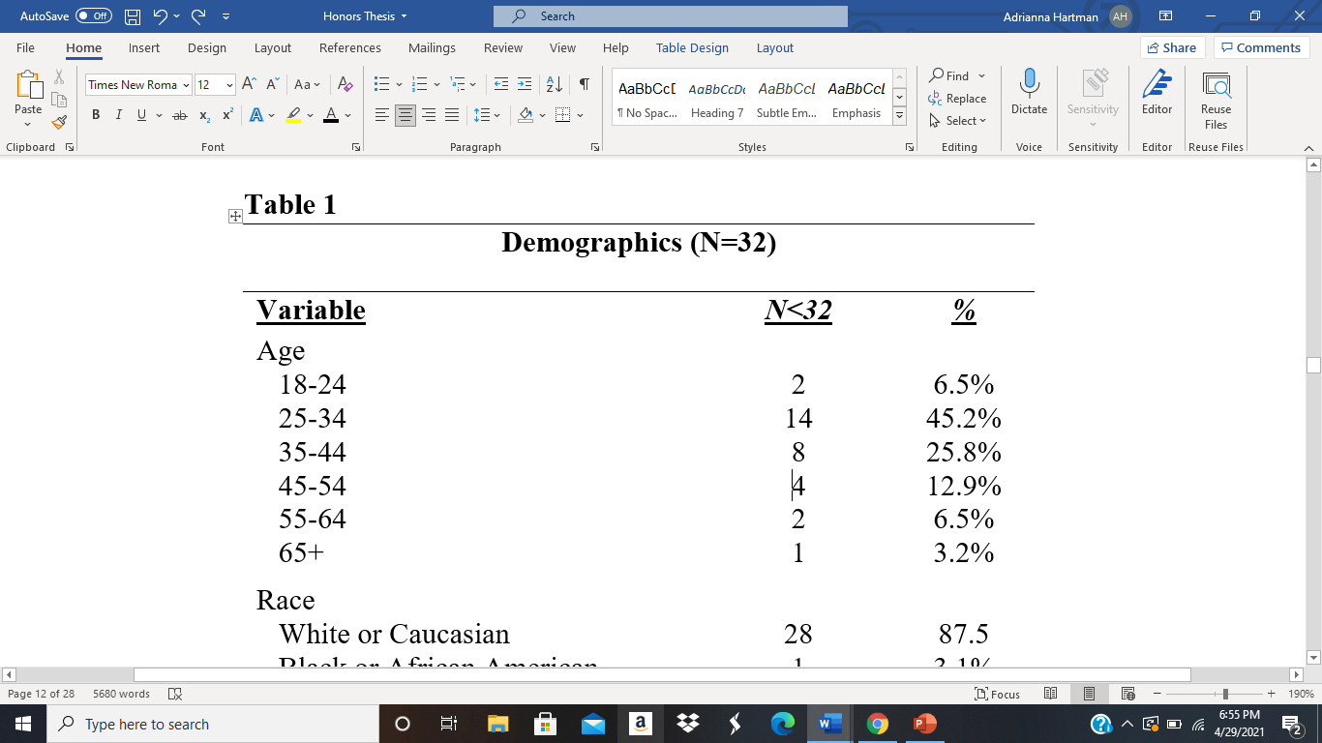
Findings Table 1 (Demographics)
N is the number of participants that picked each option, 32 is the sample
size. Variables are the demographic questions asked in the survey.

Slide 9

Findings Table 1 (Demographics)

Slide 10

Findings Table 1 (Demographics)

Slide 11
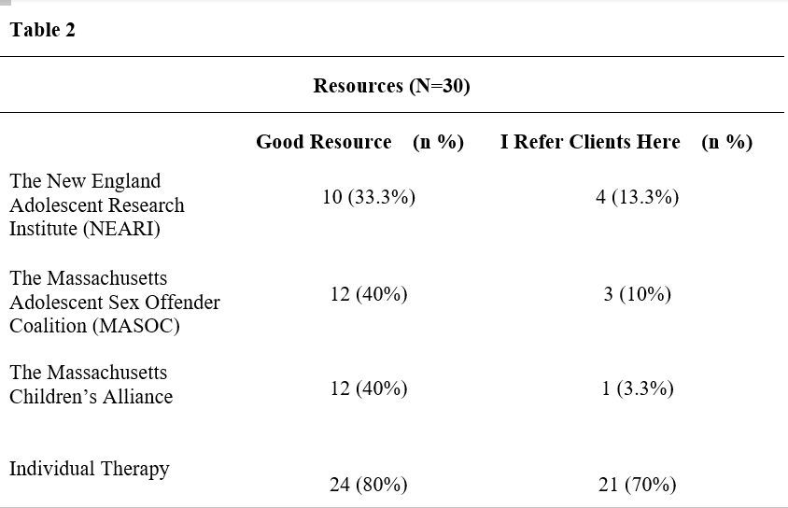
Findings Table 2 (Resources)
N is the number of participants that chose that resource, along with the percentage.
Participants were asked to name other resources that were not listed on the survey.

Slide 12
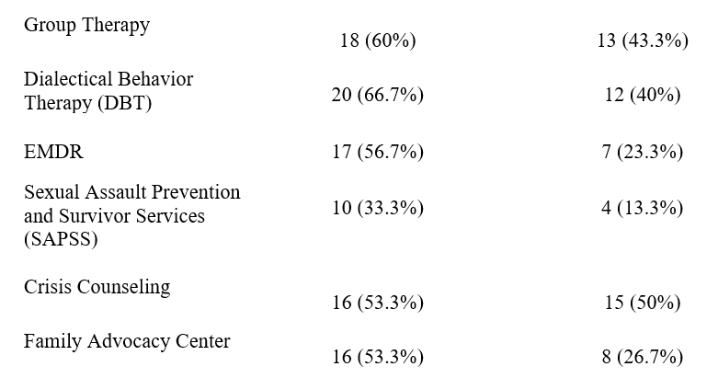
Findings Table 2 (Resources)

Slide 13
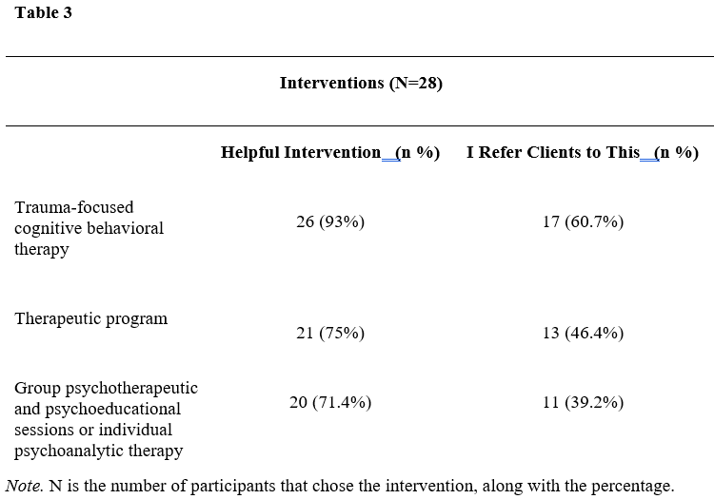
Findings Table 3 (Interventions)

Slide 14
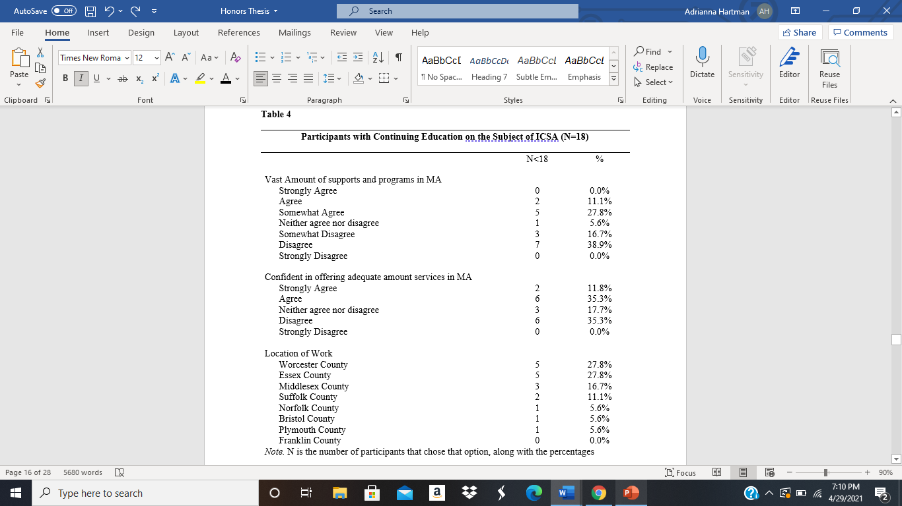

Participants without continuing knowledge of ICSA
Participants with continuing knowledge of ICSA

Slide 15
Discussion
The lasting psychological effects on survivors of intrafamilial childhood sexual abuse (ICSA) is well documented (e.g., De Bellis et al., 2011; Kristensen & Lau, 2007; Trickett et al., 2011; Roberts, 2004; Jay et al., 2018).
Although in this study the types of interventions available for the survivors appears to be generally well known, more is unknown when it comes to the confidence in referring clients to these interventions and services/resources in Massachusetts.

Slide 16
Overall Findings
Findings suggest that service providers working with child sexual abuse survivors perceive Trauma-focused Cognitive Behavior Therapy (CBT) (96.3%, n=26) and Eye Movement Desensitization and Reprocessing (EMDR) (89.4%, n=17) as being a helpful intervention available to survivors of intrafamilial childhood sexual abuse (ICSA).
Not surprising, 66.7% (n=20) perceived Dialectical Behavior Therapy (DBT) as a helpful intervention, which is backed by Görg et al. (2017).

Slide 17
Continued…
When it comes to confidence in the ability to offer survivors of intrafamilial childhood sexual abuse (ICSA) an adequate amount of resources, half of participants said they disagreed. This may reflect a general need within the professional to research and understand said interventions, resources, and services.
Ceccucci (2018) explored the confidence of nurse practitioners working with child sexual abuse survivors in New York, finding that although nurse practitioners see value in pursuing specialist referrals for child sexual abuse survivors, they don’t have access to the appropriate resources, or they are not aware of the availability of these resources within the community they work. These findings reflect the literature, and suggest that in Massachusetts, as in New York City, there may be a lack of appropriate resources and interventions in their area for child sexual abuse survivors.

Slide 18
Implications
Individuals who work with survivors of intrafamilial childhood sexual abuse (ICSA) in the state of Massachusetts can use the findings of this study to consider their own advances in knowledge as well as services and interventions for survivors of ICSA.
The findings from this study and previous research (e.g Ceccucci, 2018) emphasize the importance of education on the topic as well as knowing which resources and interventions are available in the area.
Taking these steps would positively impact survivors of ICSA because the individuals who work with this population would be more knowledgeable about the proper interventions, helpful services/resources, and the subject in general.

Slide 19
Continued…
In turn, this will make referring clients more precise and create a more positive outcome for survivors of ICSA.
In addition to understanding the importance of continuing knowledge, individuals and agencies who work with survivors of ICSA can use the findings in this study to train entering workers on the importance of said knowledge.

Slide 20
Conclusion
Intrafamilial Childhood Sexual Abuse (ICSA) is something that effects tens of thousands of children and families in the United States every year.
Although the effects of childhood sexual abuse are well known, the available services, resources, and interventions in the state of Massachusetts may not be.
The findings of this study suggest that Dialectical Behavioral Therapy and Trauma-focused Cognitive Behavioral Therapy are very well known and referred to for these survivors.
These analyses add to the literature by increasing the general understanding of what types of services/resources and interventions practitioners believe are helpful to clients, as well as how confident practitioners in Massachusetts are in referring clients to said services/resources and interventions.

Slide 21
References
Ceccucci, J. (2018). Evaluating nurse practitioners’ perceived knowledge, competence, and comfort level in caring for the sexually abused child. Journal of Forensic Nursing, 14(1), 42–49. https://doi.org/10.1097/jfn.0000000000000184
Centers for Disease Control and Prevention. (2020, March 20). Preventing Child Sexual Abuse |Violence Prevention|Injury Center|CDC. Centers for Disease Control and Prevention. https://www.cdc.gov/violenceprevention/childabuseandneglect/childsexualabuse.html.
Jay, A., Evans, M., Frank, I., & Sharpling, D. (2018, August 20). 3.2 The effects of child sexual abuse. Interim Report. https://www.iicsa.org.uk/publications/inquiry/interim/nature-effects-child-sexual-abuse/effects-child-sexual-abuse.
Kristensen, E., & Lau, M. (2007). Women with a history of childhood sexual abuse. Long-term social and psychiatric aspects. Nordic Journal of Psychiatry, 61(2), 115–120. https://doi.org/10.1080/08039480701226096

Slide 22
References
Nelson, A. (2019). Understanding Fear and Self-Blame Symptoms for Child Sexual Abuse Victims in Treatment: An Interaction of Youth Age, Perpetrator Type, and Treatment Time Period. DigitalCommons@University of Nebraska - Lincoln. https://digitalcommons.unl.edu/honorstheses/89/.
RAINN. (2016). Children and Teens: Statistics. RAINN.
https://www.rainn.org/statistics/children-and-teens.
Roberts, R., O'Connor, T., Dunn, J., Golding, J., & ALSPAC Study Team (2004). The effects of
child sexual abuse in later family life; mental health, parenting and adjustment of
offspring. Child Abuse & Neglect, 28(5), 525–545.
https://doi.org/10.1016/j.chiabu.2003.07.006
TAALK. (2017). Statistics. TAALK. https://www.taalk.org/resources/statistics.

Slide 23
References
Trickett, P. K., Noll, J. G., & Putnam, F. W. (2011). The impact of sexual abuse on female development: Lessons from a multigenerational, longitudinal research study. Development and Psychopathology, 23(2), 453–476. https://doi.org/10.1017/s0954579411000174

