Slide 1
Narrative Therapy with Latinos
SWK 724
Yvonne Ruiz, PhD

Slide 2
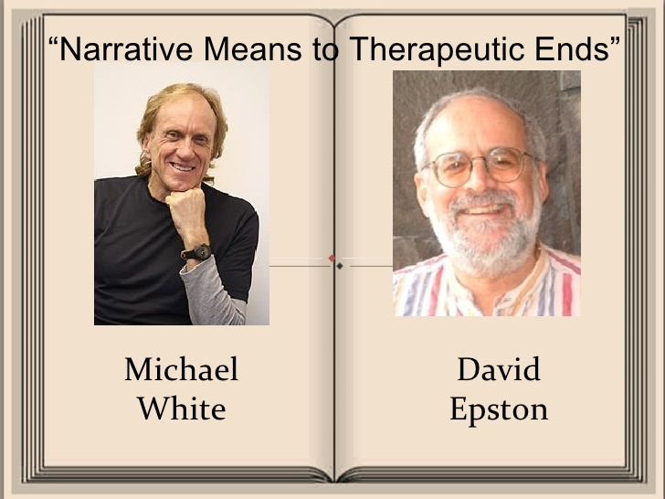
Origins of Narrative Therapy
The use of a narrative approach as a therapeutic tool was developed by Michael White and David Epston in the 1980s with the idea that narratives provide meaning and coherence in people’s lives, and thus have the potential to empower clients and help them gain greater control over their lives (White & Epston, 1990).

Slide 3

The Narrative Approach
Narrative theory is based on the premise that all people are engaged in constructing a life story, or a personal narrative, that determines their understanding of themselves and their position in the world
Narrative therapy provides opportunities for growth and development, ways to find meaning, and a pathway to a better understanding of ourselves
The goal is to help the client and/or family transform their narrative to expand their possibilities

Slide 4
Functions of the Narrative Therapist
To facilitate therapeutic conversations that elicit the clients’ perspective and meaning-making
To demonstrate openness, empathy, care, interest, respect, curiosity, and collaboration
To adopt a not-knowing attitude that is guided by the clients’ narrative
To engage with the clients’ story through active listening, normalizing, reflecting, and analysis, with the aim of reconstructing an alternate life story and celebrating new possibilities

Slide 5
The Narrative Process
1. The personal narrative - the practitioner encourages the client to express, describe, and explore her narrative
2. Deconstruction - the practitioner helps the client reflect and analyze underlying assumptions, sources of knowledge, and social and cultural forces that might be influencing or shaping the situation and the perception of events in order to separate from oppressive conditions that contribute to the problem situation
3. Reconstruction or re-authoring - a new, alternative personal narrative is developed that is more supportive and empowering of a new sense of self
4. Celebration and connection - refers to the client’s reconnection with others in the acknowledgment and celebration of the re- authored narrative

Slide 6
Questions in Narrative Therapy
Questions are used as a way to generate experience, not to gather information
The approach is based on not-knowing
Worker maintains a curious, open, and respectful approach
Questions are designed to assist clients in exploring various dimensions of their lives
Questions lead to deconstructing problem-saturated stories

Slide 7
Externalizing Questions
Externalization is the central therapeutic technique used by White to help clients begin to define their problems as separate from their identities
Identifies problems that have been internalized as part of self and identity
The problem is located outside of the individual rather than as inherent characteristic
Locates problems as products of culture and history
Enables the person to begin to revise their relationship with the problem

Slide 8
Deconstructing Questions
Deconstruction refers to breaking down the problem or problems the client is having, making it easier to understand and address
This technique helps the client dig deep into the problem to better understand the impact
Makes the issue more specific
Avoids overgeneralizing
Clarifies the core issue or issues

Slide 9

The Narrative Approach with Latinos
The narrative approach is culturally relevant because it is consistent with the Latino culture’s emphasis on personal connection, relationships, inter-dependence, and a collaborative approach to gaining greater understanding into one’s situation and problem-solving

Slide 10
Latino Perspectives on Narrative Approaches
Cultural stories have a vital role in the lives of Latino clients
Storytelling with multicultural clients is a culturally respectful way of engagement and assessment
Latinos prefer approaches that are based on comfort with conversation, ability to listen, and curiosity, particularly as related to Latino culture
Stability, harmony, constancy, humor, and purposefulness are therapist qualities that are desired by Latino clients.
Many Latinos prefer smooth social relations based on warmth, respect, and avoidance of confrontation and criticism
Narratives on immigration support processes of adaptation and coping
A more respectful and collaborative approach may ameliorate some of the stigma attached to mental health treatment.

Slide 11
Bibliography
Dulwich Centre www.dulwichcentre.com.au
Falicov, C.J. (2014). Latino families in therapy (2nd Ed.). New York: The Guilford Press.
Jiménez, A.L., Alegría, M., Camino-Gaztambide, R.F., & Zayas, L.V. (2014). Cultural sensitivity: What should we understand about Latinos (pp. 61-87)? In R. Parekh (Ed.), The Massachusetts General Hospital Textbook on Diversity and Cultural Sensitivity in Mental Health. New York: Humana Press.
Narrative Therapy Initiative www.narrativetherapyinitiative.org Salem, MA
Roscoe, K.D., Carson, A.M, & Madoc-Jones, L. (2011). Narrative social work: conversations between theory and practice. Journal of Social Work Practice, 25(1), 47–61.
White, M. (2007). Maps of narrative practice. New York: W. W. Norton & Company.
White, M., & Epston, D. (1990). Narrative means to therapeutic ends. New York: W. W. Norton & Company.

