Slide 1

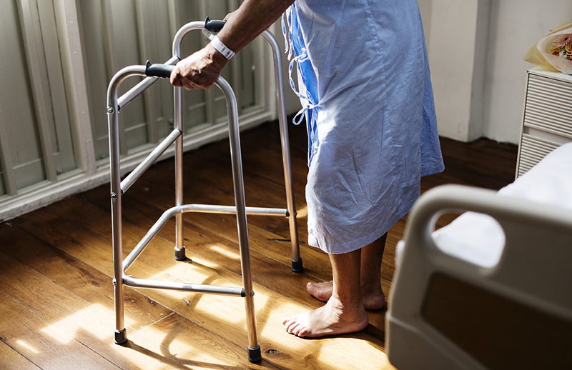
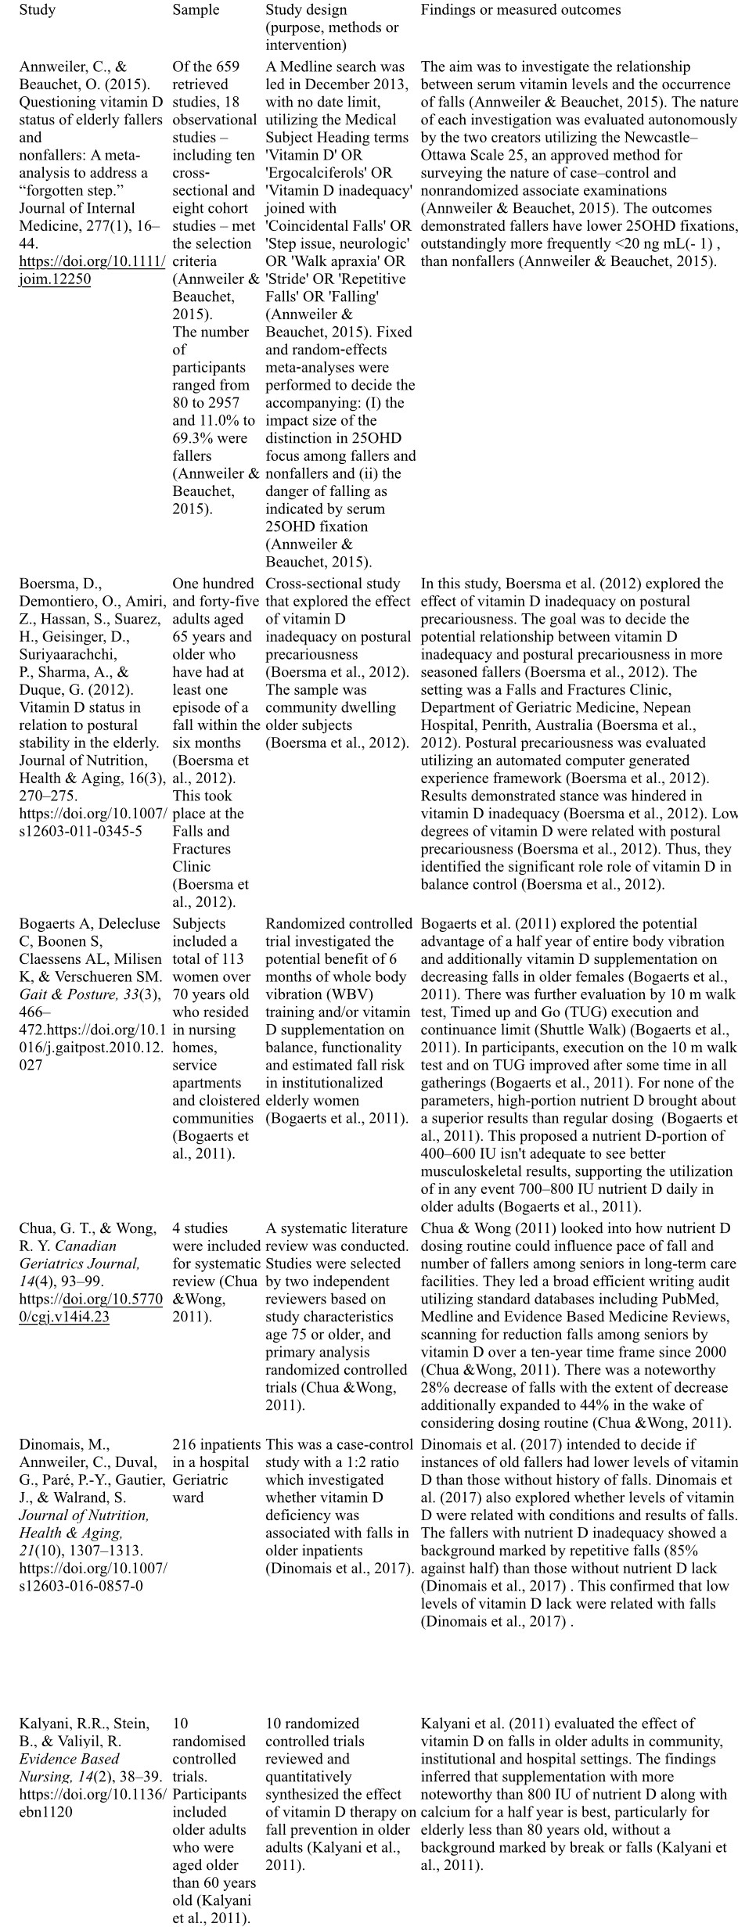
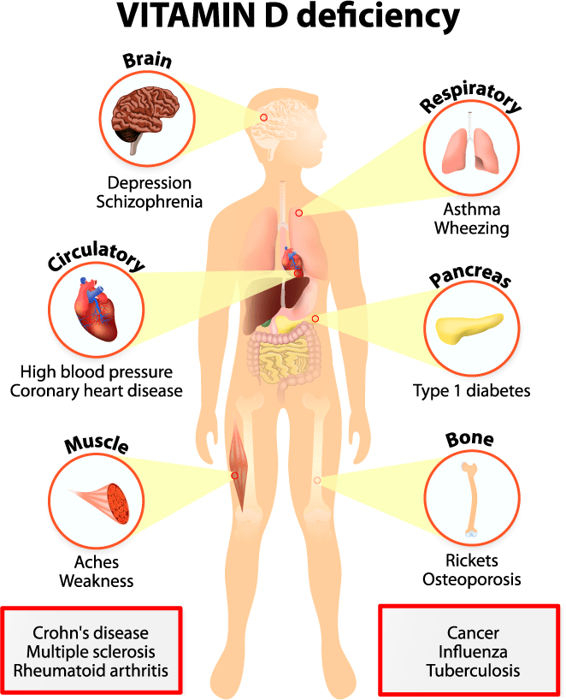
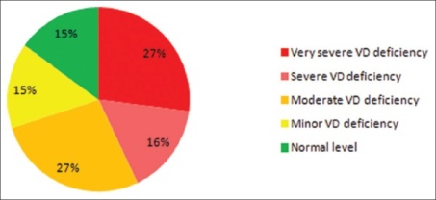
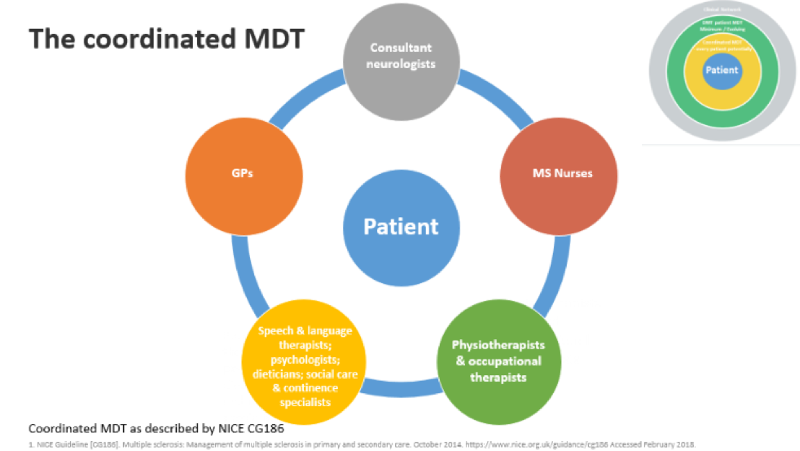

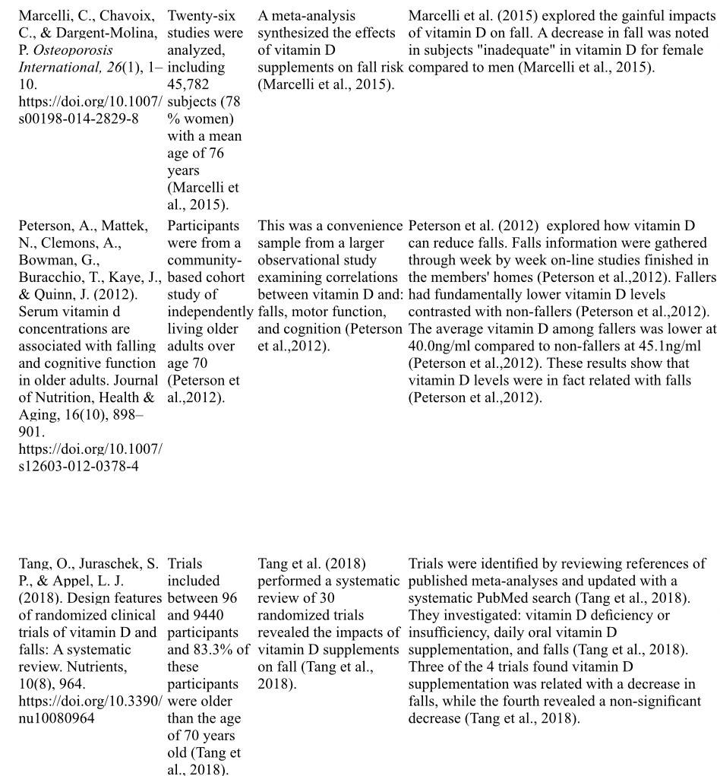
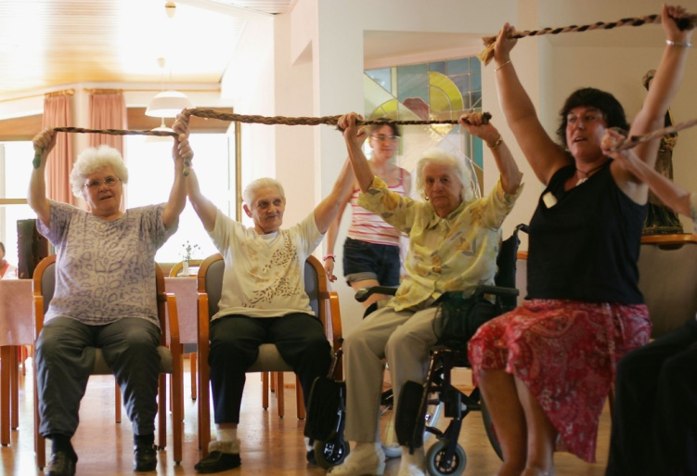
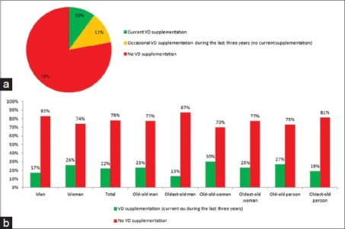
Role of Vitamin D in preventing falls in Nursing Home Patients
Mahala StPaul, RN, BSN, MSN [c]
Salem State University
CURRENT CLINICAL GUIDELINES
STUDIES
CONCLUSIONS
-Routine vitamin D supplementation in community-dwelling adults is not recommended (M. LeFevre & N. LeFevre, 2018)
-Routine vitamin D supplementation does not prolong life, decrease the incidence of cancer or cardiovascular disease, or decrease fracture rates (M. LeFevre & N. LeFevre, 2018)
-There is insufficient evidence to recommend screening the general population for vitamin D deficiency (M. LeFevre & N. LeFevre, 2018)
-The USPSTF found adequate evidence that treating vitamin D deficiency does not reduce risk of cancer, type 2 diabetes mellitus, or death in community-dwelling adults, or fractures in persons not at high risk of fractures. Evidence is insufficient for other outcomes, including psychosocial and physical functioning (M. LeFevre & N. LeFevre, 2018)
-The recommended dietary allowances of 600 IU per day for persons one to 70 years of age and 800 IU per day for persons older than 70 years (M. LeFevre & N. LeFevre, 2018)
-Vitamin D supplementation of 700 to 800 IU per day reduces falls in older adults (M. LeFevre & N. LeFevre, 2018)
Review of Literature
The use of Vitamin D effectiveness in preventing falls is well documented in the literature Annweiler & Beachet, (2015): Fallers have lower 25 OHD levels than non fallers in an an elderly population. Boersma, et.al, (2012), found that balance is impacted adversely by Vitamin D deficiency. Bogart, et al (2011) found that higher does of 700-800 IU of Vitamin D daily demonstrated superior results of musculoskeletal response to walking tests. Chua & Wong (2011) conducted a systematic review and found there was a 28% decrease in falls in elderly taking Vit D supplementation. Kalyani, Stein and Valiyil, (2011) in a case controlled study of 10 elderly over 6 months revealed less falls in those receiving Vit D supplementation Marcelli et.sl, (2015), explored gainful impacts of Vit D on fall and noted a decreaed number of falls for those on supplementation Peterson, et.al., (2012), in a convenience sample gathered fall information on line in members homes. Those with lower Vitamin D levels had significantly higher falls. Tang et al, in a systematic review, found that in 3 out of 4 trials reviewed, Vitamin D supplementation was related to a decrease number of falls.
-Studies included implementation of vitamin D supplementation in adults, and found that vitamin D supplementation was associated with a reduction in falls.
-Through thorough analysis of the evidence, it was discovered that in endeavor to reduce fall rates among elderly, daily 800-1000 IU doses of vitamin D is therapeutic.
-Rather than inferring that nutrient D is inadequate as a way to forestall falls, these discoveries propose that further research is warranted in order to implement into practice daily vitamin D supplements as intervention to prevent falls.
INTRODUCTION
-Vitamin D or calciferol is a fat-soluble vitamin. Two main sources of vitamin D are dietary and endogenous synthesis
-25(OH)D levels were categorized as follows: (1) very severe VD deficiency: <12.5 nmol/L; (2) severe VD deficiency: 12.5–24 nmol/L; (3) moderate VD deficiency: 25–49 nmol/L; (4) minor VD deficiency: 50–74 nmol/L; and (5) normal VD level: 75–175 nmol/L
-Vitamin D plays a crucial role in blood calcium and phosphate homeostasis supporting the body's metabolic functions, neuromuscular transmission, and bone mineralization. Vitamin D supplementation accelerates fracture-healing rates and decreases the risk of bone fracture
-Old age is an independent risk factor for vitamin D deficiency
-In regard to the elderly, a direct association between low 25(OH)D levels and frailty syndrome has recently been reported. Increasingly, vitamin D deficiency is associated with several known geriatric syndromes
-In spite of its high prevalence, particularly among elderly people, vitamin D deficiency is still underestimated by many clinicians
RECOMMENDATIONS
- The viability of results that have for reducing falls relies on a multidisciplinary healthcare team and physical movement (Annweiler et al., 2010)
- The literature shows that supplementation of nutrient may decrease the fall rates, and vitamin D supplements seem to have a high potential because of their basic application and their minimal financial burden (Annweiler et al., 2010)
- Vitamin D supplementation should be coordinated into essential and auxiliary fall anticipation techniques for older adults (Annweiler et al., 2010)
-Vitamin D supplementation notwithstanding exercise is progressively considered as an effective system to impact physical, neurological, and muscular abilities and decrease the likelihood of falls in older adults (Annweiler et al., 2010)
- The literature concluded that implementation of 700–800 IU at the minimum of vitamin D is a simple, cost-effective intervention that should be incorporated in addition to existing fall prevention strategies in older adults (Annweiler et al., 2010)
PICO
Vitamin D status in the study patient sample. More than a quarter of the patients were classified as “very sever Vitamin D deficiency” group. The Vitamin D recommended level was found only in 15% of the patients (Kweder & Eidi, 2018)
In patients ages 65 and older living in nursing care facilities, does the implementation of vitamin D supplementation in addition to fall prevention strategies in comparison to fall prevention strategies alone decrease the risk for falls?
METHODS
REFERENCES
-In order to answer the PICO question, the nurse practitioner must do extensive research and perform a literature review.
-The database searched was CINAHL Plus with Full Text.
-Keywords: vitamin D and falls. A total number of 9 articles published between 2010 and 2020 were chosen.
-The articles included systematic reviews, randomized controlled trials, cohort studies, cross-sectional studies, case-control studies, meta-analysis, and an observational study.
Annweiler, C., Montero-Odasso, M., Schott, A. M., Berrut, G., Fantino, B., & Beauchet, O.
(2010). Fall prevention and vitamin D in the elderly: An overview of the key role of the non-bone effects. Journal of Neuroengineering and Rehabilitation, 7, 50. https://doi.org/10.1186/1743-0003-7-50
Annweiler, C., & Beauchet, O. (2015). Questioning vitamin D status of elderly fallers and
nonfallers: A meta-analysis to address a “forgotten step.” Journal of Internal Medicine, 277(1), 16–44. https://doi.org/10.1111/joim.12250
Boersma, D., Demontiero, O., Amiri, Z., Hassan, S., Suarez, H., Geisinger, D., Suriyaarachchi,
P., Sharma, A., & Duque, G. (2012). Vitamin D status in relation to postural stability in the elderly. Journal of Nutrition, Health & Aging, 16(3), 270–275. https://doi.org/10.1007/s12603-011-0345-5
Bogaerts A, Delecluse C, Boonen S, Claessens AL, Milisen K, & Verschueren SM. (2011). Changes in balance, functional performance and fall risk following whole body vibration training and vitamin D supplementation in institutionalized elderly women: A 6 month randomized controlled trial. Gait & Posture, 33(3), 466–472. https://doi.org/10.1016/j.gaitpost.2010.12.027
Chua, G. T., & Wong, R. Y. (2011). Association between vitamin D dosing regimen and fall prevention in long-term care seniors. Canadian Geriatrics Journal, 14(4), 93–99. https://doi.org/10.57700/cgj.v14i4.23
Dinomais, M., Annweiler, C., Duval, G., Paré, P.-Y., Gautier, J., & Walrand, S. (2017).Vitamin D and the mechanisms, circumstances and consequences of falls in older adults: A case-controlstudy. Journal of Nutrition, Health & Aging, 21(10), 1307–1313. https://doi.org/10.1007/s12603-016-0857-0
Kalyani, R.R., Stein, B., & Valiyil, R. (2011). Vitamin D reduces the risk of falls in older adults compared with calcium or placebo. Evidence Based Nursing, 14(2), 38–39. https://doi.org/10.1136/ebn1120
Kweder, H., & Eidi, H. (2018). Vitamin D deficiency in elderly: Risk factors and drugs impact on vitamin D status. Avicenna Journal of Medicine, 8(4), 139–146. https://doi.org/10.4103/ajm.AJM_20_18
LeFevre, M.L., & LeFevre, N.M. (2018). Vitamin D screening and supplementation in community-dwelling adults: Common questions and answers. American Family Physician, 97(4), 254-260
Marcelli, C., Chavoix, C., & Dargent-Molina, P. (2015). Beneficial effects of vitamin D on falls and fractures: is cognition rather than bone or muscle behind these benefits? Osteoporosis International, 26(1), 1–10. https://doi.org/10.1007/s00198-014-2829-8
Peterson, A., Mattek, N., Clemons, A., Bowman, G., Buracchio, T., Kaye, J., & Quinn, J. (2012).
Serum vitamin d concentrations are associated with falling and cognitive function in older adults. Journal of Nutrition, Health & Aging, 16(10), 898–901. https://doi.org/10.1007/s12603-012-0378-4
Tang, O., Juraschek, S. P., & Appel, L. J. (2018). Design features of randomized clinical trials of
vitamin D and falls: A systematic review. Nutrients, 10(8), 964. https://doi.org/10.3390/nu10080964
The data shows the the rate of Vitamin D prescription. Few elderly people receive Vitamin D supplementation.

