Slide 1

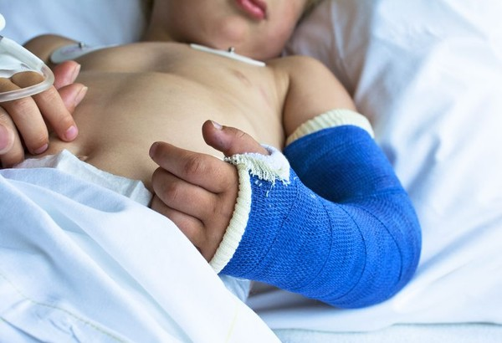

MINIMIZING THE RISK OF ORTHOPEDIC SURGICAL SITE INFECTIONS IN THE PEDIATRIC POPULATION: USING EVIDENCE TO INFORM PRACTICE
Alaina Gridley
Commonwealth Honors Program
Introduction
Results
Conclusion
Surgical site infections are some of the most common hospital-acquired infections and are associated with higher rates of morbidity and mortality for patients.
Surgical site infections can increase length of hospital stay for patients and elevate healthcare costs.
Surgical site infections account for the largest portion of healthcare associated infection costs nationally and inflict an estimated cost of $20,785 per case.
Research exploring surgical site infections in the pediatric orthopedic population is limited. Many interventions and assumed risks within the pediatric population are extrapolated from data collected from adults.
Weight and Nutritional Status
Weight and nutritional status play a role in predicting the incidences of a surgical site within the pediatric orthopedic population.
The risk of developing surgical site infection is increased in children who are overweight or obese.
The risk of developing a surgical site infection increased in children who are underweight and malnourished.
Prophylactic Antibiotic Selection
Prophylactic antibiotic selection and dosing needs to be specific to both the possible pathogen and the patient. There are many challenges that can make this difficult to achieve.
Staphylococcus aureus which is present on the skin in the normal flora is the most common causative agent in orthopedic surgical site infection development for the pediatric population
To mitigate the risk of staphylococcus aureus risk cefazolin must be dosed adequately for the child’s weight.
Children who screened positive for MRSA must have adjustments in their antibiotic prophylactic regimen to include vancomycin.
Longer operation time is associated with increase blood loss. Amount of blood loss matters because antibiotics are lost with the blood causing a decrease in the serum concentration within the body.
Bundle Approach to Interventions
A bundle approach to interventions can help to reduce the rate of surgical site infections, however, strict compliance amongst staff, patients and their families can be difficult to ensure.
Compliance plays a role in the bundles success.
The research shows that meaningful reduction in surgical site infections within the pediatric population can be achieved, however, there are numerous challenges.
There is still a need for more research within population to further identify associated risk factors and interventions.
It is imperative that nurses and other medical staff members implement proper preventative measures to decrease the incidences of surgical site infections in order to promote safe, high quality patient care.
Positive outcomes within this population can promote proper growth and development and foster further health promotion into adulthood.
Methods
References
A systematic review of the literature was conducted to identify risk factors associated with acquiring surgical site infections in pediatric patients undergoing orthopedic surgery.
Additionally, identified in the search was interventions used within the pediatric orthopedic population to mitigate the risk of acquiring a surgical site infection.
The database Cumulative Index of Nursing and Allied Health Literature (CINAHL) Plus with Full Text was used.
A Boolean search was conducted using the key words, “pediatric” and orthopedic surgery” and “surgical site infections”.
The search was narrowed down to identify articles that were published between 2011 to 2021.
19 articles underwent full text review. 9 articles were relevant to the topic and met criteria to be included in this systematic review.
Ballard, R. M., Miller , N. H., Nyquist, A.-C., Elise, B., Baulesh, D. M., &
Erikson, M. A. (2012). A Multidisciplinary Approach Improves Infection
Rates in Pediatric Spine Surgery. Journal of Pediatric Orthopaedics.
Blackwood, B. P., Gause, C. D., Harris, J. C., Theodorou, C. M., Helenowski,
I., Lautz, T. B., . . . Hunter, C. J. (2017). Overweight and Obese Pediatric
Patients Have an Increased Risk of Developing a Surgical Site Infection.
Surgical Infections.
Center for Disease Control and Prevention. (2015). National Center for
Health Statistics Orthopedic Surgery Fact Sheet. Retrieved from
CDC.gov: https://www.cdc.gov/nchs/data/names/NAM_2-
14_15_Orthopedic_Surgery-508.pdf
Center for Disease Control and Prevention. (2019, May 9). Frequently Asked
Questions About Surgical Site Infections. Retrieved from CDC.gov:
https://www.cdc.gov/hai/ssi/faq_ssi.html
Cies, J. J., Chan, S., Hossain, J., Brenn, B. R., & Di Pentima, M. C. (2012).
Influence of Body Mass Index and Antibiotic Dose on the Risk of
Surgical Site Infections in the Pediatric Clean Orthopedic Surgery.
Surgical Infections.
Formaini, N., Jacob, P., Willis, L., & Kean, J. R. (2012). Evaluating the Use
of Preoperative Antibiotics in Pediatric Orthopaedic Surgery. Journal of
Pediatric Orthopaedics.
Gutman, I. M., Niemeier, T. E., & Gilbert, S. R. (2019). National Databases
in Pediatric Orthopaedic Surgery: A Comparison of Demographics,
Procedures, and Outcomes. Journal of Pediatric Orthopaedics.
Jones, S., Shepherd, J., Robinson, K., & Khanderkar, S. A. (2018). Surgical
Site Infections Following Elective Nonspinal Paediatric Orthopaedic
Surgery: A Prospective Review. Journal of Pediatric Orthopaedics.
Saito, J. M., Chen, L. E., Kraemer, K., Barnhart, D. C., Byrd, C., Cohen, M.
E., . . . Richards, K. (2013). Risk-Adjusted Hospital Outcomes for
Children's Surgery. American Academy of Pediatrics.
Schriefer, J., Sanders, J., Michels, J., Wolcott, K., Ruddy, C., & Jenna
Hanson. (2017). Implementation of a Pediatric Orthopaedic Bundle to
Reduce Surgical Site Infections. National Association of Orthopaedic
Nurses.
Vandenberg, C., Niswander, C., Carry, P., Bloch, N., Pan, Z., Erickson, M., &
Garg, S. (2018). Compliance With A Comprehensive Antibiotic Protocol
Improves Infection Incidence In Pediatric Spine Surgery. Journal of
Pediatric Orthopaedics.
Zimlichman, E., Henderson, D., Tamir, O., Franz, C., Song, P., Yamin, C. K.,
. . . Bates, D. W. (2013). Health Care-Associated Infections A Meta-
analysis of Costs and Financial Impact on the US Health System. JAMA Internal Medicine.
Background
While the incidence rate of surgical site infection in the pediatric population is relatively low, 1.8%, it still is a source of preventable harm with the pediatric orthopedic population.
In 2015 there were 56 million visits to physicians specializing in orthopedic surgery in the United States with 4% of these patients being 15 years old or younger.
Outcomes within the pediatric orthopedic population can impact children’s view on the healthcare setting as a whole for the rest of their life.
The promotion of positive experiences within the healthcare setting for the pediatric population can create a trusting relationship that fosters further health promotion as the pediatric patient goes through growth and development and reaches adulthood.
The pediatric orthopedic population’s care is multifaceted. Dimensions that must be considered include proper implementation of family-centered care and effective communication that meets the child’s developmental.
Discussion
Weight and nutritional status must be considered. Nutritional screening and weight based prophylactic antibiotics can help mitigate these risks.
Antibiotic selection must be tailored to the individual patient and potential pathogens they may have.
Screening for pathogens can help determine antibiotic selection.
Antibiotic dosing must be adjusted to maintain therapeutic serum concentrations when a procedure has prolonged operating time.
Bundled interventions can have a meaningful impact on decreasing pediatric orthopedic surgical site infections but there is a need for auditing and regular meetings to promote compliance.

