Slide 1
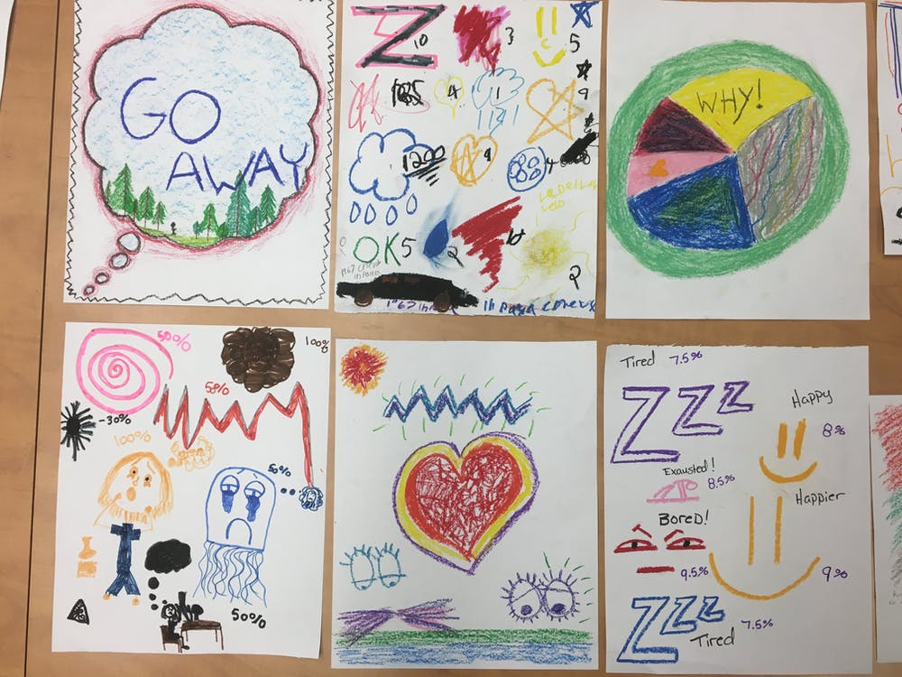


Working with Children in Crisis on a Behavioral Health Unit: Need for an Age-Appropriate Restraint Debriefing Policy
Lincoln Akre Teal, RN, BSN (MSN ‘21)
gatewaygazette.ca
Notes:
https://gatewaygazette.ca/visual-arts-help-marginalized-youth-learn-mindfulness-and-self-compassion/

Slide 2
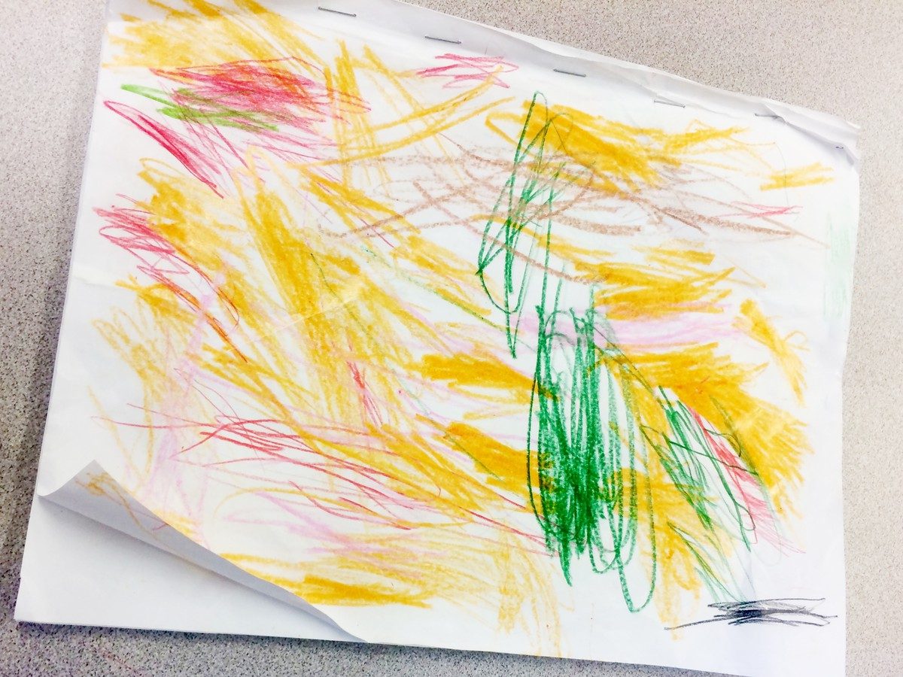

Restraint Debriefing Policy Objectives
Prove the need for a Child Restraint Debriefing form through literature search, expert consultation, and data collecting.
Develop a Child Restraint Debriefing form policy; MSN student with collaboration from a child psychologist.
Pilot will have a higher completion % than pre-pilot data forms self-reported by patients 11 years old or younger.
Post pilot completion % correlate with a lower reoccurrence of restraints by pediatric patients.
                arteascuola.com
Notes:
http://arteascuola.com/it/2016/11/disegno-musica-emozioni-lavoro-di-gruppo/

Slide 3
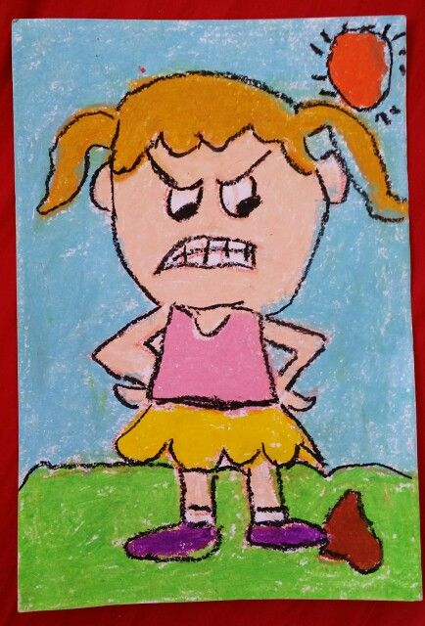
Background and Significance
Two research articles were reviewed and both identified the same results: (Magnowski, 2020; Vidal, 2020)
Children 12 years old or younger have a higher risk of restraints on pediatric/ adolescent behavioral health units
Children living with Neurodevelopmental Disorders such as ADHD, learning disorders, developmental delayed and autism, along with Disruptive Mood Dysregulation Disorder are high risk predictors of restraints.
Children in Massachusetts have a higher rate of restraints than any other age group (MA, DMH, 2004).
pinterest.com
Notes:
https://www.pinterest.com/smashingpins/kids-drawing/

Slide 4
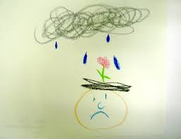
2004 MA Restraint Reduction Initiative
In 2004, MA released, Child and Adolescent Inpatient Restraint Reduction: A State Initiative to Promote Strength-Based Care
One of the many authors is the current HHS Secretary, Marylou Sudders.
The reasoning for this initiative was due to the increasingly high rates of restraints on child and adolescent units compared to adults.
In the article, there is mention of improving Tertiary Prevention, including patient debriefing comment forms.
There was no mention on how they were going to address Tertiary Prevention through the debriefing forms.
expressivehearts.com
Notes:
http://www.expressivehearts.com/art_gallery.html

Slide 5
Laws and Regulations
Massachusetts Department of Mental Health: 104 CMR 27.12 section 5 states that restraints are traumatic events for both staff and patients. Debriefing is critical in treatment planning and restraint prevention, along with addressing the emotional needs of the patients and staff.
27.12 (5b): Patient Debriefing is to be done as soon as possible and addresses the following:
  “review of the circumstance leading to the episode”
  “consideration of staff or patient actions that could have helped to prevent or that may have contributed to the episode, including the adequacy of the patient’s Individualized Crisis Prevention Plan”
  “a discussion of the type of restraint or seclusion used, and any physical or psychological effects the patient may be experiencing from the restraint or seclusion”
If possible, the staff involved in the restraint should not participate in the debriefing
Staff shall provide “any necessary assistance in completing the patient debriefing”
The patient has the right to refuse to participate in the debriefing, in which the staff person documents on the debriefing form.
Restraint debriefing forms have not been updated in 2006 and the only form available was made for adults.
arteascuola.com
Notes:
http://arteascuola.com/it/2016/11/disegno-musica-emozioni-lavoro-di-gruppo/

Slide 6
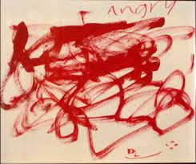
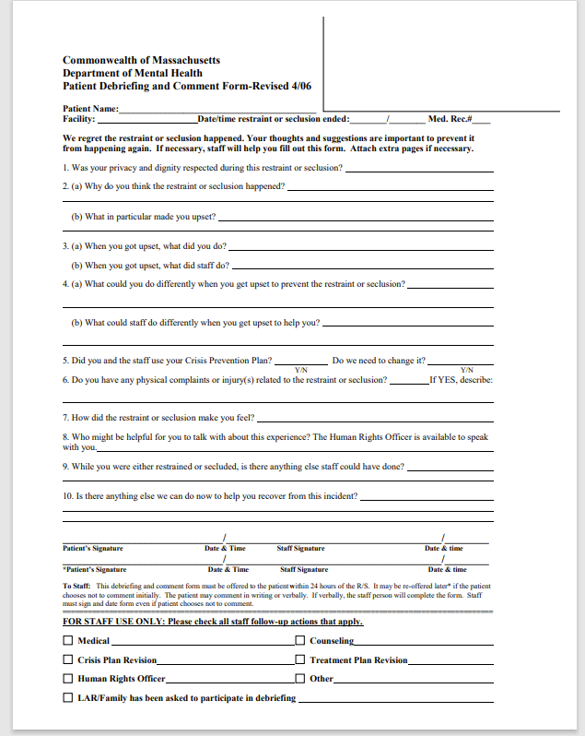
expressivehearts.com
Notes:
http://www.expressivehearts.com/Angry.jpg

Slide 7
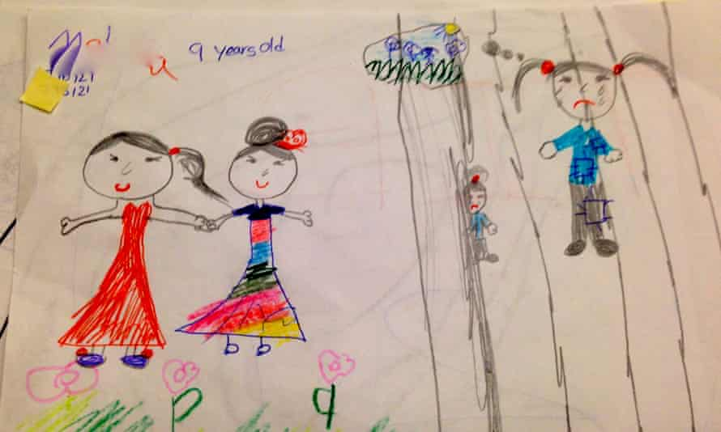
Stakeholders
The patients on the child/ adolescent psychiatric unit
  Ages 5-11 who have been restrained and will utilize the revised “kid-friendly” tool
Interdisciplinary staff on the unit
Commonwealth of Massachusetts Department of Mental Health
The parents or guardians of the restrained children:
  Receive a debriefing phone call ASAP
  Post discharge: The goal is to decrease restraint-related behaviors
  theguardian.com
Notes:
https://www.theguardian.com/commentisfree/2014/may/12/sadness-and-fear-what-the-drawings-by-children-in-detention-showed-us

Slide 8
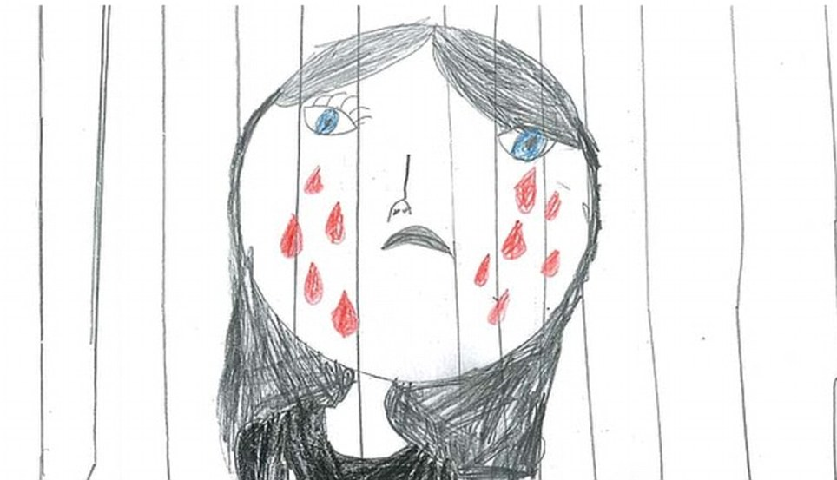
Methods: MSN Student-Led
Performed a 2020 chart audit of a 30 bed mixed child/ adolescent psychiatric unit in relation to restraint use by age group and completion of patient debriefing forms by children 11 and under.
Developed a Child Restraint Debriefing form (“kid-friendly”)
Provide training (2021) to staff on how to properly utilize the form.
Pilot the Child Debriefing Form on the unit (N = 25) for post data.
  Modify form if any issues arise (n = 5).
  healthindetentrescentres.cm
Notes:
https://healthindetentioncentres.wordpress.com/2015/03/18/childrens-health/

Slide 9
Chart Audit of Restraints in 2020 (n = 53) arteascuola.com
Ages | Number of Restraints | Number of Patients Restrained
7-9 | 58 ( range 1 - 21) | n = 10
10-11 | 46 (range 1 -21) | n = 9
12-13 | 33 | 10
14-15 | 27 | 11
16-18 | 40 Total = 206 | 13 Total = 53
Notes:
http://arteascuola.com/it/2016/11/disegno-musica-emozioni-lavoro-di-gruppo/

Slide 10
expressiveheart.com
Notes:
http://www.expressivehearts.com/Angry.jpg

Slide 11

Further evaluation of Pre-Pilot data of 7-11 yo
Of the 19 patients restrained, only 2 patients had one occurrence.
13 patients were restrained at least 3 times.
2 patients (an 8 years old and 10 years old) were restrained 21 times each
Only 14 of the restraints for children 11 years old or under had patient self-reported Debriefing Forms completed
  13.5% completion rate
  Goal is a negative correlation: with an increase in completion of the forms (and communication of the results to staff) there will be a decrease in restraint use in the age group 7 – 11
  Healthymindsforhappykids.com
Notes:
https://www.healthymindsforhappykids.com/self-regulation

Slide 12


Quadruple Aim: For Further Pediatric Policies and Implementation
Improving the patient experience of care
  The debriefing forms being completed will decrease the number of restraint occurrences and will let the patient be better heard.
Improving the (mental) health of populations
  Improve care of the young patients in restraints by having a better understanding of the incident from the patient’s perspective of the incident and how to improve.
Reducing the per capita cost of health care
  Restraints lead to longer stays, increased staffing and in some cases, injuries to patients or staff.
Staff Engagement
  Staff will be working with the patients on reducing the restraint reoccurrences.
  arteascuola.com
Notes:
http://arteascuola.com/it/2016/11/disegno-musica-emozioni-lavoro-di-gruppo/

Slide 13
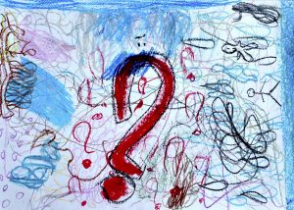
Pediatric Patient Debriefing and Comment Form
We are sorry the restraint or seclusion happened. We would like your help in explaining what happened and what we can do to not have it happen again. Ask staff if you would like any help?
arteascuola.com
Notes:
http://arteascuola.com/2016/11/drawings-music-emotions-collaborative-project/

Slide 14
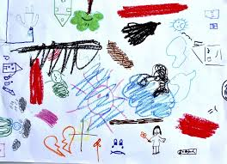
“Review of the circumstance leading to the episode” (27.12 (5b))
1. What happened before you got so sad or mad?
2. When you were sad or mad, what did you do?
3. When you were sad or mad, what did staff do?
arteascuola.com
Notes:
http://arteascuola.com/it/2016/11/disegno-musica-emozioni-lavoro-di-gruppo/

Slide 15
“Consideration of staff or patient actions that could have helped to prevent or that may have contributed to the episode” (27.12 (5b))
4. What are some coping skills you could have used to calm down?
5. What could staff have done to help you calm down?
The improvement and usage of coping skills are a key component of care on the unit
The inclusion on “the adequacy of the Patient’s Individualized Crisis Prevention Plan,” should be discussed in the Staff Debriefing
arteascola.com
Notes:
http://arteascuola.com/it/2016/11/disegno-musica-emozioni-lavoro-di-gruppo/

Slide 16
“a discussion of any physical or psychological effects the patient may be experiencing from the restraint or seclusion” (27.12 (5b))
6. Did you get hurt?
7. How did you feel when you were restrained?
“a discussion of the type of restraint or seclusion used” is reviewed in Question 3.
The form was reduced from 13 questions to 7 questions, which makes it easier for patient with a lower attention span.
arteascola.com
Notes:
http://arteascuola.com/it/2016/11/disegno-musica-emozioni-lavoro-di-gruppo/

Slide 17
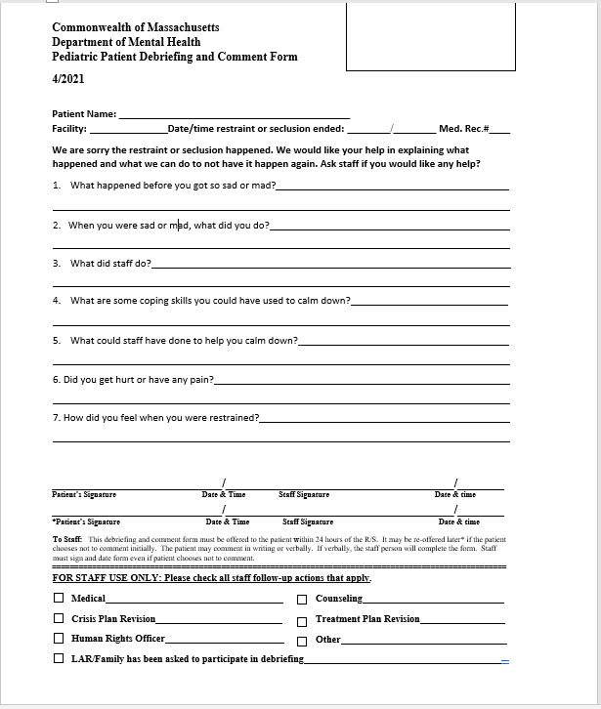
arteascuola.com
Notes:
http://arteascuola.com/it/2016/11/disegno-musica-emozioni-lavoro-di-gruppo/

Slide 18
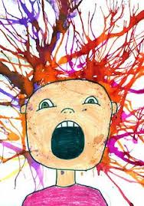
Timeline
Pre-data phase 2020
Literature review and expert consultation (2020-2021)
A rollout on 30 bed child/ adolescent psychiatry unit.
Pilot begins 2021
  Every 3 months, data will be collected on restraints among children 11 years old or younger, including the number of repeated occurrences and completed debriefing form.
After a year of data is collect, the results will be formulated and present to DMH.
Further dissemination could include journal article, presentations to other stakeholders locally and nationally.
magicofchildren.ca
Notes:
http://magicofchildren.ca/childrens-art-classes/art-sprouts-age-4-7-years

Slide 19
Select References and Resources
Magnowski, S. R., Kick, D., Cook, J., & Kay, B. (2020). Algorithmic Prediction of Restraint and Seclusion in an Inpatient Child and Adolescent Psychiatric Population. Journal of the American Psychiatric Nurses Association. https://doi.org/10.1177/1078390320971014
LeBel, J., Stromberg, N., Duckworth, K., Kerzner, J., Goldstein, R., Weeks, M., Harper, G., LaFlair, L., & Sudders, M. (2004). Child and adolescent inpatient restraint reduction: a state initiative to promote strength-based care. Journal of the American Academy of Child and Adolescent Psychiatry, 43(1), 37–45. https://doi.org/10.1097/00004583-200401000-00013
Vidal, C., Reynolds, E.K., Praglowski (2020) Risk Factors for Seclusion in Children and Adolescents Inpatient Psychiatry: The Role of Demographic Characteristics, Clinical Severity, Life Experiences and Diagnoses. Child Psychiatry Hum Dev . 51, 648–655. https://doi.org/10.1007/s10578-020-00963-0
Department of Mental Health MA
gatewaygazette.ca
Notes:
https://gatewaygazette.ca/visual-arts-help-marginalized-youth-learn-mindfulness-and-self-compassion/

Slide 20
Acknowledgements
Massachusetts Department on Mental Health Inpatient/ IRTP Licensing Division
Dr Melanie Harkins, Psychologist
Maria Stacy, Program Director NSMC Pediatric psychiatry
North Shore Medical Center Epstein Center Pediatric Psychiatry Unit
Background artwork credit citations from the WWW are on bottom right of slides
gatewaygazette.ca
Notes:
https://gatewaygazette.ca/visual-arts-help-marginalized-youth-learn-mindfulness-and-self-compassion/

