Slide 1

Sport Related Performance Anxiety in Collegiate Student Athletes
Examining Effects of Covid-19
Gracie Hogan & Professor Christopher Schoen

Slide 2
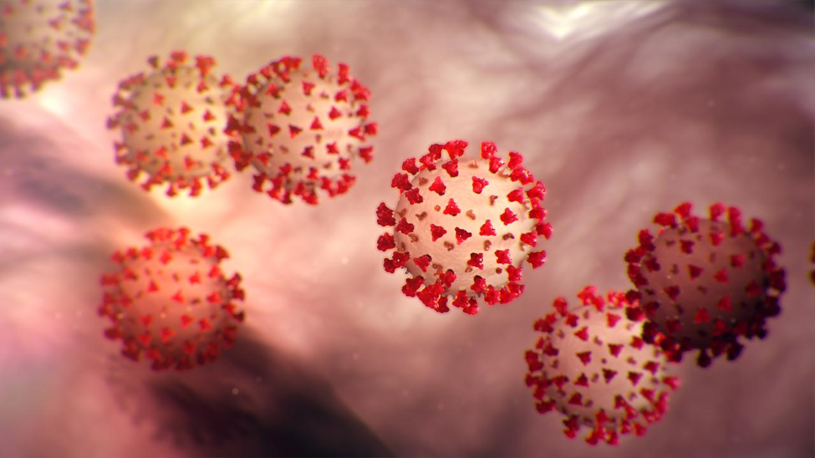
Statement of Purpose
The purpose of this study was to examine collegiate student athlete performance anxiety specifically in division 3 student athletes and to learn about the impact of the Covid-19 Pandemic.

Slide 3
What is Performance Anxiety?
Performance anxiety is an undesirable psychological state as a result of perceived stress when performing under pressure.
Anxiety is an emotional state
Anxiety = cognitive + somatic symptoms
  Cognitive: worry
  Somatic: physical activation
Trait anxiety: anxiety as a stable component of personality
State anxiety: anxiety that is dependent on situation

Slide 4
Energy & Trait Anxiety
High trait anxiety
  Perceive more situations as threatening
  Respond to threatening situations with higher levels of anxiety
  Predisposition
Energy
  Trait anxiety is similar to potential energy
    Predisposition to act when faced with the triggering stimuli
      Activating stimuli in this case is sport.
Stress
Threat
State anxiety reaction
Notes:
Demands exceed capacity
Cognitive appraisal
Outcome is perceived to be of importance

Slide 5

The Covid-19 Pandemic
Severe acute respiratory syndrome coronavirus 2
First identified in Wuhan, China
World Health Organization declared Covid-19 a Public Health Emergency of International Concern on January 30, 2020
WHO declared global pandemic on March 11, 2020
As of April 21, 2022: 507 million+ cases & 6.2 million deaths
In the context of mental health & sport, covid is a time of loss and grief.

Slide 6

Review of Literature
Data from May 2020 collected by the NCAA showed that 49-75% of division 3 student athletes experienced at least one mental health concern at some point in the pandemic at that point²
NCAA research from 2021 showed that 45% of men and 59% of women had somewhat to strong negative mental health affects when they were not training for their sport or with their teammates²
Transitions that occur when an athlete gets pulled from their sport may have detrimental effects on mental health and identity⁴

Slide 7

Review of Literature
The American College of Sports Medicine found that a portion of mental distress was correlated with the lack of resources and available facilities¹
The American College of Sports Medicine reported student athletes having less motivation during the Covid-19 Pandemic¹
According to a study on collegiate SA mental health, 44% of collegiate student athletes reported not receiving any mental health education from their athletic department¹
The Sports Journal noted that over 85% of athletic directors in their study identified anxiety as a major concern for their student athletes³

Slide 8
The Scope of Collegiate Athletics
NCAA
Division 1
350 Schools
32% of NCAA
1 in 23 people are student athletes
Multi-year athletic scholarships
57% of athletes receive athletic aid
Division 3
438 Schools
40% of NCAA
1 in 6 people are student athletes
No athletic scholarships
80% of athletes receive NON athletic aid
Division 2
310 Schools
28% of NCAA
1 in 10 people are student athletes
Partial athletic scholarships
60% of athletes receive athletic aid

Slide 9
Methods
Survey administered to division 3 collegiate student athletes through online survey forum, Survey Monkey
Combination of Sport Anxiety Scale 2, Sport Competition Anxiety Test and qualitative questions
Voluntary response sampling was used
Most appropriate method for reaching large population in time constraint while also considering constraints of continued pandemic

Slide 10
Participants & Recruitment
217 division 3 student athletes
Representation from 19 different sports
Freshman through 5th year students
Social media posts
Emails to athletic directors asking for participation from their student athletes
Participants
Recruitment

Slide 11
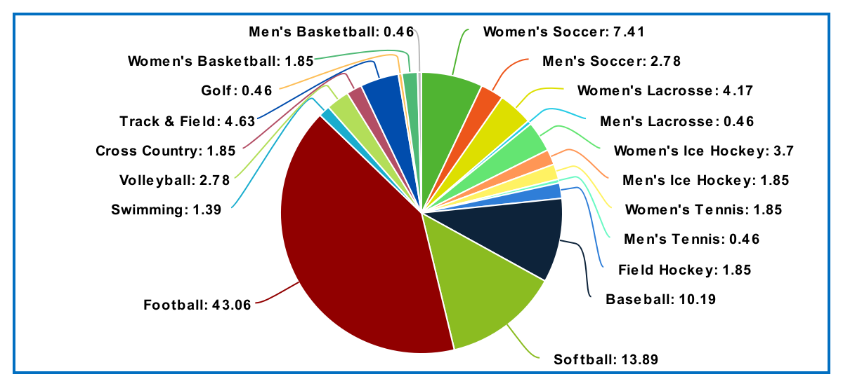
Demographics: Participants by Sport

Slide 12
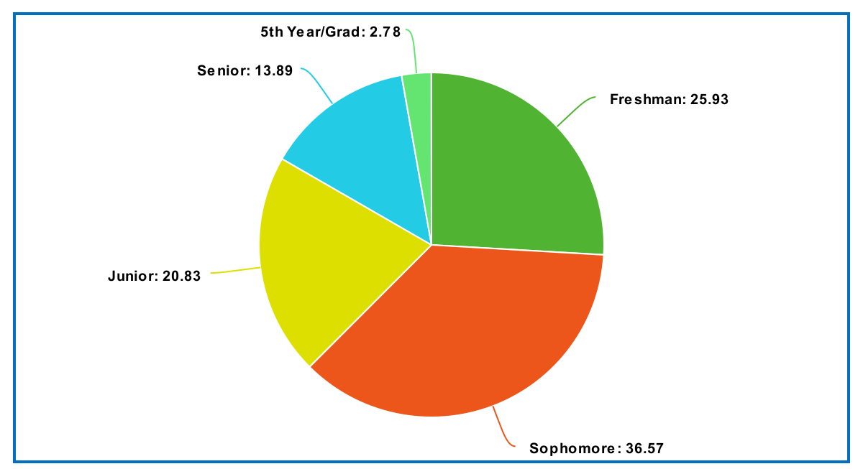
Demographics: Participants by Year in School

Slide 13
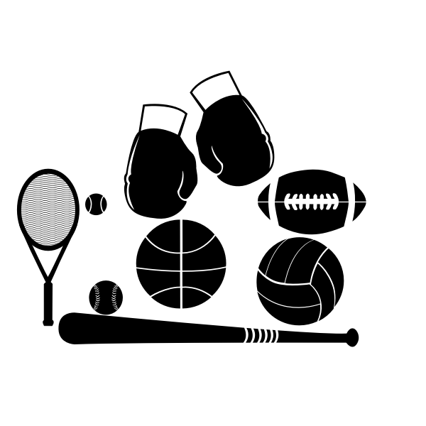

Data Through 2 Lenses

Slide 14

Sport Competition Anxiety Test
15 item survey
10 items measure symptoms of anxiety
5 additional measures reduce likelihood of internal response-set bias
Measure trait anxiety
Highest possible score: 30
Lowest possible score: 10

Slide 15

Sport Competition Anxiety Test
Competing against others is socially enjoyable.
Before I compete, I feel uneasy.
Before I compete, I worry about not performing well.
I am a good sportsman when I compete.
When I compete I worry about making mistakes.
Before I compete, I am calm.
Setting a goal is important when competing.
Before I compete, I get a queasy feeling in my stomach.
Just before competing, I notice my heart beats faster than usual.
I like to compete in games that demand a lot of physical energy.
Before I compete, I feel relaxed.
Before I compete, I am nervous.
Team sports are more exciting than individual sports.
I get nervous waiting for the game to start.
Before I compete, I usually get uptight.

Slide 16
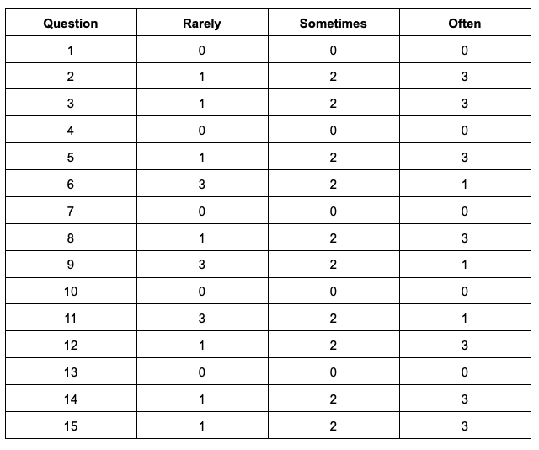
Sport Competition Anxiety Test: Scoring
<17: Low level of anxiety
17-24: Average level of anxiety
>24: High level of anxiety

Slide 17
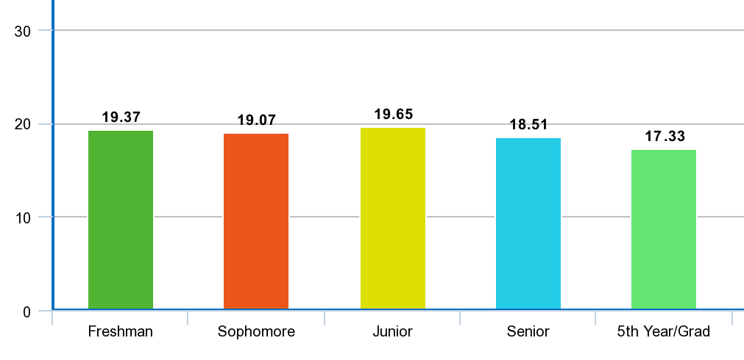
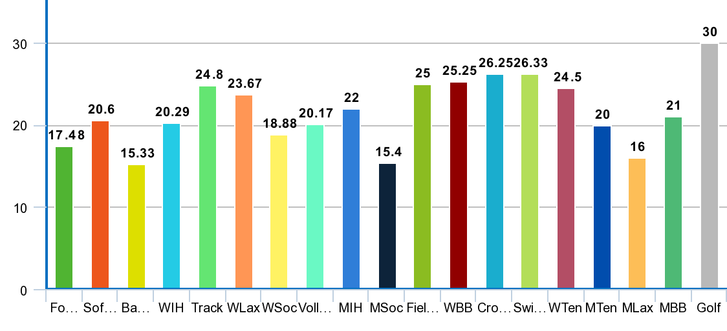
SCAT Scores
By Class
By Sport

Slide 18
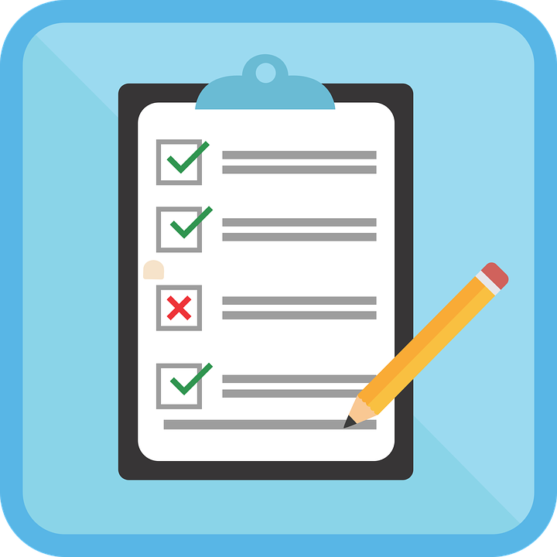
Sport Anxiety Scale 2
15 item survey
5 additional measures reduce likelihood of internal response-set bias
Measures multidimensional trait anxiety
3 factor analysis: somatic, worry, concentration disruption
5 measures for each factor
Highest possible score: 60
Lowest possible score: 15

Slide 19
Sport Anxiety Scale 2
It is hard to concentrate on the game.
I feel confident about performing well.
My body feels tense.
I worry that I will not play well.
It is hard for me to focus on what I’m supposed to do.
I worry that I will let others down.
I am confident I can meet the challenge.
I feel tense in my stomach.
I lose focus on the game.
I worry that I will not play my best.
I am confident about coming through under pressure.
I worry that I will play badly.
My muscles feel shaky.
I worry that I will mess up during the game.
My stomach feels upset.
I am able to focus on the game.
I cannot think clearly before the game.
My muscles feel tight because I am nervous.
Before competition I feel mentally relaxed.
I have a hard time focusing on what my coach tells me to do.
Somatic: 2, 6, 10, 12, 14
Worry: 3, 5, 8, 9, 11
Concentration Disruption: 1, 4, 7, 13, 15

Slide 20
Sport Anxiety Scale 2: Scoring
Not at all:
1
A little bit:
2
Pretty much:
3
Very much:
4
3 Factor Score:
Worry Score
Somatic Score
Concentration Disruption Score

Slide 21
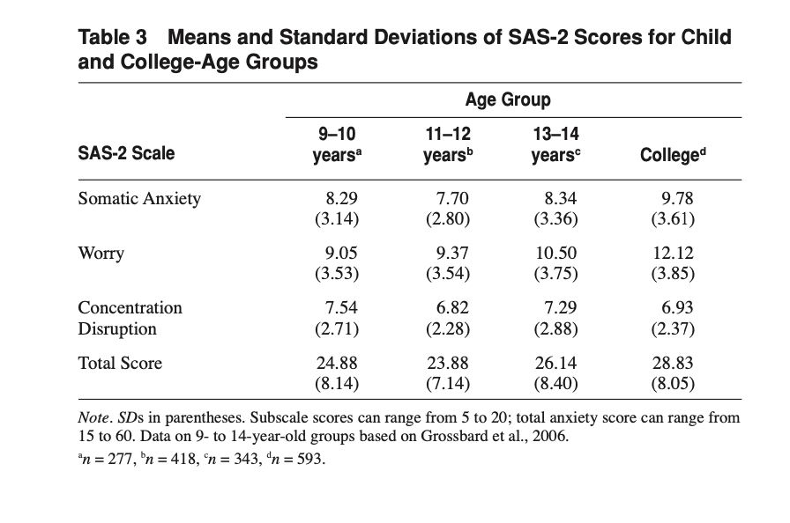
Sport Anxiety Scale 2
Notes:
Normative scores reported by Smith and Small
Our scores are lower
Study in 2006
Some people were happy with time off from covid
Differences may not be stat sig
Coming back from holiday season

Slide 22
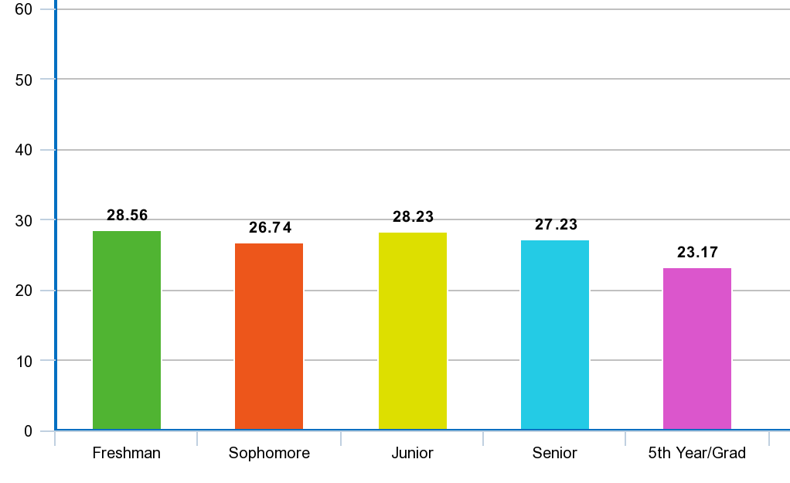
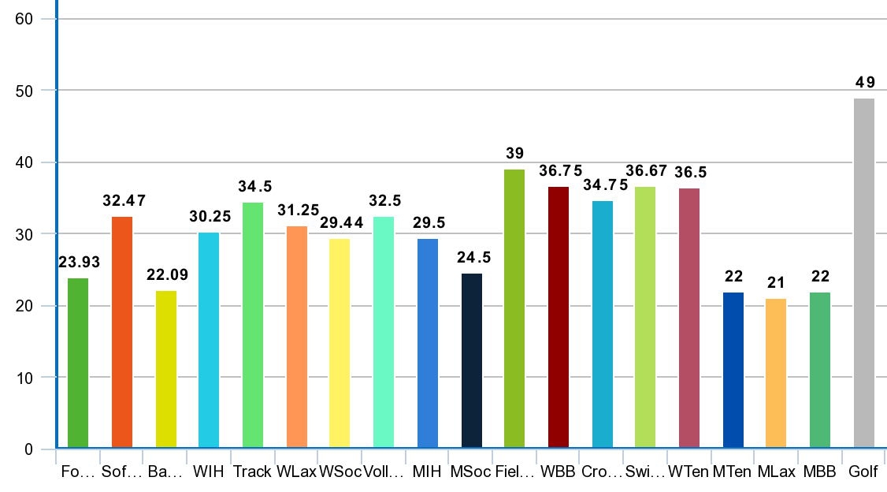
SAS-2 Total Scores
By Class
By Sport
Notes:
gender

Slide 23
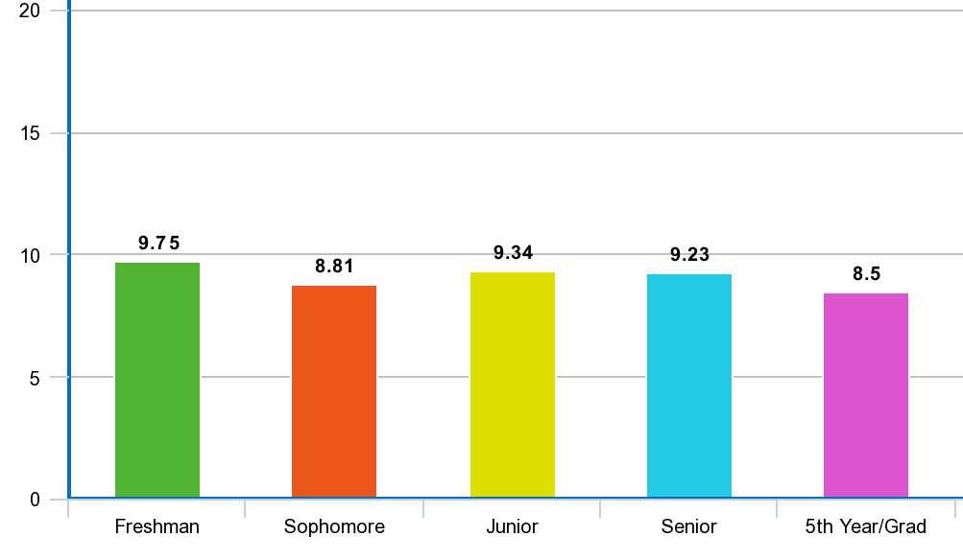
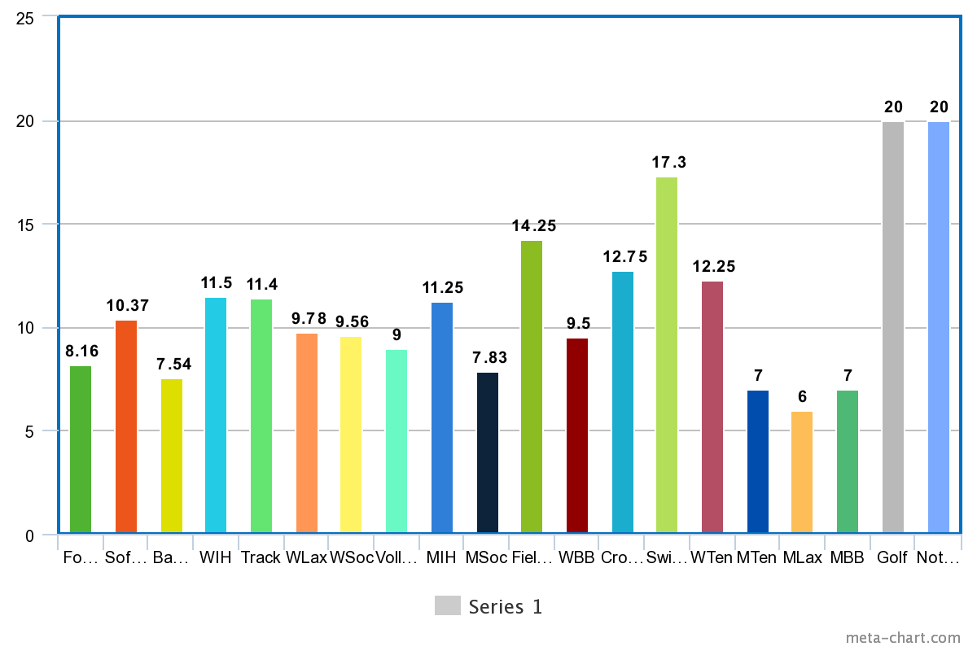
SAS-2 Somatic Scores
By Class
By Sport

Slide 24
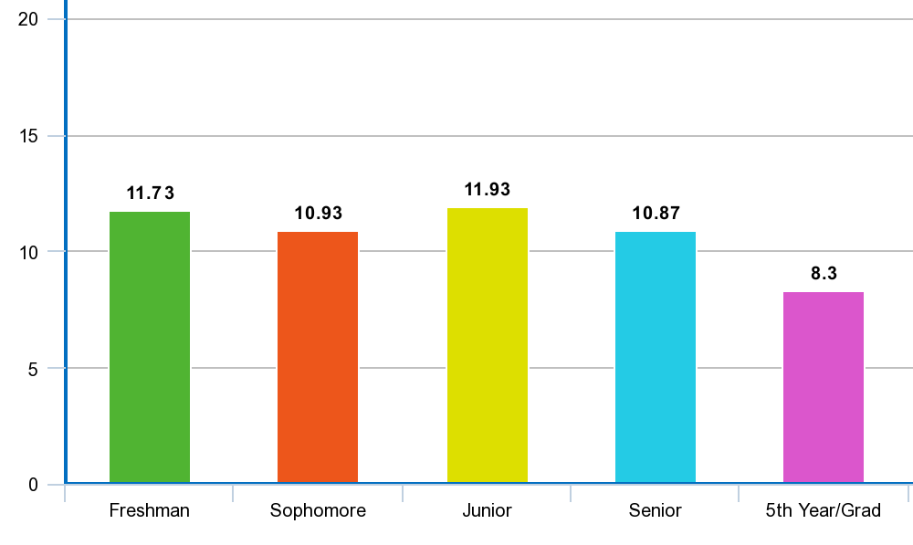
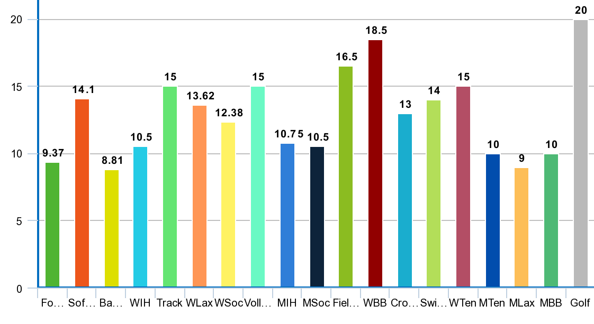
SAS-2 Worry Scores
By Class
By Sport

Slide 25
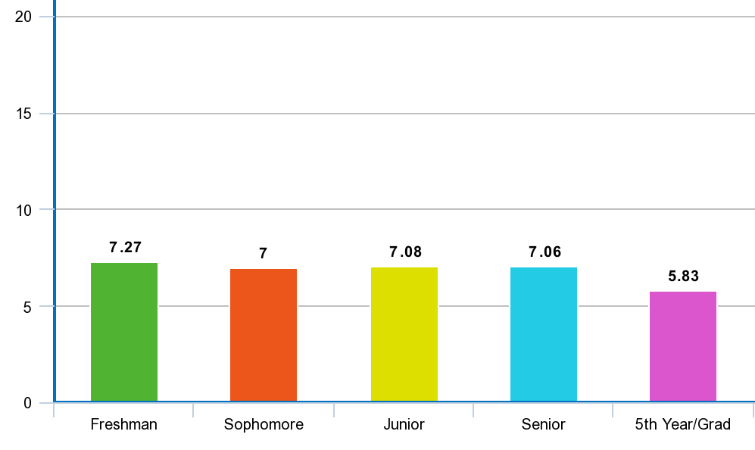
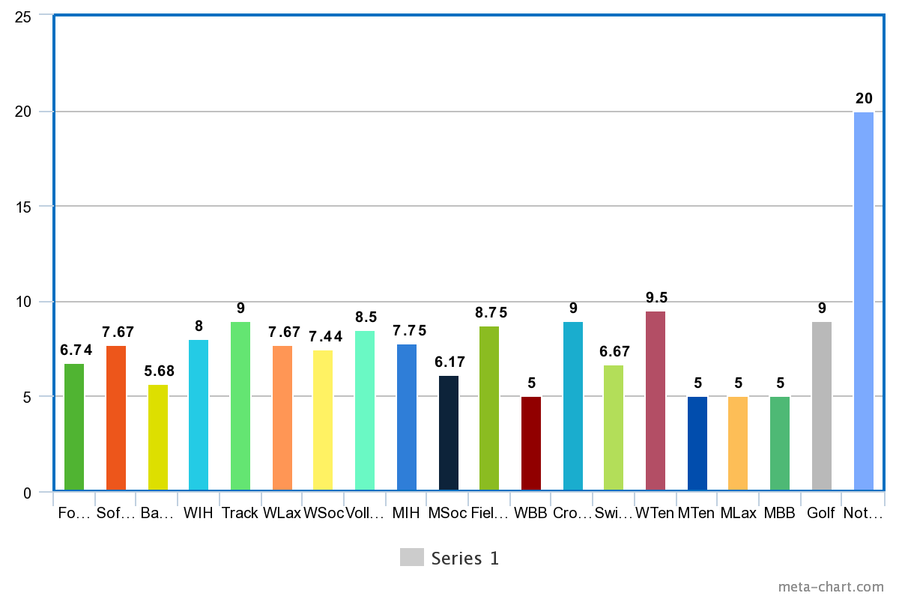
SAS-2 Concentration Disruption Scores
By Class
By Sport

Slide 26
Qualitative Data
Thematic analysis beginning with word cloud formatted through online survey instrument, Survey Monkey
Coded in relation to several broad themes
Organized and clustered responses

Slide 27
Qualitative Measures
How concerned were/are you for the potential impacts of the Covid-19 Pandemic on your season and performance?
In what specific ways do you think your performance will be impacted due to the pandemic? If you have already played your return to play season, how was your performance impacted?
Do you think your performance anxiety increased or decreased as a result of the Covid-19 pandemic?
If you answered with increased, why do you think this is the case?

Slide 28
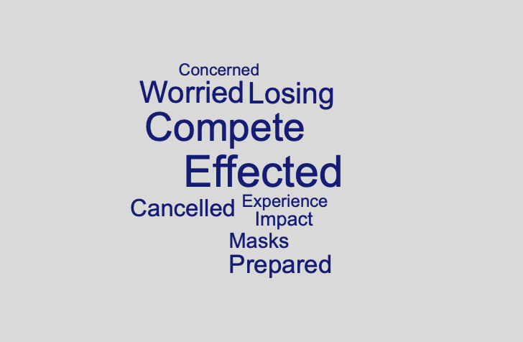
How concerned were/are you for the potential impacts of the pandemic on your season and performance?

Slide 29
How concerned where/are you for the potential impacts of the pandemic on your season and performance?
“I mostly worry that events will get cancelled, but the last two seasons of track and field have been very affected: my sophomore year everything was cancelled, and my junior year they cancelled New Englands, which was what I'd been working towards all season and would have qualified for. I'm hoping that we get to have all our normal meets this season since it will be my last year of competing at a college level. (Senior, cross country/track & field)”
“Very concerned. I got injured in a game in February 2020 so at first I was glad I would have time off to heal and wouldn’t get behind since everyone was off. However I found that having so much time off from games really affected me. I don’t think I’ve come back to my previous playing level and don’t feel like I can anymore since I basically had a 1.5 year gap in play (Sophomore, women’s soccer).

Slide 30
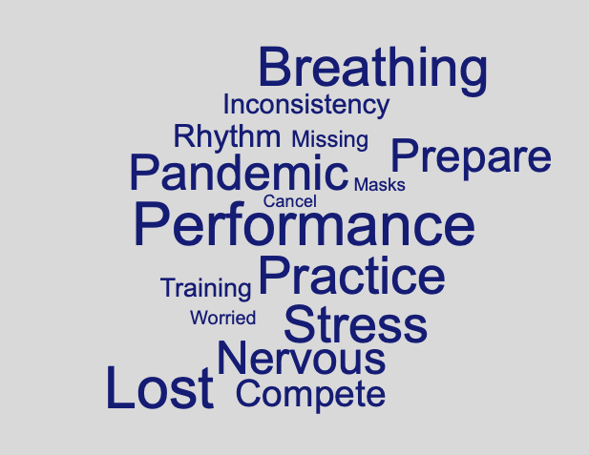
In what specific ways do you think your performance will be impacted?

Slide 31
In what specific ways do you think your performance will be impacted?
“Definitely am a little more stressed. Overall, the pandemic has caused me to feel a significant increase in tension/irritability; I sense the same in my teammates (Junior, swimming).”
“I felt that each game was even more important than I had already made them, which increased levels of anxiety and nervousness for each game (Senior, women’s basketball).”
“Lack of practice and time to prepare for games. I feel like the pandemic put a lot stress to athletes trying to become eligible to play and to make sure to get your reps in to perform in the game (Sophomore, baseball).”

Slide 32
In what specific ways do you think your performance will be impacted?
Various schools we play were able to practice more than us last year and even play games. We missed an entire season of development, far more than our opponents, which put us at a vast disadvantage. We also lost 2 freshman last year who transferred, and I don't think they would've if it weren't for covid. Living on campus last year was definitely depressing for students and boring due to the pandemic, so they didn't get a genuine experience. I don't necessarily blame (school) for this as it was the pandemics fault, but as a result we lost 2 good players and have a much smaller team. Furthermore, currently (campus gym) is closed. We've been without a gym and unable to do workouts for a month. All of our opponents have access to gyms during winter break, and they're varsity gyms at that. I understand (campus gym) is a public gym, but the fact it wasn't a priority to find a way to get winter athletes in there over winter break is incredibly frustrating. I had 2 girls on my team get Planet Fitness memberships this past month. Obviously this wasn't mandatory and it was their choice, but it speaks to the dedication and resources we need to compete with top teams in the nation that we face (Senior, women’s ice hockey).”

Slide 33
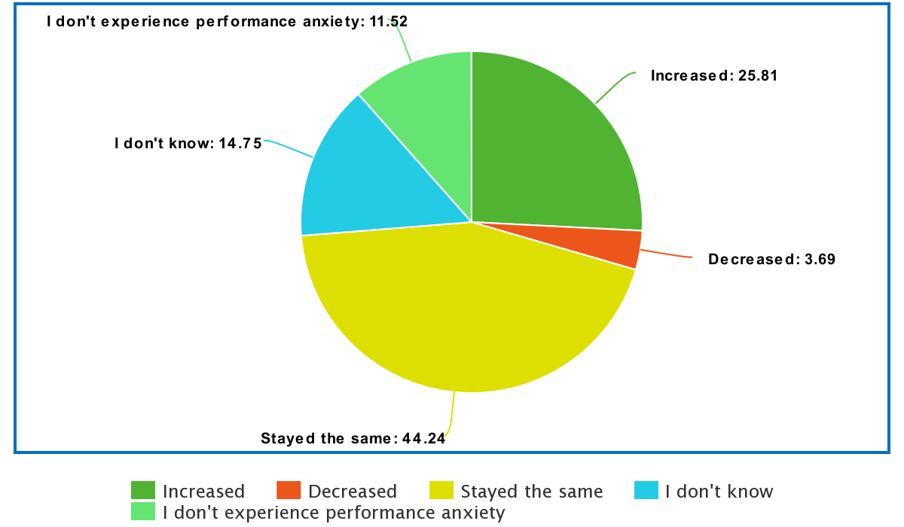
Do you think your performance anxiety increased or decreased as a result of the pandemic?

Slide 34
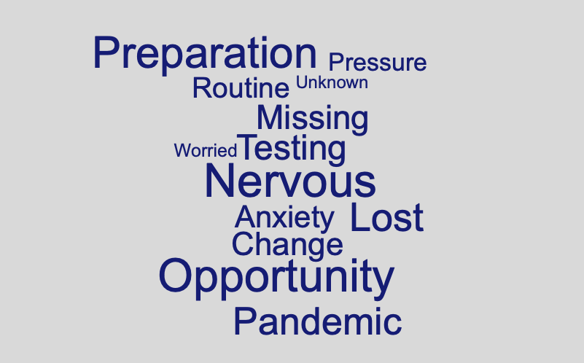
If you answered with increased, why do you think this is?

Slide 35
If you answered with increased, why do you think this?
“We were testing regularly at school anyway, but with the extra testing on weeks we competed, I felt much more stressed and would second guess decisions to hang out with friends not on the team or even go to the grocery store, because I was worried about testing positive, in which case everyone on my team wouldn't be able to practice or race for ten days. Running was already stressful because it's challenging, but Covid added a whole other layer of stress to it that mostly involved social responsibility and testing that I hadn't anticipated having to deal with (Senior, cross country/track & field).”
“Missed practices needed to improve, constant Covid testing because I don’t have the vaccine but have natural immunity, peer pressure to get a shot I’ve chosen not to get because I’ve been directed by my doctor not to with already having the virus. Policies changing every semester with Covid that restrict interactions (Freshman, swimming).”
“Stress increased when I went so long not being able to play my sport, I had to jump right back in this season after not being allowed to play for over a year. I feel that I have to make up for this lost time by playing better and impressing my new coach and teammates which caused me to overthink and not play as well as I am able to (Freshman, women’s soccer).”

Slide 36
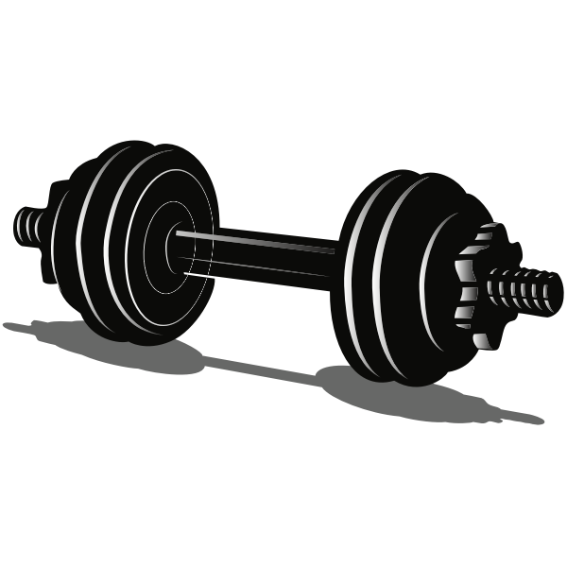
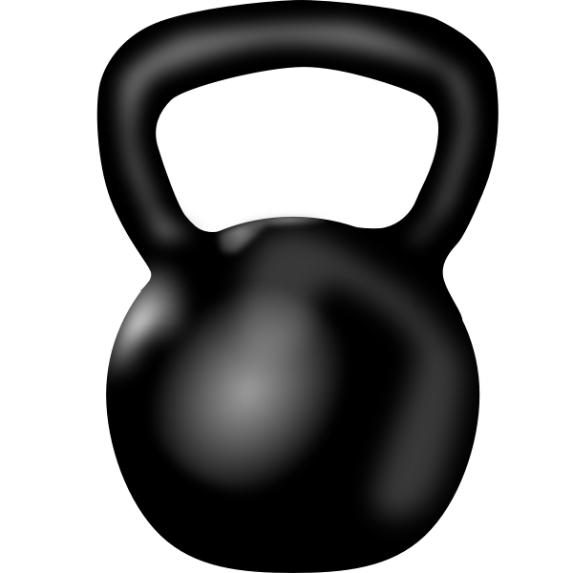
Additional Considerations
Severe performance anxiety so limited competitions was fine
“I was not very concerned about Covid impacting my season bc I get very nervous about races and really don't enjoy competing so having fewer competitions was fine with me (sophomore, cross country/track & field).”
No concern for performance, just that season would be taken away
“Not very concerned about my performance. More worried about not having a season (freshman, football).”
Forced time off gave more time to prepare and sharpen skill set for those that had access to the means necessary
“I don't think my performance was impacted negatively. If anything, I worked harder because if the season ever ended early I wanted to feel that I gave it everything I had (freshman, women’s soccer.)

Slide 37
Practical Implications
Recognize duty of care for student athletes
  Increase programming for mental health concern
  Connect student athletes to resources
  Have contact points easily accessible on campuses
  Increase funding for mental health initiatives
  Increase support for student athletes on a national and institutional level

Slide 38
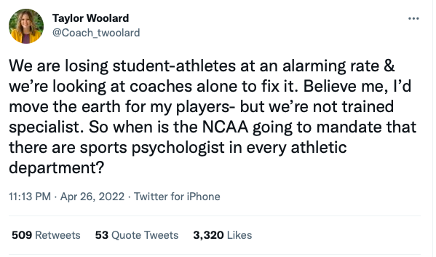
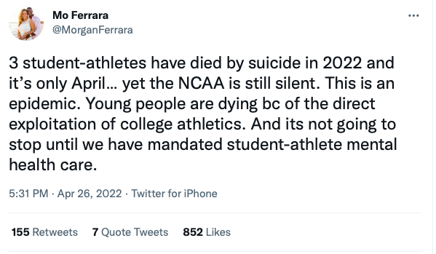

Slide 39
Bullard, J. B. (2020). The impact of COVID-19 on the well-being of division III student-athletes. The Sport Journal, 22(5), 1543-9518.⁴
Chandler, A. J., Arent, M. A., Cintineo, H. P., Torres-McGehee, T. M., Winkelmann, Z. K., & Arent, S. M. (2021). The Impacts of COVID-19 on Collegiate Student-Athlete Training, Health, and Well-Being. Translational Journal of the American College of Sports Medicine, 6(4), e000173.¹
Economou, P. J., Glascock, V., Louie, M., Poliakova, P., Zuckerberg, W., Park, H., & Economou, P. COVID-19 and its impact on student-athlete depression and anxiety: the return to campus.³
Ford, J. L., Ildefonso, K., Jones, M. L., & Arvinen-Barrow, M. (2017). Sport-related anxiety: current insights. Open access journal of sports medicine, 8, 205.
Martens, R. (1977). Sport competition anxiety test.
Martens, R., Vealey, R. S., & Burton, D. (1990). Competitive anxiety in sport.
Smith, R. E., & Smoll, F. L. (1990). Sport performance anxiety. In Handbook of social and evaluation anxiety (pp. 417-454). Springer, Boston, MA.
Smith, R. E., Smoll, F. L., Cumming, S. P., & Grossbard, J. R. (2006). Measurement of multidimensional sport performance anxiety in children and adults: The Sport Anxiety Scale-2. Journal of Sport and Exercise Psychology, 28(4), 479-501.

Slide 40
​Amaechi, J. (Dec 18, 2018). AASP 2018 Keynote: John Amaechi OBE - Overpromise & Underdeliver (A Duty of Care). Retrieved April 27, 2022. https://www.youtube.com/watch?v=K7z-toAoj_I
Durand-Bush, N., Gunter, K., Mugford, A., Haberl, P., Aoyagi, M. (May 20, 2020). Supporting Athlete Mental Health During the COVID-19 Pandemic. [Webinar]. Association of Applied Sport Psychology (AASP). https://www.facebook.com/AssociationforAppliedSportPsychology/videos/619003602081346
Valster, K. M., Cochrane-Snyman, K., Smith, D., & Jones, K. (2021). COVID-19 Distress in NCAA Division III Student-athletes. Journal of Issues in Intercollegiate Athletics, 14, 674-693.²

