Slide 1
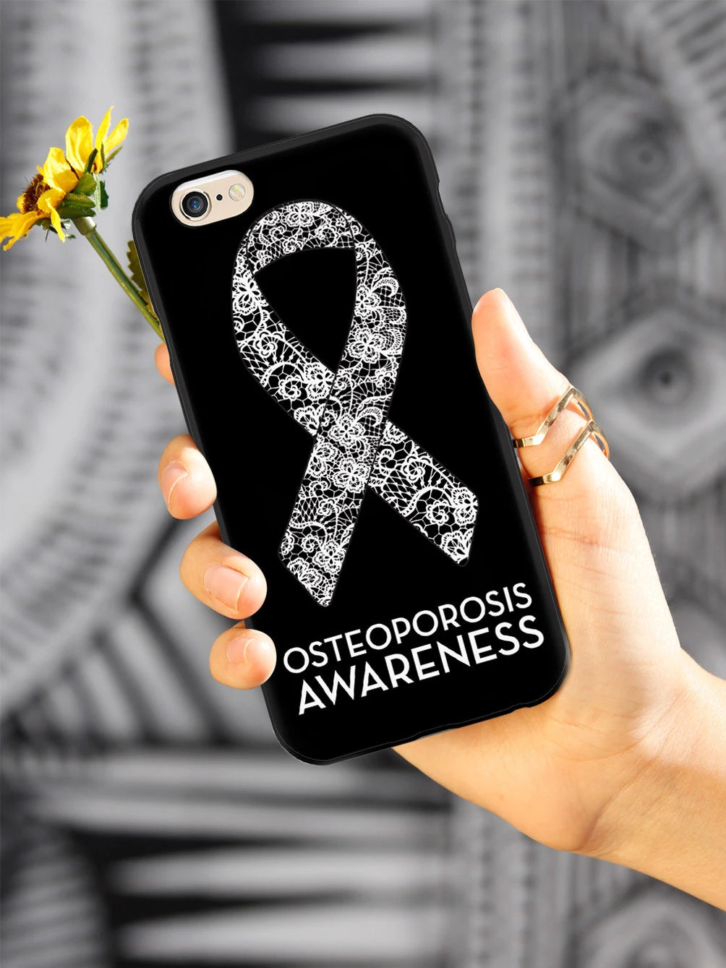

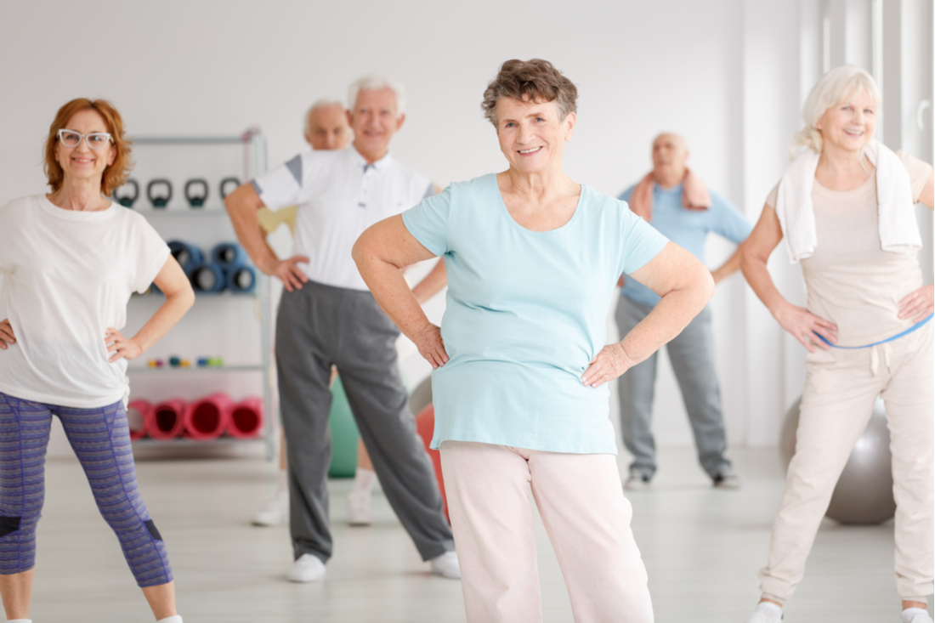

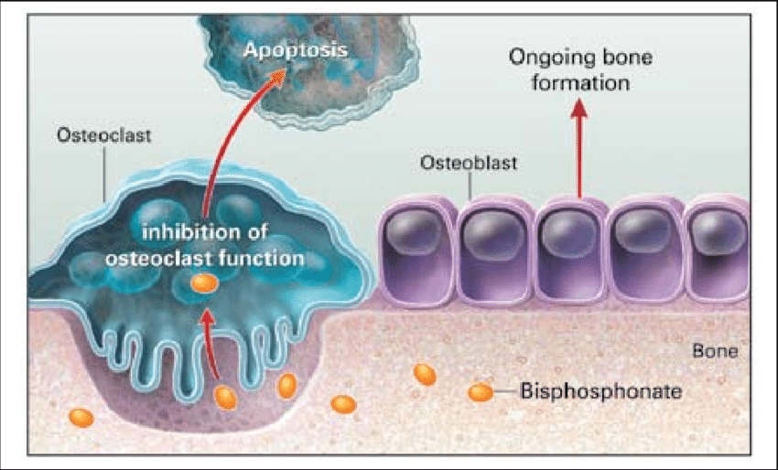
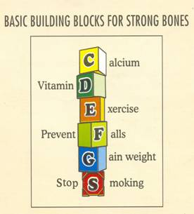

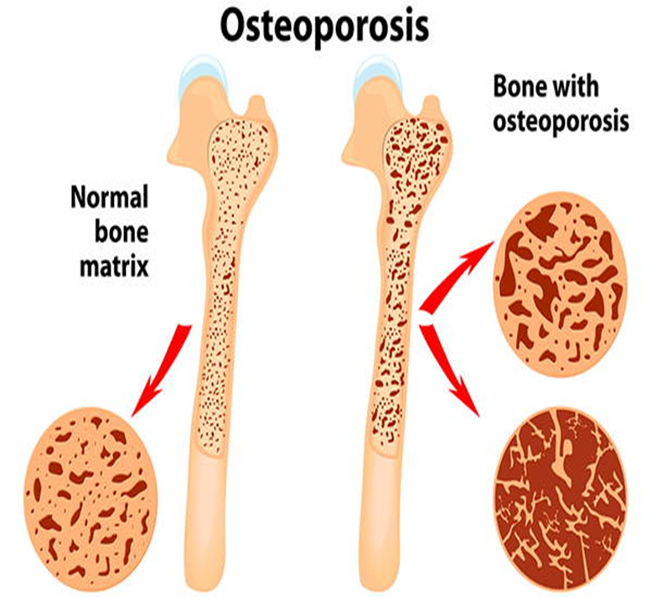
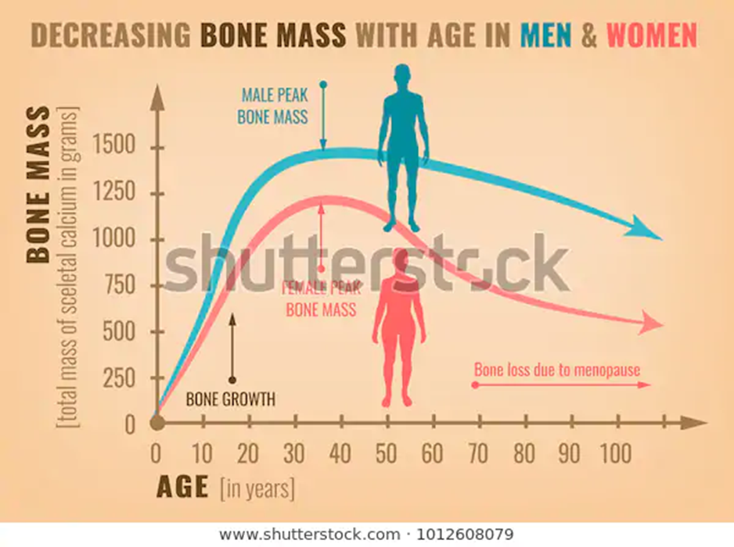
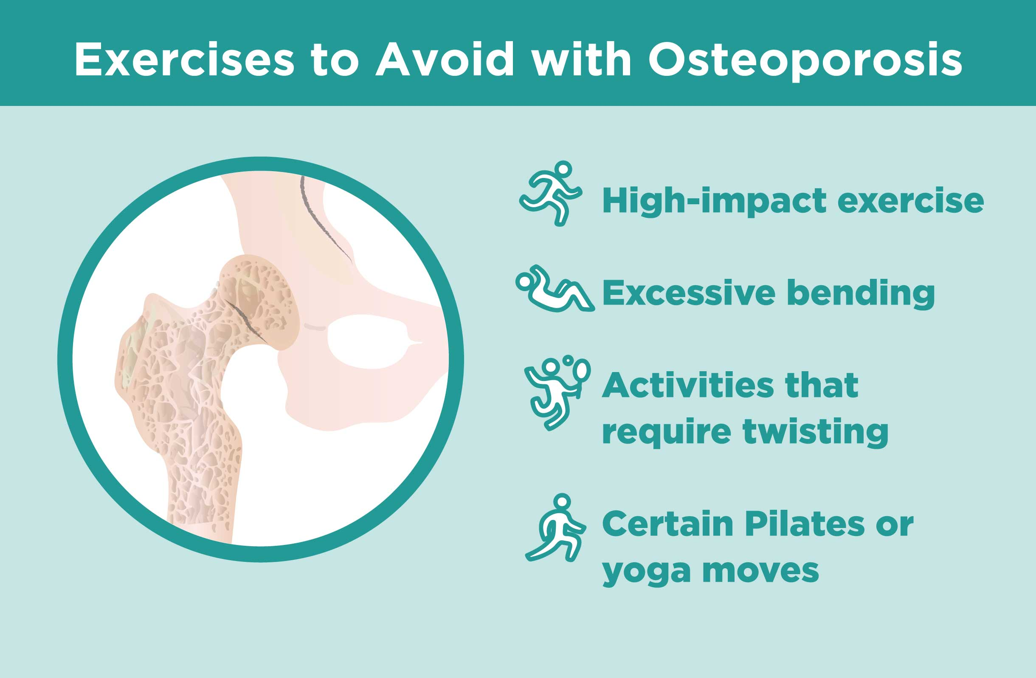
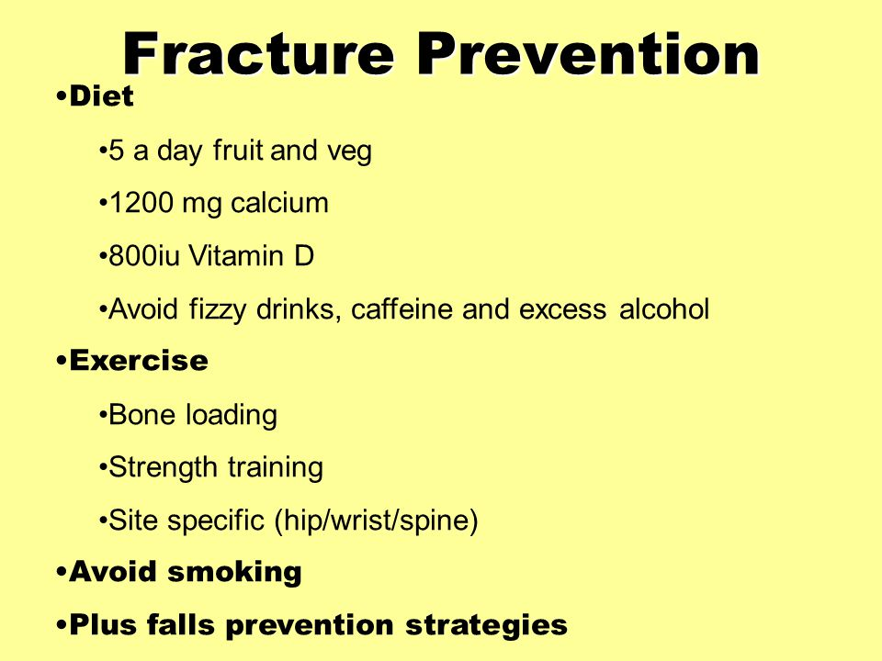
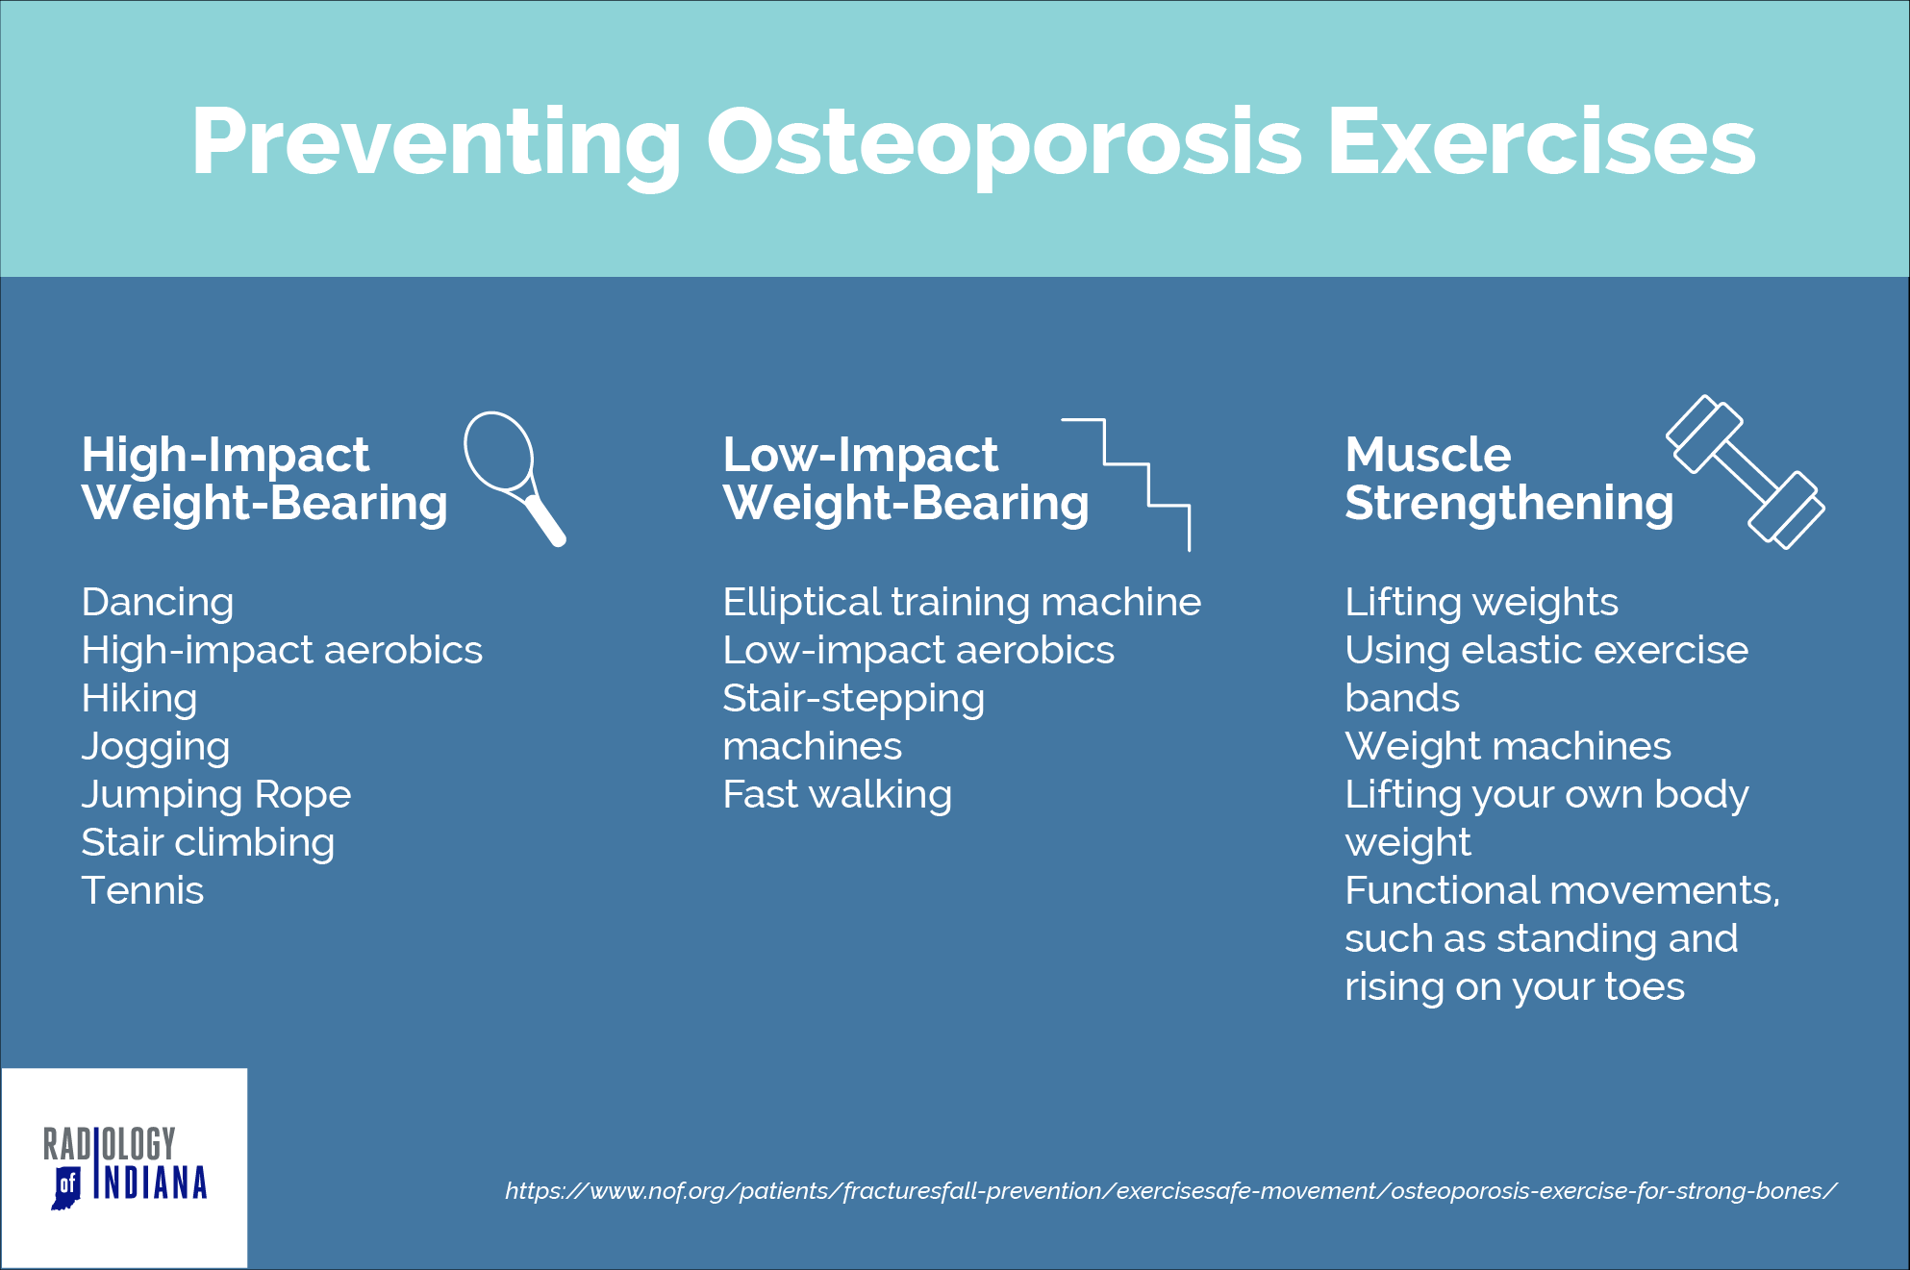

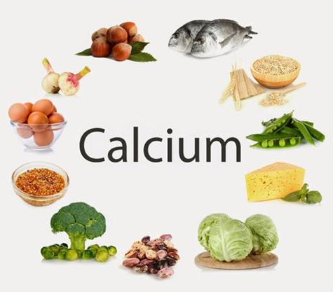
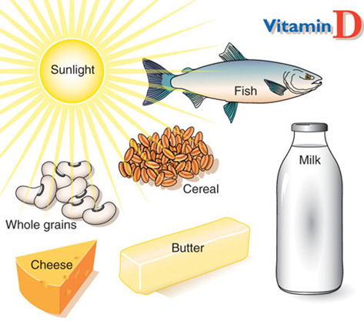
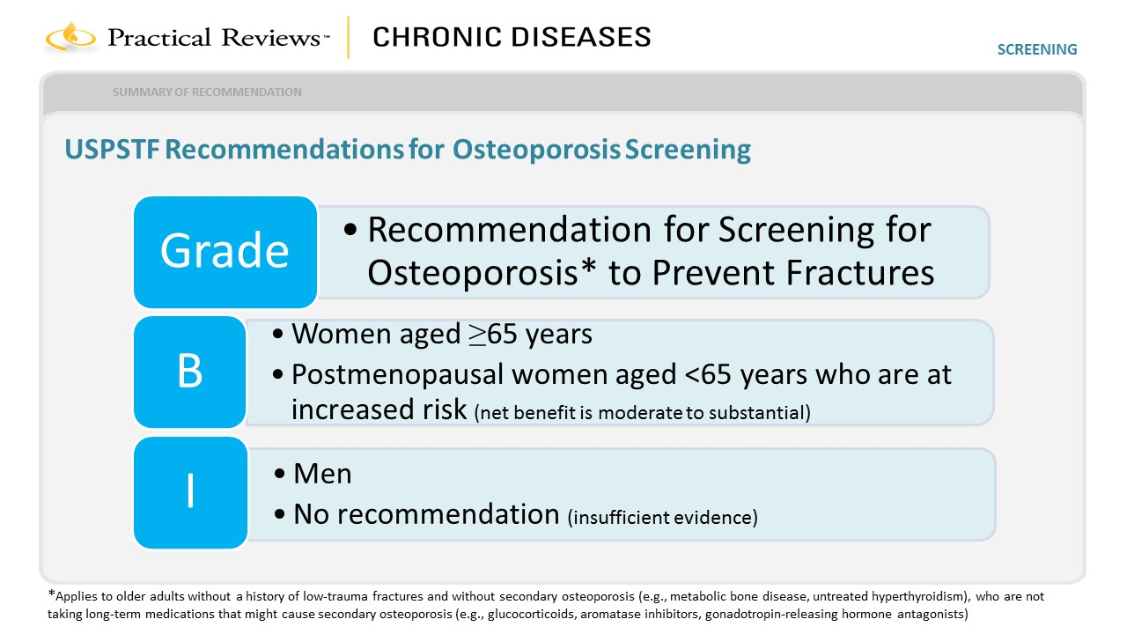
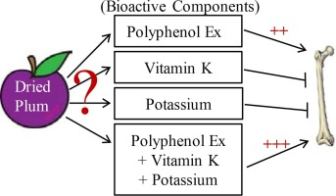
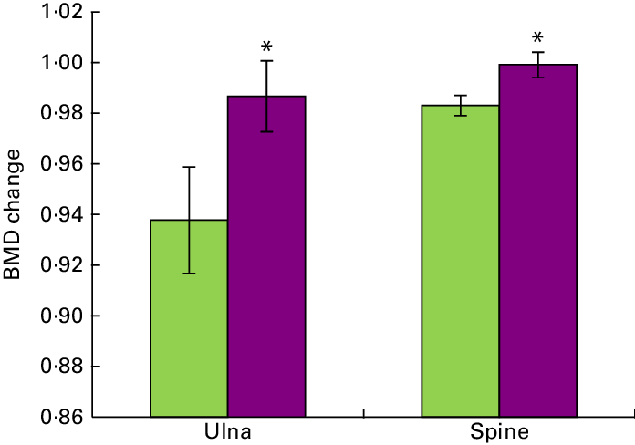
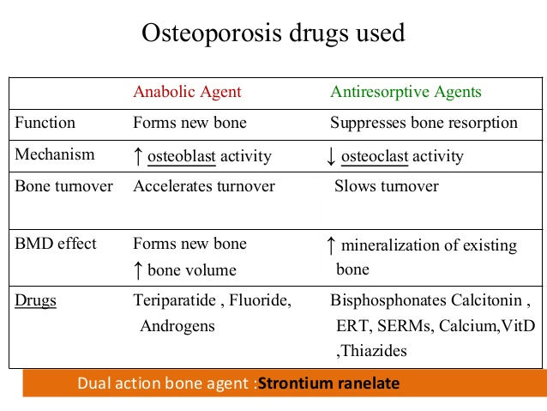
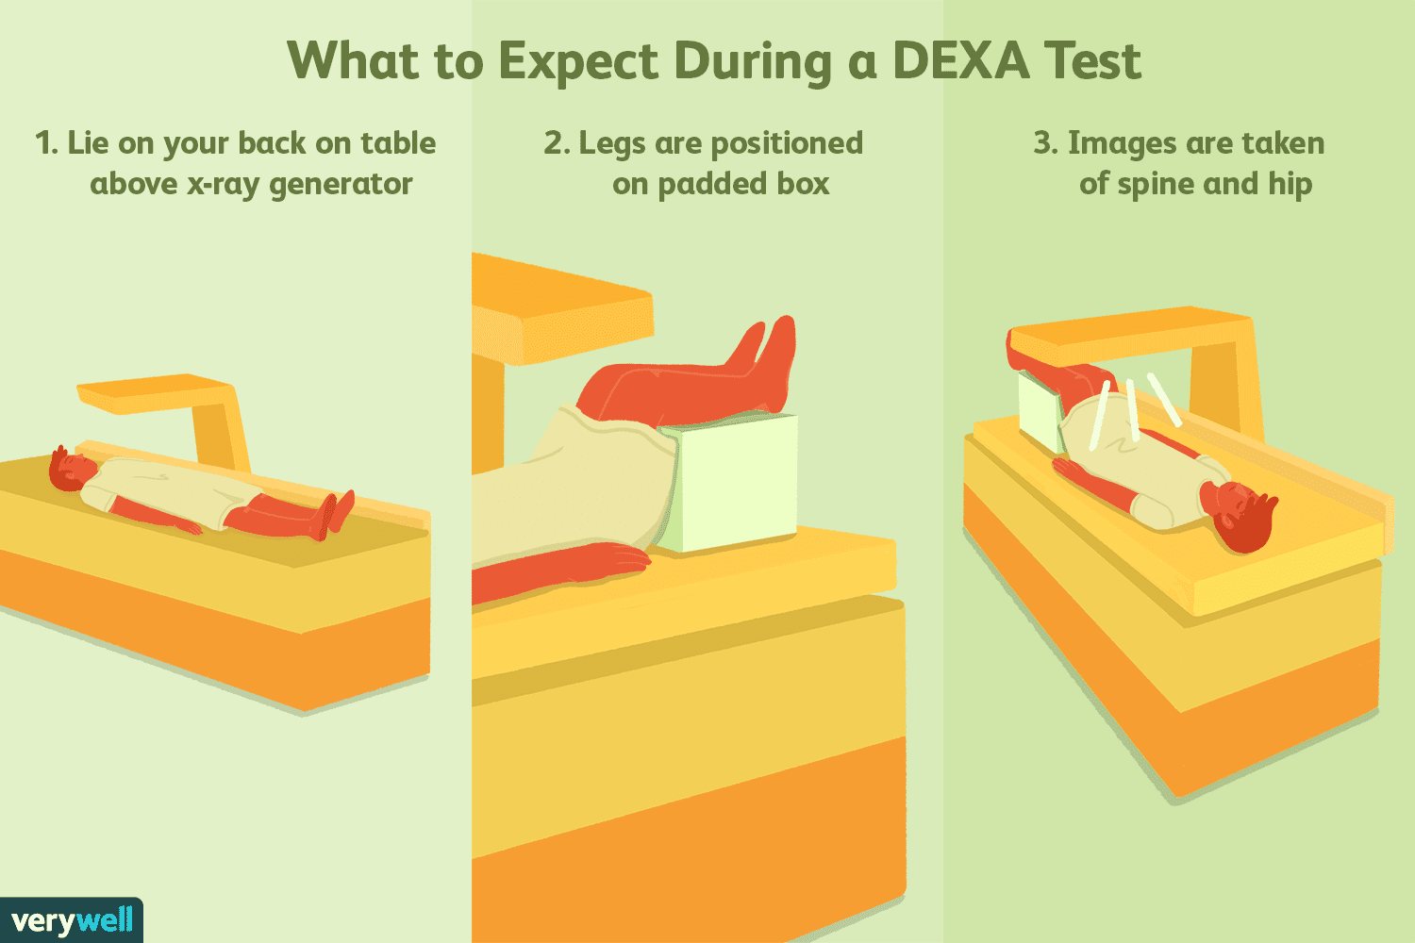
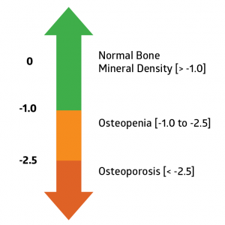
Preventing Osteoporosis in Postmenopausal Women
Blerta Balla RN, BSN, MSN [c]
Salem State University
Introduction
Objectives
Results continue…
Conclusion:
-Osteoporosis is a disease of fragile bones that occurs as a result of bone loss or making too much bone. Bones becomes increasingly porous and fragile over time (National Osteoporosis Foundation, 2020).
-Osteoporosis can be diagnosed with a bone density test which helps to estimate the density of our bones and the chance of breaking a bone by scanning the hip, spine or other bones. A dual energy x-ray absorptiometry (DXA) scan test results are reported using T-scores, and a score of -2.5 or below is a diagnosis of osteoporosis (National Osteoporosis Foundation, 2020)..
-After the age of forty, bone reabsorption begins to occur faster than the rate of formation and humans begin to lose bone mass. Women during menopause lose a significant amount of estrogen and the rate of bone reabsorption drastically outweighs new bone formation. In the ten years after menopause, women can lose forty percent of their inner spongy bone and ten percent of their hard-outer bone (American Academy of Orthopaedic Surgeons, 2012).
-Define Osteoporosis and why it is a problem.
-How to diagnose osteoporosis.
-Prevention and treatment strategies of osteoporosis in postmenopausal women:
- Calcium/Vitamin D
- Strength training exercise
- Pharmacological treatment
PICOT
In a population of postmenopausal women over the age of 50 with diagnosis of osteoporosis, will bisphosphonate therapy be more effective in decreasing fractures and muscle mass than weight bearing exercises, and adequate dietary intake of calcium and vitamin D?
Methods
Six key reviews were chosen:
1- Can dried plum have a protective effect in the bones of postmenopausal women? (Arjmandi, et al., 2017)
2- Does Denosumab work better on OP comparing to other pharmacological treatments? (Beaudin, et al., 2016).
3- What is more effective bone loading exercises with use of Risedoronate or CaD alone over the period of 12 months? (Bilek et al., 2016).
4- Are balance, strengthening and aerobic exercises effective in preventing falls in postmenopausal women with OP? (Dizdar et al., 2018).
5- What are the effects of progressive high impact exercise on femoral neck structural strength in postmenopausal women with mild knee osteoarthritis? (Multanen et al., 2017).
6- Can increasing the prevalence of vegetable-based diets lower the risk of osteoporosis in postmenopausal subjects? (Shenghan et al., 2019)
Results
Arjmandi, et al. (2017)
-In the one-year trial, dried plum consumption significantly improved the BMD of the ulna and lumbar spine compared with the dried apple control.
-The findings strongly suggest that dried plum in its whole form is a promising and efficacious functional food therapy for preventing bone loss in postmenopausal women, with the potential for long-lasting bone-protective effects.
Beaudin, et al. (2016)
- No evidence was shown of the differential safety to denosumab compared to bisphosphonate in treating individuals at risk of osteoporosis.
-It is suggestive after all that denosumab was effective to increase BMD but not lead to reduction in risk fractures.
Bilek et al. (2016)
-This study wasn’t long enough to attest that exercise programs alone can replace bisphosphonates in preventing bone loss.
- Longer studies need to assess the effectiveness of exercise improving bone structure.
Dizdar et al. (2018)
-Continuous and regular exercise provide a positive contribution to the health of patients with OP.
-No falls were reported during the time of the study in which exercises may have contributed to the reduction of fall frequency.
Multanen et al. (2017)
-A significant change was noticed in a 12-month period between-group difference in femoral neck bending strength in favor of the trainees.
-The change in femoral neck bending strength remained significant after adjusting for baseline value, age, height, and body mass. In all participants, the change in bending strength was associated with the total physical activity loading.
Shenghan et al, (2019)
-Low to moderate quality shows that combination therapy of anabolic and nonbiphosphonates antiresorptive agents is superior to monotherapy in improving the BMD and reducing the fracture risk.
-Exercise, drug therapy, and education are all necessary for increased BMD and fracture risk in those with osteoporosis.
-Diet, smoking, stress, and medications have an impact on bone health.
-Research did not suggest that medication therapy alone will aid in reducing the negative effects of osteoporosis.
-There is an abundant of medications that may contribute to bone loss and the provider should work on finding alternative medications such as glucocorticoids, thyroid hormone replacement medications, drugs that decrease estrogens and androgens such as Depo-Provera and Lupron, some cancer medications, certain diabetes medications such as Thiazolidinediones and SGLT-2 inhibitors, aluminum containing antacids, PPI’s, SSRI’s, loop diuretics, warfarin, and anti-seizure medications such as Tegretol and Dilantin.
-The takeaway message from the literature review is that children and young adults, particularly women, should be educated early in life to eat a well balanced diet with adequate vitamin D and calcium, and to build as much bone mass as possible through high intensity, high impact, and power training exercises throughout their lives.
Guidelines and Recommendations
Foods rich in Ca and Vit D:
Diagnosing Osteoporosis:
-The 2014 NOF guidelines recommend BMD measurement in women age 65 years and older and men age 70 years and older, regardless of clinical risk factors; Younger postmenopausal women and women in menopausal transition with clinical risk factors for fracture; Men age 50-69 years with clinical risk factors for fracture (National Osteoporosis Foundation, 2015).
-The US Preventative Services Task Force (USPSTF) (2019) recommends:
-Obtain a DEXA scan at menopause.
-Counsel daily intake of 1200 mg Ca+ and 800 IU Vit D, regular wight bearing exercise, smoking cessation, and avoid excessive alcohol intake.
-Use FRAX tool to determine 10-year hip or major osteoporosis related fracture probability.

