Slide 1

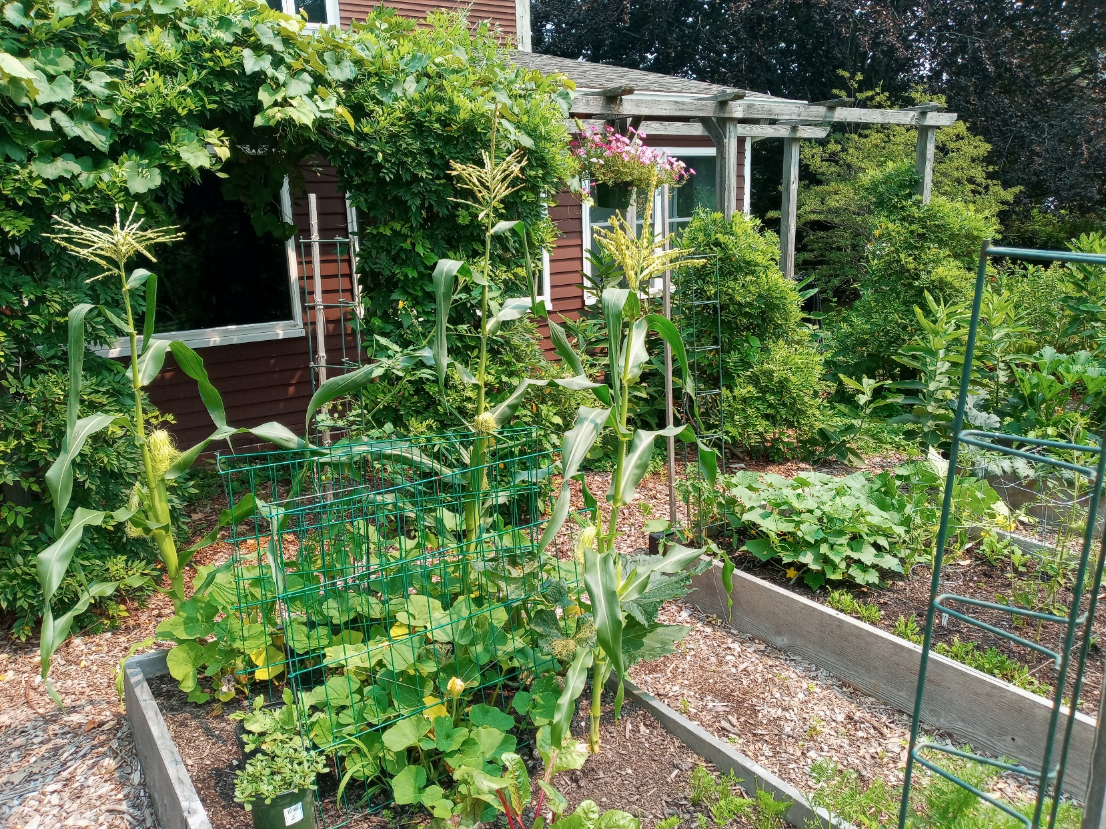
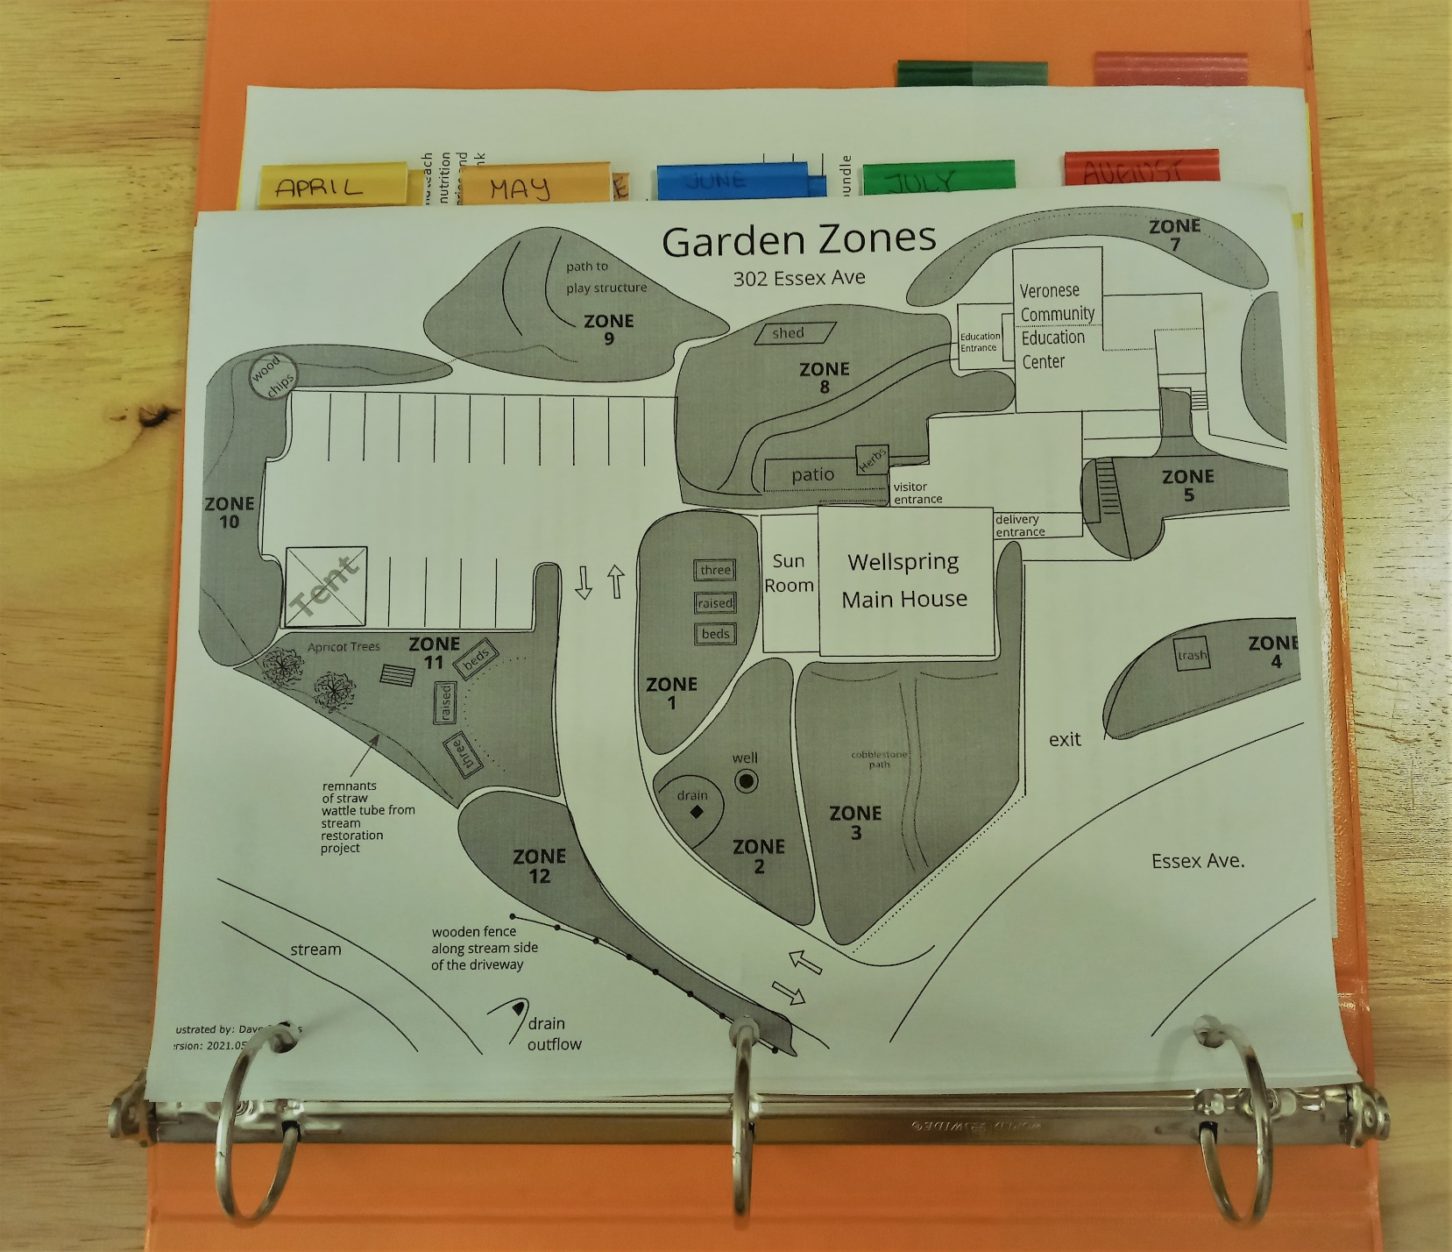
Locally Grown Food For Wellspring Residents
Rose Coffey
Healthcare Studies
INTRODUCTION
MATERIALS & METHODS
RESULTS
CONCLUSIONS
Wellspring, Inc. is an organization focused on homelessness prevention, family shelter, adult education, and career and job planning. Founded by seven women who used their own funds to purchase a house to serve as a shelter, Wellspring has always believed in hospitality and community.
The gardens have been a part of Wellspring’s hospitality since the beginning, starting with the 7 founders growing and cooking their own food to serve to residents. Today, the house that once served as the main shelter for residents is now the main office area. Guests and residents are now living miles away from the main gardens. This shift has caused a disconnect between residents and the element of locally grown food that was so vital to Wellspring’s founding.
For this growing season, the produce will be processed and packaged into a “gift basket” for each guest household. Gift baskets will contain dried herbs, sauces, and various pickled vegetables, all from Wellspring’s on-site gardens. Other items in the basket will include handmade lavender lotion bars from lavender in Wellspring’s butterfly garden and seed packets for residents to experiment growing.
Having a strong plan in place prior to the growing season is essential. This allows growers to create a budget, estimate the amount of labor that will be needed to grow and maintain plants, and predict the quantities of foods that will be produced.
Wellspring needed to create a crop plan that would:
Provide vegetables for residents that were easily storable, transportable, processable, and easy to grow.
Easy to follow and maintain
Could be used as a blueprint for many years
Wellspring’s on-site gardens
I carried out the following tasks with approval from staff:
Create/find simple print-outs that can be provided to residents with basic tips and ideas on how to cook the harvested vegetables
Create a donation/purchase “Wishlist” for the program, which includes things such as on-site refrigerators at shelters to serve as a Drop-off site for fresh vegetables that are free to take.
Rework the program’s Objectives document with bullet points for the upcoming 2022 season.
In addition to helping to create a plan which would put residents in contact with fresh food, I built connections with companies and local growers.
High Mowing Seeds Company – Secured a spot on donation list in order to receive discounted seeds for growing and gifts for residents and guests.
  Allows Wellspring to obtain seeds at the price of $5 per 25 packets, whereas before they were paying an average of $3 per packet. This results up to $350 in savings.
Cedar Rock Gardens – Connecting and fostering a relationship between the organization’s manager and the owners of this local farm will give Wellspring the opportunity to obtain excess vegetables, and seedlings as donations.
The crop plan is set in a binder that is organized by what needs to be done each month of the growing season with additional tabs for maintenance tasks, and recipes. It is focused on efficiency, ease of maintenance, and most importantly, what will best serve residents and guests. Many options are given so that the plan is flexible and easily adjustable. Colorful, unique, and flavorful crops are prioritized to encourage engagement with the gardens and fresh food.
The work that I did with the Wellspring team this summer provides us with insight for growing and community building at Wellspring House for the coming year. Some of the major takeaways include:
Providing locally grown vegetables can be a great resource for residents, but the greatest benefits come from the time spent in the gardens. More on-site gardening could be a great benefit for residents and guests.
It is not only residents and guests that benefit from the gardens. Individuals who work with vulnerable populations are often subjected to great stress. Having gardens on-site can help to relieve and refocus staff.
More organization of the program prior to the beginning of the growing season would allow for greater yields and more vegetables and benefits for residents and guests.
A decision should be made whether to prioritize giving processed foods made from the garden or delivering them fresh to residents and guests. This would help make planning for the season easier and make the program more effective and efficient.
OBJECTIVE
REFERENCES
Deliver food grown this season into the hands of shelter guests and residents. Help design a plan of action for future growing seasons that will allow residents to have more connection and access to the gardens and fresh vegetables grown in the Cape Ann area.
Howarth, M., Brettle, A., Hardman, M., & Maden, M. (2020). What is the evidence for the impact of gardens and gardening on health and well-being: a scoping review and evidence-based logic model to guide healthcare strategy decision making on the use of gardening approaches as a social prescription. BMJ open, 10(7), e036923. https://doi.org/10.1136/bmjopen-2020-036923
White, M. J., Jilcott Pitts, S. B., McGuirt, J. T., Hanson, K. L., Morgan, E. H., Kolodinsky, J., Wang, W., Sitaker, M., Ammerman, A. S., & Seguin, R. A. (2018). The perceived influence of cost-offset community-supported agriculture on food access among low-income families. Public health nutrition, 21(15), 2866–2874. https://doi.org/10.1017/S1368980018001751
Yang, F., Zhang, Y., Tariq, A., Jiang, X., Ahmed, Z., Zhihao, Z., Idrees, M., Azizullah, A., Adnan, M., & Bussmann, R. W. (2020). Food as medicine: A possible preventive measure against coronavirus disease (COVID-19). Phytotherapy research : PTR, 34(12), 3124–3136. https://doi.org/10.1002/ptr.6770
RELATED INFORMATION
Research has demonstrated links between gardening and improved mental well-being, increased physical activity and reduced social isolation (Howarth et al., 2020).
Some well-intentioned community-supported agriculture programs have seen limited success in providing access to fresh foods due to participants’ unfamiliarity with how to prepare certain foods (White et al., 2018).
Fruit and vegetable gardens in community center settings could play a role in spreading the use, benefits and knowledge of functional food plants (Yang et al., 2020).
An example page from the crop plan
depicting the different garden zones at the
main office
ACKNOWLEDGEMENTS
The binder has tabs for each month of the growing
season to make finding information easier. There are also
tabs for maintance and recipes.
Thank you to Jill Brown, my internship manager, for your support, knowledge, and friendship.

