Slide 1
Marketing US wrestling 2020
Adam Parise, Shane O’Neill, Ron Colman, Michael Negri, Darren Sanderson, Sebastian Williams, Brett Graziano, Matthew Legere, Noah Hodgkins, Justin Hicks, Chris O’Brien, Khalill Benguche, Janard Jones, Alicia Gibney, Marcus Carvalho, Madison Cifra, Patrick Sullivan, Jake Hibbert, Jaden Castillo, Shawn Calabro, Brett Molea, Matthew Cesare, Joey Van Bragt, Carl Beatrice Jr, Danae Angiulo, Dom DeLuca

Slide 2
Abstract
Referencing domestic and global practices, this study provides information on what might be implemented as best practices to advance the product, place, price and promotion of wrestling in the USA. The authors utilized the model of integrated elite and mass sport development from past research which formed the foundation for a questionnaire and interview schedule for US wrestling coaches and administrators to generate a snapshot of perceptions of the current sport system and possibilities for its further development and marketing.

Slide 3
Mission Statement
The mission of USAW is to promote the development for the sport of wrestling in the United States for both mass and elite participants. Our objective is to increase mass
participation and high performance by utilizing new and current partnerships to generate more exposure for the sport and generate new revenue streams. By obtaining new partnerships like U.S Wrestling Foundation and Beat the Streets we will create stronger ties to communities and adolescence. These ties will provide accessible sponsored programs such as clinics, tournaments, and wrestling meets to attract those of the masses and elite. To effectively advance our mission and objectives for future success of USA Wrestling we have created strategic goals to accomplish by January 1, 2024. Our intention is to unify the sport through building and improving relationships, bringing affiliates and other organizations together for the greater good of the sport amongst all groups (mass and elite). For success to be measured, we expect to attain 15 Greco-Roman medals across all weight classes and world championship/Olympic Games levels, collect $1.4M in sponsorship revenue per year, receive $3.8M in donor revenue per year, increase total viewership of USA Wrestling by 30%, grow membership by 40% in the 15 states with the lowest membership rates, and increase engagement with alumni which will result in increased donations, support, and resources.

Slide 4
Executive Summary
Medal Count
During the 1904 Olympics, in St, Louis, Missouri, USA Wrestling captured 15 medals in freestyle wrestling which resulted in capturing 100% of available medals to win in all wrestling competition. During the 1912 Olympics, in Stockholm, Sweden, USA Wrestling captured 0 medals in all wrestling competitions capturing 0% of available medals to win. During the 1920 Olympics, in Antwerp, Belgium, USA Wrestling captured 6 medals in all wrestling competition which resulted in capturing just under 40% of all available medals to win. During the 1980 Olympics, in Moscow, Soviet Union, USA Wrestling didn’t compete in any wrestling competition and captured 0% of available medals to win. During the 1984 Olympics, in Los Angeles, California, USA Wrestling captured 13 medals in all wrestling competition which resulted in capturing roughly 30% of all available medals to win. During the 2012 Olympics, in London, England, USA Wrestling captured 4 medals in all wrestling competitions resulting in capturing just over 5% of all available medals to win.
USA Wrestling medal count in recent Olympics has been declining even with the addition of new events. The Greco- Roman style of wrestling has particularly been a weakness for Team USA never earning more than 3 medals. The Greco-Roman style of wrestling has particularly been a weakness for Team USA with its highest share coming in 1984 (13.3%) Results. (2019, February 18). Retrieved from https://www.olympic.org/olympic-results.

Slide 5
Executive Summary
Membership/Participation
-Overall sport participation has not increased in past 30 years. NSGA (2016)
-The growth of the population creates the potential for increased participation. NSGA (2016)
-There hasn’t been much increase in the overall participation in sports, while the population the USA population increases. NSGA (2016)
-In USA Wrestling participation in 2009 was 2,967 went to 3,045 in 2015. Which has only increased by 80 in 6 years. USA population has been increasing. National Sporting Goods Association (2016)
-In 1988 the total membership was 90,658 and in 2019 the total population 259,414. The numbers have increased steadily over thirty years.
USA Wrestling Association (2019) USA Wrestling Membership Reports. Received in email by Shonne Vest on September 9, 2019
- USA wrestling total athlete membership has increased from the year 1988 by 2.6 times, where in 1988 it was 82,711 to 214,820 in 2019. It has a steady increase throughout 30 years.
USA Wrestling Association (2019) USA Wrestling Membership Reports. Received in email by Shonne Vest on September 9, 2019

Slide 6
Executive Summary
- There was a large upsurge from the year 2012 to 2013. Continued to grow throughout
the years. In 2012 there was 92 to 606 in 2019, which it is an increase by 514.
USA Wrestling Association (2019) USA Wrestling Membership Reports. Received in email by Shonne Vest on September 9, 2019
- There was a spike from the year of 2013 to 2014 then stayed steady (not much changed) until 2017 where it started to decline. From 2012 there was 6,854 to 18,771 in 2019 which is an increase by 11,917 teams.
USA Wrestling Association (2019) USA Wrestling Membership Reports. Received in email by Shonne Vest on September 9, 2019
- For the last 30 years the number have increased. In 1988 it was 1,229 to 4,578 clubs in 2019, which is an increase of 3,349 throughout the 30 years.
USA Wrestling Association (2019) USA Wrestling Membership Reports. Received in email by Shonne Vest on September 9, 2019

Slide 7
There was estimation that approximately 60% of the revenue that team USA wrestling received in 2018 came from mass members. This is most likely since most of their members are mass as they only have 488 “high performance athletes”. When looking it proportionally, the elite athletes bring in far more money for elite members that they have. The Membership price cost is $40 and USAW retains $26 of the money. Team USA made about 2 million from their events and programs, but only spent around 2,000 dollars on it. This is a much-needed change that must be fixed. If they spend more on their programs and events, then they will be able to make a lot more money, as the two rates are disproportionate. Of the $26, USA Wrestling reinvests $22.70 (87%) back into the sport of wrestling. $12.20 (47%) of that money is to fund wrestling at the state, local and individual competition level. $10.50 (40%) of the money is put into the National wrestling program . Membership spending in 2018 was $4,027,100. There are 49,219 registered members, 48,613 Mass members (98.76%) and 606 High performing members (1.24%).
When asked about the revenue, USA Wrestling did not disclose the actual spending with Membership spending. The spending between Mass and Elite wrestlers is rather equal. The key to this is how much membership money is split between High performance (elite) vs the rest of the athletes (mass). Results may show that much more money is being spent on the elite, while as for the rest of the athletes, the spending is rather equal. If they really want to grow the sport, US Wrestling needs to invest more money into Sport Development. They should also be open and proud of how much money they spend trying to grow and support the sport with both State Games and Beat the Streets Programs.
Total Revenues | 15,797,789
% of mass | 60%
% of elite | 40%
Total Expenses | 13,856,913
% of Mass | 45%
% of Elite | 55%
(Info from USA Wrestling
Financial Statements, 2018)
http://content.themat.com/forms/USAW_Audit_8-31-18.pdf

Slide 8
Executive Summary: Revenue and Spending
When broken down between mass and elites' revenues, it is estimated that approximately 60% of the revenue that team USA wrestling received in 2018 came from mass members. This is most likely since most of their members are mass as they only have 488 “high performance athletes”. When looking it proportionally, their elite athletes bring in far more money for elite members that they have. Membership price costs $40 and USA Wrestling gets $26 of that money. It is worth noting that Team USA made about 2 million from their events and programs, but only spent around 2,000 dollars on it. This is a much-needed change that must be fixed. If they spent more on their programs and events, then they will be able to make a lot more money, as those two rates are disproportionate. Of the $26, USA Wrestling reinvests $22.70 (87%) back into wrestling. $12.20 (47%)of that money is to fund wrestling at the state, local and individual competition level. $10.50 (40%) of the money is put into the National wrestling program . Membership spending in 2018 was $4,027,100. There are 49,219 registered members, 48,613 Mass members (98.76%) and 606 High performing members (1.24%) So if spending between the two groups was equal from the money invested from Membership fees.
When asked USA Wrestling did not disclose the actual spending. with Membership spending it is key to note that most likely the spending here is not directly proportional as the High performing members require different services than most members. Mass Spending would be $593,078.60 and spending on High Performing Members would be $7,393.20. $10.50 of membership fees go to USA Wrestling at the National level which would lead to a total of $516,799.50. The spending between Mass and Elite wrestlers is rather equal. The key to this is how much membership money is split between High performance vs the rest of the athletes. Results may show that much more money is being spent on the elite, while as for the rest of the athletes, the spending is rather equal. If they really want to grow the sport, US Wrestling needs to invest more money into Sport Development. They should also be open and proud of how much money they spend trying to grow and support the sport with State Games and We Beat the Streets.

Slide 9
Executive Summary
Spending
-Membership spending in 2018 was $4,027,100.
-There are 49,219 registered members.
-48,613 Mass members (98.76%) and 606 High performing members (1.24%).
-The ratio of mass athlete to elite membership is 80.22:1.
-Mass Spending: $593,078.60.
-High Performing Members: $7,393.20.
-$10.50 of membership fees go to USA Wrestling at the National level totaling $516,799.50.
(2019). USA Wrestling. Retrieved October 4, 2019, file:///C:/Users/s0319663/Downloads/YTD%202019.pdf
-The spending between Mass and Elite wrestlers is rather equal. The key to this is how much membership money is split between High performance vs the rest of the athletes. Results may show that much more money is being spent on the elite, while as for the rest of the athletes, the spending is rather equal. (2019). Content.themat.com. Retrieved 11 September 2019, from http://content.themat.com/forms/USAW_Audit_8-31-17.pdf

Slide 10
Executive Summary
Finances
-60% of the revenue that team USA wrestling received in 2018 came from mass members.
-When looking it proportionally, their elite athletes bring in far more money for the number of elite members that they have. Membership price costs $40 and USA Wrestling gets $26 of that money.
-It is worth noting that Team USA made about 2 million from their events and programs, but only spent around 2,000 dollars on it.
-This is a much-needed change that must be fixed. If they spent more on their programs and events, then they will be able to make a lot more money, as those two rates are disproportionate.
-Of the $26, USA Wrestling reinvests $22.70 (87%) back into wrestling. $12.20 (47%)of that money is to fund wrestling at the state, local and individual competition level. $10.50 (40%) of the money is put into the National wrestling program.

Slide 11
Executive Summary
-Membership spending in 2018 was $4,027,100. There are 49,219 registered members, 48,613 Mass members (98.76%) and 606 High performing members (1.24%) Spending between the two groups was equal from the money invested from Membership fees.
-The key to this is how much membership money is split between High performance vs the rest of the athletes. Results may show that much more money is being spent on the elite, while as for the rest of the athletes, the spending is rather equal. If they really want to grow the sport, US Wrestling needs to invest more money into Sport Development. They should also be open and proud of how much money they spend trying to grow and support the sport with State Games and We Beat the Streets.

Slide 12
Executive Summary
Collegiate
The NCAA has seen a decrease in wrestling programs since it became championship based in 1928. Over 130 Division 1 colleges have dropped their wrestling programs since 1970 and over 170 have been dropped since the establishment of college wrestling. The sport of wrestling has also lost a grand total of well over 600 collegiate programs, losing notable programs such as Alabama, Auburn, UCLA, and Boston College.
Dropped Collegiate Programs. (2018). Retrieved October 1, 2019, from http://www.nwcaonline.com/dropped-collegiate-programs

Slide 13
Executive Summary
Interscholastic
-High school wrestling competitions is an area that can be improved on when it comes to generating more revenue for USAW. There are two major areas where this revenue can be generated, with the addition of more high school wrestling competitions nationwide and adding more memberships from the athletes.
-The expenditures that would be beneficial for high school USAW would come from the adding of more competitions, and increasing the quality of the competitions, both of which would, over time, increase the revenue of high school USAW.
-In the past 5 years the number of high school wrestling competitions has been trending down, from 34,800 competitions in 2013 to 31,750 in 2018, and with the trend of the total number of competitions going down, the best course of action to create revenue is to increase the quality of the competitions to bring in revenue over time, as well as attracting additional USA wrestling memberships from high school wrestlers.
"State High School Wrestling Competitions http://:db.desmoinesregistrar.com/state-wrestling-stats"

Slide 14
Executive Summary
State Games
The State Games of America is an Olympic Style competition held featuring competition between State Games medal winners from across the nation. There are currently 30 states organizing statewide Olympic festivals known as State Games.
Eligibility. State Game of America 2015, stategamesofamerica.com/eligibility.

Slide 15
Executive Summary
Beat the Streets
-Beat the Streets is a partner of USA Wrestling that supports USAW chartered based programs in Los Angeles, Philadelphia, Lancaster, Pa, Chicago, Providence, New York City, Cleveland and Boston.
-Beat the Streets impacts a total of 6,200+ people served, a total of 208 teams supported, a total of $15 million invested in the sport of wrestling and a total of 42,000 hours of on the mat programming and helping kids develop lifelong relationships to their health.
Beat the Streets cultivates youth development in underserved communities by encouraging a desire for excellence, respect, teamwork, leadership, integrity, and perseverance through the instruction of quality wrestling programs.
New York City stands as the most impactful program in Beat the Streets, which supports and impacts over 3,200 kids annually.
- Beat the Streets National focuses on empowering the leaders of member programs to deliver sustainable and quality youth development wrestling programs.
2019, Beat the Streets National, Retrieved from: https://beatthestreets.org/beat-the-streets-1-
-USA Wrestling supports the expansion and growth of Beat the Streets City programs through its membership benefits, expanded support and through event partnerships.
-USA Wrestling gave Beat the Streets NYC an estimation of somewhere between $5,000 and $9,999 during the years of 2016, 2017 and 2018.
2019, Beat the Streets TheMAT.com, Retrieved from: https://www.teamusa.org/USA-Wrestling/Clubs/Beat-the-Streets

Slide 16
Medal Count History- US Wrestling
During the 1904 Olympics, in St, Louis, Missouri, USA Wrestling captured 15 medals in freestyle wrestling which resulted in capturing 100% of available medals to win in all wrestling competition. During the 1912 Olympics, in Stockholm, Sweden, USA Wrestling captured 0 medals in all wrestling competitions capturing 0% of available medals to win. During the 1920 Olympics, in Antwerp, Belgium, USA Wrestling captured 6 medals in all wrestling competition which resulted in capturing just under 40% of all available medals to win. During the 1980 Olympics, in Moscow, Soviet Union, USA Wrestling didn’t compete in any wrestling competition and captured 0% of available medals to win. During the 1984 Olympics, in Los Angeles, California, USA Wrestling captured 13 medals in all wrestling competition which resulted in capturing roughly 30% of all available medals to win. During the 2012 Olympics, in London, England, USA Wrestling captured 4 medals in all wrestling competitions resulting in capturing just over 5% of all available medals to win.
USA Wrestling medal count in recent Olympics has been declining even with the addition of new events. The Greco- Roman style of wrestling has particularly been a weakness for Team USA never earning more than 3 medals. The Greco-Roman style of wrestling has particularly been a weakness for Team USA with its highest share coming in 1984 (13.3%) Results. (2019, February 18). Retrieved from https://www.olympic.org/olympic-results.

Slide 17
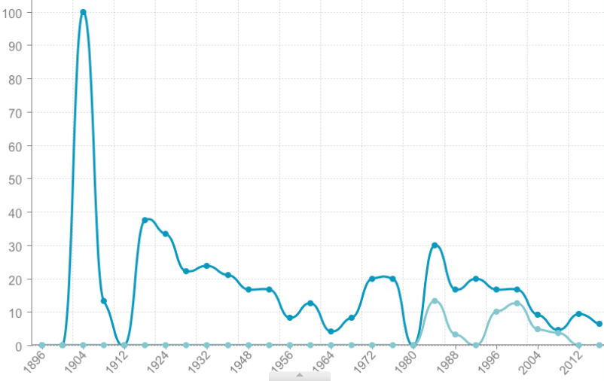
Medal Share %
Percentage of Medals won by the USA Wrestling at the Summer Olympics from the total number of medals available to win
USA Wrestling medal share in recent Olympics has been declining even with the addition of new events.
The Greco- Roman style of wrestling has particularly been a weakness for Team USA with its highest share coming in 1984 (13.3%).
Athletes leaving elite sport are provided with individualized lifestyle plans for physical and psychological health (such methodologies are being developed internationally).
During the 1904 Olympics, in St, Louis, Missouri, USA Wrestling captured 21 medals in freestyle wrestling
During the 1980 Olympics, in Moscow, Soviet Union, USA Wrestling didn’t compete in any wrestling competition
%
Of
Medals
Won
Available medals
During the 1912 Olympics, in Stockholm, Sweden, USA Wrestling captured 0 medals in all wrestling competitions
During the 1984 Olympics, in Los Angeles, California, USA Wrestling captured 13 medals in all wrestling competition
During the 1920 Olympics, in Antwerp, Belgium, USA Wrestling captured 6 medals in all wrestling competition
Freestyle
Greco-Roman
During the 2012 Olympics, in London, England, USA Wrestling captured 4 medals in all wrestling competitions resulting in capturing just over 5% of all available medals to win.
Source: Results. (2019, February 18).
Retrieved from https://www.olympic.org/olympic-results.
Year

Slide 18
USA Wrestling Medal Count
2016 Rio Games: (72 Available Medals)
- 2 Gold
- 1 Bronze
- 4.17 %
2012 London Games: (72 Available Medals)
- 2 Gold
- 2 Bronze
- 5.56 %
2008 Beijing Games: (72 Available Medals)
- 1 Gold
- 2 Bronze
- 4.17 %

Slide 19
USA Wrestling Medal Count
2004 Athens Games: (48 Available Medals) 1992 Barcelona Games: (30 Available Medals)
- 1 Gold - 3 Gold
- 3 Silver - 2 Silver
- 1 Bronze - 1 Bronze
12.5 %
- 20 %
2000 Sydney Games: (48 Available Medals)
- 2 Gold
- 2 Silver
- 3 Bronze
14.59 %
1996 Atlanta Games: (60 Available Medals)
- 3 Gold
- 4 Silver
- 1 Bronze
- 13.3 %

Slide 20
Introduction: Elite and mass participation
The mission of USAW is to promote the development for the sport of wrestling in the United States for both mass and elite participants. Our objective is to increase mass
participation and high performance by utilizing new and current partnerships to generate more exposure for the sport and generate new revenue streams. By obtaining new partnerships like U.S Wrestling Foundation and Beat the Streets we will create stronger ties to communities and adolescence. These ties will provide accessible sponsored programs such as clinics, tournaments, and wrestling meets to attract those of the masses and elite. To effectively advance our mission and objectives for future success of USA Wrestling we have created strategic goals to accomplish by January 1, 2024. Our intention is to unify the sport through building and improving relationships, bringing affiliates and other organizations together for the greater good of the sport amongst all groups (mass and elite). For success to be measured, we expect to attain15 Greco-Roman medals across all weight classes and world championship/Olympic Games levels, collect $1.4M in sponsorship revenue per year, receive $3.8M in donor revenue per year, increase total viewership of USA Wrestling by 30%, grow membership by 40% in the15 states with the lowest membership rates, and increase engagement with alumni which will result in increased donations, support, and resources.

Slide 21
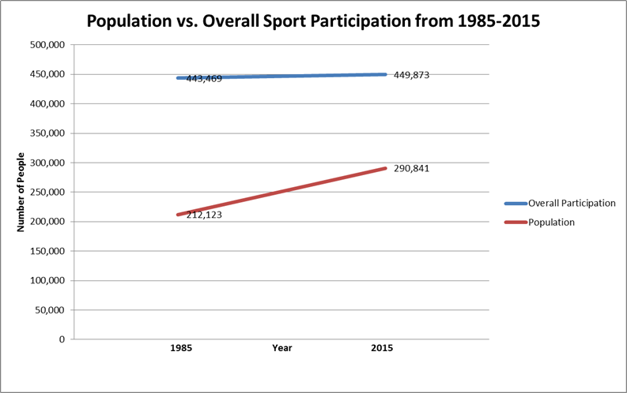
Sport Participation vs US Population
Overall sport participation has not increased in past 30 years
The growth of the population creates the potential for increased participation
Hasn’t been much increase in the overall participation in sports, while the population increases
Source: NSGA (2016)

Slide 22
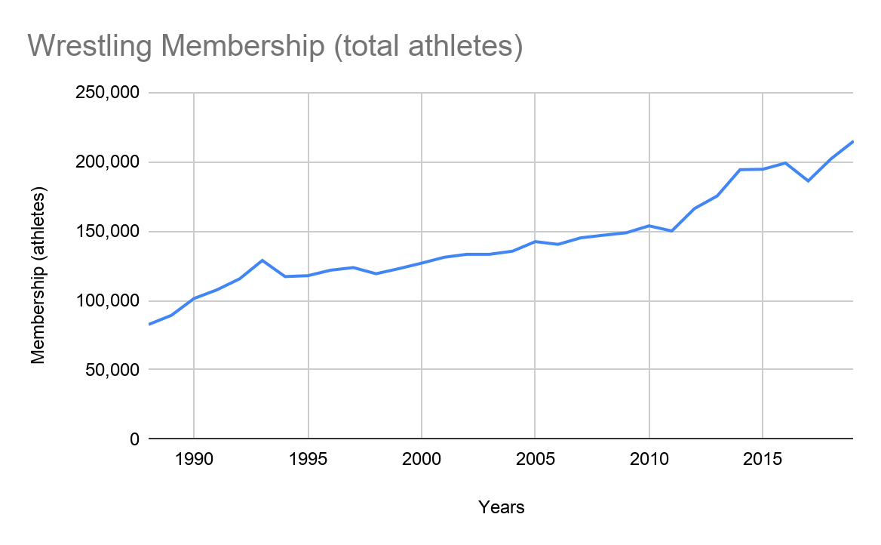
USA Wrestling Association (2019) USA Wrestling Membership Reports. Received in email by Shonne Vest on September 9, 2019
USA Wrestling
Total Membership throughout the years
Years | Membership (athletes)
1988 | 82,711
1989 | 89,284
1990 | 101,478
1991 | 107,641
1992 | 115,599
1993 | 128,833
1994 | 117,216
1995 | 117,865
1996 | 121,817
1997 | 123,701
1998 | 119,271
1999 | 122,936
2000 | 126,899
2001 | 131,149
2002 | 133,289
2003 | 133,295
2004 | 135,519
2005 | 142,399
2006 | 140,429
2007 | 145,145
2008 | 147,014
2009 | 148,767
2010 | 153,776
2011 | 150,057
2012 | 166,226
2013 | 175,326
2014 | 194,226
2015 | 194,529
2016 | 199,007
2017 | 186,121
2018 | 202,019
2019 | 214,820
USA wrestling total athlete membership has increased from the year 1988 by 2.6 times, where in 1988 it was 82,711 to 214,820 in 2019. It has a steady increase throughout 30 years.

Slide 23
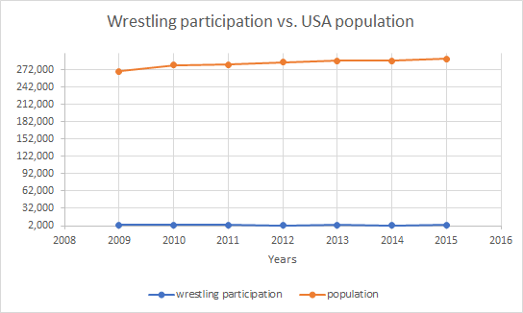
Population/Participation
years | wrestling participation | Population (millions)
2009 | 2,967 | 269,988
2010 | 2,940 | 280,215
2011 | 3,217 | 280,834
2012 | 2,841 | 285,533
2013 | 3,113 | 288,012
2014 | 2,864 | 288,012
2015 | 3,045 | 290,841
In USA Wrestling participation in 2009 was 2,967 went to 3,045 in 2015. Which has only increased by 80 in 6 years. USA population has been increasing.
Source: National Sporting Goods Association (2016)

Slide 24
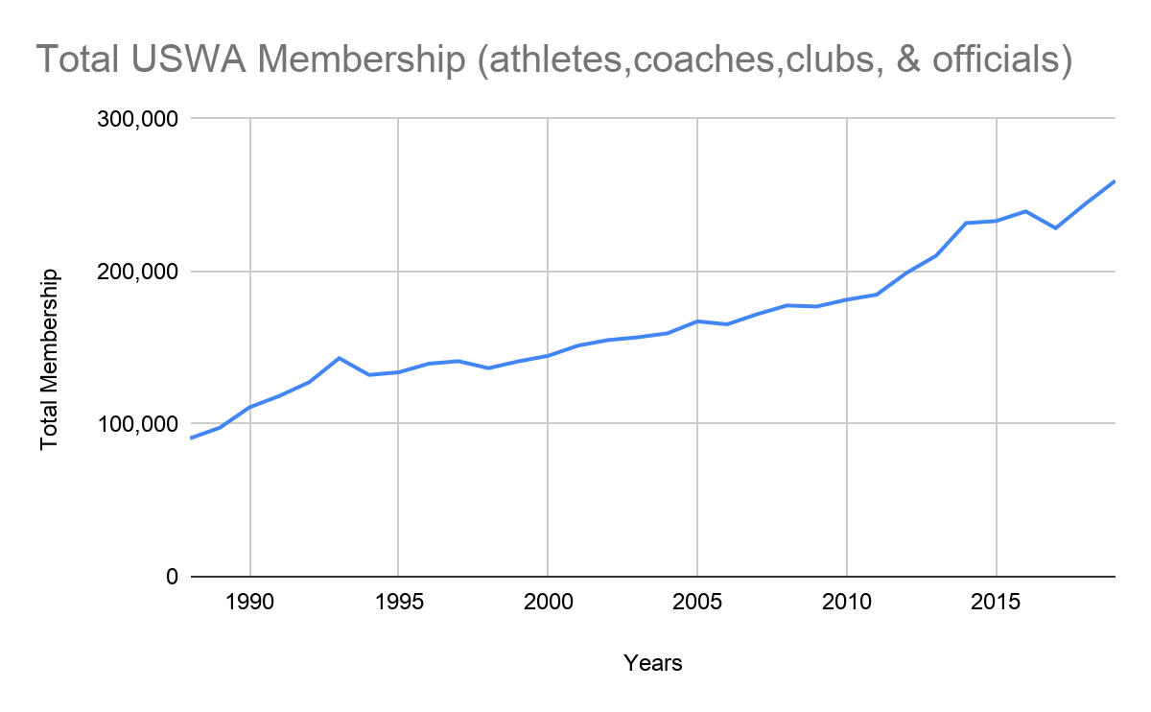
USA Wrestling
Total Membership throughout the years
Years | Total Membership
1988 | 90,658
1989 | 97,601
1990 | 110,993
1991 | 118,460
1992 | 127,494
1993 | 143,162
1994 | 132,208
1995 | 133,941
1996 | 139,577
1997 | 141,217
1998 | 136,632
1999 | 141,088
2000 | 144,733
2001 | 151,402
2003 | 156,880
2004 | 159,488
2005 | 167,295
2006 | 165,377
2007 | 171,992
2008 | 177,711
2009 | 177,040
2010 | 181,501
2011 | 184,764
2012 | 199,002
2013 | 210,386
2014 | 231,707
2015 | 233,045
2016 | 239,376
2017 | 228,387
2018 | 244,389
2019 | 259,414
In 1988 the total membership was 90,658 and in 2019 the total population 259,414. The numbers have increased steadily over thirty years.
USA Wrestling Association (2019) USA Wrestling Membership Reports. Received in email by Shonne Vest on September 9, 2019

Slide 25
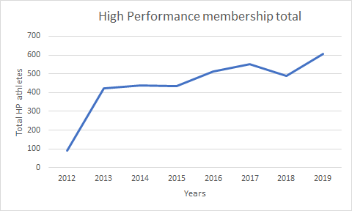
High performance membership
There was a big spike from the year 2012 to 2013. Continued to grow throughout the years. In 2012 there was 92 to 606 in 2019, which it is an increase by 514.
USA Wrestling Association (2019) USA Wrestling Membership Reports. Received in email by Shonne Vest on September 9, 2019

Slide 26
Introduction for mass participation and Elite: Membership and Involvement
-There was a large upsurge from the year 2012 to 2013. Continued to grow throughout
the years. In 2012 there was 92 to 606 in 2019, which it is an increase by 514.
USA Wrestling Association (2019) USA Wrestling Membership Reports. Received in email by Shonne Vest on September 9, 2019
- There was a spike from the year of 2013 to 2014 then stayed steady (not much changed) until 2017 where it started to decline. From 2012 there was 6,854 to 18,771 in 2019 which is an increase by 11,917 teams.
USA Wrestling Association (2019) USA Wrestling Membership Reports. Received in email by Shonne Vest on September 9, 2019
- For the last 30 years the number have increased. In 1988 it was 1,229 to 4,578 clubs in 2019, which is an increase of 3,349 throughout the 30 years.
USA Wrestling Association (2019) USA Wrestling Membership Reports. Received in email by Shonne Vest on September 9, 2019

Slide 27
-Overall sport participation has not increased in past 30 years. NSGA (2016)
-The growth of the population creates the potential for increased participation. NSGA (2016)
-There hasn’t been much increase in the overall participation in sports, while the population the USA population increases. NSGA (2016)
-In USA Wrestling participation in 2009 was 2,967 went to 3,045 in 2015. Which has only increased by 80 in 6 years. USA population has been increasing. National Sporting Goods Association (2016)
-In 1988 the total membership was 90,658 and in 2019 the total population 259,414. The numbers have increased steadily over thirty years.
USA Wrestling Association (2019) USA Wrestling Membership Reports. Received in email by Shonne Vest on September 9, 2019
- USA wrestling total athlete membership has increased from the year 1988 by 2.6 times, where in 1988 it was 82,711 to 214,820 in 2019. It has a steady increase throughout 30 years.
USA Wrestling Association (2019) USA Wrestling Membership Reports. Received in email by Shonne Vest on September 9, 2019

Slide 28
2018 Elite vs Mass Spending
Item | Elite | Mass | Admin | Total Spending
National Team | $6,069,097
Membership | $49,936.04 | $3,977,163.96
Promotions and Sport Development |  | $2,014`
Educational Programs and Events |  | $2,685,167
Total | $6,119,033.04 | $6,664,344.96 | $1,073,535

Slide 29
Finances
-60% of the revenue that team USA wrestling received in 2018 came from mass members.
-When looking it proportionally, their elite athletes bring in far more money for the number of elite members that they have. Membership price costs $40 and USA Wrestling gets $26 of that money.
-It is worth noting that Team USA made about 2 million from their events and programs, but only spent around 2,000 dollars on it.
-This is a much-needed change that must be fixed. If they spent more on their programs and events, then they will be able to make a lot more money, as those two rates are disproportionate.
-Of the $26, USA Wrestling reinvests $22.70 (87%) back into wrestling. $12.20 (47%)of that money is to fund wrestling at the state, local and individual competition level. $10.50 (40%) of the money is put into the National wrestling program.

Slide 30
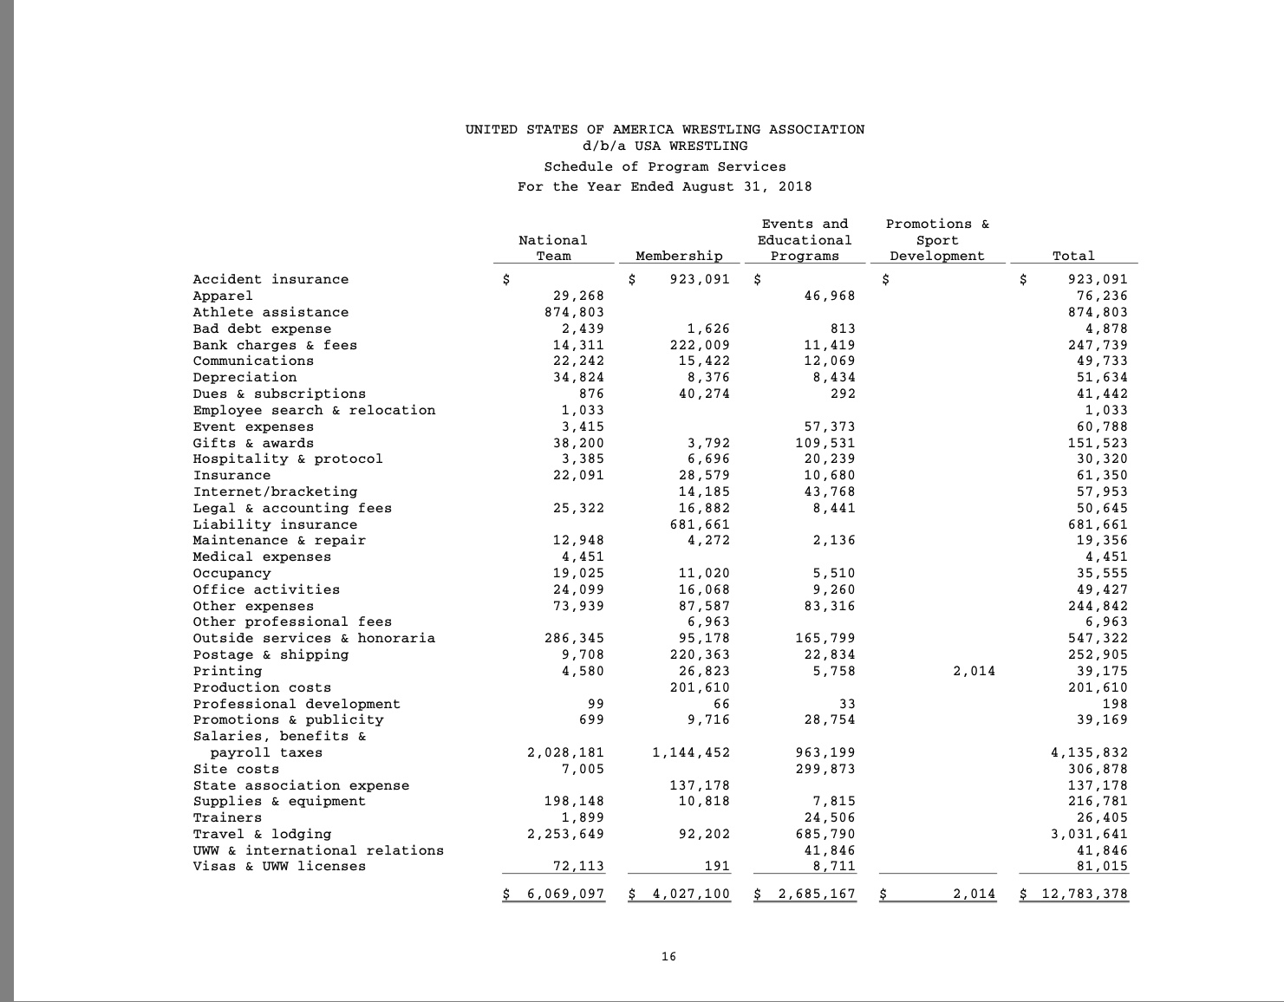
2018 Schedule of Program Services Spending

Slide 31
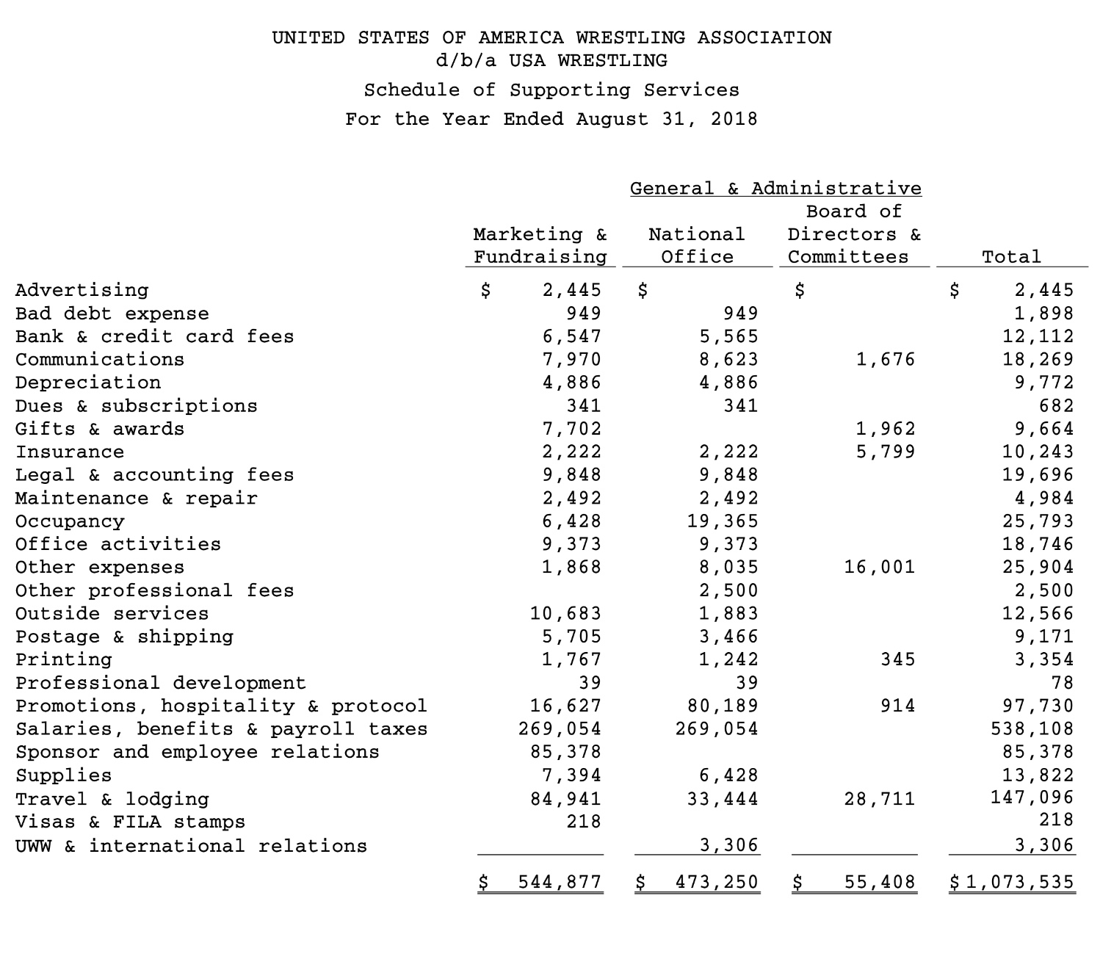
2018 General and Administrative Spending

Slide 32
Membership Spending
Membership price costs $40 and USA Wrestling gets $26 of that money. Of the $26, USA Wrestling reinvests $22.70 (87%) back into wrestling. $12.20 (47%)of that money is to fund wrestling at the state, local and individual competition level. $10.50 (40%) of the money is put into the National wrestling program
Membership spending in 2018 was $4,027,100
There are 49,219 registered members
  48,613 Mass members (98.76%)
  606 High performing members (1.24%)
The ratio of mass athlete to elite membership is 80.22:1
So if spending between the two groups was equal from the money invested from Membership fees (*when asked USA Wrestling did not disclose the actual spending*)
  Mass Spending: $593,078.60
  High Performing Members: $7,393.20
$10.50 of membership fees go to USA Wrestling at the National level
  Total: $516,799.50
** with Membership spending it is key to note that most likely the spending here is not directly proportional as the High performing members require different services than the Mass majority of members **

Slide 33
Mass Vs Elite (2018)
 | Mass Revenues ($) | Elite Revenues ($) |  | Elite Spending | Mass Spending | Admin | Total Spending
Memberships | 5,958,860.33 (99.76%) | 14,335.67 (.24%) | National Team | $6,069,097
Donations/Contributions | 0 | 2,489,154 (100%) | Membership | $49,936.04 | $3,977,163.96
Events/Educational Programs | 895,398 (40%) | 1,343,096 (60%) | Promotions and Sport Development |  | $2,014
USOC Grants | 0 | 1,727,036 (100%) | Educational Programs and Events |  | $2,685,167
Corporate Sponsors | 257,185.5 (25%) | 771,553.5 (75%)
Tour and Program Revenue | 515,064 (50%) | 515,065 (50%)
Cash | 1,835,327.5 (50%) | 1,835,327.5 (50%)
Total Revenue | 9,461,834 (60%) | 6,335,955 (40%) | Total Spending | 6,119,033.04 (44.16%) | 6,664,344.96 (48.10%) | 1,073,535 (7.74%) | 13.856.913

Slide 34
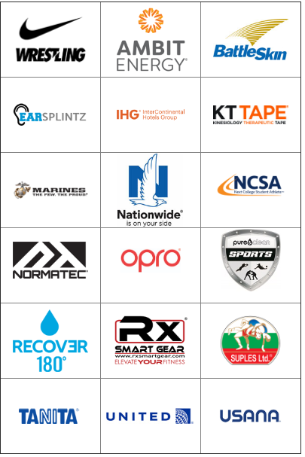
USA Wrestling Sponsors/Sponsor Revenue:
Nike
Ambit Energy
Battle Skin
EarSplintz
InterContinental Hotels Group
KT Tape
Marines
Nationwide
NCSA (Next College Student Athlete)
Normatec
OPRO
Pure Clean Sports
Recover 180
Rx Smartgear
Suples
Tanita
United Airlines
USANA Health Sciences
Year | Sponsorship Revenue
2018 | $1,028,738
2017 | $863,565
2016 | $652,161

Slide 35
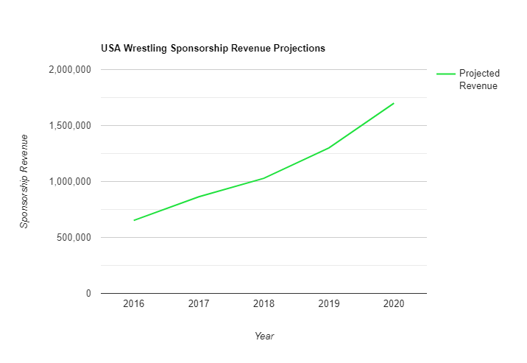
Sponsorship Revenue Data/Projections
Sponsorship Revenue is increasing at a rate of 25% per year. At this growth rate, USA Wrestling is expected to be land at about $1.9 Million by 2021

Slide 36
Survey of US wrestling coaches and administrators
Referencing domestic and global practices particularly from healthy nations successful in Wrestling could provide information on what might be implemented as “best practice” in the US to advance performance and participation structures, processes and programs (Sparvero, Chalip, and Green 2008).
The authors built the model of integrated elite and mass sport development from past research and formed the foundation for a questionnaire and interview schedule for US Wrestling coaches and administrators to generate a snapshot of perceptions of the current sport system and possibilities for its further development.
This study identifies a holistic approach to US Wrestling development using a universal seven element model of high-performance management integrated with mass participation.
We are trying to determine progressions for the sport of Wrestling with a basic thesis that a high-performance system can develop sport talent through an effective, underlying system of mass participation.
We hope to provide information that may be used to improve existing practices, and/or implement new practices.

Slide 37
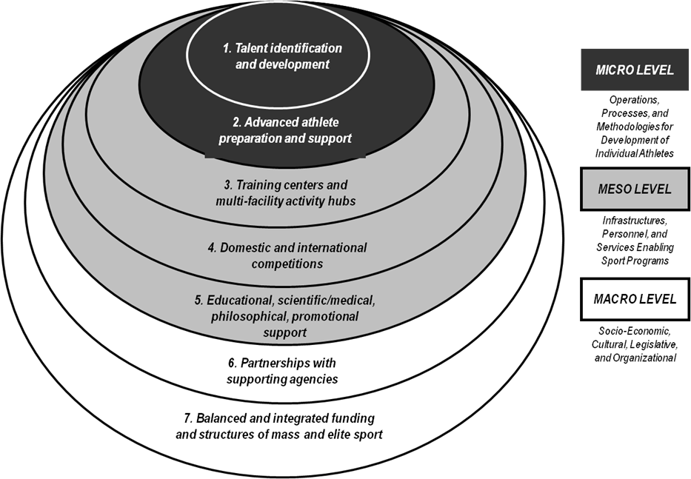
Theoretical framework – global model for integrated high performance and mass sport development

Slide 38
Methodology
The survey sample of 2,000 Wrestling coaches and administrators email addresses was collected from various sources; USA Wrestling web page, college/university athletics web pages, high school web pages and Wrestling clubs’ web pages.
Fully completed questionnaires were returned by 102 coaches for a response rate of 5%
Additionally, 10 regional US Wrestling administrators were interviewed on the 7 elements of the model to suggest possible changes to the future of US Wrestling.

Slide 39
About Survey Participants
Average age of respondents was 45
The average coaching experience of respondents is 24 years
96.5% of respondents were male, 3.5% were female
At least 69% of respondents have bachelor's degree
At least 46% of respondents have master's degree
Levels of Wrestling athletes that respondents coached:
  Beginner: 59%
  High School: 73%
  University (D I 5% , II 7%, III 10%)
  Masters/Adult: 9%
  Elite (not representing USA): 7%

Slide 40
1. Talent Search and Development (Average ratings on a 5-point scale from 1-never to 5-always)
1. Young wrestlers are trained based on clear guidelines for multiple development stages recommended by USA Wrestling (USAW) (many national governing bodies (NGBs) have guidelines for nurturing players from the introduction to sport through the achievement of peak performance on to retirement from sport (USOC encourages and helps all its NGBs to implement such guidelines as American Development Model). | 3.2
2. In addition to being introduced to wrestling by themselves and parents, potential wrestlers are attracted from outside the sport’s participation base (e.g., by a search at schools). | 3.0
3. Sufficient resources (coaching, facilities, equipment, cash, etc.) are available collectively from various supporting organizations for all young talented wrestlers to progress through all developmental stages. | 2.7
4. A multi-stage system of wrestler qualification based on results/ranking within age groups is used to reward wrestlers progress from beginner to top international level. | 3.4
5. Performance of wrestlers in each competitive age group is monitored and developed using a national database. | 3.0
6. A high number of full-time wrestling coaches are available making the athlete-coach ratio low. | 2.3
7. Wrestling coach expertise is equally high across all participant ages and levels. | 2.4
8. Wrestling coaches are paid according to multi-level certification based on coaches' education and achievements of entrusted athletes. | 1.9
9. Wrestlers with potential to represent the country (e.g. nation's top 100 players per age group) are offered the conditions to train full time with high performance standards). | 2.9
10. Wrestling training is well integrated with school/college/university education for harmonious/well-balanced development of athletes. | 2.8

Slide 41
Element 1: Coach Open Responses
Coach #86 on 10/2/2019: “Quality opportunities are not equitable at the middle school and high school level in different parts of the country. In New England, many high schools are not allowed to compete in out of state, elite tournaments due to strict state federation guidelines. Some are able to transfer out to prep schools, but those situations are cost prohibitive.” Element1. Statement 3.
Coach #78 on 10/3/2019: “USAW needs to be the leader in developing the program from the grassroots to the elite. They need to move forward with developing youth clubs in underserved areas.” Element1. Statement 3.
Coach #26 on 10/4/2019: “The sport is not promoted well. Sport role models are not promoted well. It is not funded well. Coaches receive little to no compensation. Facility availability is sparse.” Element1. Statement 6.
Coach #1 on 10/9/2019: “Most coaches are volunteers. If there is a kid that has a lot of talent but cannot afford to attend the big tournaments and travel, they are never discovered.” Element1. Statement 10.

Slide 42
Element 1. Talent Search and Development
Statement 3: Sufficient resources (coaching, facilities, equipment, cash, etc.) are available collectively from various supporting organizations for all young talented wrestlers to progress through all developmental stages.
This response was gathered from Adam Parise who was able to contact this administrator and provide us with crucial insight for our research.
I have read through his comments in the survey and noted areas that we can addresses to help USA Wrestling. In this response to Administrator 2/B (October 20, 2019 rated Element1, Statement with a 2.8 out of 5.0. I felt he was being generous based off his recommendation. His comment reflects his sentiment on: Sufficient resources (coaching, facilities, equipment, cash, etc.) are available collectively from various supporting organizations for all young talented wrestlers to progress through all developmental stages.
"This has, and I would assume will continue to be a low score as financial support of wrestling does not equal that of other organizations.
Many athletes must pay their way on age level trips, preventing some from participation in high level competition.
Overall, USAW facilities at the Olympic Training Center are fantastic. But, throughout the United States the consistency in facilities for wrestling tend to be lacking.
More progressive and creative strategies for fundraising, promotional events, and corporate partnerships are needed to improve this number.“
Based off this recommendation we should start brainstorming possible corporate partnerships that will increase awareness and generate revenue through strategic partnerships in order to generate revenue that can be allocated or used for talent development and search. I would love to hear some possible examples that make sense for USA Wrestling that would help locate top level talent and increase revenue for both parties.

Slide 43
2. Advanced Athlete Support (Average ratings on a 5-point scale from 1-never to 5-always)
1. Athletes, including wrestlers, are supported at places of work similar to those at companies such as Hilton or the US Army where they are given paid time to train and compete. | 2.4
2. High performance wrestlers are ranked into hierarchical levels/pools with appropriate financial and technical support. | 2.7
3. Wrestlers are assisted with formal education and career outside sport by clubs, state and national wrestling governing bodies, USOC and/or sponsors. | 2.7
4. Athlete support is well shared/balanced between coaches and advisors (e.g., coach may provide psychological, nutritional and performance science support, while independent advisors may best assist with medicine, career, education and personal finances). | 3.1
5. Scientific research (e.g., biomechanics of athlete movement and psychophysiological analysis) is applied quickly and effectively to immediately benefit athlete performance. | 3.0
6. A wrestling career is prolonged by medical personnel knowledgeable in wrestling (helping with such things as injury prevention, adjustment of training levels, nutrition, pharmacology, rest and stimulation therapy, doping use prevention). | 3.4
7. Doping is controlled by the USAW and is based on the most recent guidelines from the World Anti-Doping Agency. | 4.2
8. Athletes leaving elite sport are provided with individualized lifestyle plans for physical and psychological health. | 2.5

Slide 44
Element 2: Coach Open Responses
Coach #66 on 10/4/2019: “Depends on resources that are available based upon the state. For wrestlers to get the resources being talked about they need to be seen. The less resources a state has, the less opportunity a high caliber athlete will be seen which may lead them into another sport avenue.” Element 2. Statement 4.

Slide 45
Element 2. Advanced Athlete Report
Statement 1: Athletes, including wrestlers, are supported at places of work similar to those at companies such as Hilton or the US Army where they are given paid time to train and compete.
Administrator 7/G said on December 2, 2019, “Any programs that Wisconsin has would be helpful, the Hilton and the US Army are well trained and can be very useful in different programs.”
The US Army are well trained and with the techniques that they have learned it will be useful to work on different skills. I think there should be more programs that have US Army men or women to help increase skills. It was scaled 2.4 out of 5 being the lowest. In the military and Army there is a such thing as Army Forces Wrestling. Everything that you need it is pointed out by the military just like obstacle courses, strength and muscles, and mental toughness. Military teaches children of all ages disciple, good sportsmanship, friendship, sacrifice and self- reliance. Every state that have wrestling should have at least one person or more in each program who has been in the US Army or even Hilton. The recommendation I would give would be to expand the training knowledge with the Army and military, it would be helpful for anyone who does wrestling.

Slide 46
3. Training Centers (Average ratings on a 5-point scale from 1-never to 5-always)
1. High performance athletes are provided with priority access to specific high-quality equipment and facilities. | 3.6
2. Training centers/clubs provide specialized facilities and equipment for each age and level of participation. | 3.2
3. All national, regional and local training centers are available to athletes at affordable costs. | 2.8
4. Travel from home to training facilities takes little time for US wrestlers of all levels and types. | 2.6
5. Training facilities are close to all facilities for athlete support (e.g., school/college, medical, room & board, leisure/entertainment). | 2.8
6. An organized network of training centers is used to prepare US wrestlers in different environments/sociogeoclimates (e.g., high altitude/temperature/humidity, city/pollution, rural/resort). | 2.9
7. Wrestling training centers are located close to other sport facilities so that players participate in and learn from other sports. | 2.7

Slide 47
Element 3: Coach Open Responses
Coach #26 on 10/4/2019: “You save prime real estate, increase opportunity to train and related equipment, services and science based on commercial or economic viability. Although wrestling will never be a revenue generator like football or basketball, which receive the best facilities, prime location, ease of access and best equipped to develop future elites, it has the potential to be elevated with a created vision and plan to execute. There is not plan or leadership to deliver that in wrestling.” Element 3. Statement 1.
Coach #32 on 10/4/2019: “We have several training centers in the state of Georgia, but sometimes they are prohibitively expensive. I don't necessarily think they are trying to price themselves that high, it's just that what it costs to operate a facility like that. I have several athletes, who would like to participate more with those training centers, however they cannot afford to have the monthly memberships like other athletes can.” Element 3. Statement 3.
Coach #9 on 10/3/2019: “The only training center that I know of in the state of Wyoming is on the campus at the University, my team is only a short 1 hour drive from the facility but many other town maybe a full day trip away from the facility which really limits the ability to be exposed to that higher level.” Element 3. Statement 5.

Slide 48
Element 3. Training Centers (Average ratings on a 5-point scale from 1-never to 5-always)
Statement 3: All national, regional and local training centers are available to athletes at affordable costs.
Administrator 1/A said on October 30, 2019) “The clubs and regional centers have state of the art facilities. They have modern training aids. D1 colleges are filming practices.”
“Elite athletes are having their own shoes made by companies based on what they are looking for in their equipment. Technology continues to change and improve. Shoes and other gear given to elite athletes aids in their improvement.”
Administrator 1/A said on October 30, 2018), “I believe that clubs are affordable for all levels. Clubs do need to charge to exist, but they also assist those athletes that are in need.”
One-way to help support different athletes that train at these local training centers would be to create scholarships that elite level wrestlers can apply to. We should also opportunities for need based grants or membership that are available to athletes that need finical assistance.

Slide 49
4. Competition Systems (Average ratings on a 5-point scale from 1-never to 5-always)
1. Hosted international events and international opportunities are sufficient for all athletes with potential to represent the country. | 3.0
2. Competitions are well structured at all levels (e.g., club/training center, regional, and national). | 3.3
3. USAW and their support mechanisms sufficiently assist in local and developmental events. | 3.0
4. USAW attempts to integrate professional and amateur tournaments into a progressive plan of competitions gradually preparing athletes for peak performance at "elite events” (i.e. Olympic Games, World and US Championships). | 3.3
5. USAW tries to coordinate all domestic and international competitions for all ages and levels, between and within all possible organizations. | 3.2
6. Event sponsorship incomes are used to develop competitions for all participation levels. | 2.8

Slide 50
Element 4: Coach Open Responses
Coach #1 on 10/2/2019: “I have not seen USAW come in and help out the beginners unless it is for some inner-city publicity photo shoot. Nor have I seen them send a team of young kids to a foreign country, unless they are the top in the country. I understand that we want to win, but that is what we would be doing when we allow more kids to go and not just the top 3.” Element 4. Statement 1.
Coach #16 on 10/3/2019: “One of the biggest barriers I've experienced is USAW's refusal to work with athletes or states that are not sanctioned by USAW. If the goal is truly growing the sport, then everyone needs to make nice, put the politics aside and let a kid from PA attend a youth tournament in CT without having to pay for a full year membership to USAW. You want to improve regionally then remove the barriers and let the kids roam and compete.” Element 4. Statement 3.
Coach #41 on 10/4/2019: “I can only speak on the behalf of my independent wrestler who was ranked high in his area and there was ZERO support from anyone in the professional field. The only support he had was colleges trying to recruit him. We as coaches have to track our athletes and I feel the wrestling world should be tracking the more elite wrestlers on their own just like the colleges do. If this was happening there would be more elite wrestlers out competing at higher levels. Our Junior Olympics for Cross Country spot the elite runners and talk with them at races to pull them in. Why is wrestling not doing the same?” Element 4. Statement 4.

Slide 51
Element 4. Competition system
Statement 6: Event sponsorship incomes are used to develop competitions for all participation levels.
Administrator 7/G said on December 2, 2019, “I believe it is important to offer a more advertisement of requirements to make national teams at the High School and kid’s levels would be helpful. To be able to provide and help build up the states from hosting events. We need more sponsorships to be able to expand more. “
This was scaled 2.8 out of 5 being the lowest compared to the rest. There should be more advertisement of requirements to make high school team national. The recommendation I would give is to offer more advertisements in the lower level being able to help the kids, where kids can be scouted to go to different colleges and universities. Sponsorship should be expanded especially under education student athletes.

Slide 52
5. Intellectual Services (Average ratings on a 5-point scale from 1-never to 5-always)
1. All specialists engaged in the development of wrestling are well educated for their roles - from grass roots volunteer instructors to high performance managers, coaches, referees, physicians, nutritionists, psychologists, etc. | 3.0
2. USAW fosters research on all important aspects of wrestling development (from training methods and nutrition to event and facility management). | 3.5
3. Principles of sportsman like conduct and Olympism are communicated well (e.g., through mass media, school education, and through the arts as part of track and field events). | 3.3
4. Research results are well communicated to coaches (e.g., by research institutes, universities, USAW). | 2.8
5. Communication by the USAW contributes to national values and identity by inspiring participants to strive for excellence, to show the best results and character in the world. | 3.3
6. USAW provides vision and leadership in improving all aspects of the participants' well-being through wrestling (e.g., physical, social, emotional, mental, spiritual, and environmental/ecological). | 3.2

Slide 53
Element 5: Coach Open Responses
Coach #12 on 10/4/2019: “The biggest issue is that wrestling is not well known by the uninitiated. Our sport is arcane and requires patience to understand it and appreciate it. Additionally, as a coach I would like to see more research studies, and it would be nice if they were compiled in a place and written format that would be easily accessible.” Element 5. Statement 4.
Coach #16 on 10/4/2019: “USAW doesn't have a spokesperson (that I'm aware of). You have all kinds of recognizable faces. Get someone people recognize (Taylor, Dake, Burroughs) and have them take 15 mins and do some PSA's for wrestling that explain what USAW is all about. You have zero public relations. People don't even know what principles USAW promotes other than what the local youth or HS coach tells them. You have NO presence. Even among the participants in the sport!” Element 5. Statement 6.
Coach #66 on 10/2/2019: “USA Wrestling has not shown to be open to views outside of a certain clique or level of coaching. It is difficult for those outside of the system to have access.” Element 5. Statement 6.

Slide 54
Element 5. Intellectual Services
Statement 4: Research results are well communicated to coaches (e.g., by research institutes, universities, USAW)
Administrator 7/G said on December 2, 2019, “Communicating to the states, coaches and athlete’s parents needs work. I believe it is important to get back to the face to face conversation instead of having video formats. It is better to have more people going to the events, so they can see the overall vision of the organization. Coaches are so passionate for what they do, and they want for people to have that face to face interaction.”
I do agree with him in the form of it is important to have a connection with the athlete’s parents and making sure the coaches formally meet them in person. Communication with every single person in the institution or in the program. Yes, this generation is all about the technology, but it is so much better when it is face to face. It was scaled to being 2.8 out of 5, which was the lowest in this element. The recommendation I would give would be to increase in the lack of communication to different places and people like the athlete’s parents. It is important for coaches to have an interaction in person with the parents. With face to face, people gain trust from the parents and other people.

Slide 55
1. Support for wrestling development is adequate from various levels of government. | 2.2
2. Sufficient help is obtained from USAW and other national governing bodies of wrestling that provide coach education and certification. | 3.1
3. Role of clubs/community programs in wrestling development is sound/strong. | 3.1
4. Wrestling is well supported by educational sector (e.g., schools, colleges, universities). | 2.6
5. Cooperation with agencies outside of sport industry (e.g., medical, scientific, military, philanthropic and sponsoring organizations, lotteries) is in place. | 2.8
6. USAW influences media coverage and popularity of wrestling to increase support from the society. | 2.4

Slide 56
Element 6: Coach Open Responses
Coach #90 on 10/5/2019: “Education at the school administration levels. What do I mean? I think what hurts our sport is the unknown of school administrators Athletic Department Heads, Principals and Superintendents they all know and understand Baseball, Football, Soccer and Basketball or other big money making sports. When it comes to wrestling, they don't know or understand what the school or the kid gets out of it. We need to educate why kids need wrestling in their lives these days when there is no discipline in sports these days and the training it takes to do this sport. We need to simply educate them.” Element 6. Statement 4.
Coach #46 on 10/2/2019: “Wrestling is too divided between governing bodies and not enough college wrestling in all parts of the country which determines success...Outside of the area surrounding Oklahoma to Iowa to Penn State” Element 6. Statement 4.
Coach #84 on 10/4/2019: “Wrestling gets zero publicity. We had two men and two women just recently win world gold medals and numerous others take home silver and bronze. Nothing was said, absolute zero coverage on major TV networks. No parades, no Whitehouse meeting, just a pat on the back. Many times kids don't even know the sport exist until middles school or high school at which point, they are very reluctant to try a new sport. USA needs to contact TV networks and other various media outlets to start getting our great athletes the recognition they deserve.” Element 6. Statement 6.

Slide 57
Element 6: Coach Open Responses Continued…
Coach #100 on 10/4/2019: “There is a distinct lack of media coverage for the sport. Unless you are involved with wrestling and know about flow wrestling or track wrestling you rarely get to see it on television. A partnership with an organization like the UFC to promote wrestling and get it televised would help increase the popularity and revenue the sport would generate.” Element 6. Statement 6.
Coach #87 on 10/4/2019: “Wrestling is not a visible sport on TV as others are. With the rules for different styles of wrestling staying similar over the past few years, the opportunity to understand scoring while viewing is increasing. The sport must continue to push to get more coverage. Having 40,000 at this year's NCAA tournament is a step in the right direction.” Element 6. Statement 6.
Coach #4 on 10/3/2019: “National based advertising on print and digital media is virtually nonexistent, Where other sports get constant exposure on televised media, wrestling is nearly in a vacuum with only those involved in the sport made aware of the opportunities.” Element 6. Statement 6.

Slide 58
Element 6. Partnerships with Supporting Agencies
Statement 1: Support for wrestling development is adequate from various levels of government.
I am citing an administrator that governors wrestling in MA; Administrator 1/A (October 30, 2019) . This is a response that was shared in an email from Professor Smolianov. I read through his remarks and comments took some notes in areas that we can addresses to help USA Wrestling. In this response Administrator 1/A (October 30, 2019) rated Element 6 statement 1 with a 2.2 out of 5.0. His comment reads,
"Political Action Committees focused solely on developing governmental partnerships with the wrestling community could improve this number.
Put together a political candidate list of allies and supporters of the sport of wrestling and sending it to USAW membership.“
This advice seems to be positive in regards of convincing USWA governing board that USA Wrestling as an organization has a vision of expanding and creating a more supportive organization for their athletes in hopes to bring recognition to wrestling in the US through opportunities like Olympic Games and media coverage of NCAA wrestling. If USA Wrestling makes effort to put together a political candidate, they are showing that they are serious about promoting and developing the organization into an elite level national contention program! Like the Boston Youth Wrestling’s diverse, accomplished, and networked executive committee it seems foreseeable to assemble a committee with connection and expertise in a multitude of industries and political savviness.

Slide 59
1. Corporate and philanthropic tax incentives provide sufficient support of mass and elite wrestling. | 2.4
2. Participation in various sports, as a foundation for wrestling development, is encouraged through physical education requirements. | 2.6
3. Sport participation, including wrestling, is rewarded with reduced personal tax. | 1.5
4. Wrestling programs service both recreational and high-performance players. | 3.4
5. Specialized sport schools similar to IMG academies are available and affordable to all talented wrestlers. | 2.1
6. A multi-stage system of elite wrestling qualification is integrated with a system of fitness tests for mass participation. | 2.2
7. Memberships and other "fees" affordable for all are available in various wrestling clubs. | 3.0
8. Wrestling participants are diverse as general population. | 3.5
9. USAW demonstrates systematic/strategic management in developing wrestlers on every level. | 2.9
10. USAW is effective in fostering both mass participation and high performance in wrestling. | 2.8
11. Wrestling is developed in integration with Olympic and Paralympic sports to achieve sustainable competitive excellence. | 3.1

Slide 60
Element 7: Coach Open Responses
Coach #26 on 10/3/2019: “Leadership, visions, people to execute and money. Let's talk about the money first, with the exception of a tax write off if the wrestling program is a non-profit, other than that the government should not be in the business of creating sports stars. The money is there just look at football, basketball, baseball, soccer, volleyball...and the other sports where parents empty their wallets to get little Johnny or Jannie better opportunities. Corporate money will come when business leaders can see USAW leadership can articulate a compelling long-term plan and inspire a shared vision. And let's throw Crooked Hillary and her merry pranksters in jail (Comey, Brennan, Clapper, Obama, Biden...)” Element 7. Statement 1.
Coach #99 on 10/5/2019: “Mass appeal of wrestling is limited--inherently challenging and not necessarily USAW shortcoming. Wrestling is not well-accessible to young people in broad swaths of the country” Element 7. Statement 7.
Coach #18 on 10/2/2019: “The Olympic Committee tried to drop wrestling from the summer venue. Thankfully, from a unified outcry from the wrestling community was it restored.” Element 7. Statement 11.

Slide 61
Element 7. Balanced and Integrated Funding and Structures of Mass and Elite Sport
Statement 5: Specialized sport schools similar to IMG academies are available and affordable to all talented wrestlers.
I am citing an administrator that governors wrestling in MA; . This is a response that was shared in an email from Professor Smolianov. I read through his remarks and comments took some notes in areas that we can addresses to help USA Wrestling. In this response Administrator 1/A (October 30, 2019) rated statement 5 with a 2.1 out of 5.0. His comment reads,
"These exist, but not at the level of IMG (Montini Catholic, Bergen, Blair, etc.).”
“This is difficult to improve on as there is little in the way of making educational institutions change affordability.”
“One possible improvement could be a result from improving partnerships with educational institutions in regard to their relationship with wrestling programs.“
There seems to be a huge disparity in creating an equally opportunities to all schools. However, it seems like schools and wrestling programs can create a more effective way to promote their wrestlers in high school or in club wrestling to give the athlete an opportunity to participate in collegiate wrestling. This will take a creative partnership that will benefit both university and public/private wrestling program, club or organization. If a successful partnership can be made then resources, networking, and idea can be shared and communicated more readily amongst both parties. This can be an advantageous scenario for both parties.

Slide 62
Conclusions to consider
Element 1: USWA should start brainstorming possible corporate partnerships that will increase awareness and generate revenue through strategic partnerships in order to generate revenue that can be allocated or used for talent development and search. I would love to hear some possible examples that make sense for USA Wrestling that would help locate top level talent and increase revenue for both parties.
Administrator 2/B (October 20, 2019). “More progressive and creative strategies for fundraising, promotional events, and corporate partnerships are needed to improve this number.“
Element 2: Military teaches children of all ages disciple, good sportsmanship, friendship, sacrifice and self- reliance. Every state that have wrestling should have at least one person or more in each program who has been in the US Army or even Hilton. The recommendation I would give would be to expand the training knowledge with the Army and military, it would be helpful for anyone who does wrestling.
Administrator 7/G (December 2, 2019). “Any programs that Wisconsin has would be helpful, the Hilton and the US Army are well trained and can be very useful in different programs.”
Element 3: One-way to help support different athletes that train at these local training centers would be to create scholarships that elite level wrestlers can apply to. We should also create opportunities for need based grants or membership that are available to athletes that need finical assistance at all level. Resources that are given to elite level athletes should be available to any wrestler that is registered with USWA. Sharing resources will have a positive effect on both elite and mass wrestlers.
Administrator 1/A said on October 30, 2019) “The clubs and regional centers have state of the art facilities. They have modern training aids. D1 colleges are filming practices.”

Slide 63
Conclusions to consider
Element 4: USWA needs to allocate resources across all levels of competition more proportionally and restructure the policies which would allow USWA to intervene and help wrestlers get the exposures they need by allowing wrestlers to enter tournaments in different regions with lower restrictions.
Coach #16 on 10/3/2019: “One of the biggest barriers I've experienced is USAW's refusal to work with athletes or states that are not sanctioned by USAW. If the goal is truly growing the sport, then everyone needs to make nice, put the politics aside and let a kid from PA attend a youth tournament in CT without having to pay for a full year membership to USAW. You want to improve regionally then remove the barriers and let the kids roam and compete.”
Administrator 7/G (December 2, 2019). “The recommendation I would give is to offer more advertisements in the lower level being able to help the kids, where kids can be scouted to go to different colleges and universities. Sponsorship should be expanded especially under education student athletes.”
Element 5: USWA needs to better communicate research results to coaches through a shared database system.
Administrator 7/G (December 2, 2019). “Communicating to the states, coaches and athlete’s parents needs work. I believe it is important to get back to the face to face conversation instead of having video formats. It is better to have more people going to the events, so they can see the overall vision of the organization. Coaches are so passionate for what they do, and they want for people to have that face to face interaction.”
Coach #12 on 10/4/2019: “The biggest issue is that wrestling is not well known by the uninitiated. Our sport is arcane and requires patience to understand it and appreciate it. Additionally, as a coach I would like to see more research studies, and it would be nice if they were compiled in a place and written format that would be easily accessible.”

Slide 64
Conclusions to consider
Element 6: USWA needs to grow support from media which will hopefully influence society to perceive wrestling as a mass appeal with highly athletic and competitive wrestlers competing year-round to represent their nation.
Administrator 1/A (October 30, 2019) “This advice seems to be positive in regards of convincing USWA governing board that USA Wrestling as an organization has a vision of expanding and creating a more supportive organization for their athletes in hopes to bring recognition to wrestling in the US through opportunities like Olympic Games and media coverage of NCAA wrestling. If USA Wrestling makes effort to put together a political candidate, they are showing that they are serious about promoting and developing the organization into an elite level national contention program! Like the Boston Youth Wrestling’s diverse, accomplished, and networked executive committee it seems foreseeable to assemble a committee with connection and expertise in a multitude of industries and political savviness.
Coach #87 on 10/4/2019: “Wrestling is not a visible sport on TV as others are. With the rules for different styles of wrestling staying similar over the past few years, the opportunity to understand scoring while viewing is increasing. The sport must continue to push to get more coverage. Having 40,000 at this year's NCAA tournament is a step in the right direction.”
Coach #100 on 10/4/2019: “There is a distinct lack of media coverage for the sport. Unless you are involved with wrestling and know about flow wrestling or track wrestling you rarely get to see it on television. A partnership with an organization like the UFC to promote wrestling and get it televised would help increase the popularity and revenue the sport would generate.”

Slide 65
Conclusions to consider
Element 7: USWA needs restructure funding for mass and elite wrestling where an increase in capital and funding local and state government should be utilized under privileged and lower income participants.
Administrator 1/A (October 30, 2019) “One possible improvement could be a result from improving partnerships with educational institutions in regard to their relationship with wrestling programs.“
“There seems to be a huge disparity in creating an equally opportunities to all schools. However, it seems like schools and wrestling programs can create a more effective way to promote their wrestlers in high school or in club wrestling to give the athlete an opportunity to participate in collegiate wrestling. This will take a creative partnership that will benefit both university and public/private wrestling program, club or organization. If a successful partnership can be made then resources, networking, and idea can be shared and communicated more readily amongst both parties. This can be an advantageous scenario for both parties.”
Coach #99 on 10/5/2019: “Mass appeal of wrestling is limited--inherently challenging and not necessarily USAW shortcoming. Wrestling is not well-accessible to young people in broad swaths of the country”

Slide 66
Conclusions from Survey
The key message from the study is that sufficient public resources have not been available for development of USWA, particularly at the mass participation level (high school, collegiate, clubs, etc.).
Respondents were not positive about current practices as mean scores for each element were below average and coaches and administrator were eager to provided positive feedback and criticisms.
Throughout all seven elements, the coaches’ open responses demonstrated that the need for accessible and proximal facilities that are properly funded to hold mass and elite level training/competitions. USWA could benefit from strategical investing into public relation which could help educational and promotional support for the sport. Before building more facilities for training it is more important to fill the current facilities and allow access to participants of all wrestling level, with the exception they are registered with USWA.
Most of these conclusions and recommendations are consistent with the study by Run, Jump, Throw aimed to better the lives of children through sport and recreation, stressing the challenge of costs, commitment and indicating that programs need to be revitalized, with a focus on improving the quality and affordability of the offering as well as the number of participants through new places to play.

Slide 67



Conclusion: Micro level
At micro level, more than half of the open responses regarding talent search and development indicated that coach expertise should be higher across all participant ages and levels. It is also evident that wrestling coaches should be paid according to multi-level certification based on coaches' education and achievements of entrusted athletes.
The responses indicates that there is need for higher level coaching across all ages and levels as well as a development program for public organizations and that paying coaches according to certification level may incentive more potential coaches to go through certification programs provided by USWA.
To improve advanced athlete support, the benefits of training should focus on communities and wrestling programs that are underfunded to ensure all athletes receive equal support from the USWA .

Slide 68


Conclusion: Macro level
At macro level, partnerships with supporting agencies could be mutually beneficial to both parties. The public funding could be improved through brand recognition with our strategic partners which would increase awareness and participation. NGB’s need to work directly with the government to increase financial assistance and allocate resources tactfully. USWA should also look to make strategic partnership with US Army, US Marines, and US Navy.
Public-private wrestling partnerships such as the Beat the Streets should work in correspondence with USWA. Coaches should be certified to USWA satisfaction and there ought to be talent development and scouts that have exposure to some of the less fortunate participants that may have promising potential at a competitive wrestler. In addition, the instructors of these programs should be paid according to their certification and experience. Wrestling needs to be spearheaded and promoted more in educational systems, afterschool programs, and community recreational centers so potential participants have access and knowledge to the sport of wrestling.
Programs should be better designed to reach impoverished areas and lower-income families. Findings from this study suggest working along with IMG-type academies in order to allow more financial flexibility and possibly propose programs accepting financial aid recipients, so that a variety of individuals from different demographics can learn the sport of wrestling early adolescence or at the youth stage of development.

Slide 69
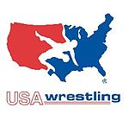

Conclusion: Meso level
At meso level, to advance training centers, most programs should cost less and be easier to gain entry regardless of one’s financial means or talent. All participants should have access to instructions from USWA certified coaches—not only those who can pay or show promise as wrestlers. Programs and facilities need to be made more economical and accepting of these athletes from all levels.
Coach #13 on 10/2/2019: “Everything is pay to play or pay to practice this restricts many kids from joining the sport unlike basketball where you can go to a park and train.”
Coach #26 on 10/4/2019: “Funding is holding back some of these areas. The funding problems goes directly to the lack of awareness to the sport (marketing 101...donors, sponsors). Sport role models, branding, compelling stories, sell the sizzle. This is just not done or performed at a remedial level.”

Slide 70
Key takeaways from survey results – Product & Place
There is not enough financial support for USAW
  Many high-level athletes must pay their own way for trips, causing less participation in the sport
The sport needs more efficient fundraising, sponsorships, creative ways to generate revenue, etc. To attain higher quality facilities that can attract more athletes and fans
Younger athletes need to be recruited to the sport in an effort to galvanize the popularity
An administrator suggested a political committee that can focus on creating governmental partnerships for USAW
  Another suggested improved partnerships with educational institutions to obtain higher quality facilities and attract more athletes
More equipment should be provided for wrestling athletes
USAW guidelines are ok, but could be more clearer in guiding athletes through all stages of development.

Slide 71
Key takeaways from survey results – Product & Place
There needs to be more sponsorships to help fund and set up more competitions for athletes to compete in.
While technology is important, it is more important for coaches, parents, athletes, and anyone else that is involved in the organization to meet in person to acquire more knowledge about the sport.
More full-time wrestling coaches need to be hired to improve the coach-athlete ratio. This will ensure the organization will build a high-level competitive sport.
  In addition, these coaches need to be knowledgeable and experts at the sport of wrestling in every age group.
An administrator suggested that coaches should be paid based on their experience and quality, along with their certifications.

Slide 72
Key takeaways from survey results – Product & Place
Practices should be held every day to ensure athletes have the opportunity to work on their skills and have a better opportunity to represent USAW.
Wrestling needs to have a better relationship with schools to ensure athletes have a good balance of training and education.
Partnerships with facilities will be important to allow for expansion to many areas of the U.S. and allow for more recognition of the sport.
Allowing for equal opportunities to all potential new wrestlers will be important to growing USAW. This means creating high school programs and club teams to get any interested athletes involved and give them a pathway to college wrestling.

Slide 73
Key takeaways from survey results – Product & Place
The events need be need to be advertised better, once it is more people can realize where watch the product and see how good it really is
The more people the know about USAW the better product will be viewed whenever competitions are being held in certain facilities

Slide 74
SWOT ANALYSIS
By: Brett Graziano, Alicia Gibney, Jake Hibbert, Madison Cifra

Slide 75
Strengths
Improves health and fitness routines for our kids
Takes place inside, no worries about weather and the
There are four levels of coaches and are home to over 4000 wrestling clubs with 232,000 total members
The opportunity to travel abroad with Developmental Tours for Cadet, Junior, Women, University and Senior level athletes.
Insurance waivers are given out to members to make sure your covered if you get seriously injured.
There is multiple types of a membership including an Athlete, Booster, medical and sponsor giving people different ways to get involved.
“Membership Levels.” Team USA, www.teamusa.org/usa-wrestling/membership/membership-levels.

Slide 76
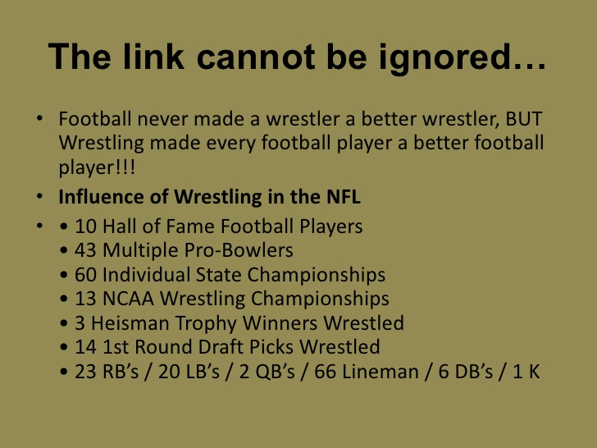

Slide 77
Weakness
Shortage of coaches that understand the sport well enough for teaching it
Lack of knowledge on how to wrestle. A lot of technique and precision skills are what is needed to participate.
Injuries. Wrestling can be very dangerous which does not attract many athletes compared to Baseball, Basketball, etc.
Lack of facilities that work with the sport of wrestling
U.S potential. International wrestling is worth more to invest then here in America due to our main sports

Slide 78
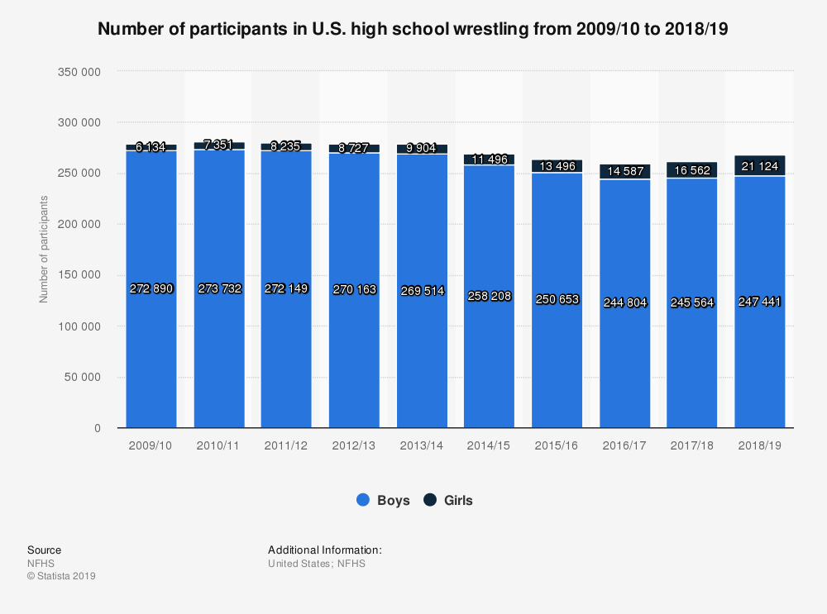
https://www.nfhs.org/media/1020406/2018-19-participation-survey.pdf

Slide 79
Opportunities
“No Missed Meals” program. This has helped athletes along with their families to work on eating habits.
Nutrition is so important for wrestling. Bringing families into their son or daughters athletic career can go a long way.
Bring wrestling into more high schools, colleges and even leagues after school.
Branding can be improved with better marketing campaigns to attract a bigger audience
Bring more women into the sport

Slide 80
















Slide 81
Threats
USA Wrestling medals have gone down in the Olympic Games
“Over 130 Division 1 colleges have dropped their wrestling programs since 1970 and over 170 have been dropped since the establishment of college wrestling.”
With the population increasing, the sport is not increasing the same rate
Other sports. Basketball, Football and lacrosse are strong programs that dominate the NCAA. Wrestling is an outcast especially in the United States.

Slide 82
References
https://www.slideshare.net/valentit/football-and-wrestling-2131633 (Picture 1)
https://www.statista.com/statistics/268028/participation-in-us-high-school-wrestling/ (Picture 2)
https://www.teamusa.org/usa-wrestling/about-us/sponsors (Sponsors)

Slide 83

Bay State Games
Athletes from Massachusetts, Maine, Vermont, New Hampshire, Rhode Island and New York are eligible for the Bay State Games Wrestling
To be eligible to compete in the Bay State Games an athlete must meet at least one of the following states and a full-time student at a recognized academic institution or member of a wrestling club of one of the above states

Slide 84
Bay State Games Divisions
Divisions
Junior = 5th-8th graders
Scholastic = 9th-11th graders
Open = 12th graders-Athletes 19 years old and up
Any athlete who wins a gold, silver or bronze medal at the Bay State Games Wrestling competition will qualify to compete in the State Games of America. This year athletes who wins will compete in Ames, Iowa against medal-winning wrestlers from other state games programs nationwide.

Slide 85








Bay State Games Sponsors

Slide 86

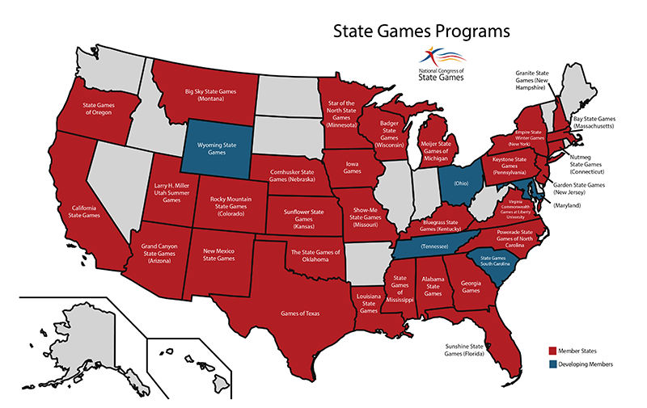
State Games Of America
An Olympic Style competition held featuring competition between State Games medal winners from across the nation. There are currently 30 states organizing statewide sports festivals known as State Games. This years state games was held in Lynchburg, Virginia
“Eligibility.” State Game of America 2015, stategamesofamerica.com/eligibility.

Slide 87
State Games Wrestling Divisions / Eligibility
- Elementary/Pee Wee Division - 3rd Grade & Under
- Youth Division - 4th & 5th Grades
- Middle School - 6th - 8th Grades
- High School - 9th - 12th Grades
- Open Division (Post High School)
All Virginia, West Virginia, and Maryland Residents are eligible to participate and can register into the State Games of America like a traditional VA Commonwealth Games at Liberty University Summer Games.
For non-Virginia residents, All gold, silver and bronze medalists from National Congress of State Games (NCSG) Member State programs (Winter and Summer) in 2017 (after July 1), 2018 and prior to July 1 of 2019 are eligible to compete in SGA 2019. All medalists from any previous State Games of America are also eligible to compete.

Slide 88










State Games Sponsorships / Partners
GOLD MEDAL SPONSORS - PowerAde , Papa John’s, BWX Technologies,
SILVER MEDAL SPONSORS - Grand Home Furnishings, Cothran Insurance, Sherwood Memorial Park, Gentry Locke Attorneys
BRONZE MEDAL SPONSORS - Arby’s, Ethos technologies, U.S. Army, Lynchburg Regional Airport

Slide 89









State Games Partners

Slide 90

Empire State Summer Games
An Annual Olympic style competition for amatuer athletes in New York City. Athletes of all ages come and compete at this event
The Empire State Summer Games is split up into 2 divisions, Open and Scholastic
Open Division - New York athlete's 18 years old and older
Scholastic Division - New York athletes 17 years old and younger

Slide 91
Sources
.“State Games of America.” Edited by Kevin Cummings, Bay State Games, Penn Monto, 2019, www.baystategames.org/state-games-of-america.
Engelbarts, Eric. “Welcome to the National Congress of State Games.” Welcome to the National Congress of State Games | National Congress State Games, Centra, 2019, www.stategames.org/index.php?module=cms&page=1.

Slide 92
Product and Place USA Wrestling
USA Wrestling Research. Secondary sources
Ronald Colman, Sebastian Williams, Michael Negri, Darren Sanderson, Noah Hodgkins

Slide 93
USAW Target Audience
The target audience for USAW is the 33 million males that are between the ages of 0-25 and are fans of sports
These fans are mostly made up of the major sports: Football, Baseball, Basketball, Soccer, and Hockey
Our goal is to convert these sports fans over to wrestling, and target the 64 million males ages 25-54 to become coaches of wrestling

Slide 94
Methods of Reaching Target Audience
This audience can be effectively reached through elementary schools, middle schools, high schools, and colleges around the United States.
Partnering with these schools to develop programs to introduce and guide the students through the sport of wrestling will increase participation numbers, and keep the cost of gaining new members low
Advertisements through other popular sports should be effective in gaining interest within the sport of wrestling
Social media will be a crucial way to target this audience with the prevalence of smartphones and social media use among younger generations.

Slide 95
Wrestling Demographics Analysis
The sport of wrestling is 94% Male across all of high school, NCAA, and USA levels
There are over 260,000 high school wrestling participants across the USA
There are 55 million males between the ages of 0-25 in the US
6 out of 10 Americans identify as a sports fan, meaning over half the population is a fan of a sport
Taking these numbers you can say there are 33 million males in the US ages 0-25 that are a fan of sports

Slide 96
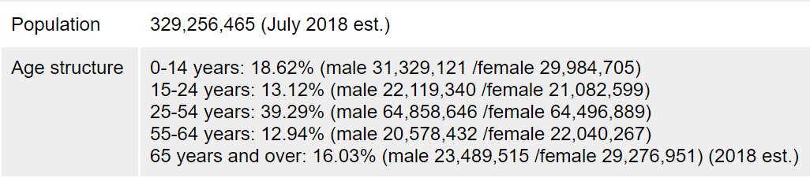
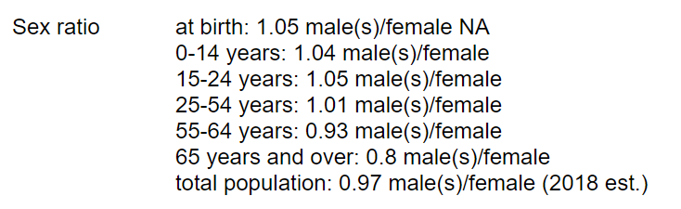
Wrestling Demographics Analysis

Slide 97
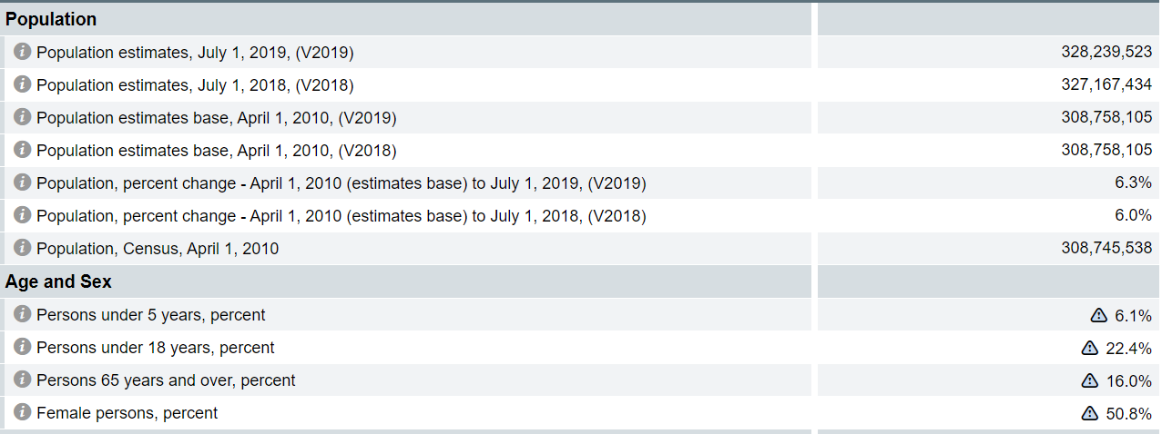
USA Population and Statistics

Slide 98
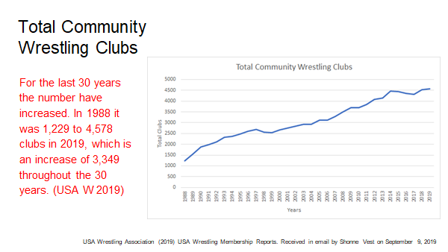

Slide 99
Wrestling programs after school
USA Wrestling has many programs across the country for everyone.
Their website allows anyone looking to wrestle to search their zip code and find clubs within a certain mile radius from their zip code.
This keeps wrestlers easily involved in the sport recreationally after school with a simple and quick search.
There are 4,400 wrestling clubs and 2,100 local, state, regional, and national competitions. (Source: https://www.teamusa.org/USA-Wrestling/Membership/Benefits-of-Membership)
Source: https://www.teamusa.org/usa-wrestling/membership/find-a-club

Slide 100
USAW Membership benefits
232,000 USA Wrestling memberships.
1. Participation in Local, Regional, and National Competitions.
2. Four levels of Coaches Certification.
3. The opportunity to travel abroad with Developmental Tours for Cadet, Junior, Women, University and Senior level athletes.
4. Educational videos and written materials.
5. Regional and National Training and Developmental Camps for Youth through Senior-level athletes.
6. Free subscription to USA Wrestler/WIN Magazine Edition, the official publication of USA Wrestling. Members also have the option to purchase an additional 6 issues of WIN Magazine, at a discounted rate of $18, to be delivered in the off-months of USA Wrestler/WIN Magazine Edition.
7. Free subscription to USA Wrestling’s newsletter, which is sent electronically bi-weekly
8. Discounts on USA Wrestling Merchandise.
Source: https://www.teamusa.org/USA-Wrestling/Membership/Benefits-of-Membership

Slide 101
Improving the USA Wrestling product
When a sport consumer identifies with their team, they will be more satisfied with the team. This increases the consumer’s loyalty and increases the intention to buy tickets and merchandise for the team’s event. (Silveira, Cardoso, and Quevedo-Silva, 2018)
Suggestion based on research: Building USA wrestling around one of the best wrestlers with a likable personality could benefit our product. This would allow for our audience to have a favorite wrestler and want to attend an event to see them in action.
Now that we have an audience in attendance, it is important to have a quality event for optimal fan satisfaction. This can increase fan attendance at our wrestling events. (Foroughi, 2014)
Ron Colman

Slide 102
Improving The USA Wrestling Product cont.
Wrestling needs to target girls and women to participate. The sport is dominated by the male gender.
The National Wrestling Coaches Association (NWCA), the number of girls who wrestle at the high school level has grown from 804 in 1994 to 16,562 in 2018.
With more female involvement in wrestling, girls will have more role models, setting up the probability of greater growth to come
Female wrestling supports an increase in USA Wrestling membership, which adds revenue that supports wrestling across the board.
Krumie, M. (2019, May 9). The Impact of Girls Wrestling. Retrieved from https://www.teamusa.org/USA-Wrestling/Features/2019/May/09/The-Impact-of-Girls-Wrestling
Darren Sanderson

Slide 103
Improving the USA Wrestling product cont.
Suggestion based things I looked up: Other sports do a fantastic job of building their sport around marketing their sports top performers and their personalities. The NBA does this with LeBron James as he is the most popular basketball player he is always on tv, and he promotes the game as well. Pat Mahomes is now the face of the NFL and has a great personality,he is now in a lot of commercials and ads as well. Some top wrestlers I found over the last few years based rankings are Thomas Gilman, and Anothy Ramos. USAW needs to inform about how good their wrestlers for people to tune in. (used usaw.org to find top wrestlers)
There are many ways you can to sell consumers on why they should attend a USAW event. They could easily create a highlight reel on former events and post it on social media. Doing that will show people how great the event can be with the millions on social media now. You can put ads on tv about USAW and why attending an event will be a good idea with a performer explaining why.(Reynolds, K. (2019, January 21). 16 Ways to Use Social Media to Promote Your Event. Retrieved from https://www.socialmediaexaminer.com/use-social-media-to-promote-your-event/)
Michael Negri

Slide 104
Improving the USA Wrestling Product cont.
Real-time photo elicitation has proven to improve the experience attendees significantly (Petermans, Kent, & Van Cleempoel, 2014)
Having attendees take more photos at USA Wrestling events will both increase engagement and provide more exposure to obtain more members and fans
Improving fan interactions with vendors would lead to an increase in engagement (Wei Liu, Beverley Sparks, And Alexandra Coghlan, 2017)
Sebastian Williams

Slide 105
Sources
https://collegewrestlingrecruiting.com/2nd-child-page/
https://www.census.gov/quickfacts/fact/table/US/PST045219#PST045219
https://www.indexmundi.com/united_states/demographics_profile.html
statista.com/statistics/300148/interest-nfl-football-age-canada/

Slide 106
2018 Schedule of Program Services Spending

Slide 107
2018 General and Administrative Spending

Slide 108




USA Wrestling Suppliers
-Supplies all wrestling gear used by the elite athletes
Supplies wrestling mats for all USA Wrestling events
-Supplies all trophies/medals for events
- Books venues for events and assists with food for the elite athletes

Slide 109
Sponsorship Revenue Data/Projections
Sponsorship Revenue is increasing at a rate of 25% per year. At this growth rate, USA Wrestling is expected to be land at about $1.9 Million by 2021

Slide 110
Price
By Janard Jones, Jaden Castillo, Patrick Sullivan, and Marcus Carvalho

Slide 111
Membership Spending
●Membership price costs $40 and USA Wrestling gets $26 of that money. Of the $26, USA Wrestling reinvests $22.70 (87%) back into wrestling. $12.20 (47%)of that money is to fund wrestling at the state, local and individual competition level. $10.50 (40%) of the money is put into the National wrestling program
●Membership spending in 2018 was $4,027,100
●There are 49,219 registered members
○48,613 Mass members (98.76%)
○606 High performing members (1.24%)
●The ratio of mass athlete to elite membership is 80.22:1

Slide 112
Membership Spending Continued
●So if spending between the two groups was equal from the money invested from Membership fees (*when asked USA Wrestling did not disclose the actual spending*)
○Mass Spending: $593,078.60
○High Performing Members: $7,393.20
●$10.50 of membership fees go to USA Wrestling at the National level
○Total: $516,799.50
** with Membership spending it is key to note that most likely the spending here is not directly proportional as the High performing members require different services than the Mass majority of members **

Slide 113
Costs for USA Wrestling
Membership Costs ($40) (USA Wrestling Spending. (n.d.). Retrieved April 6, 2020, from https://www.teamusa.org/usa-wrestling/membership)
Equipment Costs
Wrestling Headgear ($25-$50)(USA Wrestling Spending. (n.d.). Retrieved April 6, 2020, from https://www.wrestlingmart.com/)
Wrestling Singlets ($25-$90)(USA Wrestling Spending. (n.d.). Retrieved April 6, 2020, from https://www.wrestlingmart.com/)
Wrestling Shoes ($50-$160)(USA Wrestling Spending. (n.d.). Retrieved April 6, 2020, from https://www.wrestlingmart.com/)
Mouthguard ($7-$25)(USA Wrestling Spending. (n.d.). Retrieved April 6, 2020, from https://www.wrestlingmart.com/)
Knee Pads ($12-$50) (USA Wrestling Spending. (n.d.). Retrieved April 6, 2020, from https://www.wrestlingmart.com/)
Coaching-Facility fees
2 Year Wrestling Coach Card ($75) (USA Wrestling Spending. (n.d.). Retrieved April 6, 2020, from https://www.teamusa.org/usa-wrestling/membership)
Ohio State Facility ($49.7 Million) (USA Wrestling Spending. (n.d.). Retrieved April 6, 2020, from https://intermatwrestle.com/articles/18262)

Slide 114
USA Wrestling Memberships
Types
Athlete Memberships (Membership Levels. (n.d.). Retrieved April 2, 2020, from https://www.teamusa.org/USA-Wrestling/Membership/Membership-Levels)
Wrestling Leader Membership (Membership Levels. (n.d.). Retrieved April 2, 2020, from https://www.teamusa.org/USA-Wrestling/Membership/Membership-Levels)
Booster Club Membership (Membership Levels. (n.d.). Retrieved April 2, 2020, from https://www.teamusa.org/USA-Wrestling/Membership/Membership-Levels)
Medical Memberships (Membership Levels. (n.d.). Retrieved April 2, 2020, from https://www.teamusa.org/USA-Wrestling/Membership/Membership-Levels)
Sponsor/ Vendor Membership (Membership Levels. (n.d.). Retrieved April 2, 2020, from https://www.teamusa.org/USA-Wrestling/Membership/Membership-Levels)
Event Volunteer(Membership Levels. (n.d.). Retrieved April 2, 2020, from https://www.teamusa.org/USA-Wrestling/Membership/Membership-Levels)

Slide 115
Benefits of Memberships
- Athlete Membership/Wrestling Leadership: secondary, non-duplicating sports accident insurance provided by an outside carrier, sports accident supplemental benefits provided to USA Wrestling members who participate in limited non-sanctioned events, a one-year subscription to USA Wrestler magazine; the privilege to compete and take advantage of events, camps, clinics, international exchanges, and club programs; and other national discount programs as they become available. (Membership Levels. (n.d.). Retrieved April 2, 2020, from https://www.teamusa.org/USA-Wrestling/Membership/Membership-Levels)
- Booster Club: one-year subscription to USA Wrestling(Membership Levels. (n.d.). Retrieved April 2, 2020, from https://www.teamusa.org/USA-Wrestling/Membership/Membership-Levels)
- Medical Memberships: assigned medical personnel at USA Wrestling regional and/or national championships(Membership Levels. (n.d.). Retrieved April 2, 2020, from https://www.teamusa.org/USA-Wrestling/Membership/Membership-Levels)
-Sponsor/Vendor Membership: personnel and employees of USA Wrestling partner companies who will be attending USA Wrestling regional and/or national championships.(Membership Levels. (n.d.). Retrieved April 2, 2020, from https://www.teamusa.org/USA-Wrestling/Membership/Membership-Levels)

Slide 116
Improving US Wrestling Memberships
Gaining more exposure on all levels of wrestling,( Local, Regional, State and Nation Wide)
Gaining more advertising and using social media as more of a branding platform.
Also doing Wrestling Camps to bring in new members in areas with high memberships such as Arizona, California, Florida, Michigan and etc.
Bringing new Wrestling clubs to areas who don’t have a lot of memberships
Inviting former College Wrestling athletes to volunteer or work as a wrestling coach
Abbott, G. (2014). USA Wrestling Sets Membership Records In Five Categories. Amateur Wrestling News, 60(4), 28.
file:///C:/Users/lmper/AppData/Local/Packages/Microsoft.MicrosoftEdge_8wekyb3d8bbwe/TempState/Downloads/Wrestling%20membership%20price%20(1).pdf
Marcus Carvalho

Slide 117
Ways to help bring in funds
USA wrestling can earn money by fundraising, a way we can do this is by crowdfunding which is small amounts of money from a large number of people. This is usually done online because there is a wider range of people to connect too and could pull in people from all over the country, to donate. If every person involved in the USA wrestling team can get people to donate it could be very profitable.
Fundraising costs can cover wrestling gear, travel, medical insurance, wrestling clinics, etc.
Sponsorships with sport drink companies (Gatorade, Powerade, Vitamin Water), gear companies (Adidas, Nike)
Concessions at wrestling events
Renting out facilities for other entertainment usage.

Slide 118
Improving the US Wrestling Price
There should be more focus on funding for USA Wrestling
A way this can be improved is through crowdfunding especially for mass members.
Crowdfunding is fundraising small donations from a large group and since there is a broader range of ways to fund such as gofundme, cashapp, and social media to spread awareness, wrestling teams can profit off of mini events and refreshments.
Some of these include family bowling, parent-athlete dinner, and laser tagging.
theMatBoss. (n.d.). Blog. Retrieved April 4, 2020, from https://matboss.com/how-wrestling-programs-can-raise-more-money-than-ever-through-crowdfunding/

Slide 119
Improving the US Wrestling Price Cont.
For the elite members, we need to utilize the better quality facilities more in the appropriate times.
Wrestling tournaments should be held at stadiums and colleges for the elite national competitors such as college, professional and olympic wrestlers.
With elite members having access to these stadiums, they can generate enough revenue for the city particularly professionals because fans will pay for the more experienced wrestlers due to better entertainment.
For example, Wrestlemania is an annual WWE pay-per-view (PPV) event that generates millions of dollars in revenue. Because they have the best wrestlers performing in this PPV event, it is expected that they have a high-quality facility for not only the matches but to also tour around the stadium and enjoy the festivities beforehand.
Staszewski, J. (2020, March 12). WWE's WrestleMania generates $165 million for New York, New Jersey area. Retrieved April 5, 2020, from https://nypost.com/2019/11/11/wwes-wrestlemania-generates-165-million-for-tri-state-area/

Slide 120
USA Wrestling Participation
Boys high school wrestling remained the No. 7 sport among boys on the high school level in terms of participants, and the No. 8 sport for boys in terms of number of schools.
In 2018-19, boys high school wrestling grew to 247,441 athletes, an increase of 1,877 athletes from last year. Among the top 10 participation sports for boys, wrestling saw the third biggest increase, behind only track and soccer.
The combined number of high school wrestlers, including both boys and girls, grew to 268,565, an increase of 6,439 athletes, which comes in at a 2.5% growth.
Abbott, G. (2019, August 26). NFHS reports high school wrestling participation up for boys and girls in all categories for 2018-19. Retrieved April 23, 2020, from https://www.teamusa.org/usa-wrestling/features/2019/august/26/nfhs-stats-show-high-school-wrestling-growing-in-all-categories
- The National Federation of State High School Associations (NFHS) has released its 2018-19 High School Participation Survey, and the sport of wrestling has grown in all five categories reported.
- The biggest jump within wrestling came in girls wrestling, which grew for its 30th straight year.
- There were 21,124 girls participants in 2018-19, an increase of 4,562 athletes from the year before. This is a tremendous 27.5% increase from last year.
- Girls high school wrestling has climbed to the No. 17 most popular high school sport for girls. There are currently 18 state high school associations which have developed or announced official girls high school wrestling championships, an increase from just six two seasons ago.
Janard Jones

Slide 121
What this means for USAW Price?
More participation in USAW amongst the youth increases the revenue being brought into the Wrestling Business. Some ways USAW can help increase the revenue is by competing in more tournaments, building sponsorships with other companies, and possibly eliminate wasteless expenses. Chilson, M. (2017, March 19). Kids wrestling tournament is an economic boon for Topeka. Retrieved April 25, 2020, from https://www.cjonline.com/news/local/business/2017-03-18/kids-wrestling-tournament-economic-boon-topeka
However, high schools cut wrestling out of their school budgets sometimes in order to save funds for the school and focus on what is “necessary” to make money. Perry, N. (2019, November 6). Increasing Student Participation, Retention in High School Sports. Retrieved April 24, 2020, from https://www.nfhs.org/articles/increasing-student-participation-retention-in-high-school-sports/
Specialization – or students focusing all their abilities on one sport – also brings about negative effects on overall participation, especially at the youth sports level. Perry, N. (2019, November 6). Increasing Student Participation, Retention in High School Sports. Retrieved April 24, 2020, from https://www.nfhs.org/articles/increasing-student-participation-retention-in-high-school-sports/
Janard Jones

Slide 122
How can we improve Participation and Improve Performance?
- Using music as part of pre-match and timeout entertainment can get fans involved and excited for wrestling matches.
- Bring alumni back to help teach younger wrestlers winning strategies and tactics to improve their performance.
- Live stream matches through social networks such as Facebook, Twitch, Youtube, etc…
-Building a team website and utilize social media accounts to help promote the team.
Reasbeck, J. (2013, May 17). How can wrestling promote itself better? Retrieved April 25, 2020, from https://www.win-magazine.com/how-can-wrestling-promote-itself-better/
Janard Jones

Slide 123
No Missed Meals
USA Wrestling and Chobani have teamed up to promote healthy eating habits and challenge the accepted, yet unproductive, practice of weight cutting. The No Missed Meals campaign offers a learning opportunity for athletes, parents and coaches – showing what good nutrition means, how to stick to it, and the long-term effects it can have on performance. After all, food should be a friend, not foe of wrestlers at all levels.

Slide 124
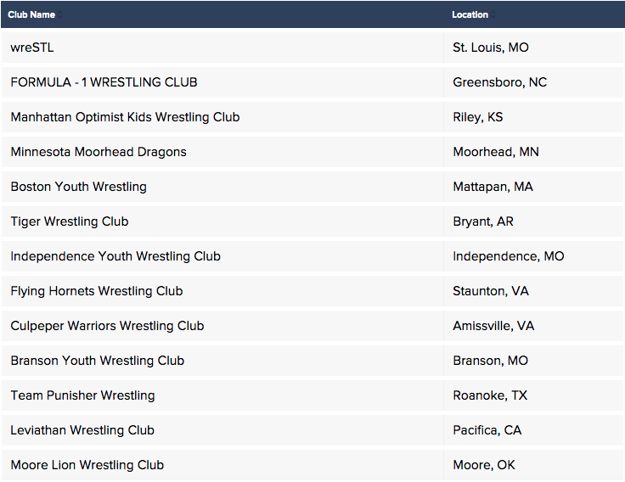
No Missed Meals Clubs

Slide 125
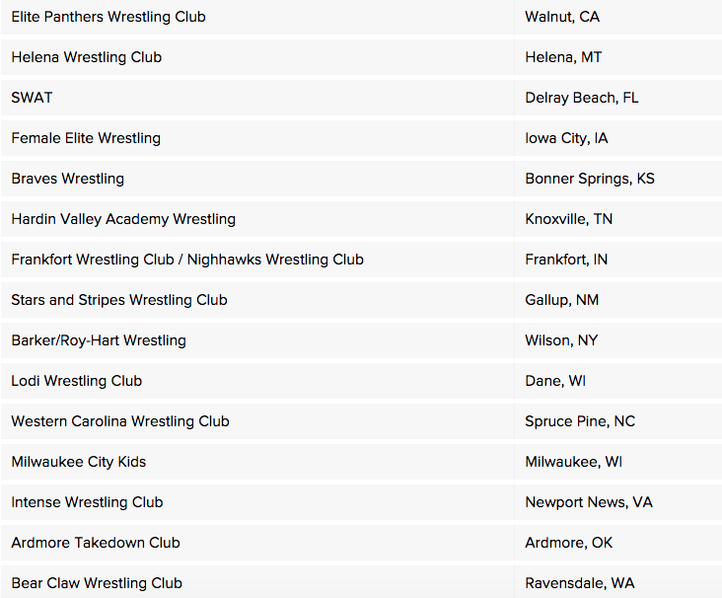
No Missed Meals Clubs

Slide 126
Marine Week Detriot
The United States Marine Corps, USA Wrestling, and the US Wrestling Foundation have come together to host a FREE wrestling clinic for the youth and high school athletes of Detroit and the surrounding areas. Don't miss out on this amazing opportunity to learn from the best wrestlers in the world!

Slide 127
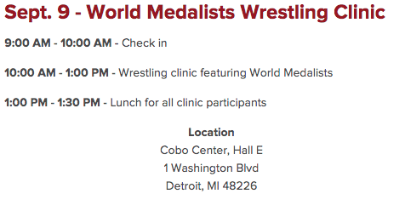
Marine Week Detriot

Slide 128
Work Cited
(n.d.). Finance Reports. Retrieved from https://www.teamusa.org/usa-wrestling/about-us/financials

Slide 129
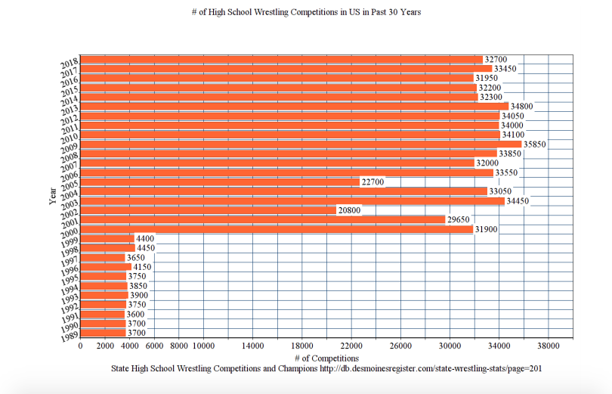

Slide 130
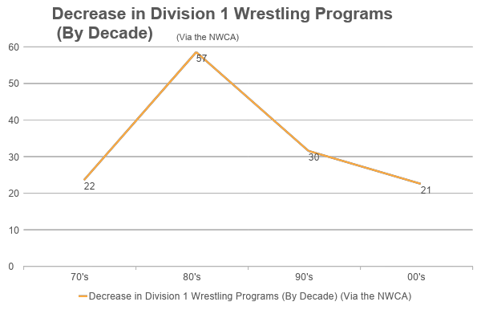

Slide 131
Promotion of Wrestling
By Khalill Benguche and Chris O’Brien

Slide 132
Posters, Influencers and Contests
Benefits of using Posters-They are cheaper than many forms of advertising, good at attracting the attention of your consumer, due to their striking visual nature, posters will promote the event as long as they’re left intact. Advantages of Advertising: 12 Major Advantages of Advertising– Explained!
Influencers- Using well known influencers to spread awareness of a wrestling would be a great idea because Influencers could: Post promotion videos on their social media accounts, organize meet and greets for fans, show up at the event itself. Trackwrestling partners with USA Wrestling for upcoming United World Wrestling Senior World Championships promotion
Contests- Organizing free ticket giveaways that consists of fun to play mini games is a great way to boost attendance at your event. This is an effective strategy used by many businesses such as Red Bull and Jam’n 94.5 because it gives people incentive to engage in something free of charge. E-Magazine

Slide 133
Promoting Wrestling on and off the mat
Promoting wrestling takes time and commitment by creating and implementing strong promotions to achieve success.-Promoting Wrestling On and Off the Mat
Tips on how to promote-
Make you venue look packed
Expand the number of managers and mat-mates you have in your program and give them meaningful tasks
Reach out to alumni to help build database
Don’t rest on success
How can wrestling promote itself better?

Slide 134
Benefits of a membership
1. Participation in Local, Regional, and National Competitions.
2. Four levels of Coaches Certification.
3. The opportunity to travel abroad with Developmental Tours for Cadet, Junior, Women, University and Senior level athletes.
4. Educational videos and written materials.
5. Regional and National Training and Developmental Camps for Youth through Senior-level athletes.
6. Free subscription to USA Wrestler/WIN Magazine Edition, the official publication of USA Wrestling. Members also have the option to purchase an additional 6 issues of WIN Magazine, at a discounted rate of $18, to be delivered in the off-months of USA Wrestler/WIN Magazine Edition.
7. Free subscription to USA Wrestling’s newsletter, which is sent electronically bi-weekly
8. Discounts on USA Wrestling Merchandise.
Benefits of Membership

Slide 135
Trackwrestling.com has partnered with USA wrestling to help promote its upcoming events. Trackwrestling is a sports engine and website that is used by mostly all tournaments around the world. At this website you will register the wrestler, use it to look up the wrestlers bracket, mat assignment and bout numbers. With this new partnership Trackwrestling will contribute $5 to USA Wrestling each time the promo code USAW is used at checkout on trackwrestling.com USA Wrestling will use the funds raised through this promotion for further development of their training programs and initiatives. The promotion also extends a discount to the consumer when a subscription is purchased."This is another example of a great partnership that makes the wrestling community stronger," said Rich Bender, Executive Director of USA Wrestling.
Each year The Senior World Championship is broadcasted on Trackwrestling as one of its premier events. An event like this can be accessed through their Gold+ subscription. Trackwrestling is the perfect partnership to help promote this sport in all sorts of ways, including increased revenue and publicity. As well as getting new wrestlers to sign up with easier access. "This collaboration will increase the visibility of UWW's marquee championship event and shine a spotlight on USA Wrestling world team athletes as they compete for gold and aim to qualify their weight class for the 2020 Olympic Games."
Trackwrestling Partners With USA Wrestling for Upcoming United World Wrestling Senior World Championships Promotion. (2019, September 12). Plus Company Updates. Retrieved from https://corvette.salemstate.edu:6676/apps/doc/A599254909/ITOF?u=mlin_n_state&sid=ITOF&xid=65f4129f
Justin Hicks

Slide 136
PROMOTING PARTICIPATION ACROSS THE U.S.
SportsEngine, Inc., an NBC Sports Group company, will partner with USA Wrestling to promote participation in youth wrestling across the United States. Beginning in October 2018, SportsEngine’s youth sports directory has dedicated its homepage to USA Wrestling, the national governing body for the sport of wrestling in the United States. The site features local wrestling programs from across the country and resources to help families find clubs in their area that are the right fit for their children who are interested in the sport.
“Popularity in youth wrestling continues to grow and we’re excited to bring greater awareness to local USA Wrestling Clubs across the country through this partnership with SportsEngine,” stated Tony Black, Director of State Services for USA Wrestling. “USA Wrestling’s mission is to provide quality opportunities for its members to achieve their full human and athletic potential. We believe USA Wrestling’s feature across SportsEngine.com will only enhance those opportunities.”
“We’re excited to partner with USA Wrestling to shine a brighter spotlight on the sport,” stated Travis Shives, SportsEngine Vice President of Sports. “By prominently featuring USA Wrestling on SportsEngine.com, coupled with the advertising horsepower of NBC Sports during the Wrestling World Championships, we see this as an opportunity to share wrestling with a larger audience and ultimately get more kids involved.”
Matthew Legere
Soule, Jenna. “SportsEngine Partners with USA Wrestling to Promote Participation across the U.S.” SportsEngine, SportsEngine Inc., 18 Oct. 2018, www.sportsengine.com/solutions/articles/sportsengine-partners-with-usa-wrestling/.

Slide 137
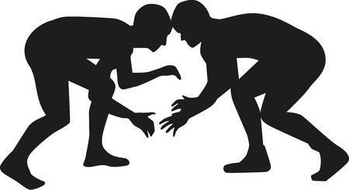
LIFE LESSONS START ON THE MAT.
Why Choose USA Wrestling?
As a parent, you place your child’s development ahead of everything. USA Wrestling does the same. under the guidance of our certified coaches, your child will learn to handle challenges—both on and off the mat—leaving you amazed at their transformation during the course of a single season.
Ask the parents of any of our 170,000+ members and they’ll tell you that wrestling:
Improves self confidence and the belief that anything is possible
Teaches young people to respect themselves and others
Promotes excellence and encourages athletes to set goals
Builds personal accountability because the athlete alone is responsible for the outcome
Develops integrity, discipline, and a strong work ethic—traits that will last a lifetime
Exposes athletes to positive role models
Wrestling’s alumni have gone on to achieve success in every field. Presidents, astronauts, authors, and respected business executives credit wrestling, and the life lessons learned on the mat, for their success.
At USA Wrestling, we believe our wrestlers will become elite at whatever they choose to do in life.
Matthew Legere
The Mat. The Mat, The Mat, content.themat.com/usawrestling/marketing-posters/WhatWillWrestlingDoForYourChild.pdf.

Slide 138

Benefits:
The best coaching, officiating, training, and club support in a safe environment, with all the tools necessary to advance in wrestling and life.
1. The complete wrestling experience
USA Wrestling promotes all styles of wrestling to ensure that competitors develop into complete wrestlers who can bridge a variety of techniques for maximum success.
2. Safe environment
Every USA Wrestling coach and official must pass a criminal background check.
3. Comprehensive sports accident and liability insurance
Our industry-leading insurance covers member athletes, coaches, and officials.
4. Top-flight competition
Your membership gives you access to over 40 uSa Wrestling-sponsored regional and national events.
5. Coaches education and certification
Our education and certi cation programs expose coaches to cutting-edge technique and training methods, which enhance our athletes’ experience at every stage in their wrestling career.
6. Opportunities for advancement
USA Wrestling’s elite developmental programs offer domestic and international training and competitive opportunities to our olympic hopefuls.
7. An investment in wrestling at all levels
Your membership supports all levels and styles of wrestling—from local beginners’ tournaments to the developing and training of our u.S. olympic team.
8. Dedicated customer service for members
Our staff in Colorado Springs is available to answer questions about membership, tournaments,
and insurance. Call us at (719) 598-8181.
Matthew Legere

Slide 139
THE FACTS:
Why is this an exemplary practice?
USA WRESTLING IS NO. 2 NGB IN DIGITAL ENGAGEMENT IN Q2 OF 2019
The USOPC provides quarterly statistics on Digital Engagement for each of the National Governing Bodies in the Olympic family, in comparison with all U.S. Sport Franchises. In the second quarter of 2019 (Q2 – April-June), USA Wrestling had its best finish ever. USA Wrestling ranked No. 81 among the 222 U.S. Sports Franchises, which put USA Wrestling as the No. 2 NGB, behind only USA Soccer.
Many NBA, NFL, NHL, MLB and MLS franchises were well below USA Wrestling. This was a quarter which included the U.S. Open, Beat the Streets Gala event and Final X. The study reviews Facebook, Twitter, YouTube Instagram, Wikipedia and Tumbler. Among individual athlete rankings, also including pro sports figures, Jordan Burroughs (No. 27), David Taylor (No. 103), Kyle Snyder (No. 134), Kyle Dake (No. 303), Helen Maroulis (No. 374) and Gable Steveson (No. 376) had impressive rankings.
Matthew Legere

Slide 140
THE FACTS:
Why is this an exemplary practice? Continued.
THEMAT.COM WEBSITE TRAFFIC RISES OVER 2018 STATISTICS
Traffic on TheMat.com, USA Wrestling’s website, has grown in 2019 in comparison to 2018. With just 35 days left in the calendar year, page views have increased 5.2% and unique page views are up 4.6%. This occurred in a more-crowded wrestling digital market, with more website options for the wrestling community than ever before. Highest traffic to the website came during major events hosted by USA Wrestling and within the wrestling community. Among the highest weeks of traffic surrounded the U.S. Open, World Championships, the U23 Worlds, the USMC Junior/Cadet Nationals, Final X, the NCAA Div. I conference events and nationals and others. The highest traffic week was during the U.S. Open in Las Vegas.
Matthew Legere

Slide 141
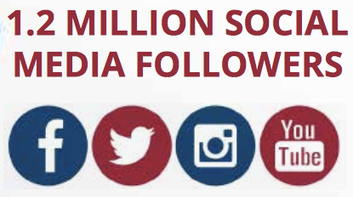
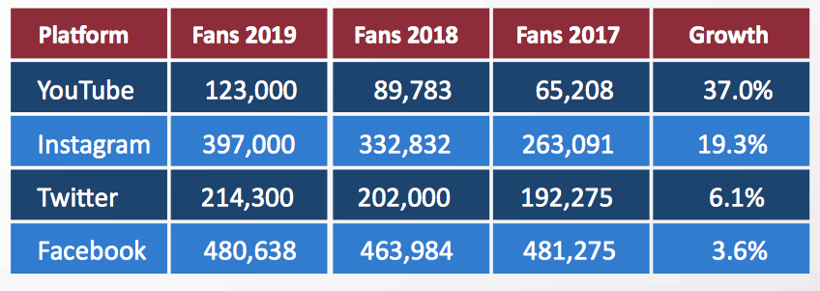
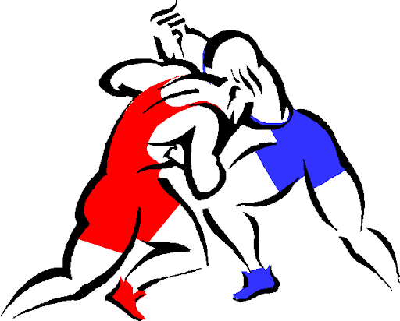
By The Numbers:
Matthew Legere

Slide 142
References
https://www.teamusa.org/USA-Wrestling/Features/2016/December/22/Promoting-Wrestling-On-and-Off-the-Mat
https://www.win-magazine.com/how-can-wrestling-promote-itself-better/
https://www.teamusa.org/usa-wrestling/membership/benefits-of-membership
https://www.linkedin.com/pulse/advantages-advertising-12-major-explained-zahira-oubaiche
https://www.teamusa.org/USA-Wrestling/Features/2019/September/12/Track-Wrestling-to-partner-with-USA-Wrestling-for-Worlds-broadcast
https://www.teamusa.org/USA-Weightlifting/Media/E-Magazine

