Slide 1


night shift nurse education Forum: Retention through engagement and empowerment
KRISTEN RICHARDS, BSN, RN, CCRN, (MSN ‘21)
RACHEL SORRENTINO, BSN, RN, CCRN-K, (MSN ‘21)
Winchester Hospital BILH Salem State University

Slide 2
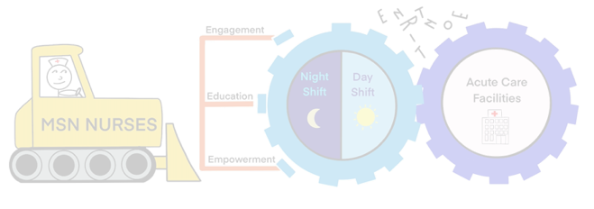
BACKGROUND and
SIGNIFICANCE

Slide 3
Will implementing a nurse driven education forum during the night shift increase engagement, empowerment and retention?

Slide 4
"Patients remain critically ill regardless of the time of day and require intensive nursing care, despite limited resources" (Margretta, Dennis, & McLaughlin, 2019)
“Nurses who work at night are motivated to learn, but have fewer opportunities and less access to programs than nurses who work during the day.” (Mayes & Schott-Bear, 2010)
Smaller hospitals may not have the financial means to employ a CNS for the night shift.
“2019, the turnover cost per RN was $44,375” (Bourgault, 2021)
  Medical surgical nurse replacement cost $42,000 (Kiel, 2020)
  Intensive care nurse replacement cost $64,000 (Kiel, 2020)

Slide 5
Shift Workers by the Numbers
1/3 full-time healthcare employees are shift workers:
  11% Evening shifts: 3pm – 11pm
  9% Night shifts: 11pm – 7am
  3% Rotating shifts: alternating day shift with night shift or split shifts
  77% Split shifts: 7am – 7pm or 7pm – 7am
Absenteeism
  Night shift workers 9%
  Day shift workers 3%
Employee turnover:
  Night shift workers 10%
  U.S. companies 3% (Claffey, 2006)

Slide 6
Shift Workers by the Numbers (continued)
Study found lower levels of commitment to the nursing profession among night shift nurses
Management:
  Less than 50% of shift workers feel managers communicate well
  Most shift workers are more loyal to their cohorts they work with than the company they work for
  Shift workers are less responsive to information coming from management and other non-shift sources
(Claffey, 2006)

Slide 7
Magnet Recognition Program focuses on advancing 3 goals Magnet organization:
  Promoting quality in setting that supports professional practice
  Identifying excellence in delivery of nursing services to patients
  Disseminating “best practices” in nursing services
Magnet Model: Forces of Magnetism:
  Transformational Leadership
  Structural Empowerment
  Exemplary Professional Practice
  New Knowledge, Innovation, and Improvement
  Empirical Quality Results (ANCC, 2021)

Slide 8
  Magnet Recognition
    Nursing delivers excellent patient outcomes
    Nurses have high level of job satisfaction
    Low staff nurse turnover rate
    Nurses are encouraged and rewarded for advancing in nursing practice (Summers, 2019)
  Factors that increase retention in Magnet hospitals include:
    Participative management style
    Nurses’ sense they are appreciated
    Nurse autonomy (Kiel, 2020)
  Hospitals with better-educated nurses have lower mortality rates
    10% increase in percent of working BSN nurses is associated with 9 fewer deaths for every 1,000 discharged patients
    (ANCC, 2021)

Slide 9
What can we do to increase engagement, empowerment and retention of night shift nurses?
PROVIDE EDUCATION IMPROVEMENTS FOR THE
NIGHT SHIFT NURSE
Fostering professional and educational growth
  Provide work environments that promote advance education levels of nurses
  Create a nighttime educational committee
  Strong leadership and preceptor training is needed
  Higher number of new grads working (Claffey, 2006)

Slide 10
nursing intellectual capital Theory
“Nursing human capital operationalized as registered nurses’ knowledge, skills, and experience, is related to patient outcomes associated with quality of patient care and organizational outcomes associated with registered nurse recruitment and retention.” (Covell & Souraya, 2013)
  Nursing intellectual capital translates into nursing and organizational performance
    Nursing performance leads to improvements in patient outcomes
    Organizational performance leads to cost related outcomes associated with recruitment and retention of knowledgeable and experienced registered nurses (Covell & Souraya, 2013)

Slide 11
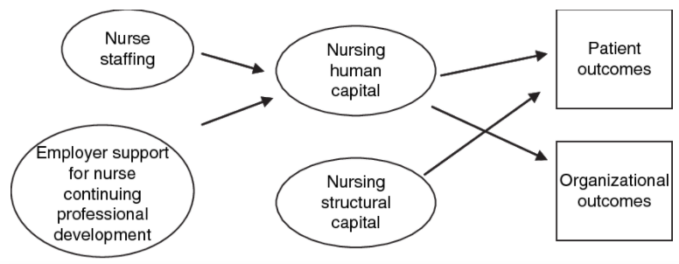
nursing intellectual capital Theory
(Covell, 2008)

Slide 12
nursing intellectual capital Theory
Nurse Staffing
Skill mix
RN-to-patient ratio
Hours per patient per day
Employer Support for
Continuing Education
Financial assistance
Replacement for educational opportunities attendance
Time off to learn
Clinical educator

Slide 13
nursing intellectual capital Theory
Nursing Human Capital
Academic preparation
Specialty certification
Hours of continuing education
Professional experience
Clinical specialty experience
Unit tenure
Nursing Structural Capital
Practice guideline for prevention of:
Patient falls
Medication errors
Hospital acquired infections

Slide 14
nursing intellectual capital Theory
Quality of Patient Care
Low rates of adverse hospital acquired infections
Medication errors
Patient falls
Organizational Outcomes
Costs related to recruitment and retention of RNs:
RN orientation hours
RN turnover rate
RN vacancy rate
RN recruitment rate

Slide 15


Slide 16
Objectives
1. Improve perception of opportunity for education for the night shift nurse.
2. Increase empowerment and knowledge base of direct care nurses by creating and implementing the “Night Shift Education Forum.”
3. Improve night shift nurses’ engagement and retention via utilization of the Professional Nurse Advancement Program (PNAP: “clinical ladder”).
4. Assist night shift nurses with pursuing specialty certification.
5. Improve night shift nurses’ perceptions of senior leadership support.

Slide 17
“Night Shift Nurse Education Forum”
Nurse Criteria for Clinical Ladder
Have a minimum of 3 years of direct patient care experience
Produce an evidenced-based poster/presentation
  Become a unit “champion” in an area of his or her interest
  Serve as liaisons for their units
  Promote the concept of rounds
  Help identify current “hot topics”
  Foster recruitment (Rachwal, et al., 2018)
Disseminates information to the other night shift nurses throughout the hospital
Contributes to “champions” pursuing PNAP (Professional Nurse Advancement Program)
  Financial compensation
  Opportunity for professional growth

Slide 18
METHODOLOGY

Slide 19
Informal discussions with inpatient medical-surgical night shift nurses to ascertain (Feb. - March 2021, anonymous qualitative notes gathered)
  A. Confidence to independently 83% “yes”
  provide clinical care
  B. Perception of educational opportunities 100% “not enough”
  during working hours
  C. Perception of opportunities for engagement 50% “available,
  in roles other than direct care nursing but have to seek out.”
  D. Interest in “Night Shift Education Forum” 83% interested
  E. Desirable times for education during the 100% 2am - 4am
  hours of 7pm to 7am
  F. Able to verbalize understanding of 50% “yes”
  PNAP program

Slide 20
2. Obtain pre-data (end of march 2021 and ongoing)
  How many nurses utilizing the PNAP program?
    20 total day and night shift nurses
  How many night shift nurses utilize the PNAP program?
    5 night shift nurses
  How many night shift nurses are certified in their specialty?
    16 night shift nurses
  How many night shift nurses are eligible for PNAP/Specialty certifications?
    44 night shift nurses out of 78
  Use this data for comparison post program implementation

Slide 21
  Pre-Program Implementation
  March 2021

Slide 22
3. Informal posters/presentations to be conducted during the
night shift
  By Staff nurses
  By Interdisciplinary team (Respiratory Therapists, IV Therapy, Psychiatry, Medical and NP Providers, CNS, and Senior leadership)
  “Nurses can learn with and from their interprofessional colleagues who share the same working environment yet often have differing perspectives.” (Rachwal et al., 2018)
4. Evaluations will be conducted after each “Night Education
Forum”

Slide 23
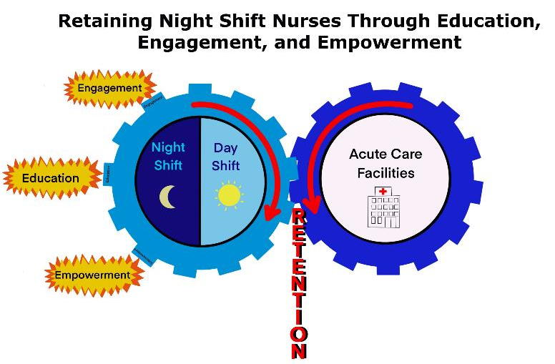

Slide 24
Results Pending (anticipate January 2022 initiation)
Planning is in the initial phase
Meetings/discussions have been conducted
  Night shift nurses
  Nursing Staff Development
  Associate Chief Nursing Officer of inpatient nursing
  PNAP board
  Associate Chief Nursing Officer of quality and patient safety and Magnet

Slide 25
Results Pending (continued)
Post forum surveys will be obtained and analyzed for:
  Improvements in perception of opportunities for education on night shift
  Improvements in perception of opportunities for engagement for night shift nurses by their interest and participation in the program
  Increased engagement and empowerment from night shift nurses determined by informal interviews
  Increased involvement in the PNAP program by night shift nurses and likelihood of attaining Certification in their specialty

Slide 26
FUTURE RECOMMENDATIONS
  Create a night shift “council” to handle night-specific issues
  Create specialty certification study groups
  Create a “Skills Fair” during Night Shift
  Provide financial resources for continuing education opportunities (tuition reimbursement, contact hour attainment, certification reimbursements)
  Provide programs with contact hours (CEUs)
  Provide professional development opportunities
  Retain Night Shift Nurses Through Education, Engagement, & Empowerment!

Slide 27
Select References
ANCC, (2021). Magnet fact sheet. Nursing World. Retrieved April 29, 2021:
https://www.nursingworld.org/globalassets/organizational-programs/magnet/magnet-factsheet.pdf
Bourgault, A. (2021). Time to train more critical care nurses: Supporting our new colleagues. Critical Care Nurse, 41(2), 7-8.
Claffey, C. (2006). Nursing in the dark: Leadership support for night staff. Nursing Management, 37(5), 41-44. https://journals.lww.com/nursingmanagement/Fulltext/2006/05000/Nursing_in_the_dark__Leadership_support_for_night.10.aspx
Covell, C., Sidani, S. (2013). Nursing intellectual capital theory: Implications for research and practice. OJIN: The Online Journal of Issues in Nursing, 18(2). doi: 10.3912/OJIN.Vol18No02Man02
Covell, C. (2008). Figure 1:Middle-range nursing intellectual capital theory. Journal of Advanced Nursing. Retrieved from
https://www.semanticscholar.org/paper/The-middle-range-theory-of-nursing-intellectual-Covell/22084091e14fcad130fbb1ab28255ca77276c34f/figure/0
Kiel, J. (2020). An analysis of restructuring orientation to enhance nurse retention. Health Care Manager, 39, 162-167. Retrieved from https://doi.org/10.1097/HCM.0000000000000303
Margretta, M., Dennis, M., & McLaughlin K.G., (2019). Coffee talk: A jolt for night shift education. American Journal of Critical Care, 28(1), 81-84. https://doi.org/10.4037/ajcc2019709 (Links to an external site.)
Mayes, P., & Schott-Baer, D. (2010). Professional development for night shift nurses. The Journal of Continuing Education in Nursing, 41(1), 17-22. https://doi.org/10.3928/00220124-20091222-05
Rachwal, C. M., Langer, T., Trainor, B. P., Bell, M. A., Browning, D. M., & Meyer, E. C. (2018). Navigating Communication Challenges in Clinical Practice: A New Approach to Team Education. Critical care nurse, 38(6), 15–22. https://doi.org/10.4037/ccn2018748
Summers, S. (2019, July 4). Magnet recognition program-Areas for improvement. The Truth About Nursing. Retrieved from https://www.truthaboutnursing.org/faq/magnet.html#gsc.tab=0

Slide 28

Acknowledgments
Kathleen Beyerman RN MS EdD, ANCO Nursing Staff Development
Pam Linzer RN PhD, ANCO Inpatient, Informatics, and Nursing Resources and Staffing CPS

