Slide 1

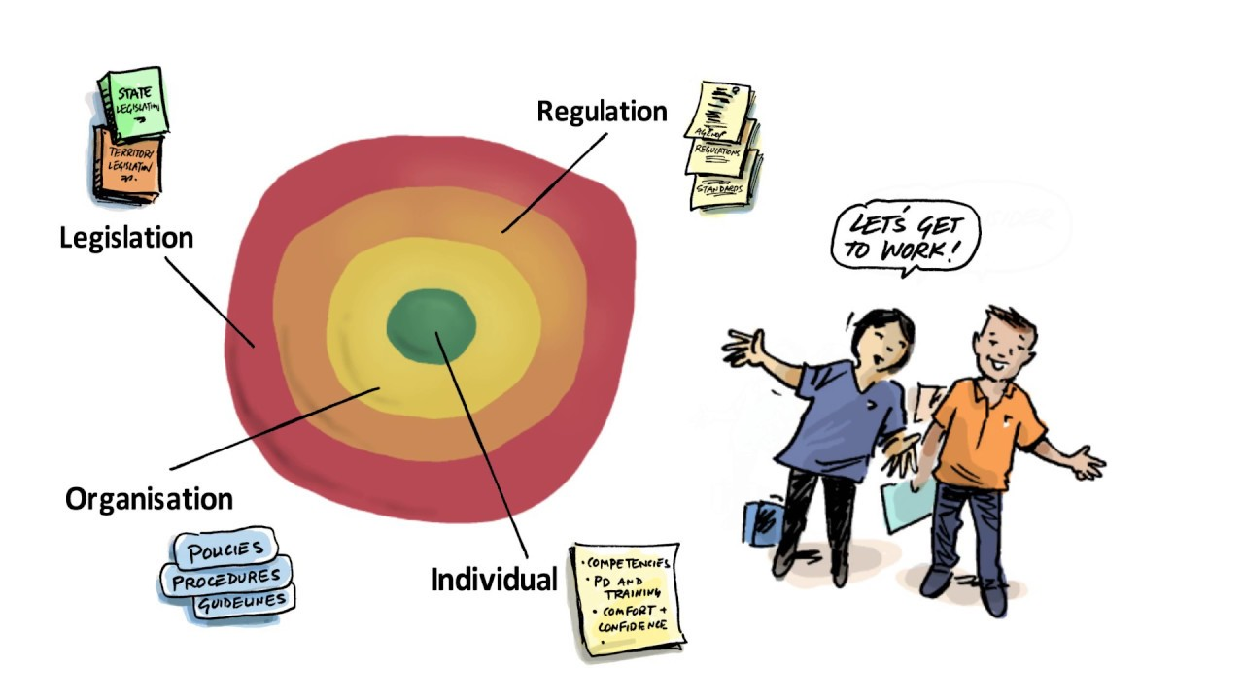
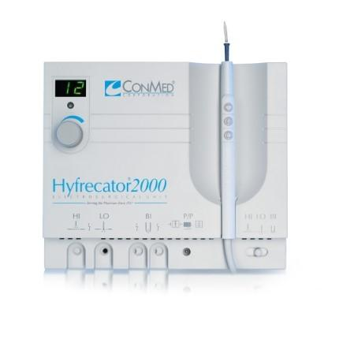

Maximizing nurse utilization to work within license scope of
practice: Establishing policies and procedures.
Kathy O’Brien, BSN, RN (MSN” 2021)
Logo
Logo
Logo
Background & Significance
Ambulatory nurse performing cautery versus pressure dressing
When is this within the nurse's scope of practice.
No existing organizational policies instruction for nurses performing cautery for best practice outcomes.
New Nurses did not know to question the practice; appraise risks; and physicians had preferences/expectations.
Massachusetts
Registered Nurses as First Assistants at Surgery
For the purposes of this advisory ruling, competencies are categorized as general, pre-operative phase, intra-operative phase, and post-operative phase
Intra-operative: Provide hemostasis
Post-operative: Provide wound care
Making it all work together
Methodology
Obtain a copy of the scope of practice for the Massachusetts nurse
Meet with other managers in dermatology
Have a meeting with MD and medical director
Objectives: Policy Development and Procedure Training
Create or find an existing training on cautery techniques; checklist; assessment tool
Create policy for nurses to perform cautery
Develop training guide and evaluation
Expand new nursing knowledge, skills, attitudes and medicine collaboration (KSA) Quality and Safety in Nursing Education (QSEN) Institute of Medicine (IOM)
Device used
Is a Hyfrecator:
Definitions
A Hyfrecator is a low-powered medical apparatus used in electrosurgery on conscious patients, usually in an office setting. It is used to destroy tissue directly, and to stop bleeding during minor surgery.
Electrocautery uses electrical current to heat a metal wire that is then applied to the target tissue in order to burn or coagulate the specific area of tissue. It is not used to pass the current through tissue, but rather is applied directly onto the targeted area of treatment. Using this technique, heat is passed through a resistant metal wire which is used as an electrode. This hot electrode is then placed directly onto the treatment area destroying that specific tissue. This use of electricity is typically applied in superficial situations encountered by dermatologists, ophthalmologists, plastic surgeons, urologists, and related specialties.
Obstacles
The medical director not wanting anyone outside the department involved
Support
Other nurse leaders
Upper management
Outcome
Keep nurses working at the top of their license
Competency approved by medical director and management
Complete staff training
References
Advisory rulings for the Board of Registration in Nursing. (2021). Retrieved 12 March 2021, from https://www.mass.gov/lists/advisory-rulings-for-the-board-of-registration-in-nursing
Buck, J., Loversidge, J., Chipps, E., Gallagher-Ford, L., Genter, L. and Yen, P., 2018. Top-of-License Nursing Practice. JONA: The Journal of Nursing Administration, 48(5), pp.266-271.
Holzheimer, C. and Lee, S., 2021. [online] Acha.org. Available at: <https://www.acha.org/documents/Programs_Services/webhandouts_2016/TH1-177_Holzheimer.pdf> [Accessed 28 February 2021].

