Slide 1

Review of Literature on the efficacy of handout use in undergraduate nursing classes
Amy Chartier BA RN-BC
Dr. Cheryl Williams PhD RN CNE NP-C

Slide 2
Objectives
Discuss purpose for this review of literature
Discuss select studies that were done on classroom handouts
Cornell note-taking system
Discuss what was found on the retention of information during class and its relevance to handouts
Review the methods used
Recommendations that came from the research

Slide 3
Purpose of review of literature
To find concrete evidence that handouts are necessary for nursing classes
Within that evidence, is there a positive correlation between handouts and grades?
If handouts are necessary, how should they be designed?
What recommendations have come of the research done?
Notes:
Students neither proved nor disproved that handouts were mandatory in classrooms, studies done on GPA and quiz grades showed there was no relationship

Slide 4
Moellenberg and Aldridge (2010)
Conducted a study on the format of handouts
Interactive outlines, fill in the blanks
Material discussed in class would help fill in these gaps
Showed interactive class style, showed a format that reaches any kind of learner
Notes:
First discuss a study that showed alternatives to PowerPoints, an interactive approach to teaching material in nursing class, to think of comparing this throughout the presentation with PowerPoints and what is traditional

Slide 5
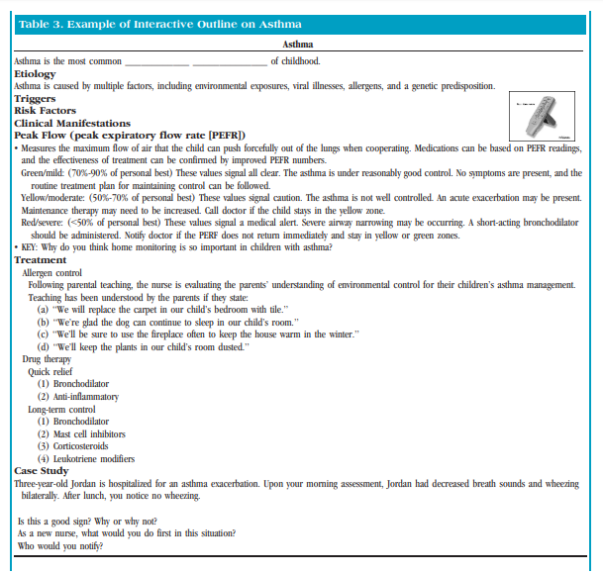
Example of Incomplete Outline from Moellenberg & Aldridge (2010)
Notes:
This is an example of the incomplete outline that moellenberg and Aldridge discussed, consists of multiple choice, fill in, case study, involving many different ways to learn, students were actually quoted stating that handouts reminded them of “books”

Slide 6
Nowak, Speakman, and Sayers (2016)
Studied the delivery of information on PowerPoint
Recovered 37 presentations from nursing curriculums
Determined that there should be standards in the way PowerPoint slides are done
Nursing curriculum is content heavy, the use of PowerPoint makes delivery of this information digestible
Students experienced “text overload”
Notes:
If PowerPoints are going to be used, what should they look like? Looked at formatting and was the handout even worth if it was full of material

Slide 7
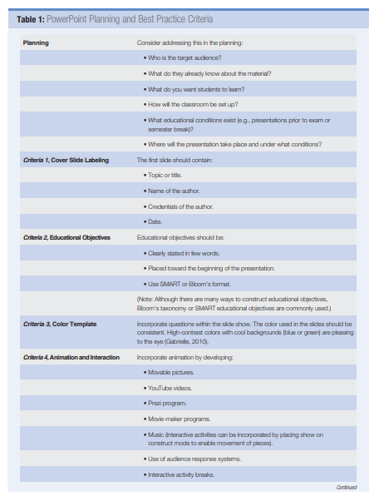
Two Content Layout with Table
Notes:
This was their recommendation for PowerPoint format and how slides should be designed to avoid “text overload”

Slide 8
Zdaniak, Gruman, and Cassidy (2017)
Discussed how students relate the delivery of handouts to their educational experience
“Perceived preparedness,” (p. 470)
Idea that physically having handouts will better prepare them for the material taught
Notes:
Handouts remain the norm, so how do students think of them in relation to what is being taught? Students believe that the distribution of handouts for a class will prepare them for all that is taught

Slide 9
Mueller and Oppenheimer (2014)
Compared note-taking with reviewing material already printed on the handouts
Students that studied from long-hand notes did much better on quizzes vs. those who took electronic notes
Cornell note-taking system
Notes:
Look at traditional way of learning material taught in classes, note-taking…students did better on quizzes with long hand notes…were the notes taken correctly? Cornell note-taking system something we should be teaching throughout levels of education? Interestingly found that classes with no handouts encouraged skipping class

Slide 10
Wilson (2019)
Found “interactive,” (p. 2) handouts provided the opportunity for students to retain what is being taught
Large number of students forget all class material “within one day…,” (p. 2)
Supports the practice of note-taking and raising the question of should we have students learn how to take notes in anticipation of higher learning?
Notes:
Article written in faculty focus about what students are absorbing, handouts that engaged them during class allowed for increased retaining of information

Slide 11
Methods
Databases used: “Medline, health source: nursing/academic edition, CINAHL, CINAHL Plus with full text”
Combination of search words were: “nursing education and handouts, nursing education and PowerPoints, nursing student education and handouts”
Over 400 articles found
Reviewed articles that were specific to material provided during class
Notes:
Also reviewed the reference section of all articles used to find additional support

Slide 12
Recommendations and Conclusion
Handouts should be provided for nursing students
Note-taking should be reviewed throughout educational experience
What is written by the student during class is what is retained
Handouts should be combination of material highlights, blank outlines, and practice questions
Discussion is imperative to the classroom, especially with nursing curriculum
Notes:
Recommendations came from research as well as field experience with Dr Gawrys

Slide 13
Thank you for listening
For any questions or thoughts related to this presentation, you may email me at a_chartier@salemstate.edu

Slide 14
References
Bartsch, R. A., & Cobern, K. M. (2003). Effectiveness of PowerPoint presentations in lectures. Computers & Education, 41 (1), 77-86. https://doi.org/10.1016/s0360-1315(03)00027-7
Day-Black, C., Merrill, E., Konzelman, L., Williams, T., & Hart, N. (2015). Gamification: an innovative teaching-learning strategy for the digital nursing students in a community health nursing course. Association of black nursing faculty, 26 (4), 90-94.
Driessnack, M. (2005). A closer look at PowerPoint. The Journal of Nursing Education, 44 8), 347.
Moellenberg, K., & Aldridge, M. (2010). Sliding away from PowerPoint. Nurse Educator, 35 (6), 268-272. https://doi.org/10.1097/NNE.0b013e3181f7f2f7
Mueller, P., & Oppenheimer, D. (2014, may 22). The pen is mightier than the keyboard: advantages of longhand over laptop note taking. Psychological Science, 25 (6), 1-10. https://doi.org/10.1177/0956797614524581

Slide 15
References
Nowak, M., Speakman, E., & Sayers, P. (2016). Evaluating PowerPoint presentations: a retrospective study examining educational barriers and strategies. Nursing Education Perspectives, 37 (1), 28-31. https://doi.org/10.5480/14-1418
Wilson, A. (2019, December 9). Combating the Curve. Faculty Focus.
Wongiektkachorn, A., Prakoonsuksapan, J., & Wangsaturaka, D. (2014). What happens when teachers do not give students handouts? Medical teacher, 36 (9), 789-793. https://doi.org/10.3109/0142159X.2014.909921

