Slide 1


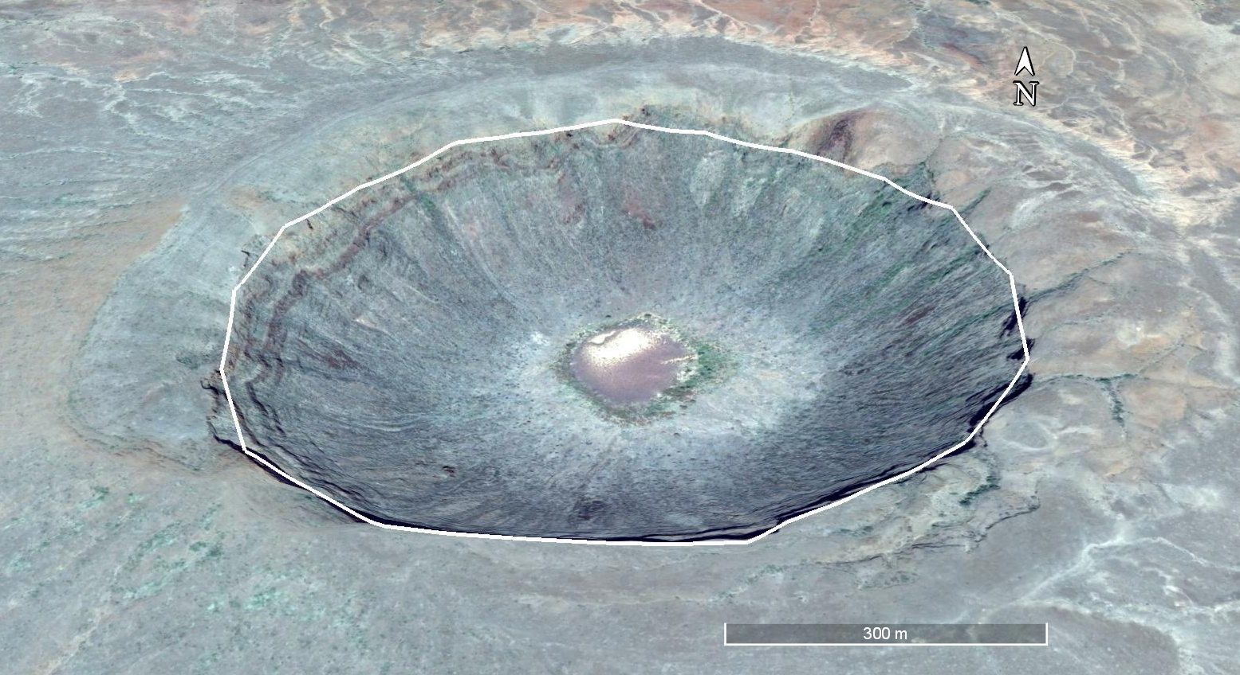
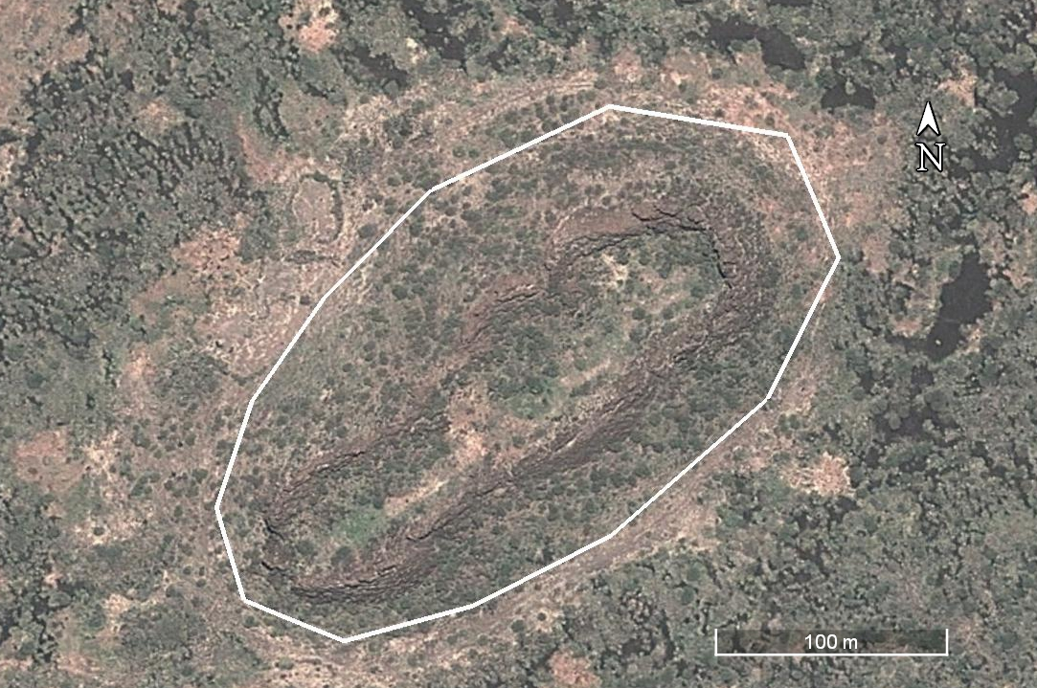
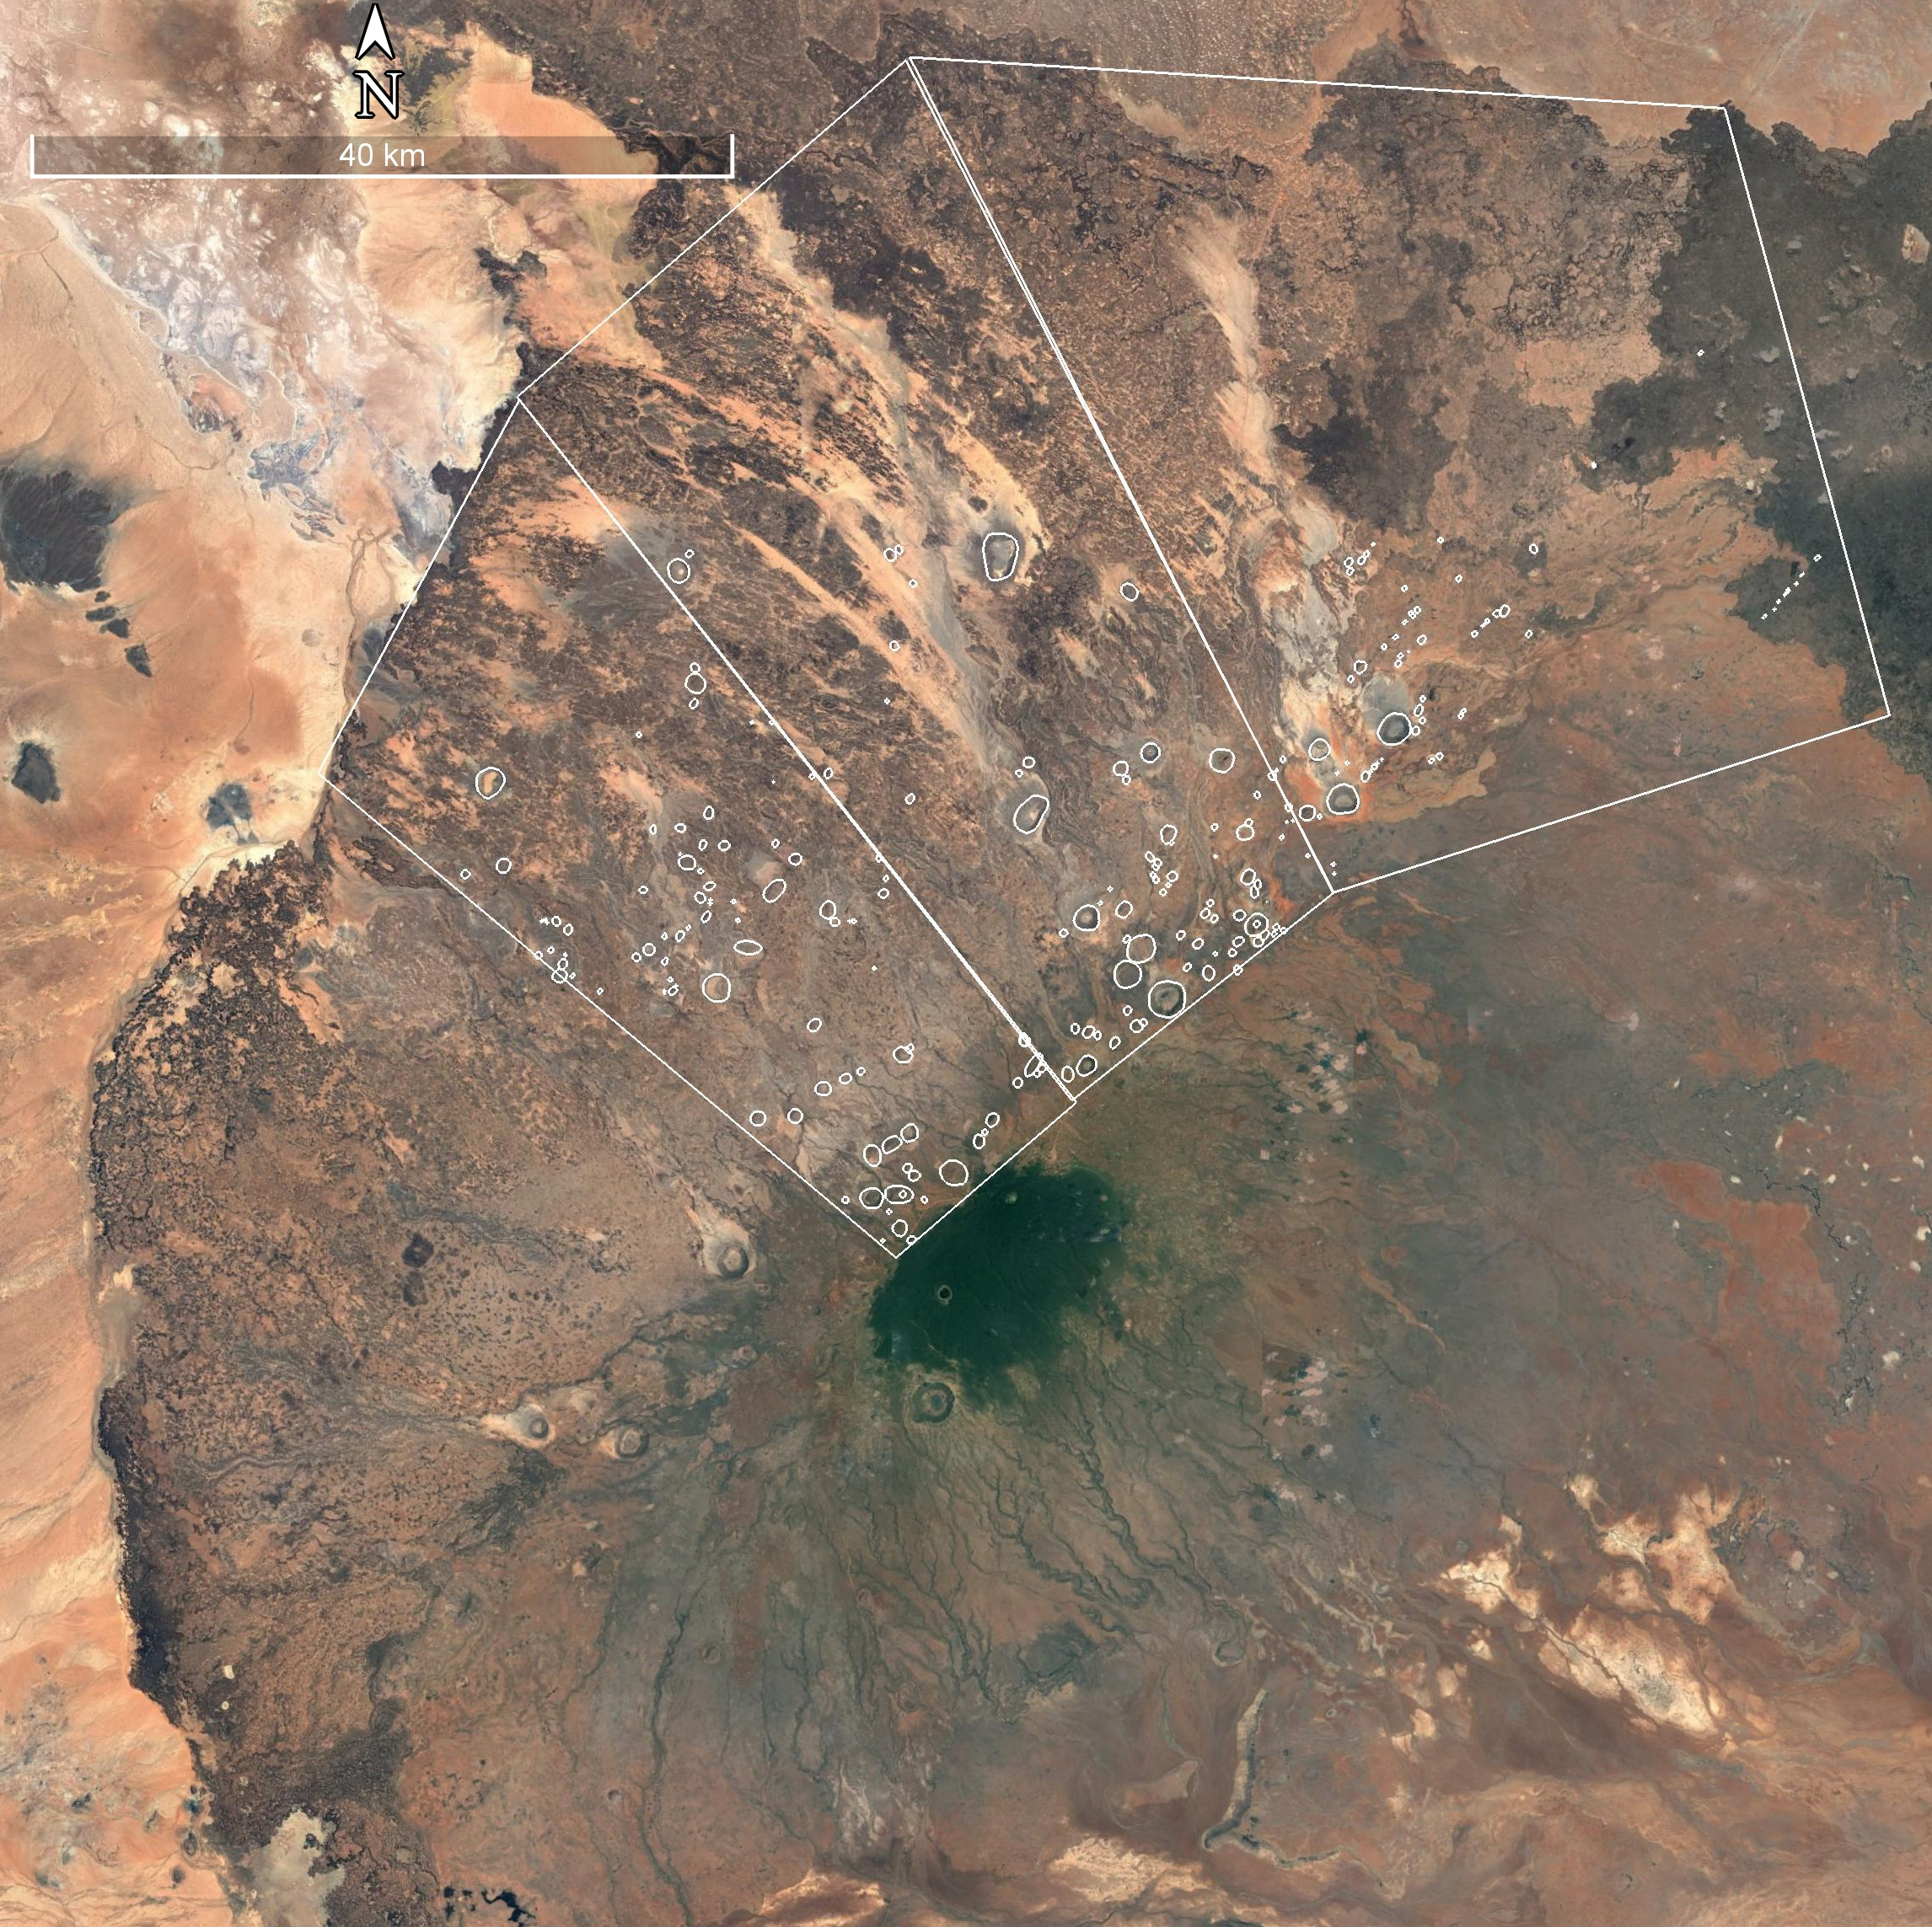
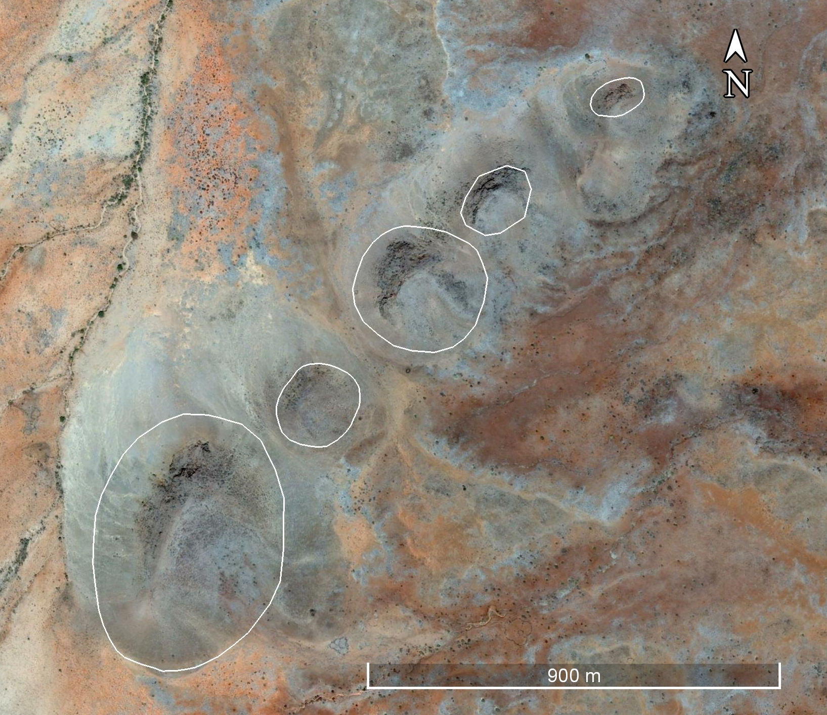
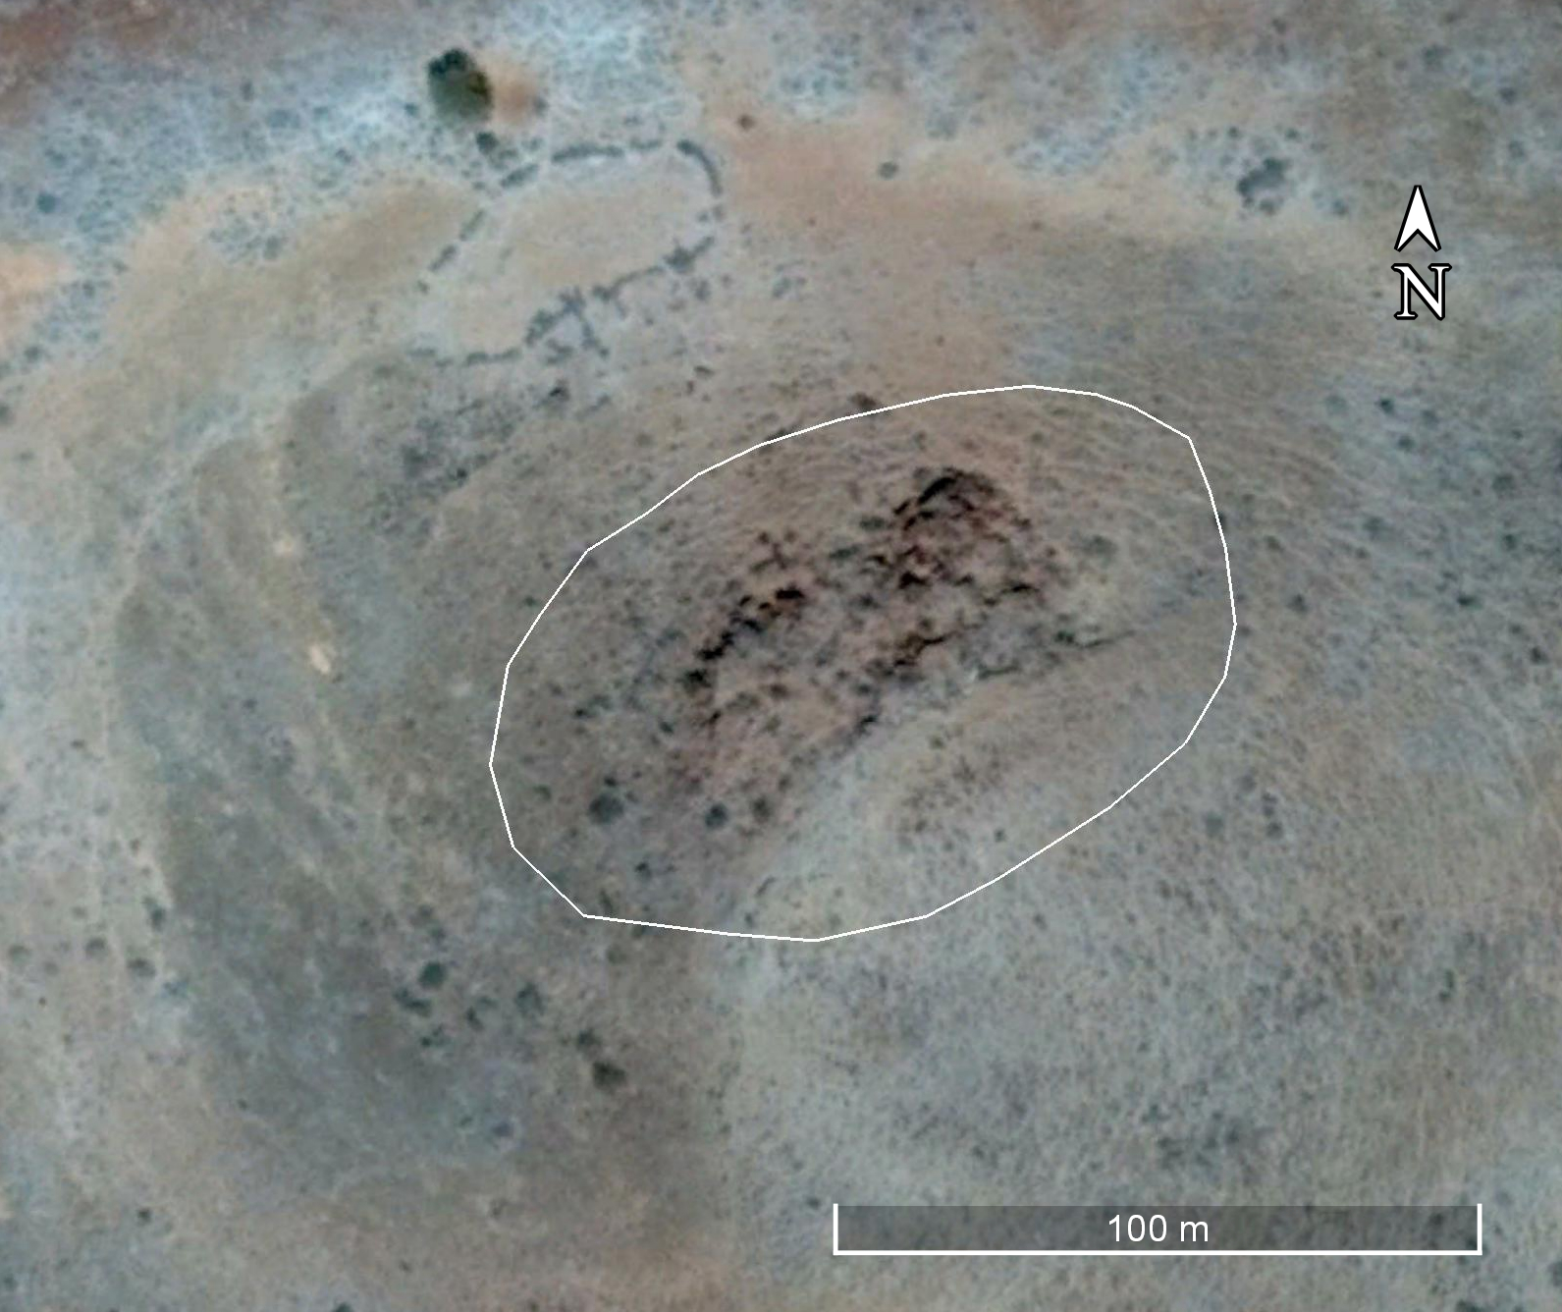
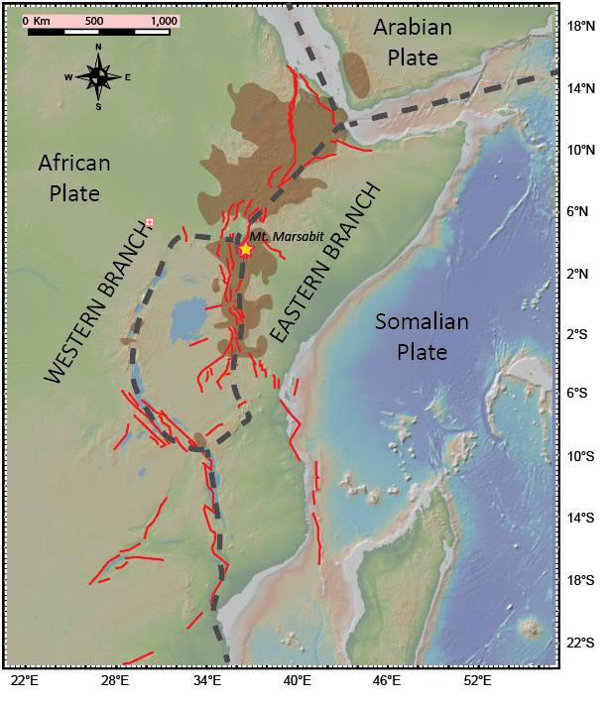
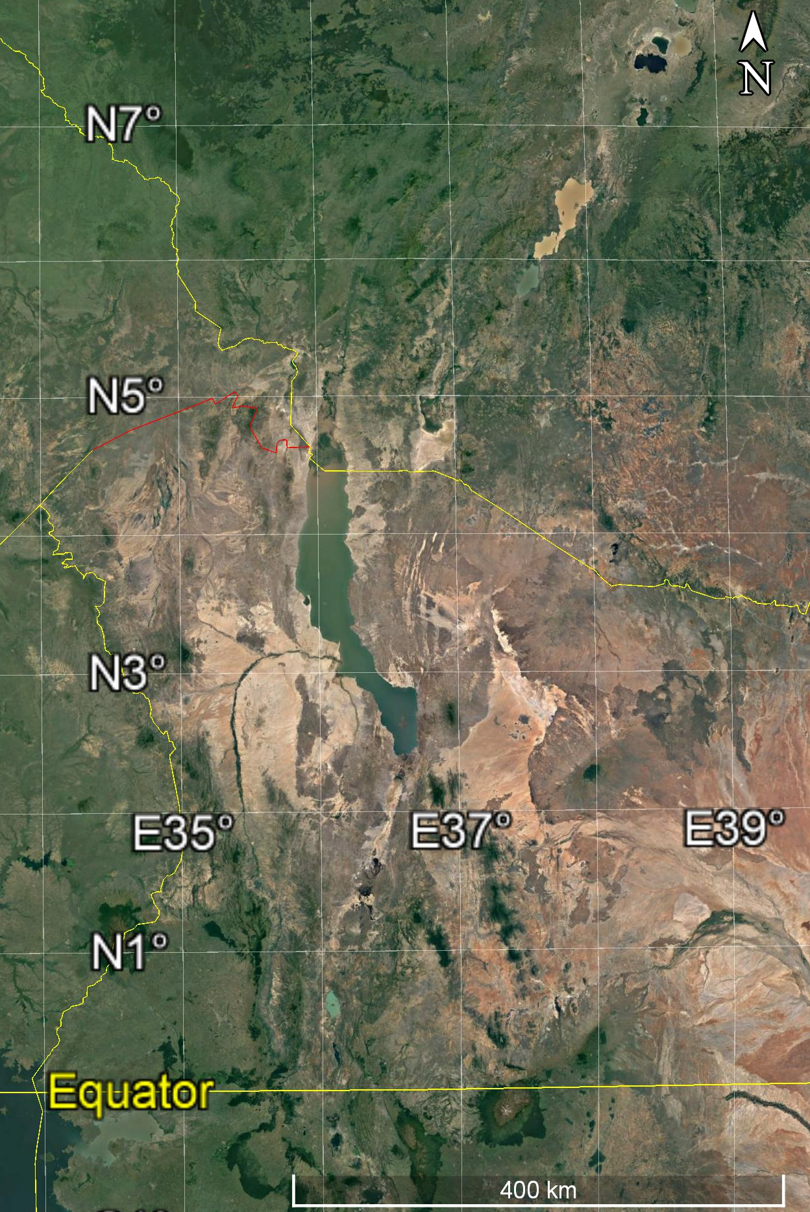
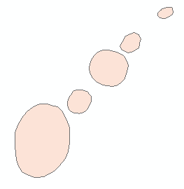
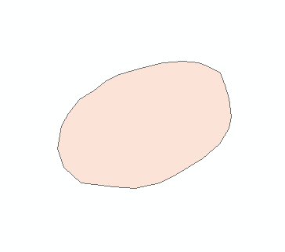
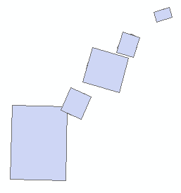

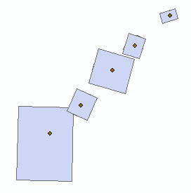
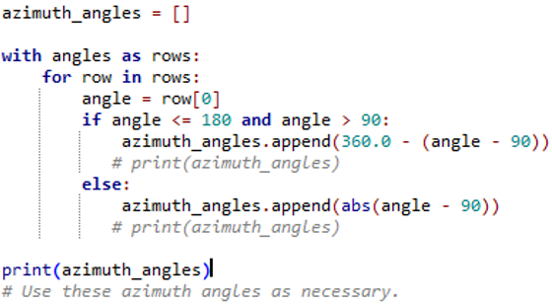
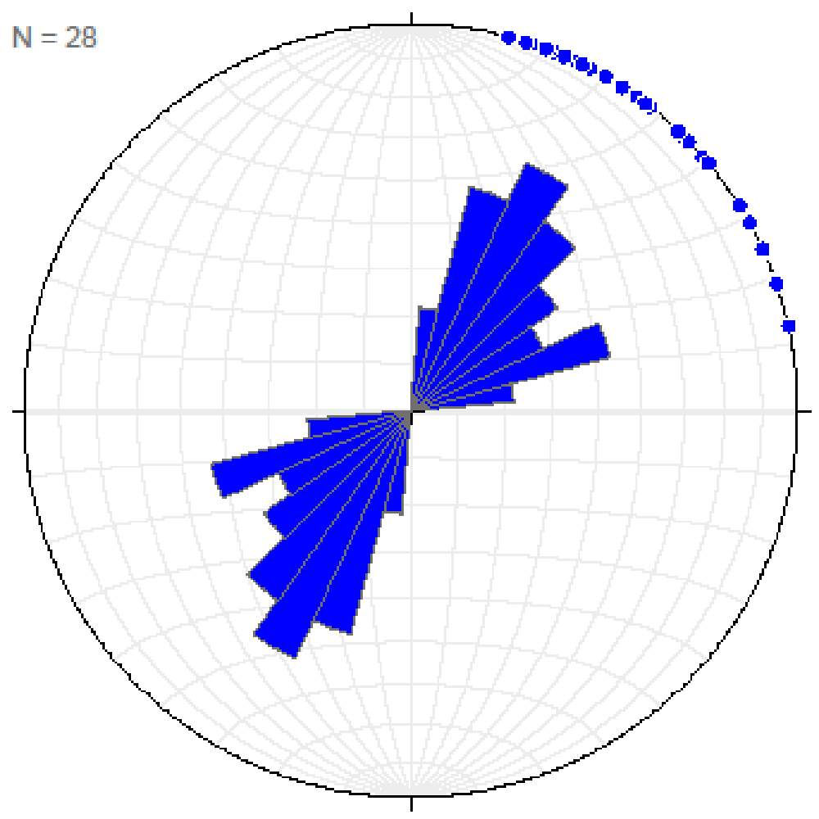
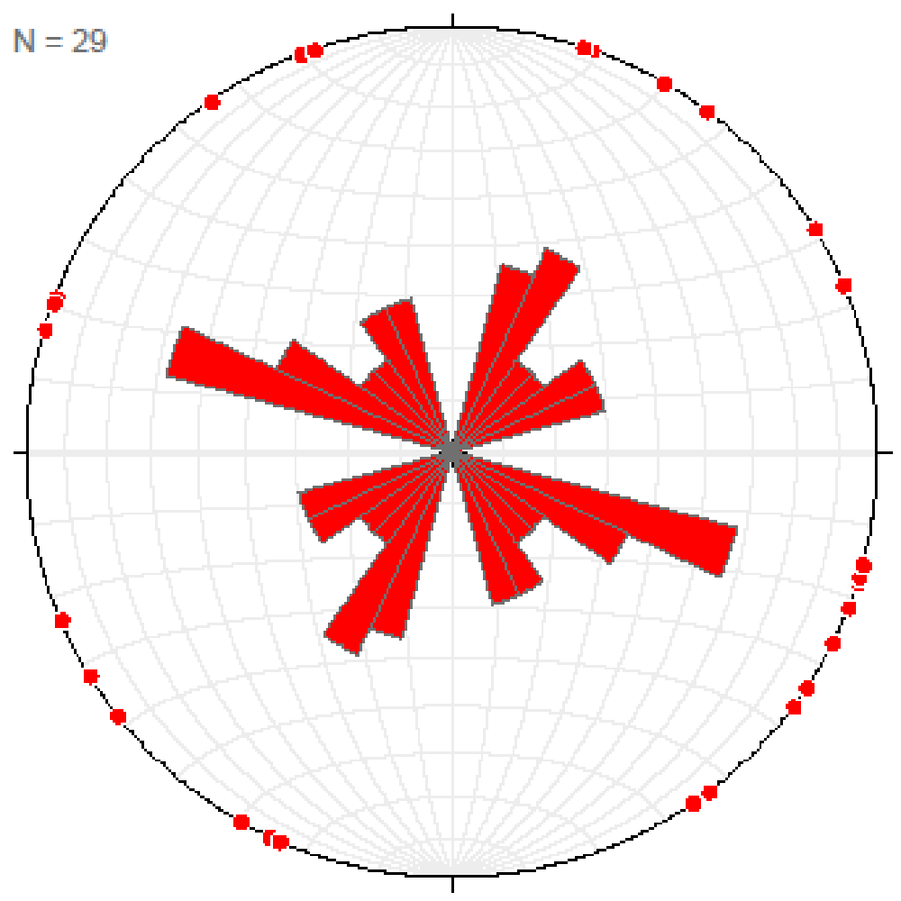
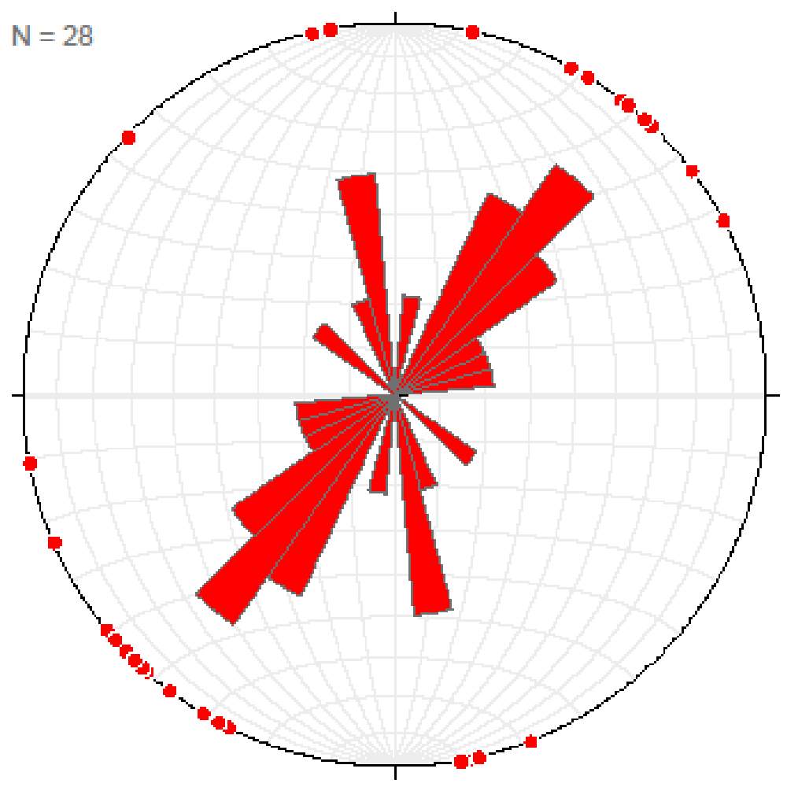
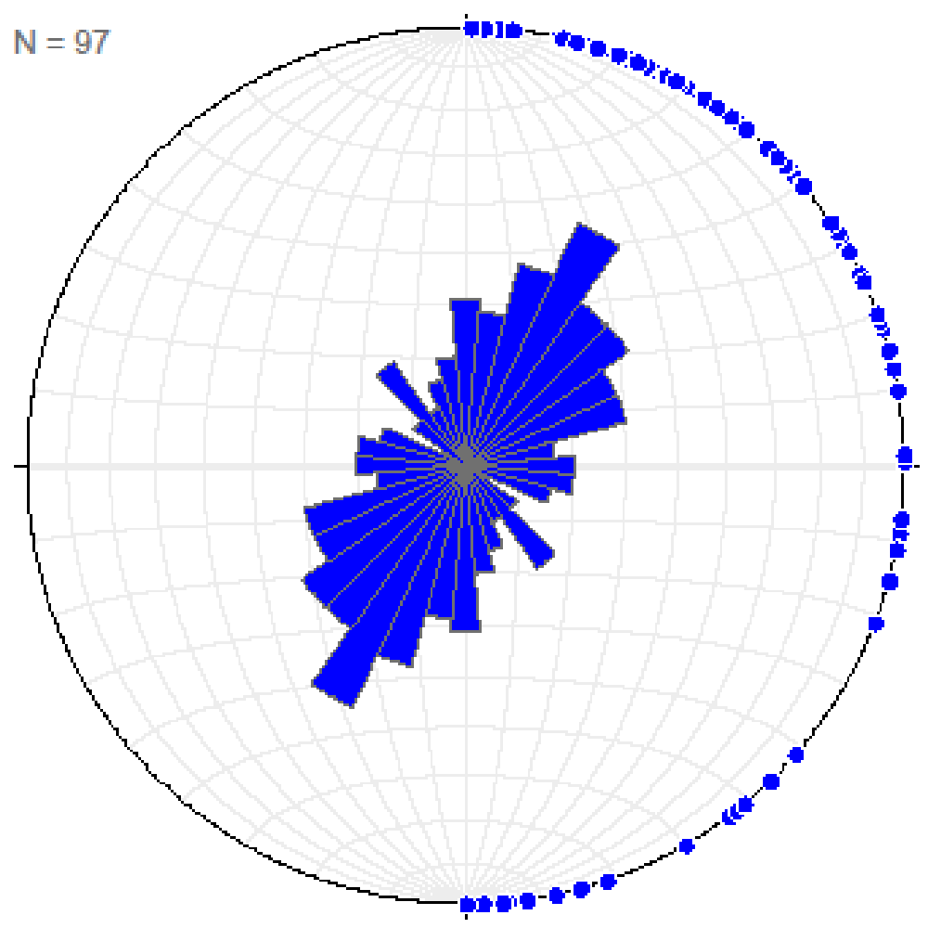
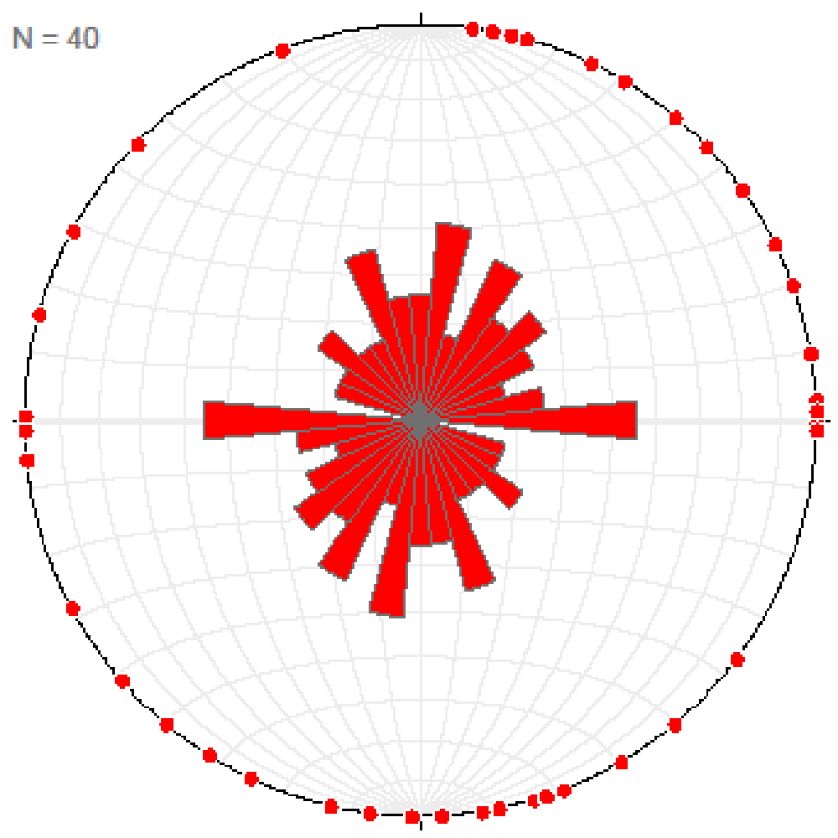
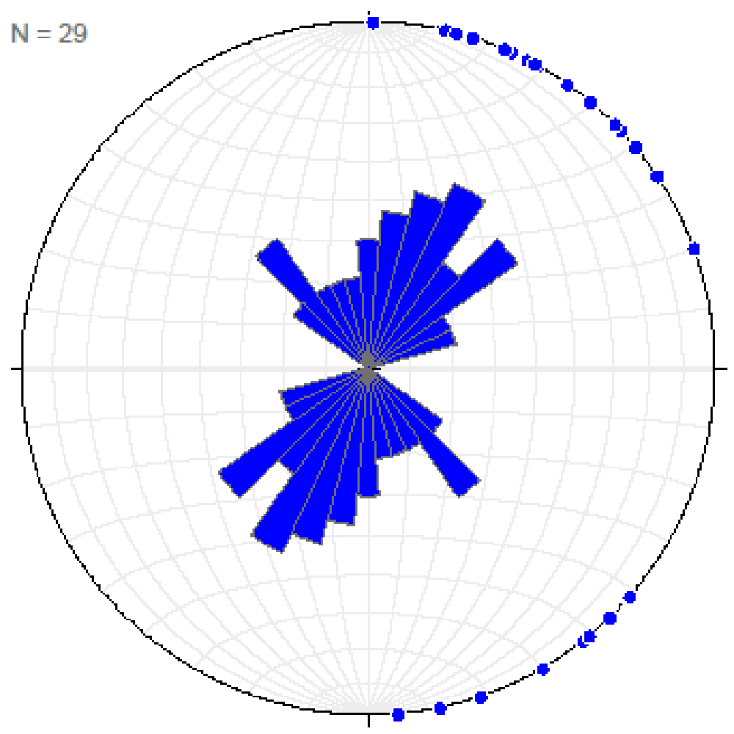
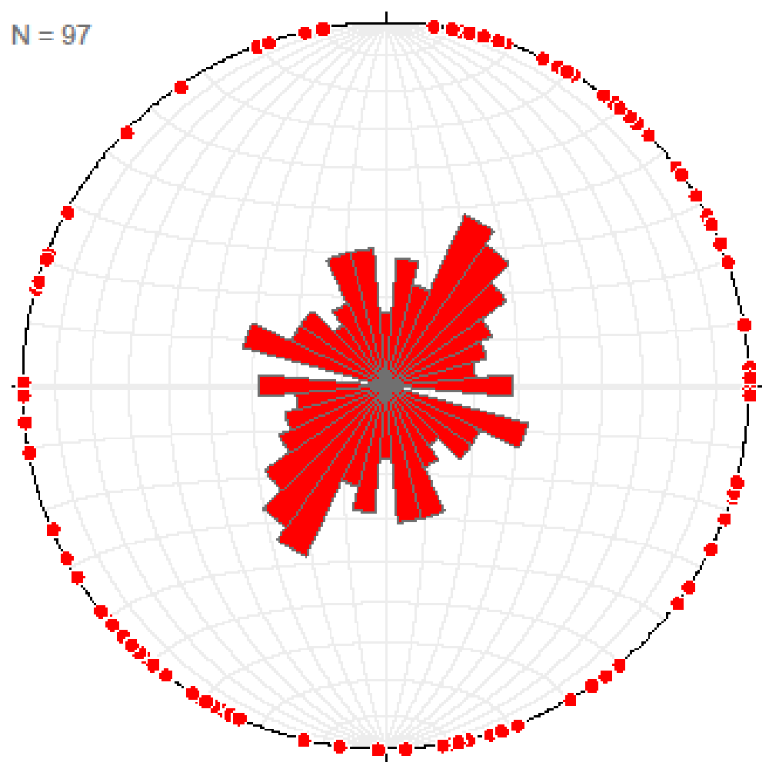
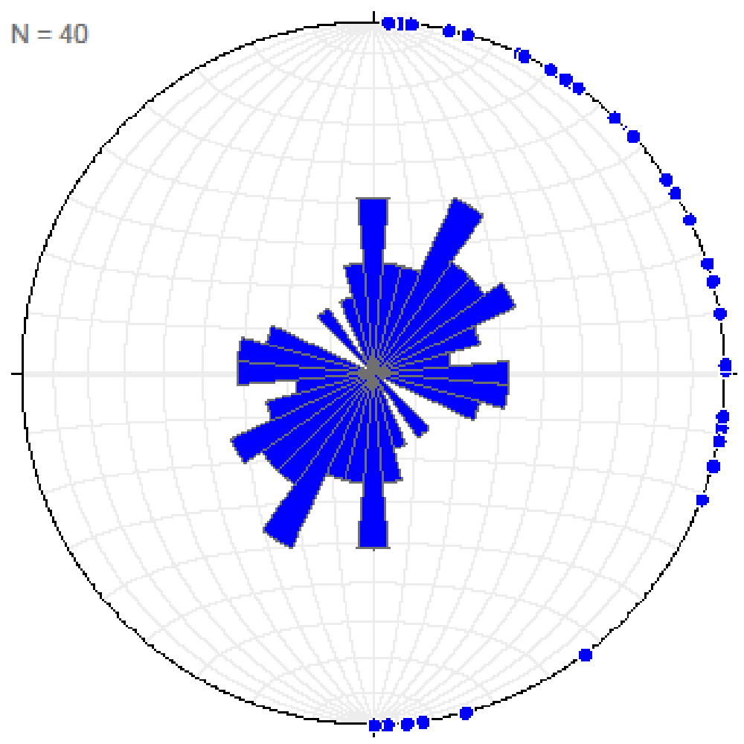
Using the Extrusive Volcanic Features of Mt. Marsabit, Kenya to Identify Regional Tectonic Stress
Cora Van Hazinga* (Salem State University), James Muirhead (Syracuse University), Sara Mana† (Salem State University) *coravh@gmail.com, †smana@salemstate.edu
INTRODUCTION
Extrusive volcanic features like vents, craters, and cones can produce alignments and other linear structures that indicate the orientations of subsurface feeder dikes and regional tectonic stresses. These dikes form parallel to the maximum compressional stress (σ₁) and perpendicular to minimum compressive stress (σ₃), and/or exploit preexisting planes of weakness. Volcanic constructs fed by these magmatic intrusions are therefore indicators of tectonic stress directions and subsurface structural fabrics, which can be deduced through detailed mapping and assessment of the spacing, shapes, and linear arrays of these features.
Mt. Marsabit (2.32°N, 37.97°E) is a massive 6,300 km² dormant stratovolcano located in northern Kenya on the eastern shoulder of the Kenyan Rift, 170 km east from the center of the East African Rift. The features of Mt. Marsabit have been long observed to trend in a NE-SW direction, oblique to the general N-S trends observed in nearby sectors of the East African Rift (Figure 1). Data from features on Mt. Marsabit have never been analyzed with newly available geographic information systems. Mapping these features can help us identify the nature of regional tectonic stress in this off-axis volcano.
PURPOSE
Asymmetry and alignment of extrusive volcanic features serve as an indicator of the orientation of regional tectonic stresses. Mt. Marsabit is of particular interest because this volcano sits in a region where the general orientation of faults changes from generally NS to NE-SW.
A better understanding of the forces operating in this area can help us understand the roots of this regional change.
CONFIDENCE LEVELS
(A) High confidence maar crater
(B) Low confidence maar crater
RESULTS
Area 3
Figure 3. (A) A maar crater that meets spatial analysis criteria. Rims are well defined, the crater is located within 500 meters of other features, and the long axis/short axis ratio is greater than 1.2. (B) A maar crater that does not meet spatial analysis criteria. It is badly eroded with unclear boundaries. The closest feature is 9 km away.
Area 2
Figure 3(B)
SPATIAL ANALYSIS
(A) Cones forming
a linear array
(B) High confidence cone
A
B
Chew Bahir
South
Sudan
Ethiopia
Area 1
Kenya
Lake Turkana
Figure 3(A)
Mt. Marsabit
Figure 4(B)
Uganda
Figure 4(A)
Figure 4. (A) Cones forming a linear array that meets analysis criteria are traced with polygons in Google Earth. An Excel file is created with UTM coordinates of the center of each feature. The Near Angle tool in ArcMap generates a table of near angle orientations of the linear arrays. This is generated using a horizontal x axis. Angles must be converted to Azimuth degrees using a Python script.
(B) A cone within the linear array that meets spatial analysis criteria is interpreted independently. The Minimum Bounding Geometry tool in ArcMap creates an enclosing rectangle around the polygon and calculates the orientation of the long axis of the featured ellipse.
Lake Victoria
Elongation of feature ellipses
Figure 1 A) Mt. Marsabit (star) in the context of the East African Rift system. Brown shading indicates the extent of magmatism, red lines indicate Miocene to Holocene major faults, dashed gray lines indicate plate boundaries. Modified from Mana et al. (2015).
B) Mt. Marsabit in the context of northern Kenya.
Linear arrays
METHODS
The northern slope of Mt. Marsabit was divided into three sections to aid in mapping and to prevent missing features.
Features were mapped using Google Earth Pro satellite imagery (Version 7.32). Oblique view, map view, and elevation profiles were utilized.
Each feature was assessed for reliability and assigned a confidence score ranging from 1 (high confidence) to 3 (low confidence). Confidence rating were decided by several factors such as proximity to other features, erosion levels, and completeness of crater rims (Figure 3).
Features with a confidence score greater than 2 and a long axis/short axis ratio of 1.2 or greater were considered likely to mark a subsurface feeder dike, and therefore candidates for analysis.
The orientation of the elongation of feature ellipses and the orientation of linear arrays were calculated using ArcMap (Version 10.7.1) (Figure 4).
Rose diagrams were created using Stereonet 9.5 (Figure 2).
N=40
Area 1
N=29
Area 2
N=26
Area 3
N=97
All Features
σ₁
σ₃
N=40
N=29
N=26
N=97
σ₁
σ₃
CONCLUSIONS
Of the 275 mapped features, 97 met analyses criteria.
The orientations of ellipses strongly indicate NE-SW trending subsurface feeder dikes.
Linear arrays are also oriented NE-SW although this trend is less pronounced.
The NE-SW orientation of volcanic features suggest either of the following:
      a local NW-SE extension direction
      a NE-SW oriented crustal fabric controls the geometry of the underlying plumbing system
The stress field observed at Mt. Marsabit is oblique when compared to other features in the eastern branch of the East African Rift.
Mapping and analysis of other volcanoes in the East African Rift is needed for a complete picture of regional tectonic stresses in this dynamic area.
Figure 2 Rose diagrams indicating the orientations of cones and craters and linear arrays of features that met mapping criteria. σ₁ and σ₃ are indicated by arrows.
References
Allmendinger, R. W., Cardozo, N. C., and Fisher, D., 2013, Structural Geology Algorithms: Vectors & Tensors: Cambridge, England, Cambridge University Press, 289 pp.
Cardozo, N., and Allmendinger, R. W., 2013, Spherical projections with OSXStereonet: Computers & Geosciences, v. 51, no. 0, p. 193 - 205, doi: 10.1016/j.cageo.2012.07.021
Mana, S., Furman, T., Turrin, B.D., Feigenson, M.D. and Swisher III, C.C., 2015. Magmatic activity across the East African north Tanzanian divergence zone. Journal of the Geological Society, 172(3), pp.368-389
Muirhead, J.D., Kattenhorn, S.A. and Le Corvec, N., 2015. Varying styles of magmatic strain accommodation across the East African Rift. Geochemistry, Geophysics, Geosystems, 16(8), pp.2775-2795.
Paulsen, T.S. and Wilson, T.J., 2010. New criteria for systematic mapping and reliability assessment of monogenetic volcanic vent alignments and elongate volcanic vents for crustal stress analyses. Tectonophysics, 482(1-4), pp.16-28.
Acknowledgements
We would like to thank Kym, Marcie, and the DGL staff; Rick Allmendinger; the geology faculty at SSU; the Kenneth N. Weaver Student Travel Award Program; and Emily, Andrew, Priscilla, Tod, and Dott.

