Slide 1
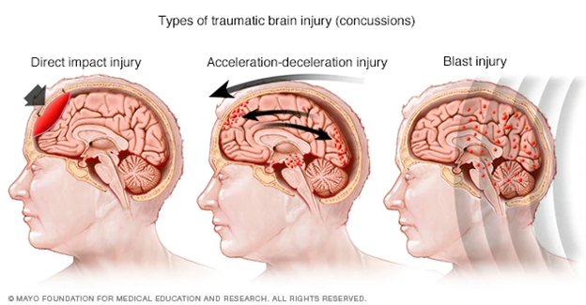
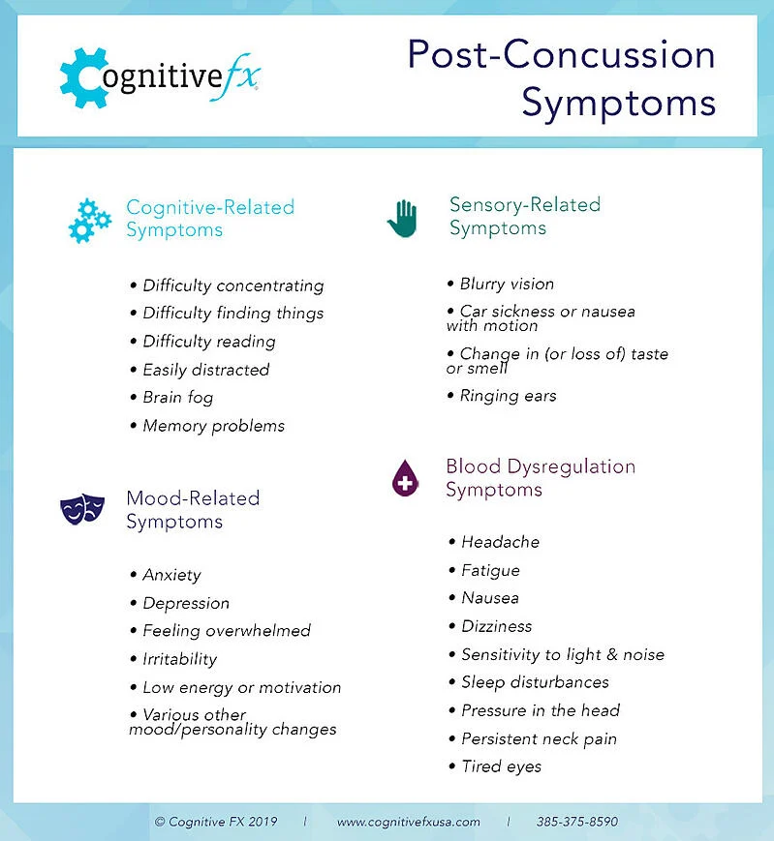
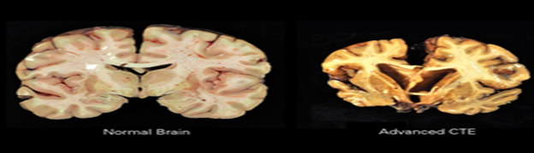
Literature Review of the Effects of Concussions on the Brain
And Mental Health of Athletes
Tyler Devine
Advisor Dr. Thomas Scottgale
Types of Concussion Injuries
Concussion rates in practice vs competition
In Men’s vs Women’s Sports
Psychological Outcomes
Normal Brain VS CTE Brain
Sport | Division | Rates of concussions in 1000 athlete exposures
Football | High school | Practice- 0.21 Competition- 1.55
 | College | Practice- 0.39 Competition- 3.02
Men’s soccer | High school | Practice- 0.04 Competition- 0.59
 | College | Practice- 0.24 College- 1.38
Women’s soccer | High school | Practice- 0.09 Competition- 0.97
 | College | Practice- 0.25 Competition- 1.80
Men’s Basketball | High school | Practice- 0.06 Competition- 0.11
 | College | Practice- 0.22 Competition- 0.45
Women’s Basketball | High school | Practice- 0.06 Competition- 0.60
 | College | Practice- 0.31 Competition- 0.85
https://www.livescience.com/59932-images-brains-cte.html
Left image shows a normal healthy brain with no history of concussions. Right image shows a brain with advanced Chronic traumatic encephalopathy (CTE).
CTE is pathologically shown by frontal and temporal lobe atrophy which is why the CTE brain on the right of the figure is substantially smaller than the healthy brain on the left.
https://www.mayoclinic.org/diseases-conditions/concussion/multimedia/img-20456526
What is a concussion?
A concussion is a form of a traumatic brain injury (TBI) that is caused either by a hit directly to the head or a forceful hit to the body that makes the person's brain move rapidly around in the skull
Direct impact injury: Injury causing bruising of the brain directly below point of impact
Acceleration-deceleration injury: Anterior and posterior damage of the brain caused by an abrupt acceleration or deceleration of the neck or head which causes swooshing of the brain in the skull
Blast Injury: A shock wave causing vibrations in the brain resulting in a concussion
Data from Gessel, et al. 2007
Football has the highest rate of concussion, but when you remove it, women’s sports are shown to have more concussions. The main cause of these concussions is a direct impact injury to the head, but a close second is the acceleration-deceleration injury of the head and neck caused by hard body-to-body contact
https://www.cognitivefxusa.com/blog/multiple-concussions-effects-and-treatment
This information is from a medical practice that researches concussions and how they can affect the brain.
Major acute symptoms: difficulty concentrating, headache, mood changes, sleep disturbance
Major chronic symptoms: anxiety, depression, behavioral changes

Slide 2
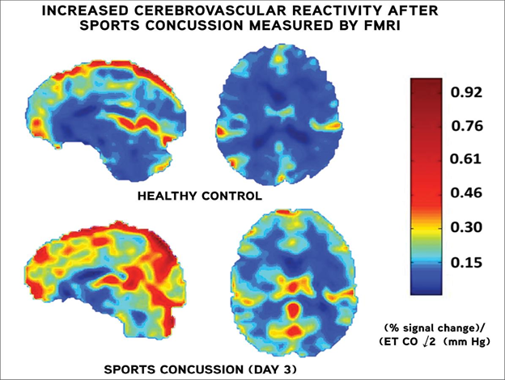
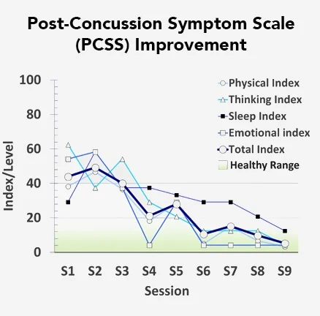
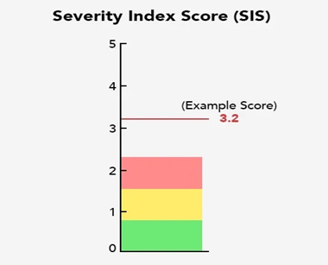
Treatment options
www.vumc.org/radiology/old-news-and-events-news-announcements/studies-point-quantitative-prognostic-role-imaging-head
This figure shows the difference between a healthy brain and a concussed brain. The top healthy brain shows mainly dark blue areas with low levels of cerebral activity, while the bottom concussed brain shows high levels of cerebral activity shown in red
www.ncbi.nlm.nih.gov/pmc/articles/PMC5725584/.
Using a Functional Neurocognitive imaging machine (fNCI) Doctors can see which parts of the brain are getting too much oxygen (hyperactive) and not enough oxygen (hypoactive). Using that information they develop a treatment plan from a graph like the image above
www.ncbi.nlm.nih.gov/pmc/articles/PMC5725584/.
An example of a Severity Index Score or SIS. This SIS shows how many standard deviations away from normal a patient’s brain is. The mean score for patients with concussions is 2.5 and 0 is healthy. Physicians would consider an average of .81 to be “very close to healthy” with the patients just needing a few more sessions
Acknowledgements
I would like to thank Dr. Scottgale for doing a wonderful job being my advisor throughout this process. This thesis went so smoothly because of his willingness to help any day of the week even with his busy schedule. Also I would like to thank Dr. Gonsalves of the Honors Program for all the help and answering every question we had during this semester.
References
https://www.mayoclinic.org/diseases-conditions/concussion/multimedia/img-20456526
Morgan, Victoria. Department of Radiology.” Studies Point to Quantitative, Prognostic Role for Imaging in Head Injury | Department of Radiology, Vanderbilt University, 1 May 2015,www.vumc.org/radiology/old-news-and-events-news-announcements/studies-point-quantitative-prognostic-role-imaging-head
Wing, Benjamin; Tucker, Braden; Fong, Alina; and Allen, Mark. “Developing the Standard of Care for Post-Concussion Treatment: Neuroimaging-Guided Rehabilitation of Neurovascular Coupling.” The Open Neuroimaging Journal, Bentham Open, 24 Oct. 2017, www.ncbi.nlm.nih.gov/pmc/articles/PMC5725584/
https://www.livescience.com/59932-images-brains-cte.html
Gessel, Luke; Fields, Sarah; Collins, Christy; Dick, Randall; and Comstock, Dawn. Concussions among United States high school and collegiate athletes. J Athl Train 2007;42(4):495–503
https://www.cognitivefxusa.com/blog/multiple-concussions-effects-and-treatment

