Slide 1
Honors Thesis:
Financial Crisis Indicators
Salem State University
Commonwealth Honor Program
Geech Hor Huot
Faculty Advisor: Professor Sanjay Jain

Slide 2
TABLE OF CONTENTS
01
02
03
The great Depression
Oil Price Shock
2007-2008 Crisis
Past Financial Crisis
TED SPREAD
Past credit growth indicators
High Debt and High price Growth Indicators
Other Indicators

Slide 3
01
The Great Depression
(1929-1939)

Slide 4
Cause
Effect:
The market expansion was at the peak
Wages were low
Consumer Debt was rising
Production were declining
Sales of goods were decreasing
Stocks were overpriced
Decrease consumer confidence and their buying power
Unemployment spikes
A lot of people were in debt
Banks went bankrupt
Creation of the New deal Program by President Roosevelt

Slide 5
02
OPEC-Oil Price Shock

Slide 6
Cause
Effect
American consumption is plummeting that they relies not just on domestic production but also importing more to meet the demand
The organisation of Arab Petroleum Exporting Countries (OAPEC) imposed the oil embargo in 1973.
Fuel shortage
A big blow on the automotive industry
Create global economic imbalance
Consumer is losing purchasing power
Energy consumption reforms

Slide 7
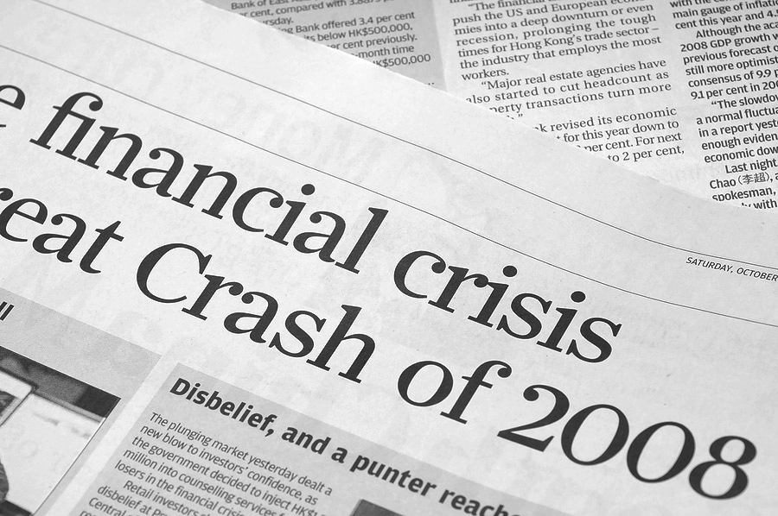
03
2007-2008 Crisis

Slide 8
Cause
Effect
Subprime mortgage crisis due to the unregulated use of derivatives and securitization of real estates
The increase in housing prices and low rates
The financial industry were heavily invested in the mortgage derivatives
A lot of money were invested in credit default swaps that during the crisis, investor lose interest and bank started to hold more capitals and becoming risk-averse in granting loans.
The house price fell and people couldn’t sell their houses, foreclosures..etc
Hedge fund collapse
Bank failures
Unemployment increase
Many businesses went bankrupt
International trade declined

Slide 9
TED SPREAD
A difference between a 3 year-treasury bond and the 3 months LIBOR based in the U.S Dollar

Slide 10
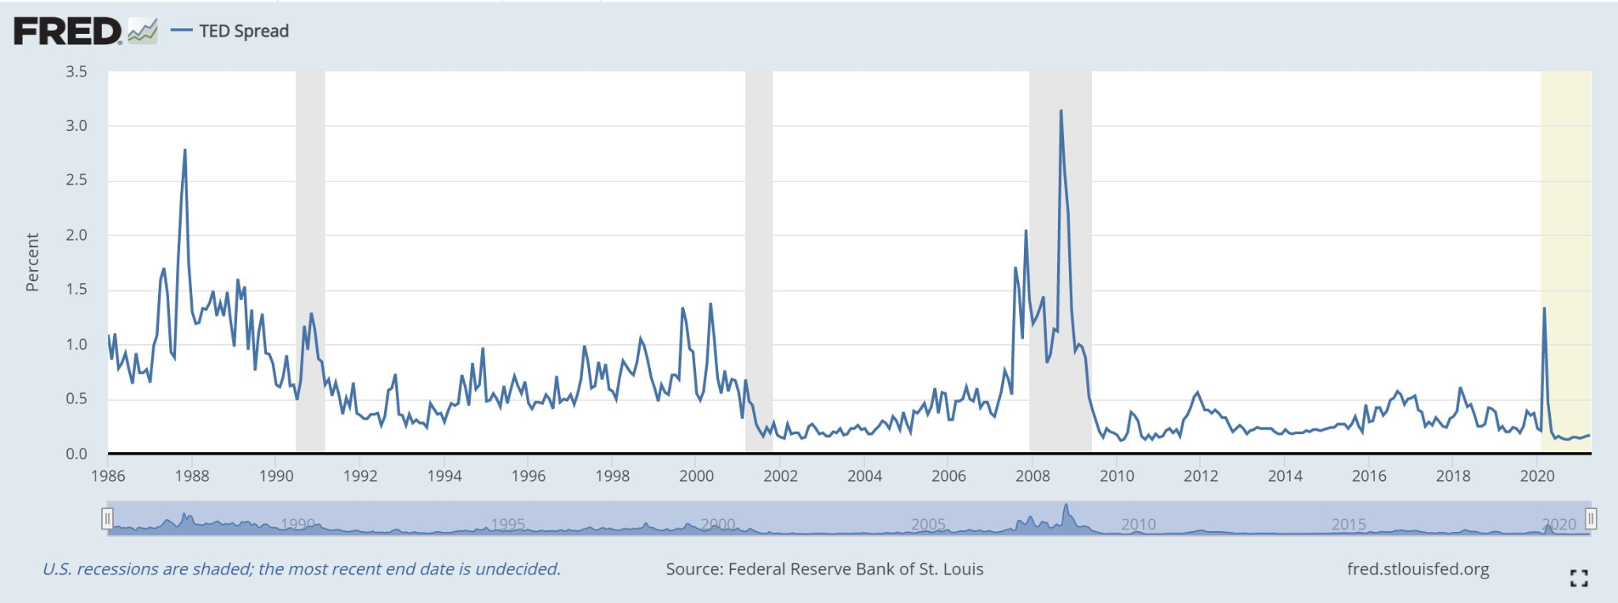
1986-2021
2007-2008 Crisis

Slide 11
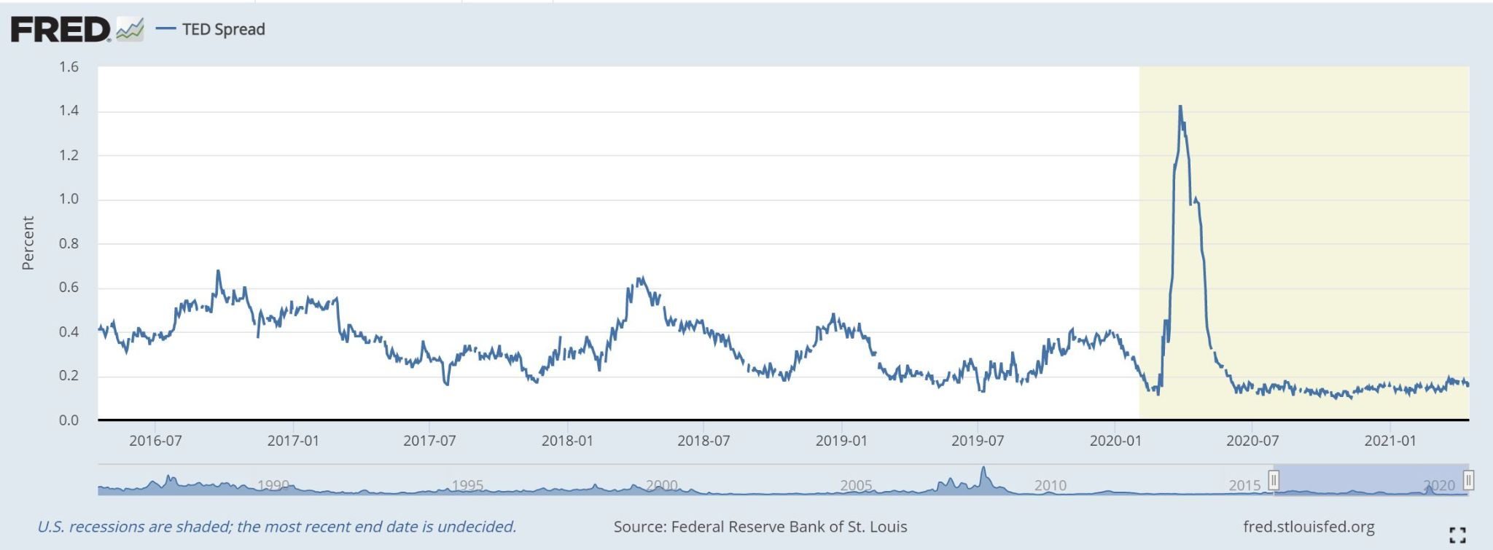
COVID Pandemic
recession
500
400
300
200
100
5 years TED SPREAD
0

Slide 12
Past Credit Growth
4 different measurements for Xit that also represents different sectors’ debts over 3 years changes.
△3(DebtPriv/GDP)it= Ratio of total private debt to GDP
△3(DebtBus/GDP)it= Ratio of business debt to GDP
△3(DebtHH/GDP)it= Ratio of household debt to GDP
△3log (DebtPriv/CPI)it= log change in real total private debt outstanding to consumer price index
Jordan-style (2005) linear forecasting regression:
Crisisi,t+1 to t+h= 𝛂i(h)+𝜷(h)3Xit+ϵi,t+1 to t+h

Slide 13
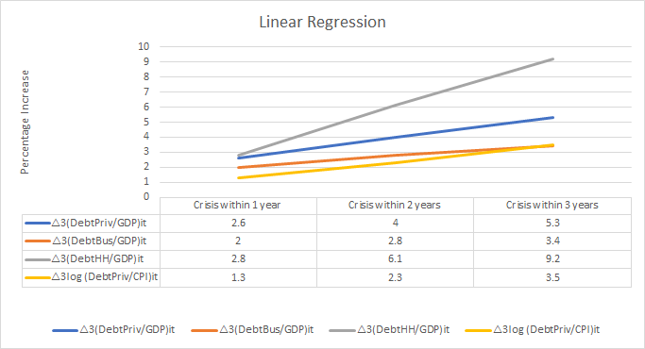
The overall results showed that the degree of predictability is low and based solely on studying the past credit growth is not sufficient to predict the future financial crisis effectively.

Slide 14
High Debt Growth and High Asset Growth
There three indicator variables to help further with the crisis prediction:
High-Debt growthit=1{3(Debt/GDP)it>80th percentile}
High-Price growthit=1{3log(Priceit)>66.7th percentile}
R-zoneit=High-Debt growthit High-Price growthit
The Crisis probability is computed by:
PT,Q(h)=E[Crisisi, t+1 to t+h | Tercile (3log(priceit)) =T,Quintile (3(Debt/GDP)it)=Q]
These two variables have a strong correlation to predicting the future financial crisis.

Slide 15
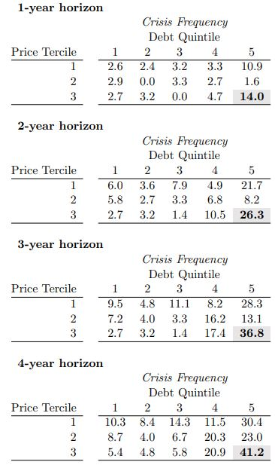
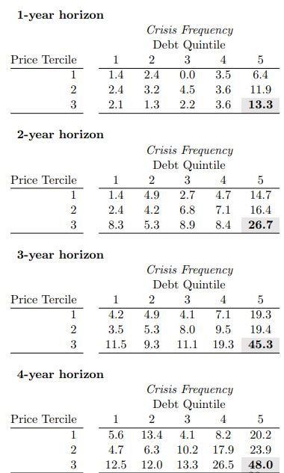
Business Debt and Equity Price growth
Household Debt and House Price growth

Slide 16
Conclusion

Slide 17
THANK YOU

Slide 18
References
Robin, Greenwood et al. “Predictable Financial Crises.” Harvard Business School, June. 2020.
Bodie, Z., Kane, A., & Marcus, A. J. (2021). Investments. New York, NY: McGraw-Hill Education.
Asian financial crisis. (n.d.). Retrieved April 07, 2021, from https://www.britannica.com/event/Asian-financial-crisis
Asian financial crisis - Overview, causes, and impact. (n.d.). Retrieved April 07, 2021, from https://corporatefinanceinstitute.com/resources/knowledge/finance/asian-financial-crisis/
History.com Editors. (2010, August 30). Energy crisis (1970s). Retrieved April 07, 2021, from https://www.history.com/topics/1970s/energy-crisis
Kliesen, K. (2017, November 24). Rising oil prices and ECONOMIC Turmoil: St. Louis Fed. Retrieved April 08, 2021, from https://www.stlouisfed.org/publications/regional-economist/january-2001/rising-oil-prices-and-economic-turmoil-must-they-always-go-hand-in-hand#:~:text=An%20oil%20price%20shock%20is,of%20most%20goods%20and%20services.
Amadeo, K. (2020, August 31). The truth about the 1973 Arab oil crisis. Retrieved April 08, 2021, from https://www.thebalance.com/opec-oil-embargo-causes-and-effects-of-the-crisis-3305806
Merrill, Karen. The Oil Crisis of 1973-1974: A Brief History with Documents. Boston: Bedford/St. Martin’s, 2007.
Federal Reserve Bank of St. Louis. “Statement by Arthur F. Burns, Chairman, Board of Governors of the Federal Reserve system before the Joint Economic Committee.” November 27, 1974, https://fraser.stlouisfed.org/scribd/?item_id=8021&filepath=/docs/historical/burns/Burns_19741127.pdf.
Corbett, M. (n.d.). Oil shock of 1973–74. Retrieved April 09, 2021, from https://www.federalreservehistory.org/essays/oil-shock-of-1973-74
Amadeo, K. (n.d.). Here's how they missed the early clues of the financial crisis. Retrieved April 09, 2021, from https://www.thebalance.com/2007-financial-crisis-overview-3306138#:~:text=The%202007%20financial%20crisis%20is,the%20unregulated%20use%20of%20derivatives.
Amadeo, K. (2020, October 26). Critical events of the 2008 financial crisis. Retrieved April 09, 2021, from https://www.thebalance.com/2008-financial-crisis-timeline-3305540

